Slide 1
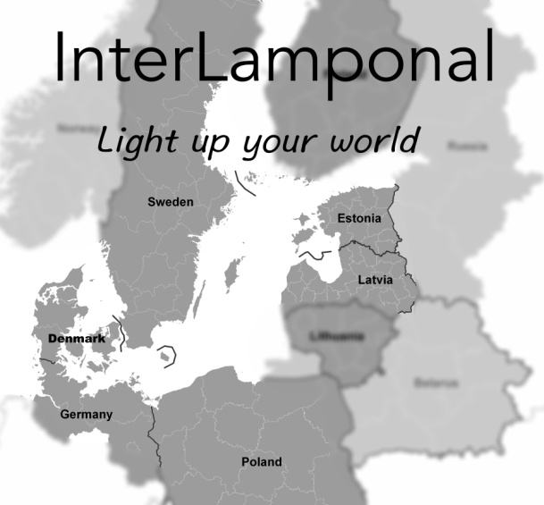
InterLamponal

Slide 2
Introduction
The name- InterLamponal
The lamps
Materials and decorations

Slide 3
The poster

Slide 4
Target group
Tourists
Adults
Young people

Slide 5
Why people should buy our product?
Handmade
Can be custom-made
National symbols (Latvia, Poland, Denmark, Estonia, Germany, Sweden)

Slide 6
Why our product is better than our competitors?
Recycled and natural materials
Handmade

Slide 7
Production
Making the lamps
Materials
How long did it take?

Slide 11
Cost of making the product
Materials
Desk lamps 22.65€
Ceiling lamps 11.65€
Salaries
Hourly 2.5€
Per lamp 6.25€

Slide 12
Cost of the product
Desk lamp- 35€
Ceiling lamp- 20€

Slide 13
The timeplan
1st year
Produce the lamps in Latvia
Sell 200 lamps
Sell our products internationally

Slide 14
Where can you buy our product?
Our website
Local furniture stores
Gift and souvenire shops

Slide 15
Plan B
Cheaper materials
Lower the price of our lamps
More advertising

Slide 16
How much money do we need?
100 lamps- 2890€
Rent for a workspace- about 2000€

Slide 17
Social media
Instagram- @InterLamponal
#InterLamponal

Slide 18
Thank you!

