Slide 1
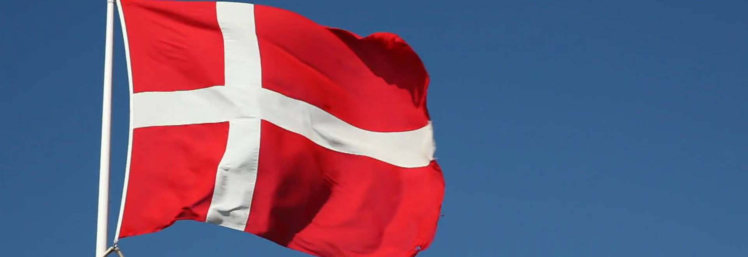
Denmark
Made by Jonas, Osvald, Mads, Emil, Julie and Olivia

Slide 2
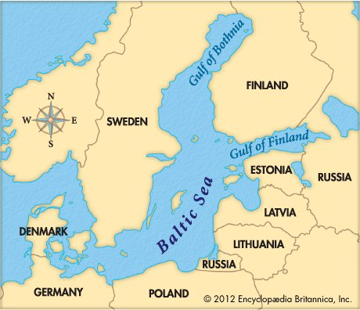
Where is Denmark?

Slide 3
What makes a Dane?
Bikes
HOTDOGS
BEER
COCIO
cHEESE

Slide 4
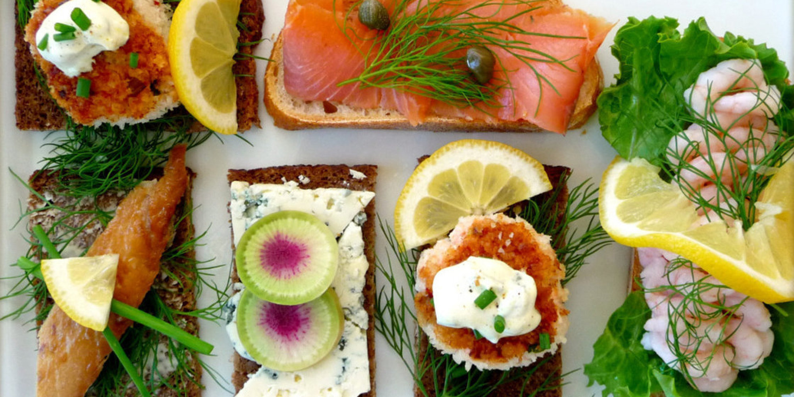
Danish food

Slide 5
Special things about Denmark
Hygge
Efterskole
Christiania
”Rød grød med fløde”
Æ, ø and å

Slide 6
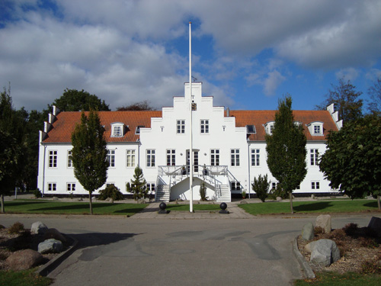
Efterskole
Notes:
"Efterskole" is a Danish expression. We are the only one who have this. It is a bit like boarding school, you live there for Some years– normally 1 or 2.
The line between efterskole and boarding school is actually quite difficult to find. Some of the main part is that at an efterskole you go there in the last years of your school life, you do it because you want to meet some new people and have a good time. A boarding school is often associated with something bad in Denmark. You go there if you are having trouble behave, or if you have to get away From a bad environment.
Efterskole is nothing like this. You come here to have a good time, and maybe to get a chance to aprove your grades. You often have some very long school days, but because you use a lot of the hours in a week on something you found funny and interresting, its not that as hard as it look.

Slide 7
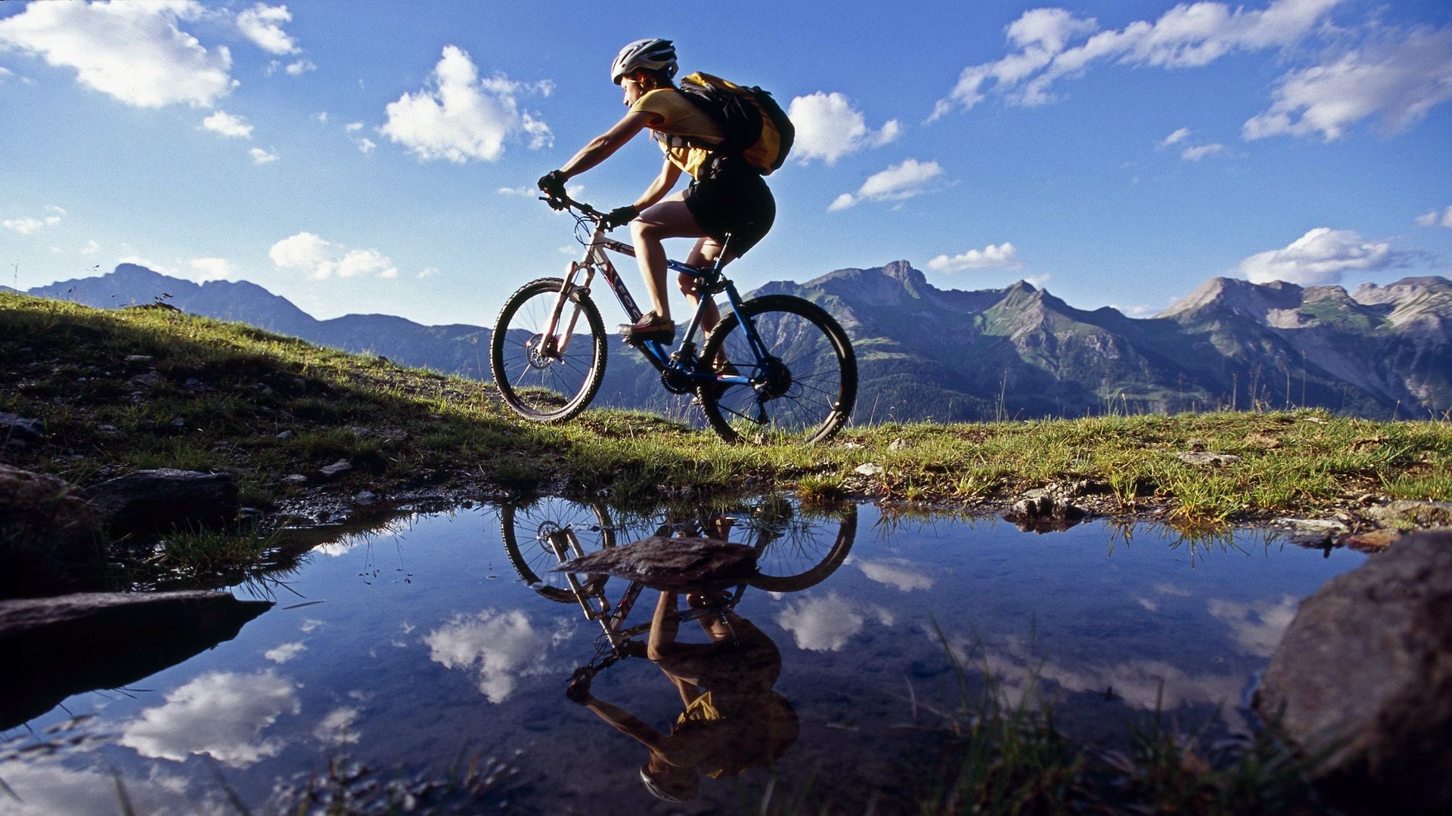
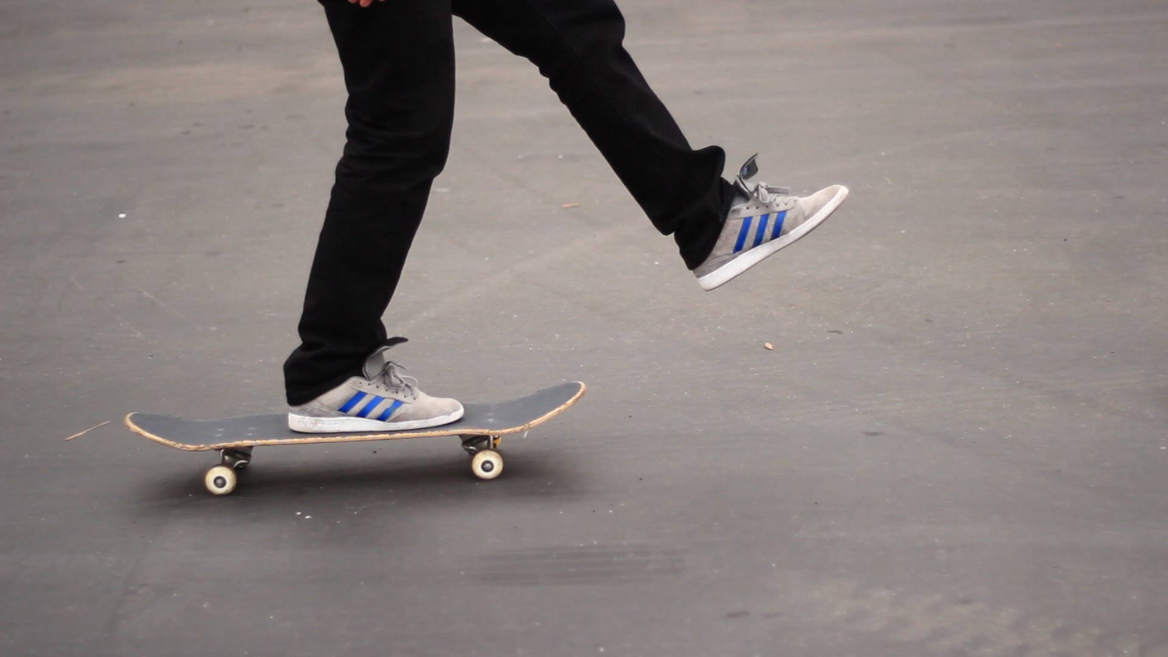
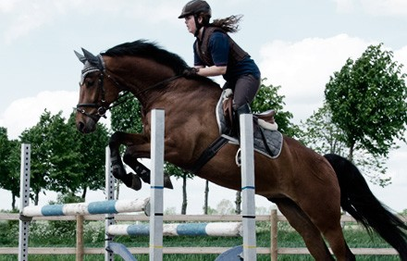
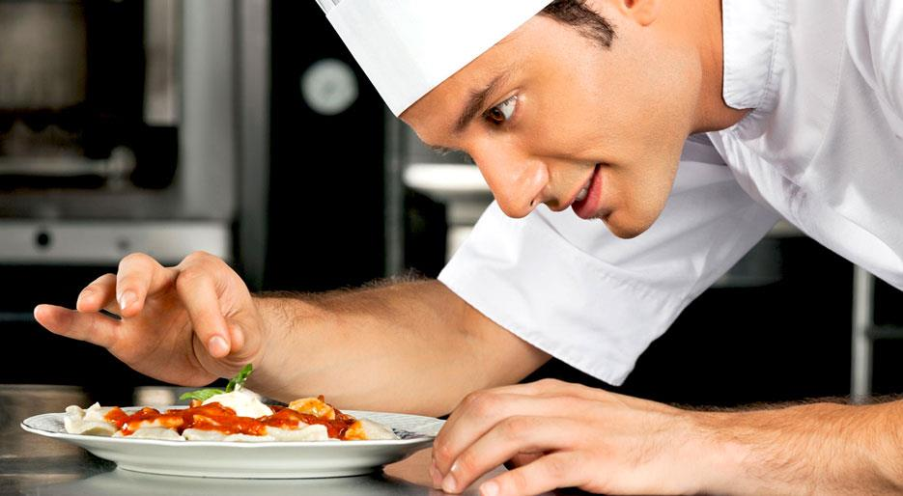
Your hobby at Your school!
Notes:
It could be your hobby! At an"efterskole" you have your hobby as a class. Some efterskoler Offers horseback ridding as a subject, so if you want to do this in your school time you can choose a school that offers it. Of course, the school dosen't have all hobbies in the world, but they choose a few to teach. Some"efterskoler" has skating and horseback-riding, while others have singing and dancing. At most "efterskoler" you can either choose a hobby you are good at or you can start from scratch with a new one. But, at some "efterskoler" you have to be at a certain level. This is a great oppertunity for you to spend a lot of time on your hobby and to get some new experince.

Slide 8
Kahoot

