Slide 1
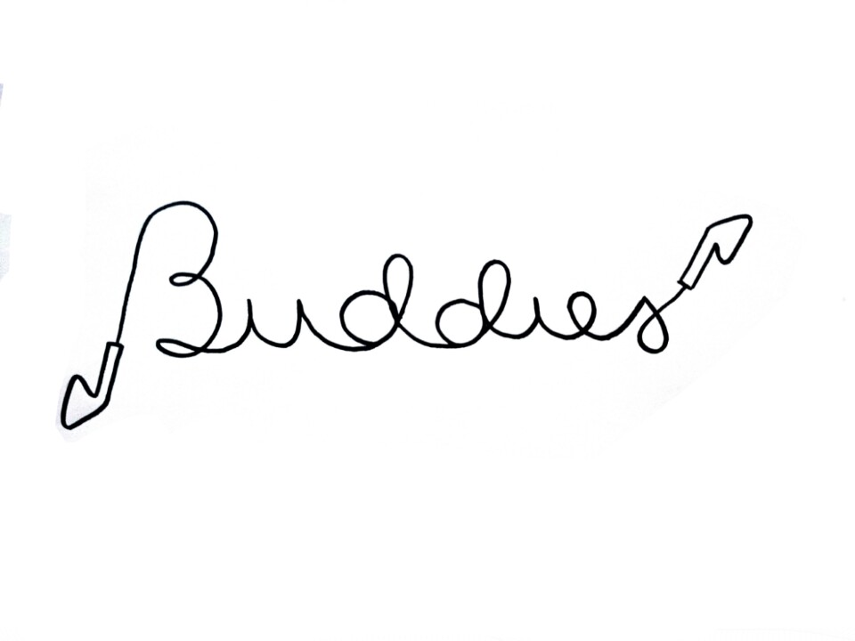

Slide 2
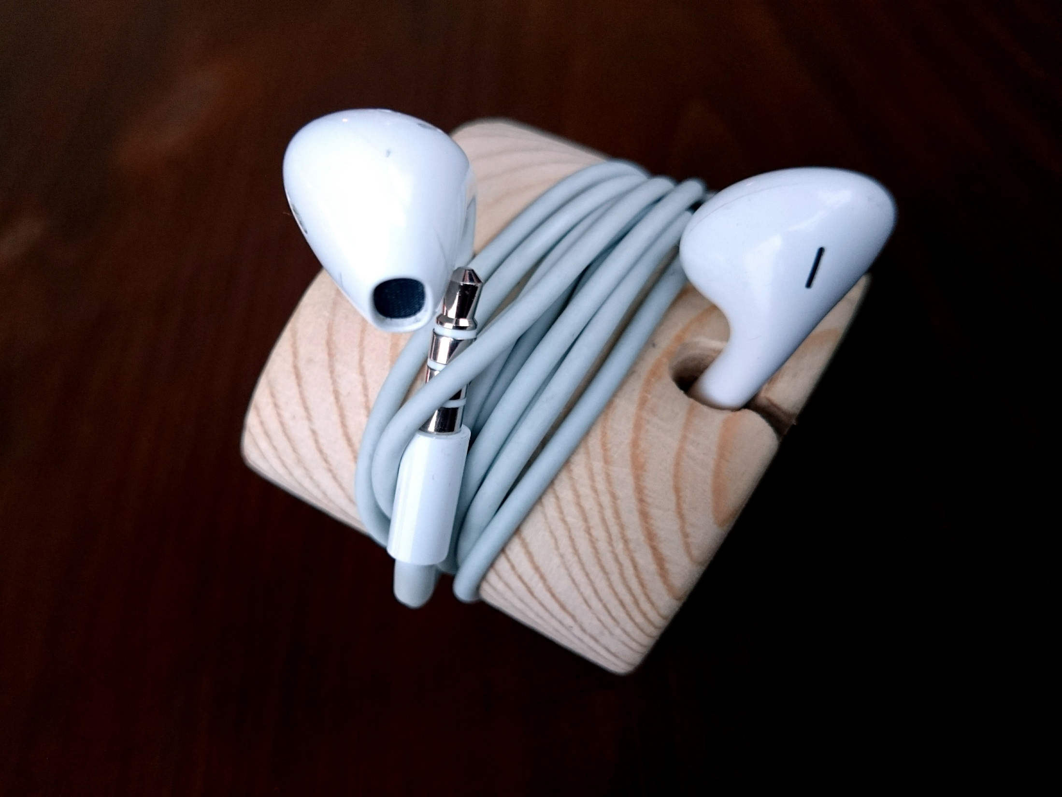
Idea explanation
To create a cheap product, which makes life easier for the customers, who can buy a very useful product for a low price.

Slide 3
Goals
To create a product with low production costs and high profit margins
To make life easier

Slide 4
Why should people buy the product?
Low price for a useful product
Solution for the known problem of tangled earphones
Good as a present (big target group)
Everybody who uses earphones
Especially for people doing sports

Slide 5
Competitors
A lot of internet websites with explanations for creating an earphone holder.
Auction houses, which are not specialized on producing and selling earphone holders.

Slide 6
Timetable
First year: price 3€/holder, customers need to request for other colours, shapes etc.
Aim: sell the first 66 000 exemplars in year 1, own internet shop
Second year: choose different product variations to sell (shapes, colours, other materials like acrylic and plastic)
Aim: to increase sales in the second year

Slide 7
Plan B and C
Highest risk: nobody buys the product
Risk isn’t even that high (low price of materials)
Plan B: lower price of product (still huge profit)
Plan C: use more advertising

Slide 8
General costs
Material costs for one unit: < 1 cent
Salaries
5€/hour
800€/month
-> above the average salaries of Latvia (606€/month)
Production costs (salaries included): ~ 50 cent

