Slide 2
How it works
Age 14-18 and 18+
Security
Payment
Locality (GPS)

Slide 3
Our flyers

Slide 4
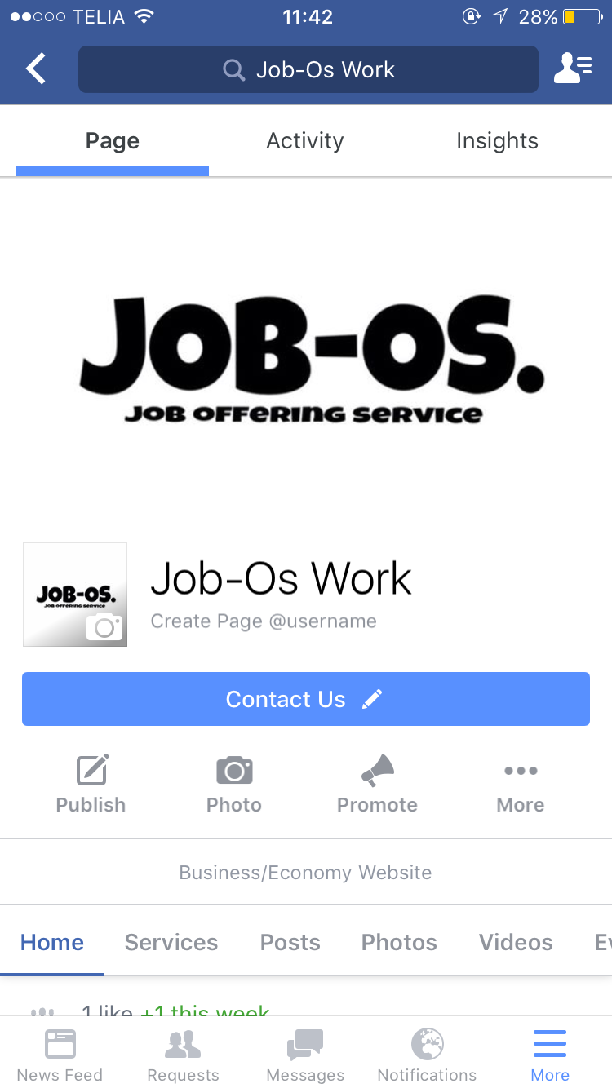
Where to find us

Slide 5
Commercial
Comercial AD

Slide 6
Our products
JOB-Os website
JOB-Os app

Slide 7
Finances

Slide 8
Finances

Slide 9
Finances

Slide 10
Thank you for your time!

