Slide 1
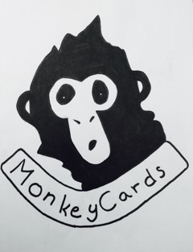
Monkey Cards
Business plan

Slide 2
Idea explanation
It is a card game created for people to learn fun facts about different countries
The aim of the game is to get four cards of the same country
Age: 8+

Slide 3
Goals
To entertain people
To gain experience

Slide 4
Why should people buy the product?
It is a entertaining and educative game
People from different age groups can play together
A fun twist on the ordinary card game “donkey”
Easy to understand

Slide 5
Plan B
Biggest risk: no one will buy it
Plan B: lower the price and salaries, use cheaper materials

Slide 6
Competitors
A lot of successful card game companies on the market
We need to stand out to get recognized

Slide 7
Timeplan
1st Year
Price: 3.99€
Start out in Latvia
Advertising
Goal: sell 250 packs of cards
1st version: Biggest European countries

Slide 8
2nd year
Same price: 3.99€
Start selling in the Hanseatic League countries
Increase publishing
Goal: sell 500 packs

Slide 9
3rd- 5th year
Higher price: 4.99€
Add more versions (America, Asia, etc.)
Start selling in more countries
Goal: sell 750 packs per year

Slide 10
Salaries
Minimum wage in Latvia: 2.20€ per hour
Our salary: 2.50€ per hour
About 1h for one pack

Slide 11
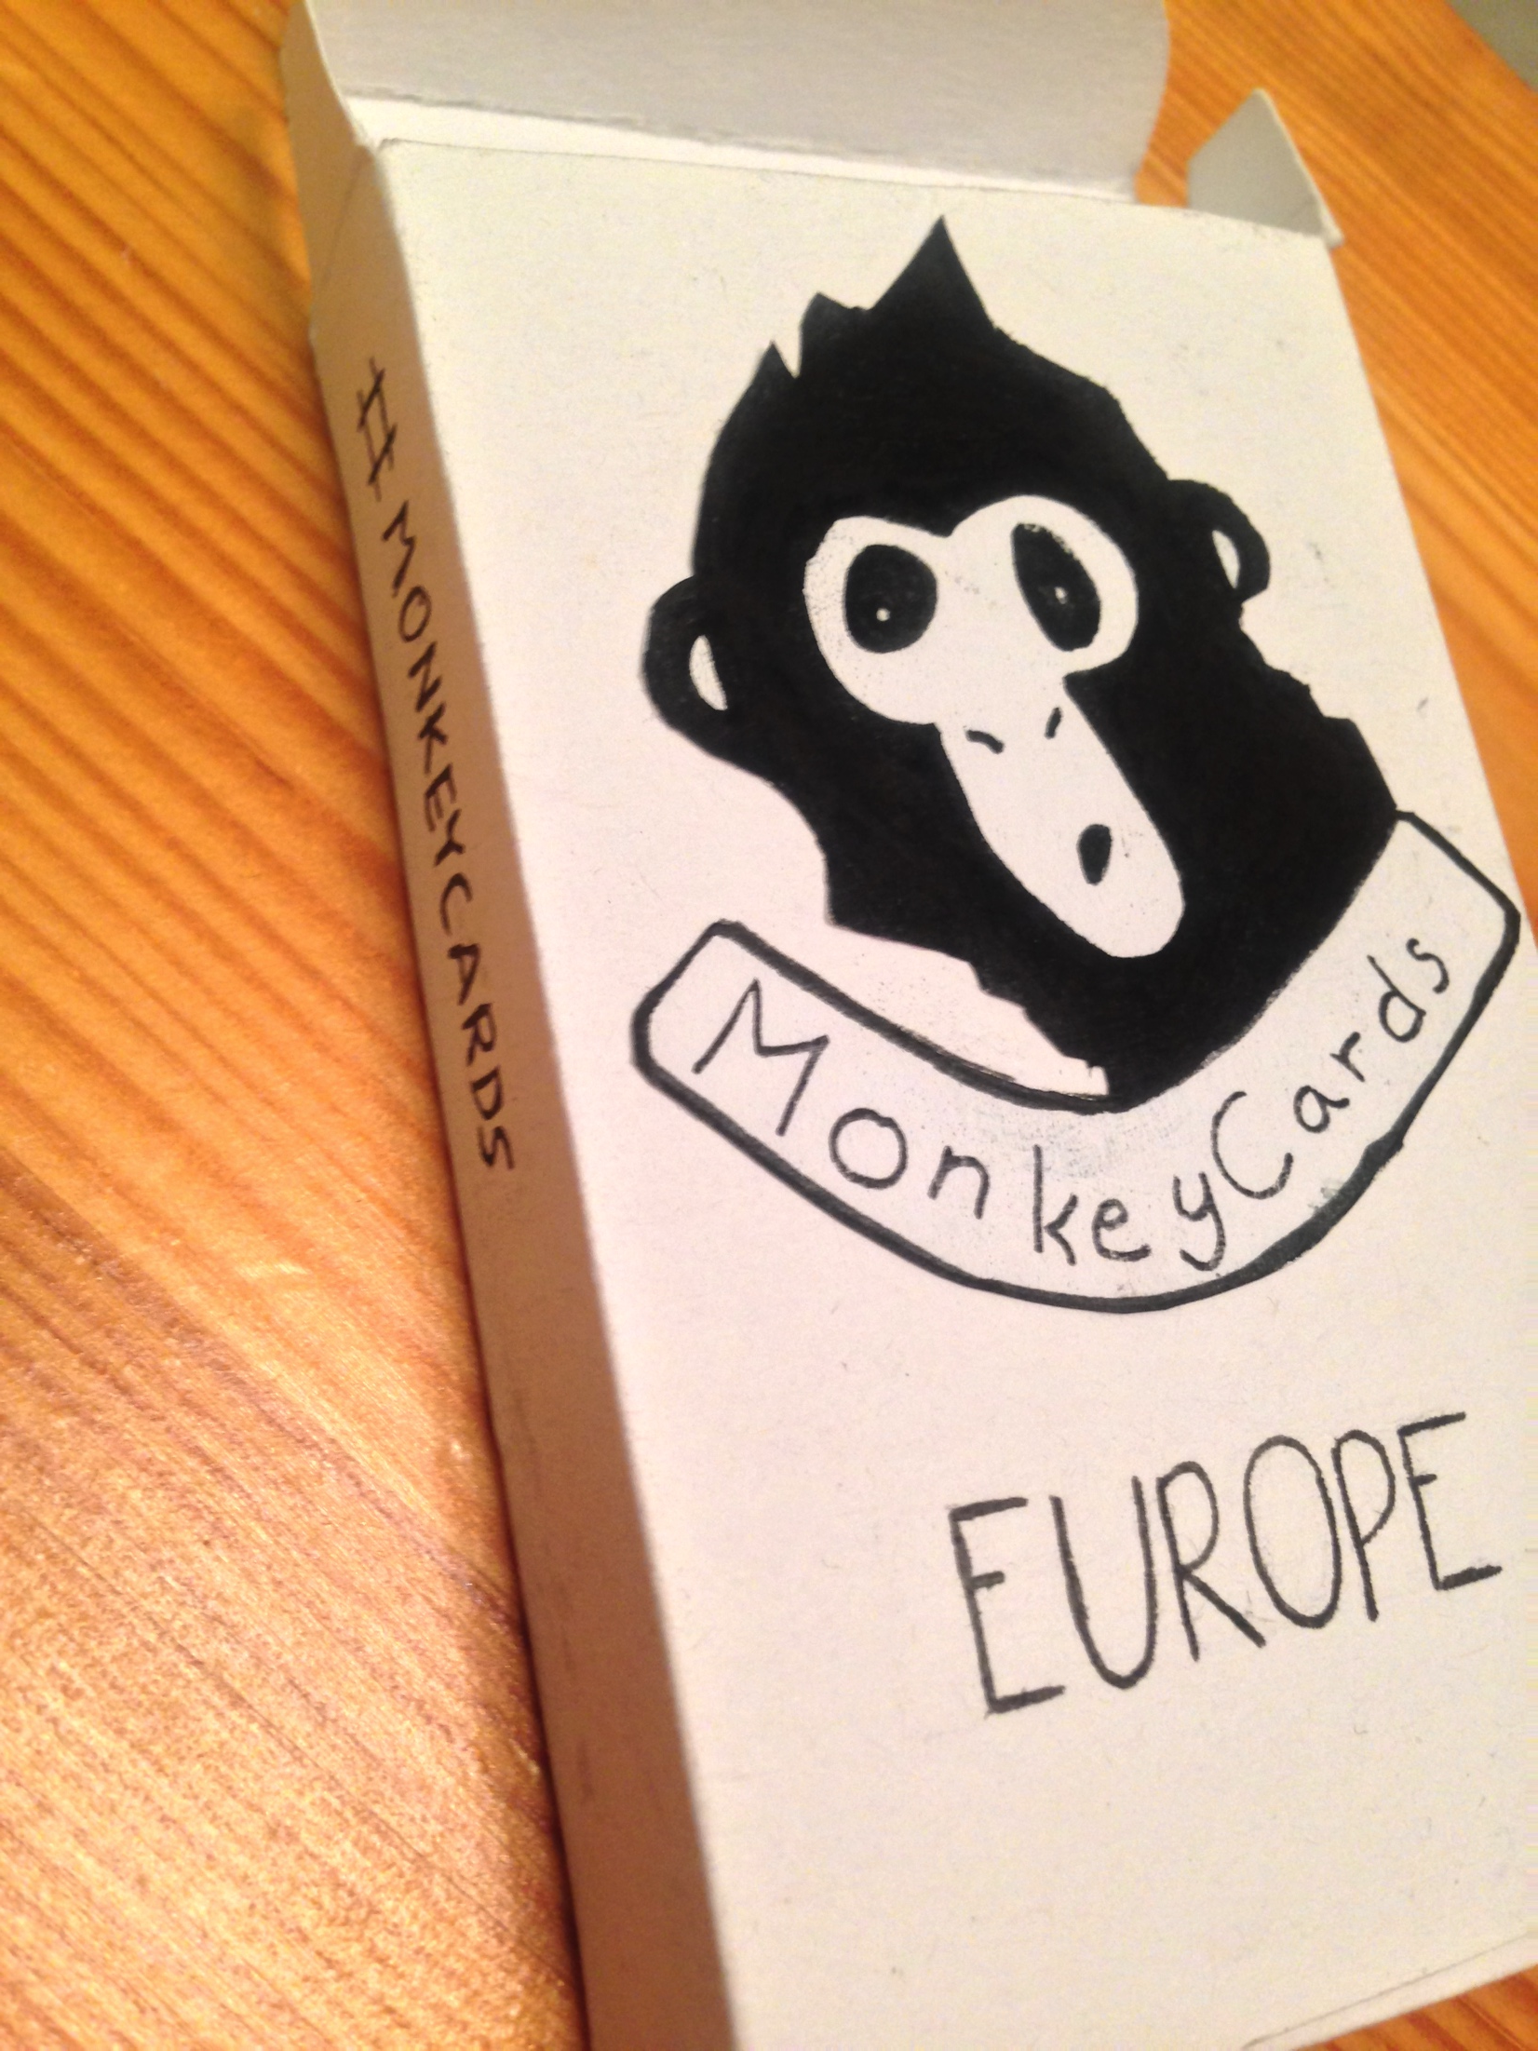
Prototype

Slide 12
Costs
Printing: 0.26€ per set
Laminating: 0.40€ per set
Box: 0.03 per set
Salary

Slide 13
Social media
Instagram: @MonkeyCardsCompany
#MonkeyCards

Slide 14
Thank you for your attention

