Slide 1
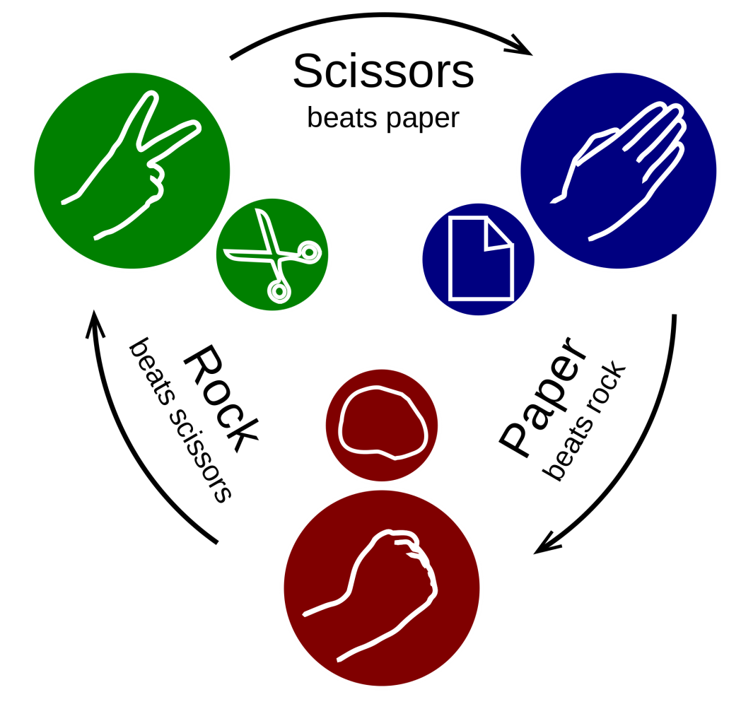
Rock, paper, scissors

Slide 2
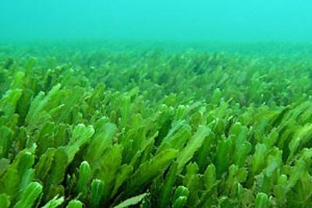
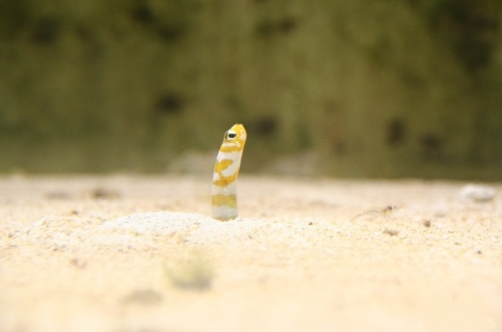
Rock, paper, scissors
1.
2.
3.
4.

Slide 3
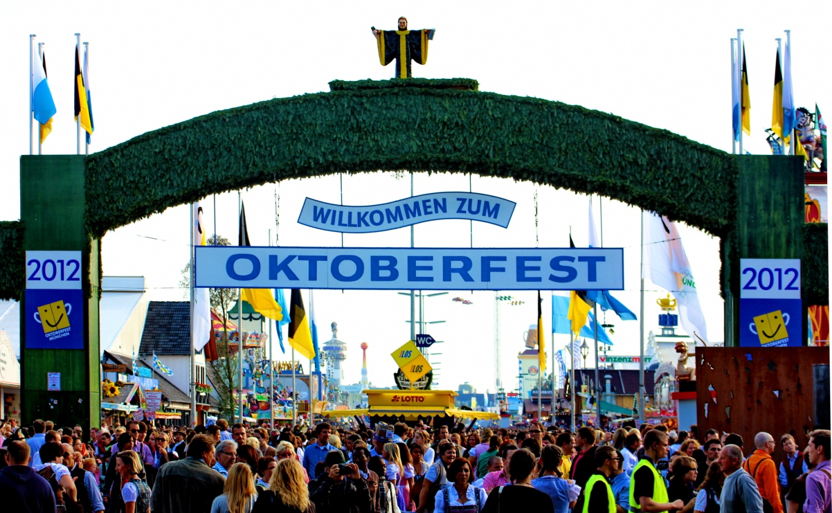
Oktoberfest

Slide 4
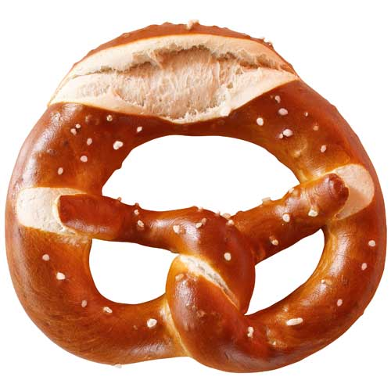
How to form a pretzel

