Slide 1
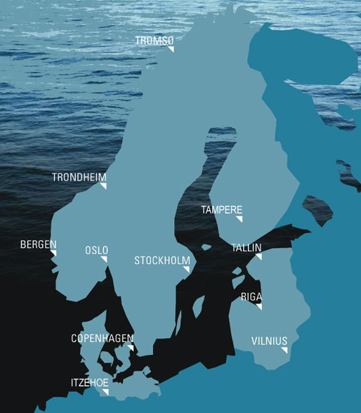
Our Company
search. find. travel.

Slide 2
Structure
About our Company
Company description
Marketing and Sales strategies
Website
Management and Staff
Setup
Financial plan
search. find. travel.

Slide 3
About our Company
Connecting people
Visiting foreign countries
Online talks and video calls
Booking flights for less money
search. find. travel.

Slide 4
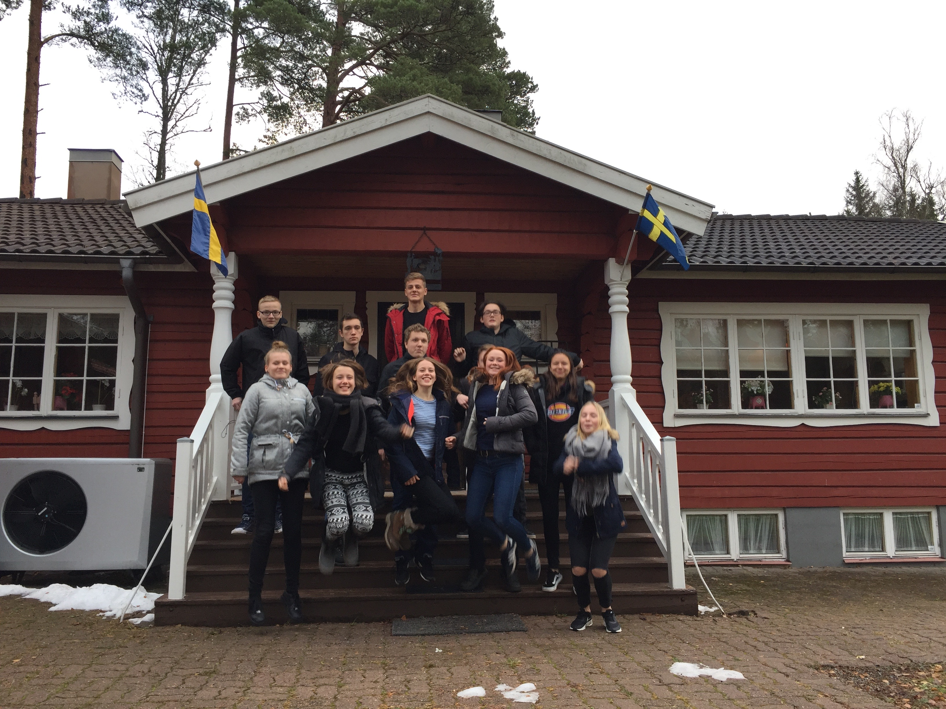
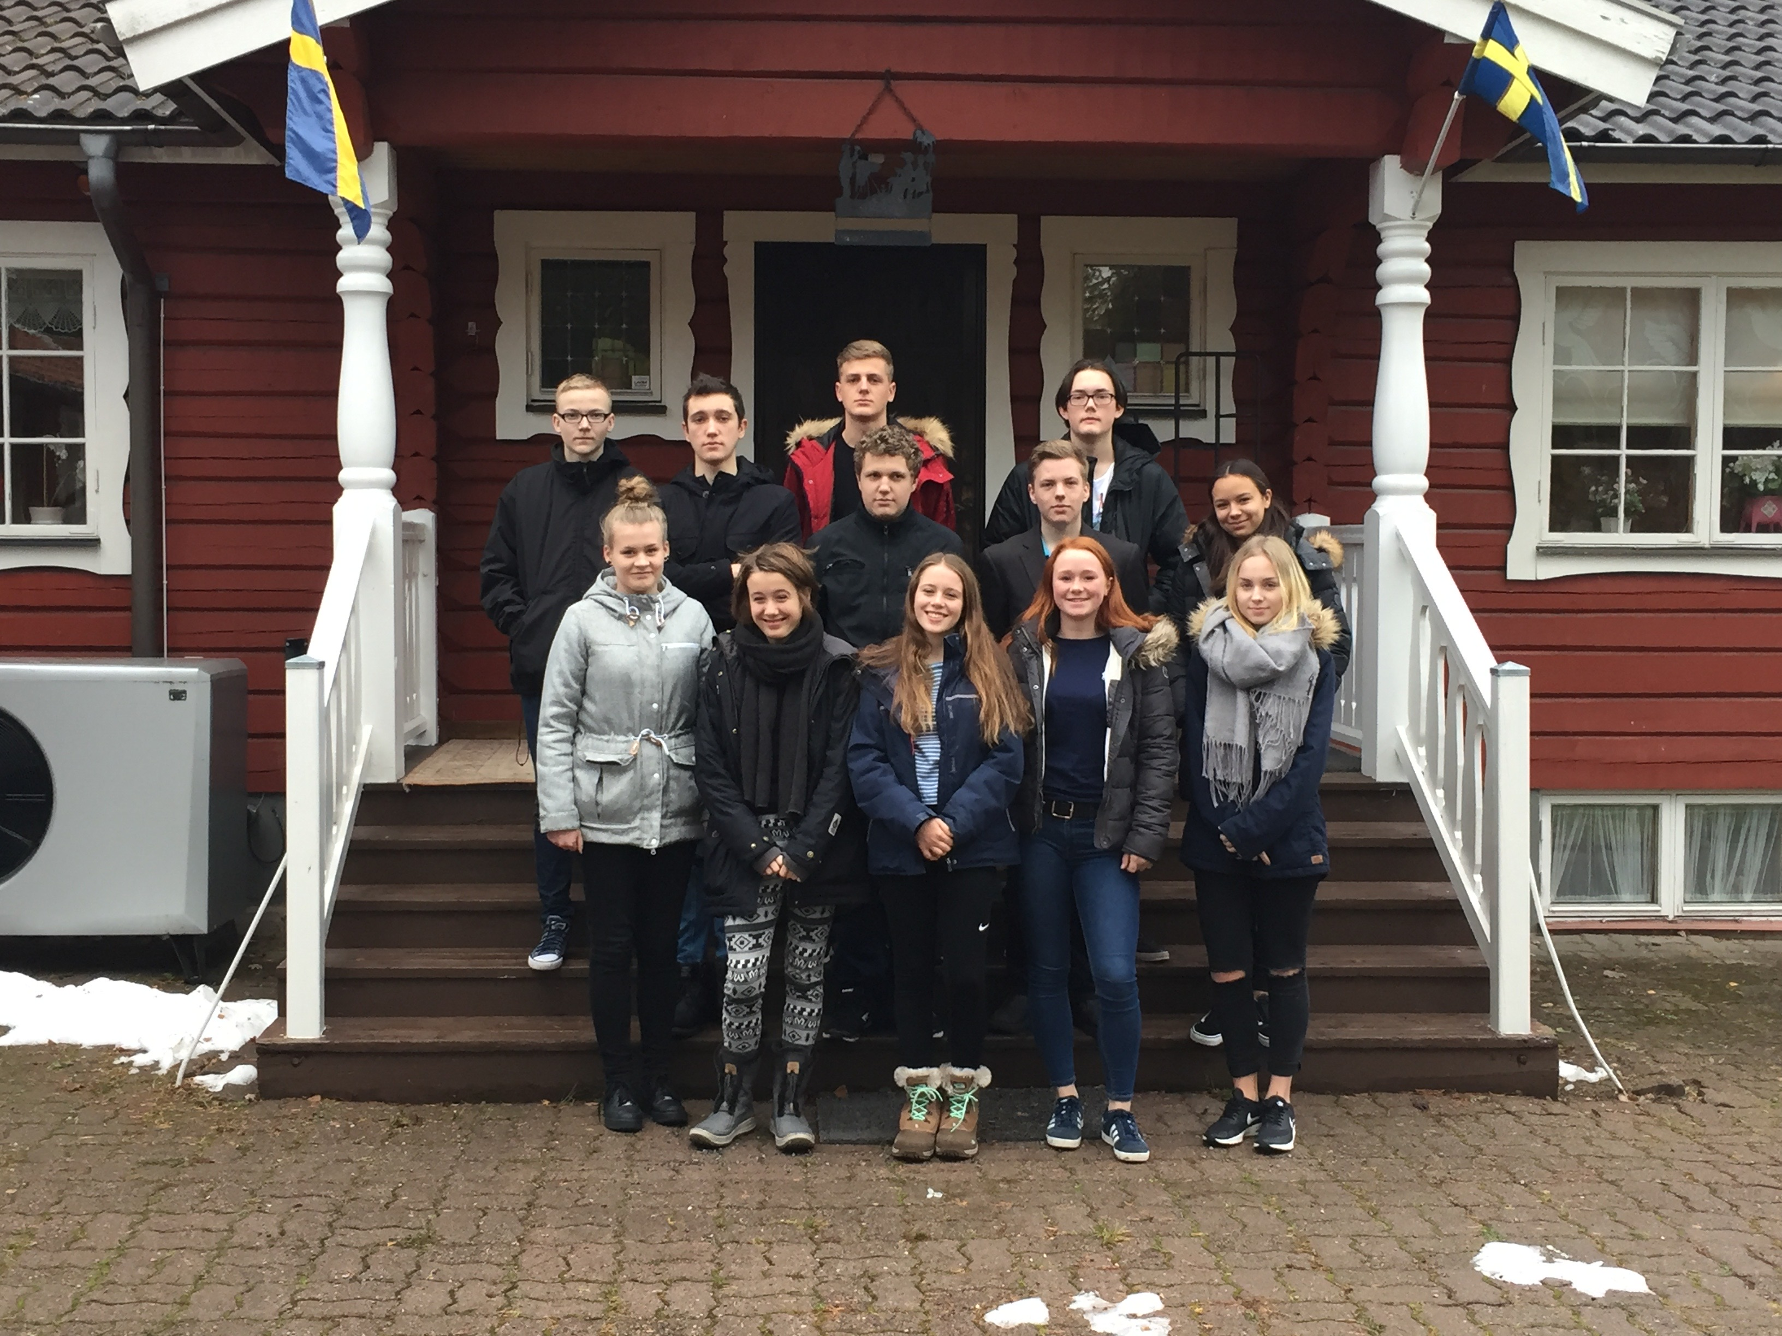
Company description
Group of students
Helping others to explore new countries
Finding new friends all over the world
Target group 12+
Service for free
Exclusive for the Baltic States
search. find. travel.

Slide 5
search. find. travel.

Slide 6
Website
Features
Premium features
Social Forum
http://jdrefsgaard.wixsite.com/travlex
search. find. travel.

Slide 7
Management and Staff
Management
Development
Finance
Marketing
12 employees
search. find. travel.

Slide 8
Setup
Webpage
Serverhall
Hosted in Estonia
Runned by four students
search. find. travel.

Slide 9
Financial plan
Year | Goal | Ad revenue | Spending (without Salary) | Profit
1 | Connecting the Baltic | 240 € | 766 € | -526 €
2 | 200+ users | 490 € | 766 € | -276 €
3 | 500+ users | 1110 € | 973 € | 137 €
4 | 1000+ users | 1350 € | 973 € | 377 €
5 | 2500+ users | 1850 € | 1213 € | 637 €
Bank Ioan
search. find. travel.

