Slide 1
Lithuanian arts
Done by Kajus Kasparavičius, Joana Barauskaitė, Elizabeth Ambrazaitė, Rokas Giedraitis and Adomas Zykus

Slide 2
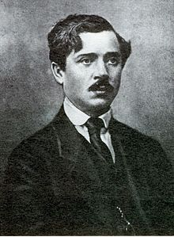
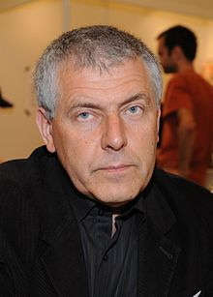
Well - known artists
Past
Present
Petras Kalpokas
Most of Kalpokas' works are landscapes and portraits, but he experimented with diverse genres and techniques. Landscapes of Kalpokas are lyric. Some of them are realistic, others have features of impressionism.
The Golden Birch Tree (1907)
Rivulet in Spring (1907)
Sylvan way (1912)
Stasys Eidrigevičius
The author has been awarded a lot of awards for his illustrations and paintings. The main motives of creation - loneliness, alienation, sadness, contemplation. Mostly he did illustrations for children books.
Vytautė Žilinskaitė. Robotas
ir peteliškė

Slide 3
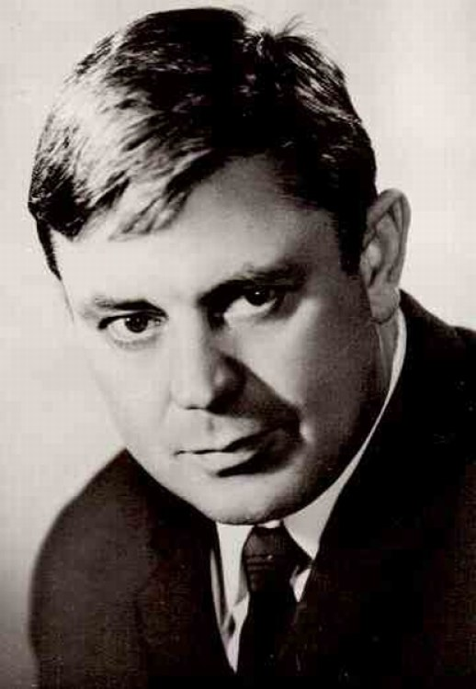
Well – known actors
Past
Present
Donatas Banionis
Banionis began his career with some films in Lithuanian, but he would later play mainly in Russian language films although his voice was dubbed by Russian actors. In 1947, Banionis appeared in the film Marytė.
Nobody Wanted to Die (1966)
Beware of the Car (1966)
Dead Season (1968)
Jokūbas Bareikis
Bareikis started his acting on stage in 2002 ‘‘Talentai ir gerbėjai“. His main acting is in comedies.
Nauji Robino Hudo nuotykiai
De Facto
Likimo valsas

Slide 4
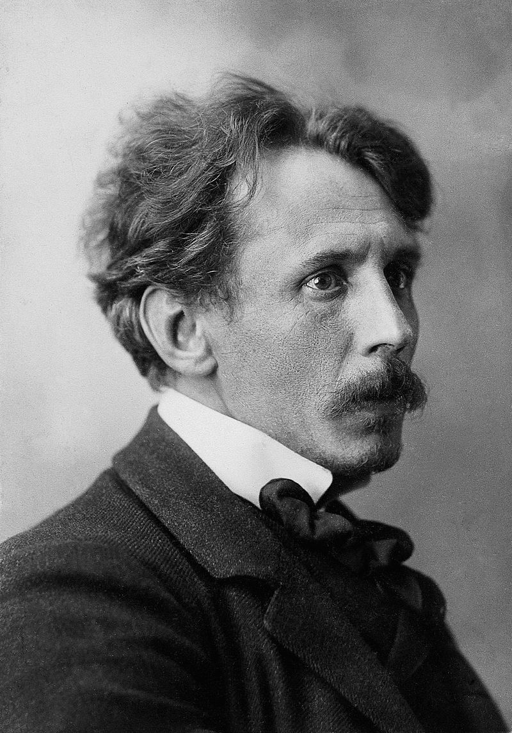
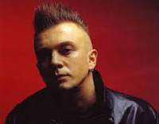
Well - know musicians
Past
Present
Mikalojus Konstantinas Čiurlionis
The precise number of Čiurlionis musical compositions is not known – a substantial part of his manuscripts did not survive, while others, assumingly, perished in the fire during the war, or were lost.
Nocturne in C sharp minor
Prelude in F sharp major
Nocturne in F minor
Andrius Mamontovas
In 1983, Andrius Mamontovas began his musical quest by forming Foje, one of the most popular bands in Lithuania. After Foje was disbanded, Mamontovas began his solo career and has since been nominated and awarded best solo act in the national music awards. He currently holds 15 Bravo Awards the Lithuanian equivalent to the Grammy Award.
Tyla
Geltona. Žalia. Raudona
Elektroninis dievas

Slide 5
Well - known artists
Past
Present
Juozas Bagdonas
He was a Lithuanian painter and founder of the Samogitian Museum of Art. He had exhibited his art in a lot of different countries and almost all Lithuanian cities.
"Returning from the Sea‘‘
Michalina Adomavičienė-Sorakaitė
She lithuanian artist, art critic. She participates in watercolor exhibitions in Lithuania and abroad. Since 1993 held eight solo exhibitions.
"Sunflowers‘‘
‘‘Winter‘‘

Slide 6
Well – known actors
Past
Present
Jonas Alekna
Lithuanian theater actor, director, artist. He studied ceramics at Kaunas Craft School and attended an acting studio at the Kaunas Labor Chamber.
E. Borisova. ‘‘Secret of the black Lake‘‘
Steponas Kosmauskas. ‘‘Who am I to blame?‘‘
Ramūnas Abukevičius
Lithuanian theater actor, director. Attended the drama studio of director Juozas Miltinis at Panevėžys Drama Theater, graduated from the Lithuanian Conservatoire, defended his Master's degree in Theater at Klaipėda University
Tenesis Viljamsas, ‘‘Summer and Smoke‘‘.
E. Schwarcas. "Snow Queen‘‘.

Slide 7
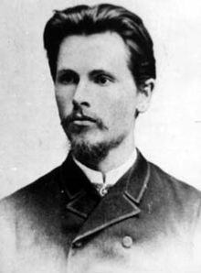
Well – known musicians
Past
Present
Vincas Kudirka
He was a Lithuanian poet and physician, author of both the Lithuanian national anthem, as well as music and lyrics. In Lithuania, he is considered a national hero.
The national Lithuanian
anthem
Justinas Jarutis
Lithuanian singer, performer, actor, vocalist, composer, judge of ‘the Voice of Lithuania‘ project. He is one of the founders of Freaks On Floor group, a vocalist and guitarist currently pursuing a solo career. In 2018 he released his first solo album.
‘‘Tell me your story‘‘
‘‘Angel‘‘

Slide 8
Main architectural styles in Lithuania
Gothic architecture - Gothic spread in Lithuania in the 14th century, and since the 15th century began to dominate in the architecture of castles, churches and dwellings. The late Lithuanian Gothic is characterized by double-arched arches, with geometric black brick patterns on the walls. The most significant Gothic churches are St. Anna and Bernardine.
Baroque architecture - Baroque architecture reached Lithuania at the end of the 17th century. Lithuanian Baroque is divided into early (1600-1650), mature (1650-1730) and late (1730-1790).
Early Baroque - The most important purchasers of early Baroque architecture were the Jesuits. They built churches like St. Casimir Church in Vilnius.
Mature baroque - In the mature baroque the most important customers were the Catholic relatives of the families who had power at a time - Pacas, Sapiegas, Bžostovskiai. They built churches like Vilnius St. Peter and Paul Church.
Late Baroque - Vilnius Baroque School became the most important center of late Baroque architecture. The most famous representative of the late Lithuanian Baroque and Vilnius Baroque schools is Jonas Kristupas Glaubicas. The Missionary Church is the church of this period.

Slide 9
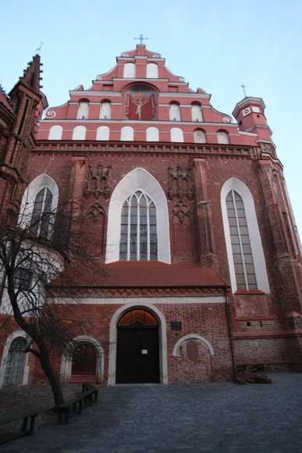
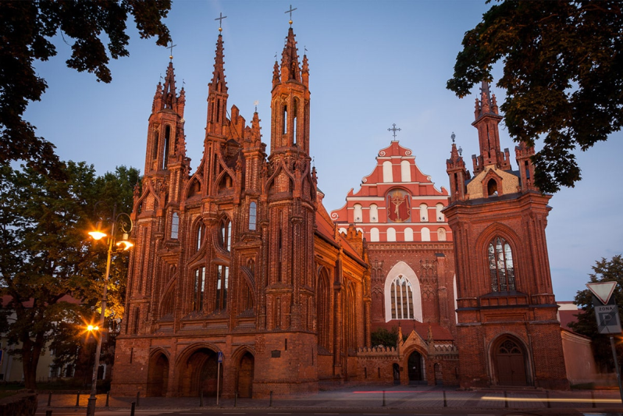
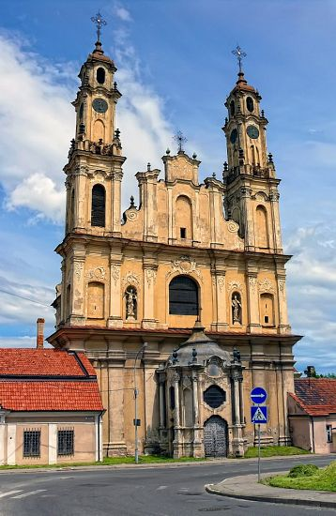
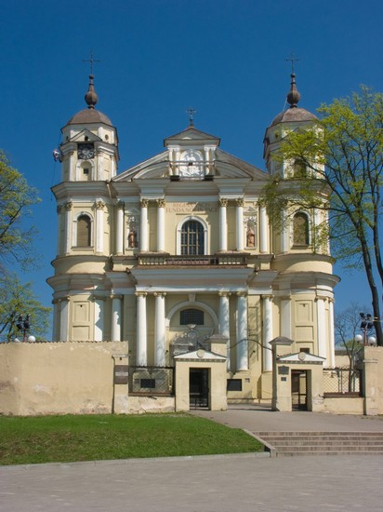
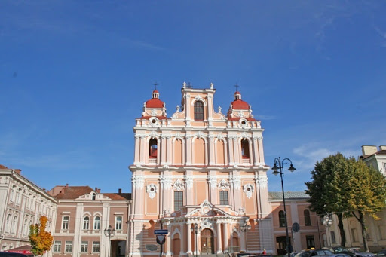
Gothic churches –
Baroque Churches-
St. Anna church
Bernardine church
St. Casimir Church in Vilnius
(Early Baroque)
The Missionary Church
(Late Baroque)
St. Peter and Paul Church
(Mature baroque)

Slide 10
Classicism - Classicism started to spread in Lithuania around 1770. Classicism was the opposite of the fancy Baroque, it was a simple but majestic style. Representatives of Classicism in Lithuania Martynas Knakfusas, Laurynas Gucevičius, Karolis Podčašinskis. Martynas Knakfusas designed the Kurtuvėnai St. Apostle James Church and Laurynas Gucevičius designed the Vilnius Cathedral.
Modernist architecture - Modernist architecture in Lithuania began to expand in the 20th century second half when Lithuania was occupied by the Soviet Union that is why Lithuanian architecture was greatly influenced by the Soviet Union then. Buildings of this period include the Green Bridge and the Modern Art Center.

Slide 11
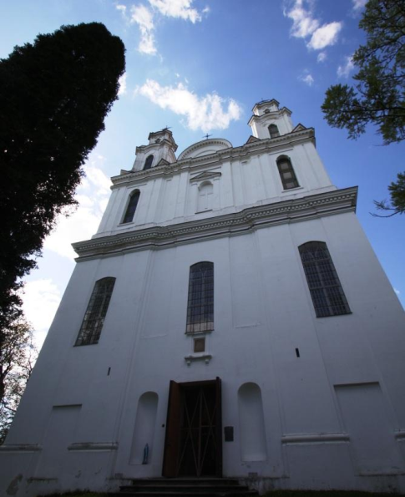
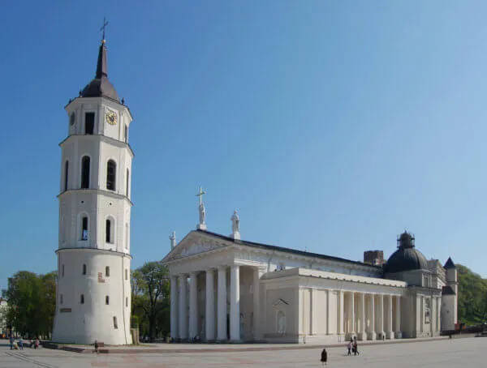
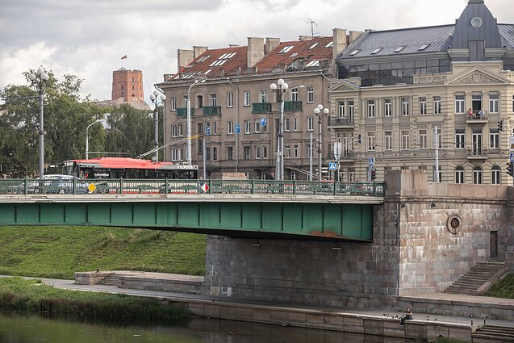
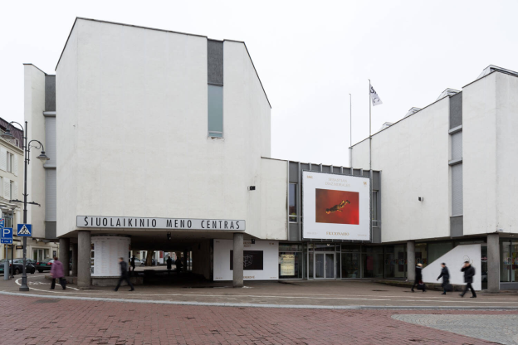
Classicism architecture -
Modernist architecture -
Vilnius cathedral
Kurtuvėnai St. Apostle James Church
Green Bridge
Modern Art Center

Slide 12
The most important architectural building
In my opinion, the most important architectural building is the Vilnius Cathedral because:
1) Vilnius Cathedral is in the Old Town next to other magnificent historical buildings.
2) The cathedral is often visited by many tourists.
3) An important gathering place for people during events and commemorations (also Kaziukas fair and Vilnius Christmas tree takes place near the cathedral)

Slide 13
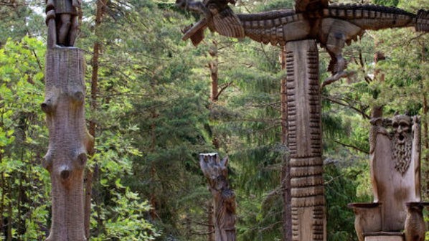
Lithuanian folk art
The Hill of Witches- is an outdoor sculpture gallery near Juodkrantė, LithuaniIt is located on a forested sand dune about 0.5 kilometer west of the Curonian Lagoon, on the Lithuanian Seaside Cycle Route. Begun in 1979, it has been expanded several times, and now contains about 80 wooden sculptures along a series of trails. The artists drew on a long tradition of woodcarving in Samogitia, and on the equally long tradition of Joninės celebrations on the hill.

Slide 14
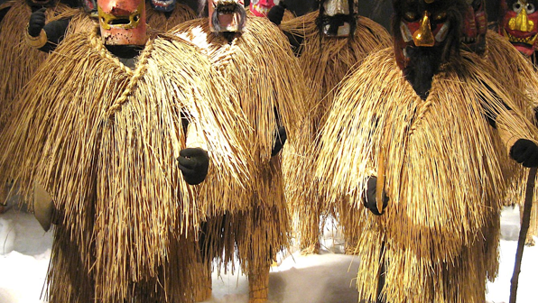
Žmuidzinavičius Museum, known as the Devils' Museum- is a museum in Kaunas, Lithuania, dedicated to collecting and exhibiting sculptures and carvings of devils from all over the world. The collection was started by artist Antanas Žmuidzinavičius (1876–1966), and a memorial museum was established in his house after his death. In 1966, the devil collection consisted of 260 sculptures but visitors began to leave their own devils as gifts to the museum.v

Slide 15
Lithuanian paintings
Lithuanian Girl with Palm Sunday Fronds is an 1844 oil on canvas painting by the Polish-Lithuanian artist Kanuty Rusiecki in the Lithuanian Art Museum. This painting shows a girl holding grasses and willow fronds on Palm Sunday. She is standing in front of a Baroque church and wearing traditional dress. Rusiecki was at the peak of his fame in Vilnius when he painted this picture. He specialized in portraits, but is also known for genre works that placed the local heritage in a monumental setting.

Slide 16
Woman with the artist- is a painting by the Lithuanian artist Vytautas Kasiulis from 1948. Vytautas Kasyulis is one of the few Lithuanian artists with an international reputation. In 1944, he moved to Austria and Germany. He taught at the School of Arts and Crafts in Freiburg. In 1948 he settled in France. In the painting Woman with the artist, he skillfully creates shading, a sophisticated harmony of colors, and the relaxed atmosphere in the room.

Slide 17
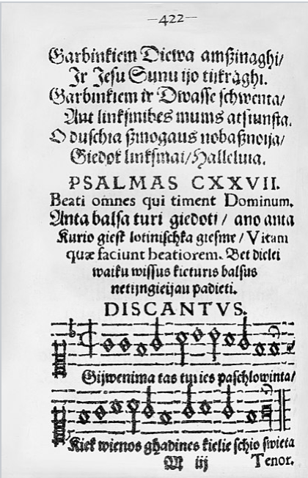
Lithuanian music
Music of Lithuania refers to all forms of music associated with Lithuania, which has a long history of the folk, popular and classical musical development. Music was an important part of polytheistic, pre-Christian Lithuania – rituals were accompanied by music instruments and singing, deeds of the heroes and those who didn't return from the war were celebrated in songs. Music was very important part of ancient Lithuanian polytheistic belief. It is known that, at the start of the 2nd millennium, Baltic tribes had special funeral traditions in which the deeds of the dead were narrated using recitation, and ritual songs about war campaigns, heroes and rulers also existed

Slide 18
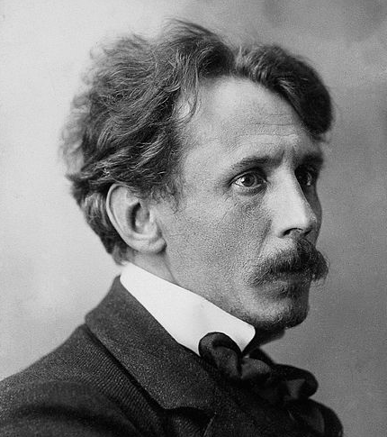
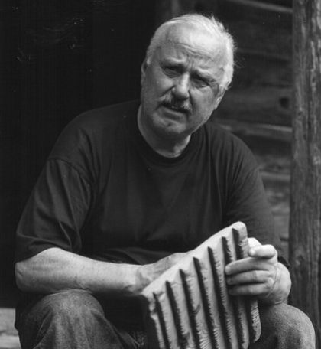
Most famous Lithuanian musicians
Mikolajus Konstantinas Čiurlionis born in September 22 1875 in Varėna—died April 10 1911 was a Lithuanian painter and composer. During his short life he created about 200 pieces of music. His works have had profound influence on modern Lithuanian culture.
.
Bronius Kutavičius born 1932 in Molainiai, is a Lithuanian composer. From 1959 to 1964 Kutavičius studied Music composition at the Lithuanian stateConverticion in composition class in Vilnius. He has written numerous oratorios and operas, among them The Last Pagan Rites, Lokys the Bear and The Gates of Jerusalem

