Slide 1
FAMILY/EVERYDAY LIFE
By Titas Vidžiūnas, Martynas Stūrys, Kamilė Višnevskaja,
Urtė Aukštuolytė and Daumantas Barštys

Slide 2
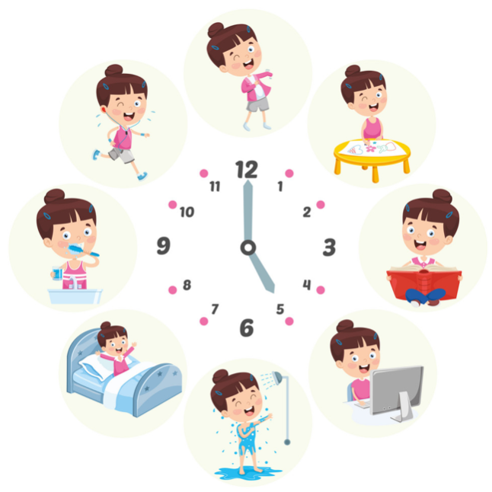
DAILY ROUTINE
We go to school very differently, depending on the person –
some of students go by bus or car, some of them go to school
on foot.
At school, we have consultations where we can repeat our
topics and if someone wants to learn more they are given
extra tasks.
The lessons take 45 minutes, in lessons we learn math,
Lithuanian, biology, geography and many other subjects.
After school, most of us do sports, go to after school clubs or
just spend time with friends. When we get home, we do our
homework and then go to bed. This is the most usual daily
routine of students in our school.

Slide 3
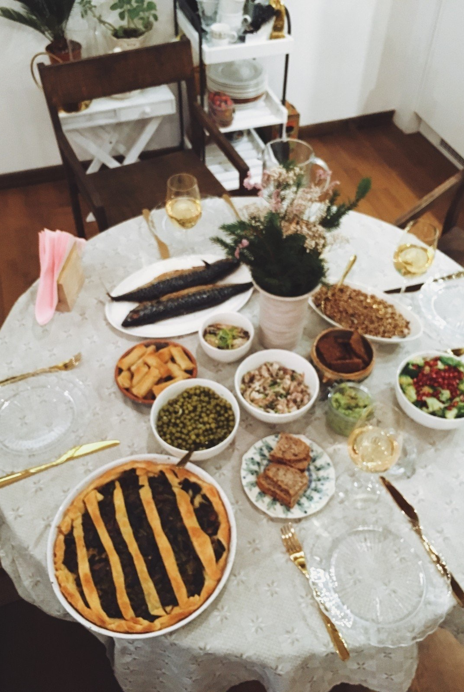
RITUALS IN FAMILY
In every country there are some rituals in families. In Lithuania those rituals are quite simple. Sunday is our day with family and no work involved. A lot of people go to church on Sunday morning and those people usually pray before eating. Whenever there is a celebration for example Christmas Eve, a birthday, a family reunion we always make sure that our tables are full of delicious and our traditional food on it. We really respect our traditions so one of main rituals is making sure we don’t forget about them.
Christmas Evening

Slide 4
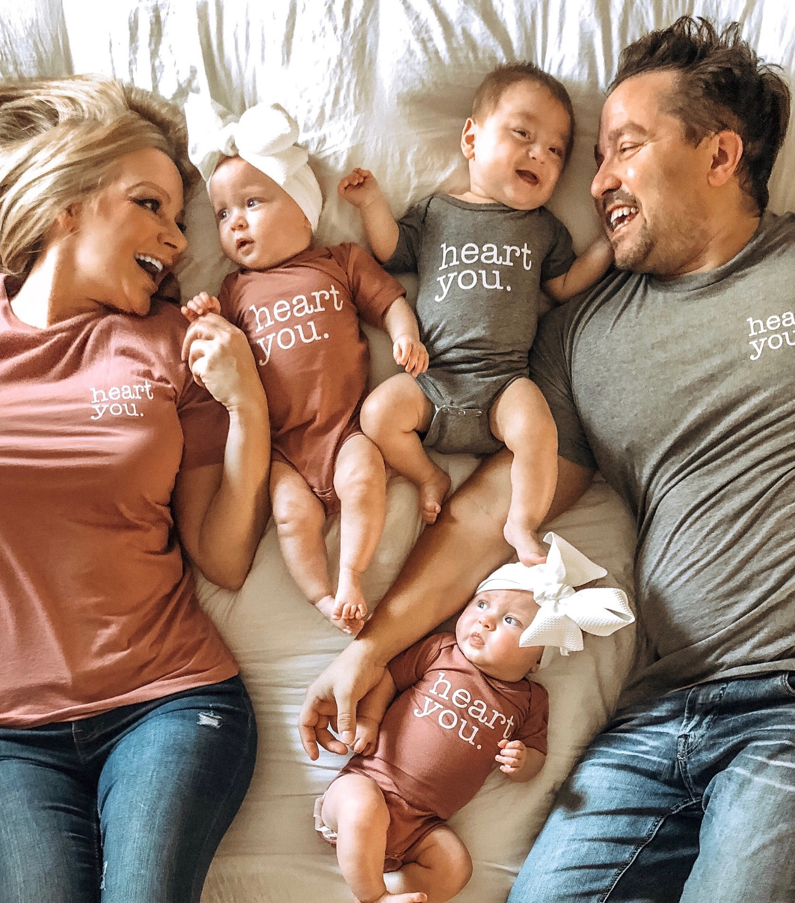
In our families there are no special roles assigned to the fathers, mothers or grandparents. They are all equally involved and can do anything you need at that time for a family. There are a lot of love and the most important thing in the families are to share it with each other.

Slide 5
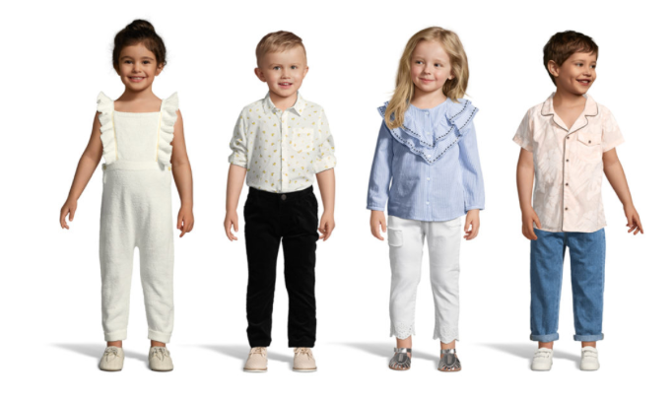
AVERAGE NUMBER OF CHILDREN PER FAMILY
So basically, average number of children per family in our class is about 2-3 children per family, but in a very accurate case it would be the number of 2. Our class students mostly have brothers, less have sisters, but very few have none. In case, average number of children per family in our country, Lithuania, is also 2.

Slide 6
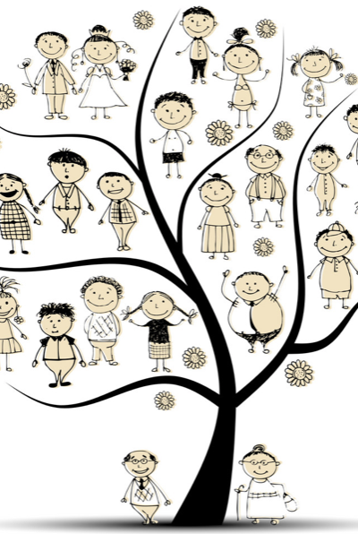
OUR RELATIVES
Usually students see their relatives during the holidays but very differently, depending on the person. It’s very usual to meet our relatives during Christmas, Easter, Lithuanian national celebrations, summer holidays or birthdays.
When relatives meet, they have some good time to talk to each other, have dinner or just have some fun.

Slide 7
MOVING AWAY FROM FAMILY’S HOUSE
There aren‘t any accurate or exact calculations on the age of young people who move away from their family in Lithuania, but it is believed to be the age from 25-31. In a percentage scale, based on those ages, our country’s young people, who live with their parents is 33,5%, and which do not is 66.5%.

