Slide 1
Celebrations, Holidays and Traditions
Done by: Jonas Žilionis, Vaiva Lenkšaitė, Jokūbas Vainius, Mindaugas Milinavičius and Aleksas Žvirblis

Slide 2
Main Holidays
Aleksas Žvirblis

Slide 3
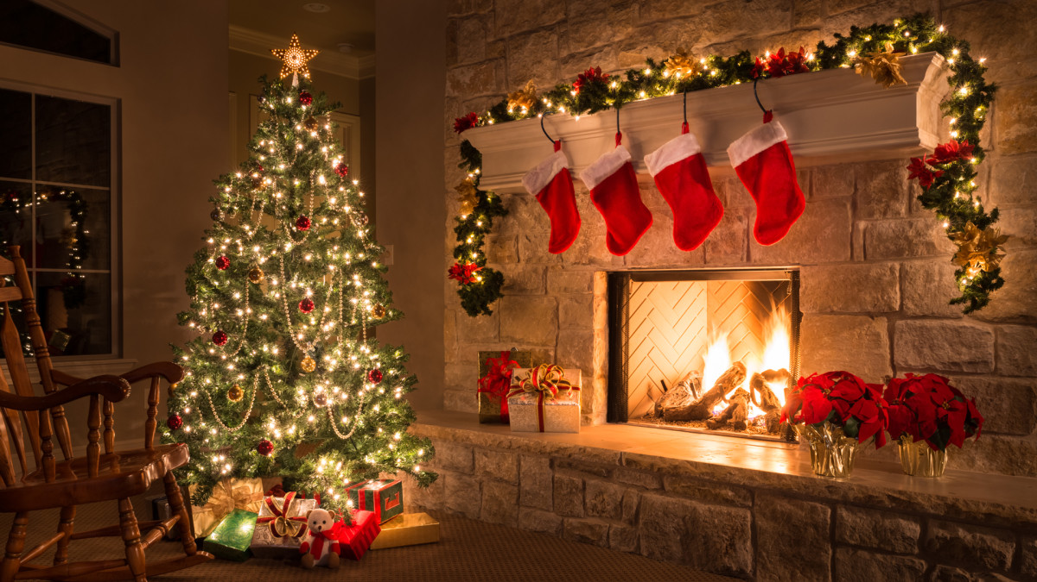
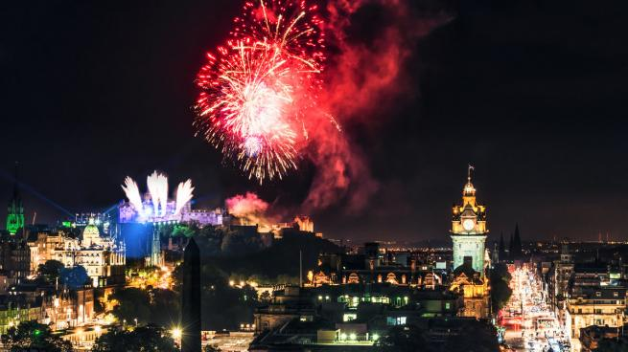
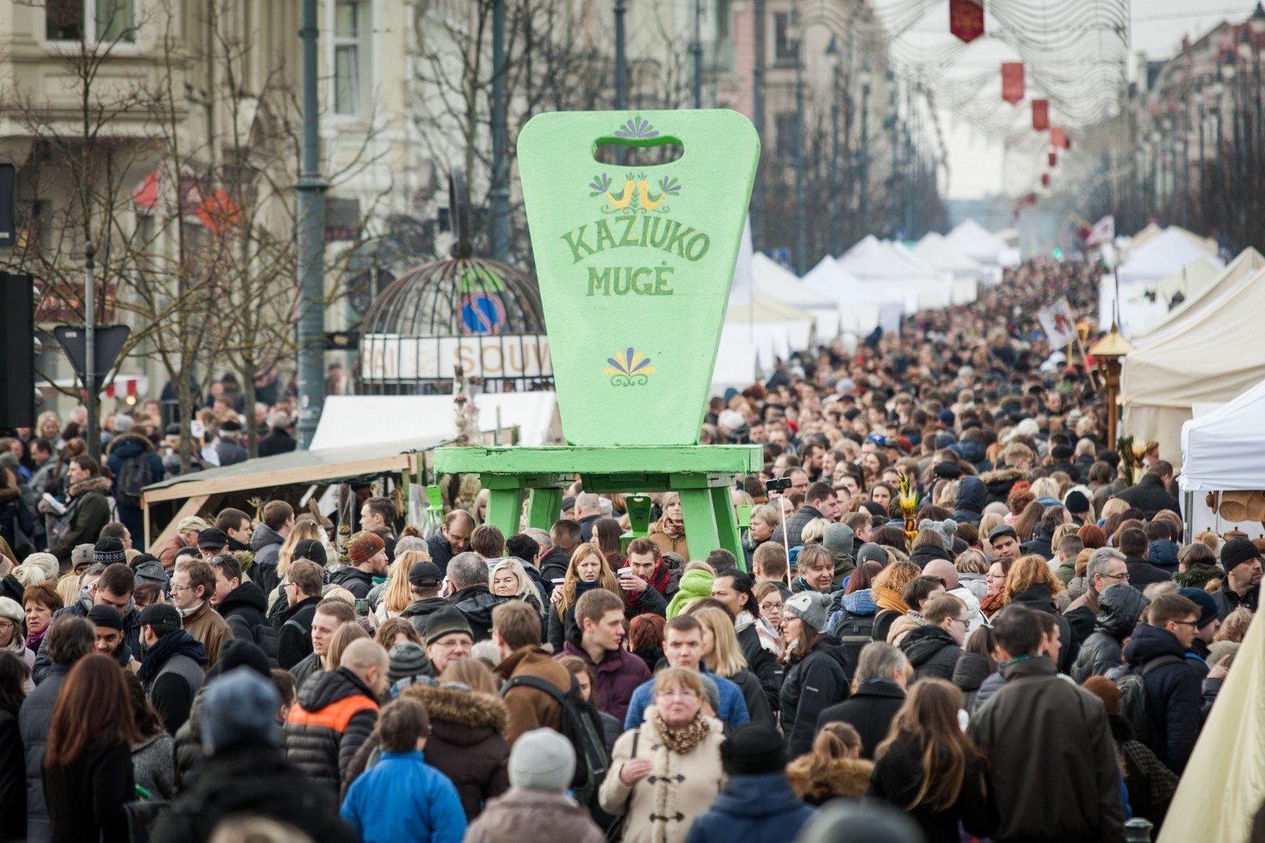
Holidays
The Holidays in Lithuania, just like in most countries, are based on national celebrations. Some of them are Lithuanian, some are foreign, but we mix it very well.

Slide 4
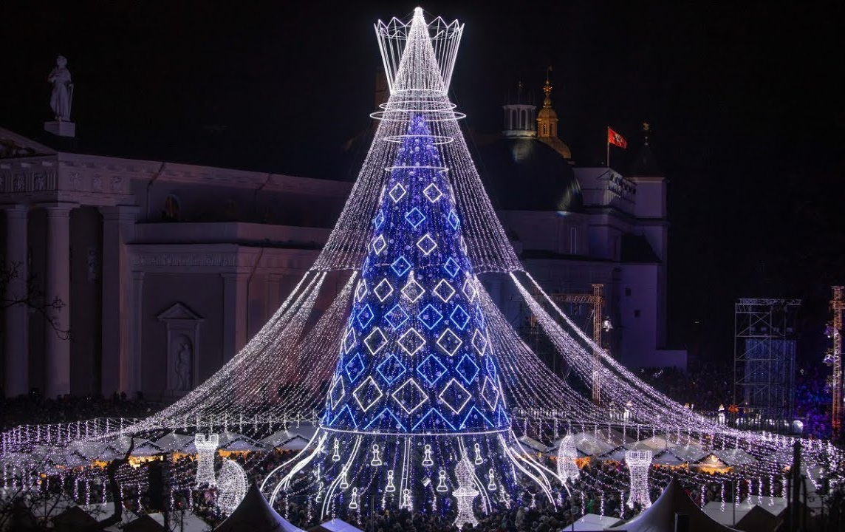
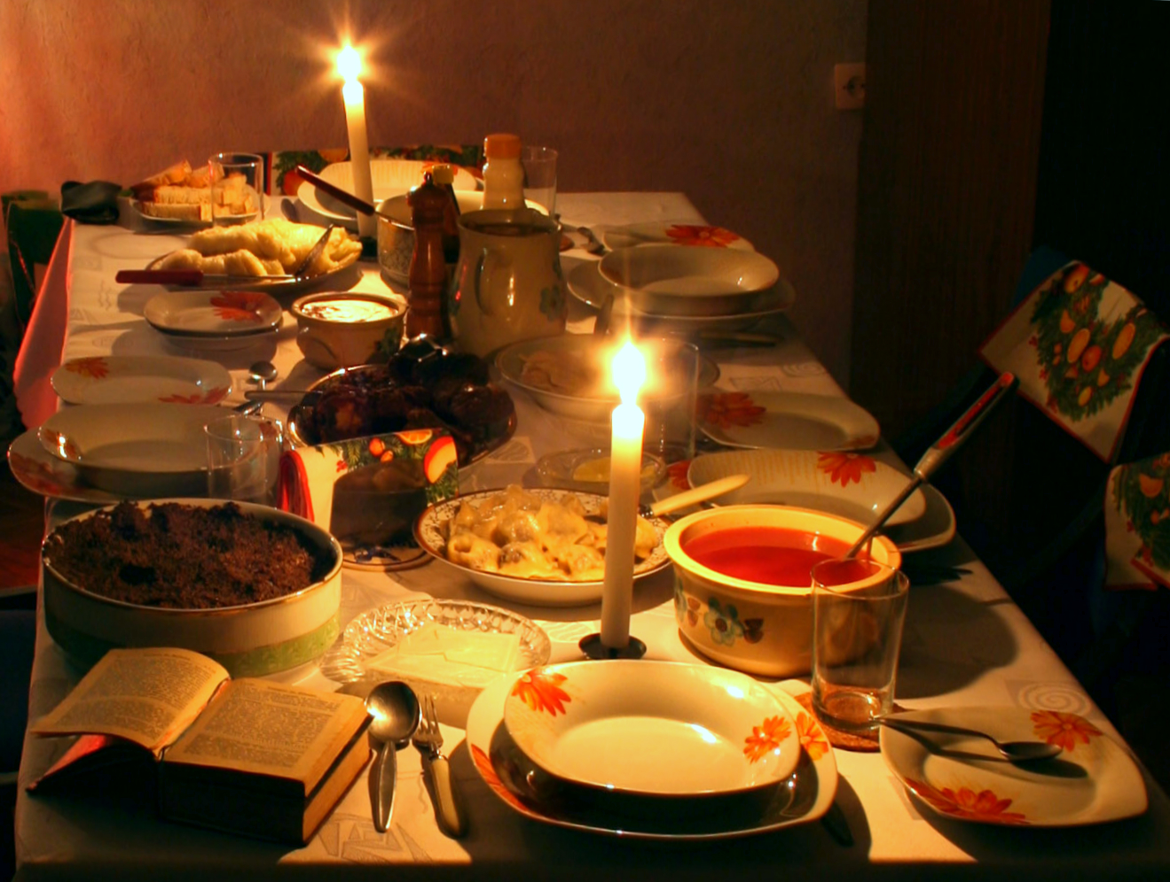
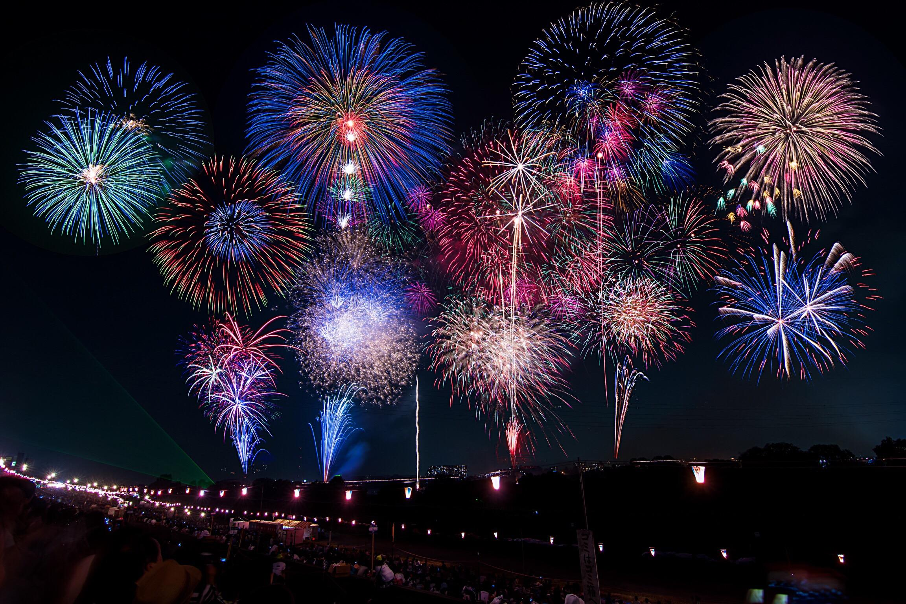
Christmas Holidays
On Christmas Eve we have our old Lithuanian traditions, but Christmas and New Year we celebrate like other countries.

Slide 5
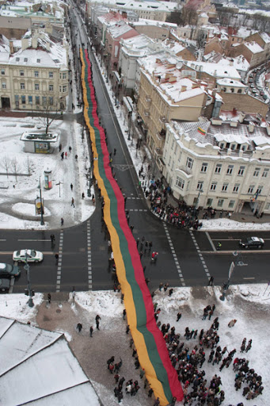
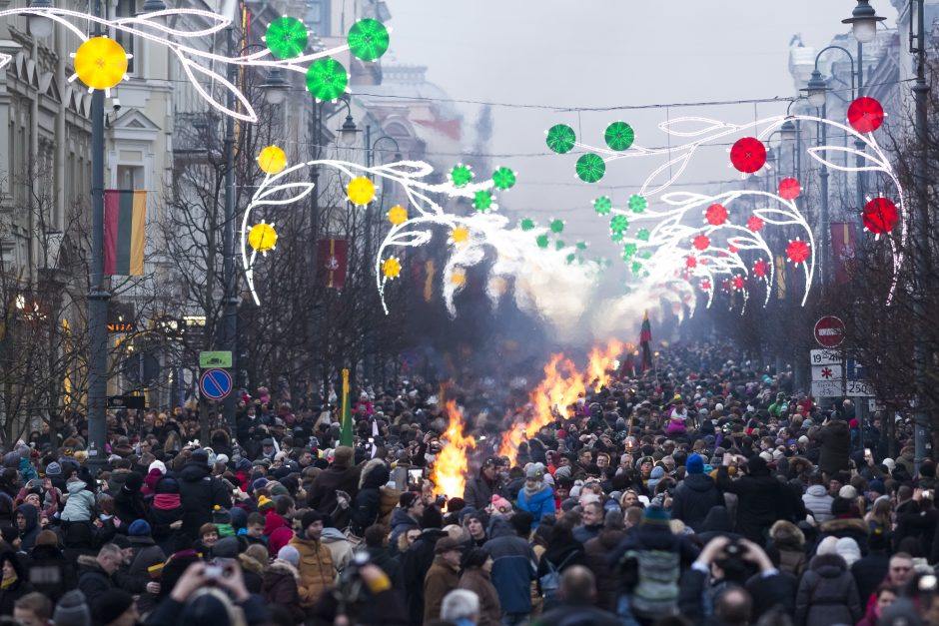
February Holidays
We have holidays on the third week of February because on the 16th February is Lithuania’s Independence Day.

Slide 6
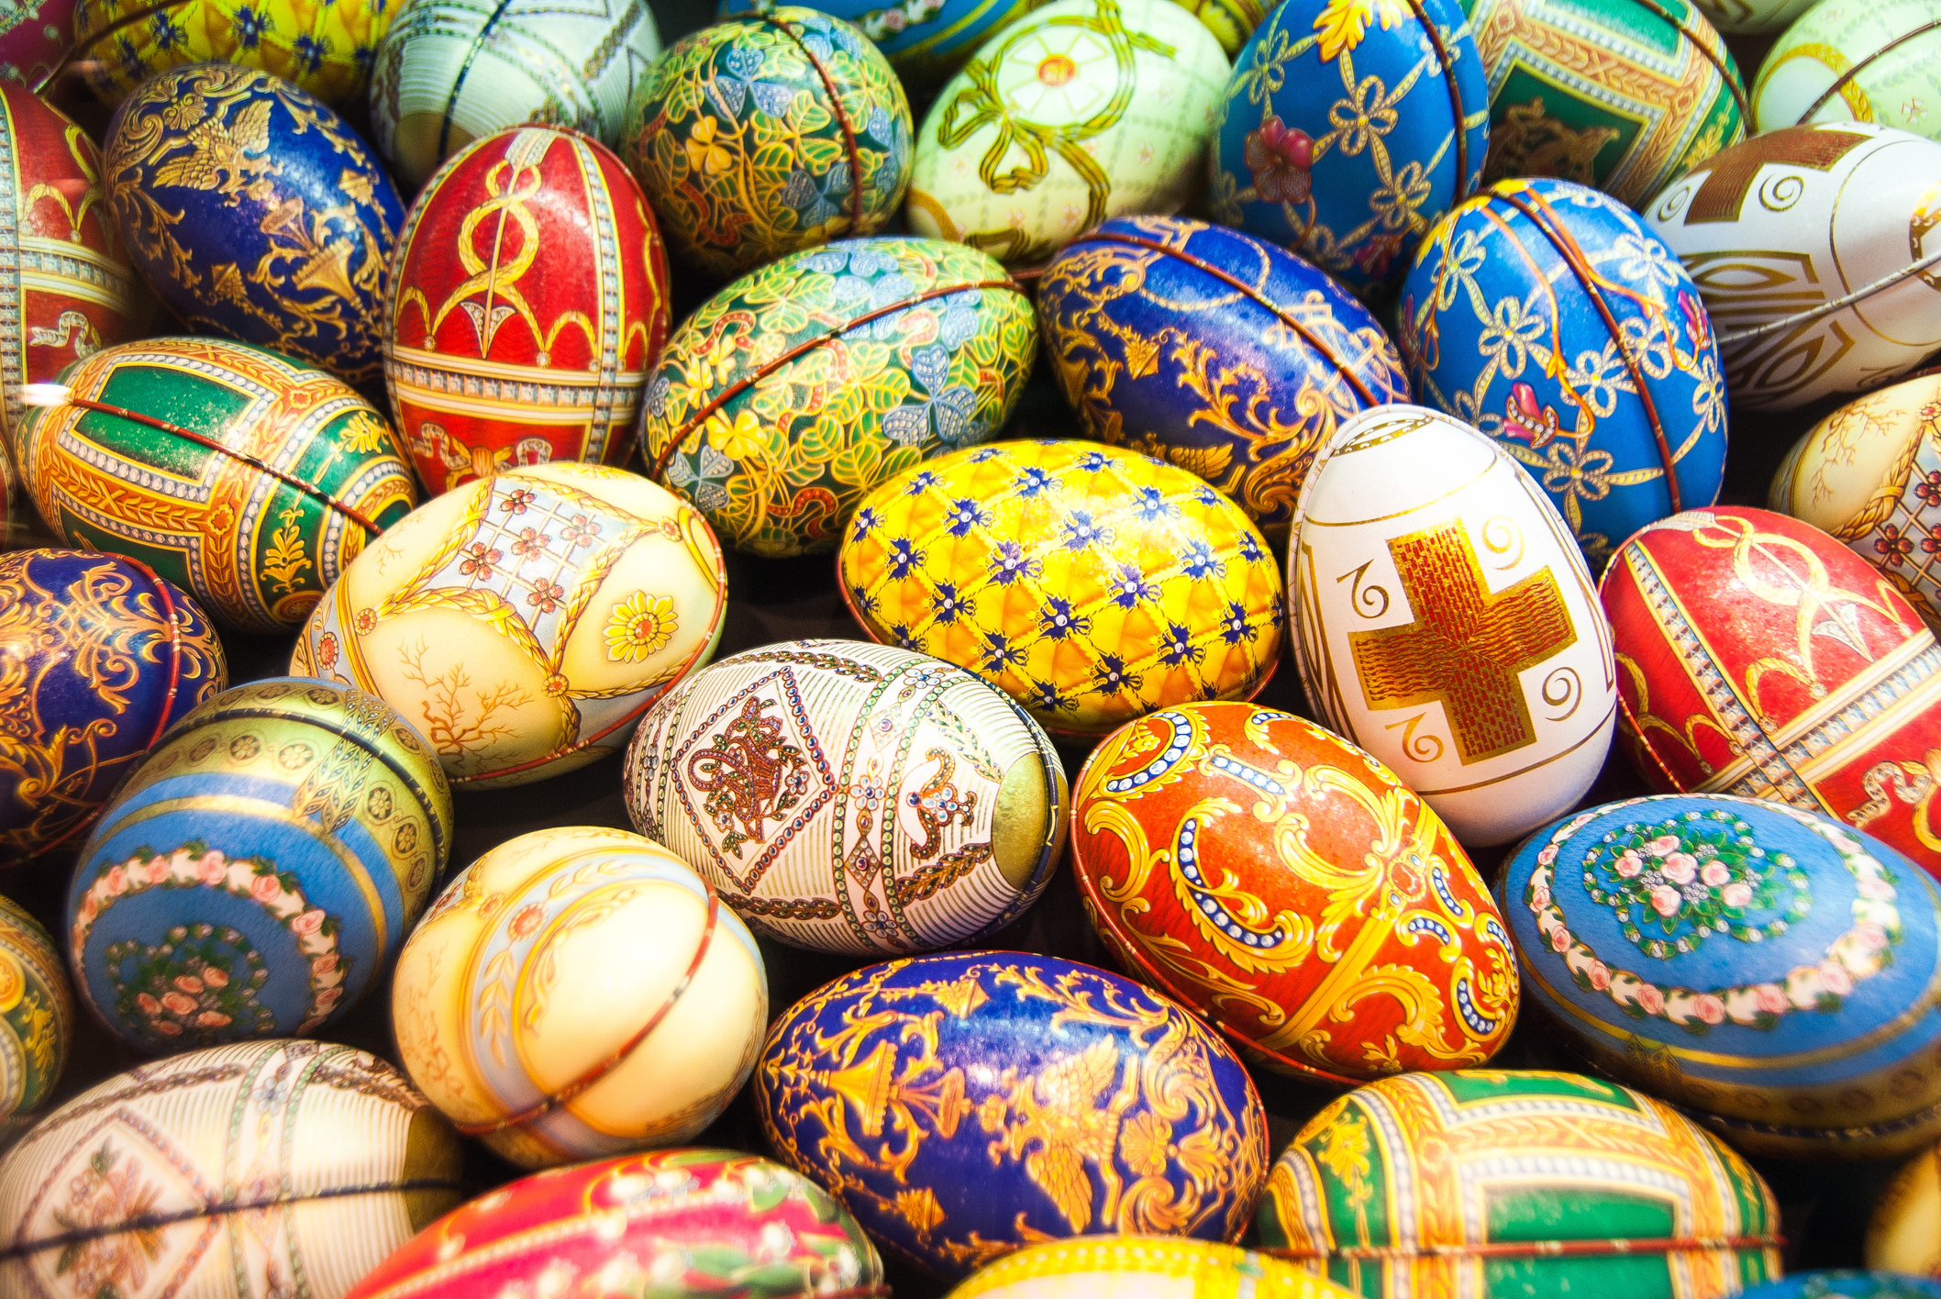
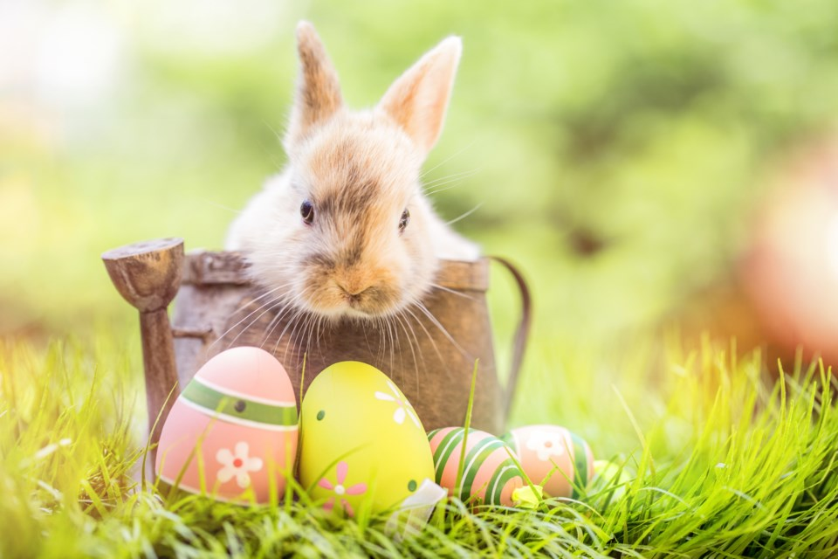
Easter Holidays
Just the same as other countries Lithuania celebrates Easter and people have holidays for a few days.

Slide 7
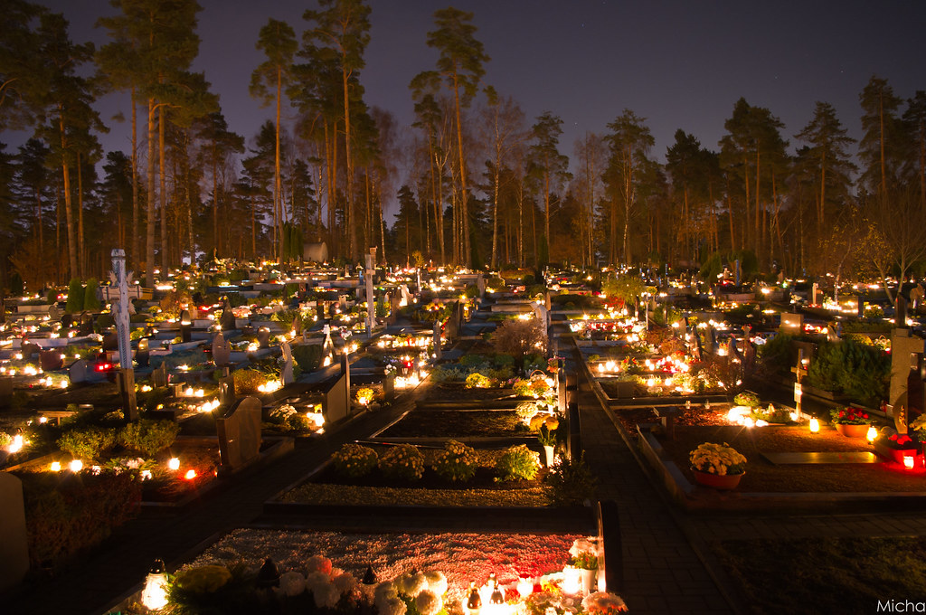
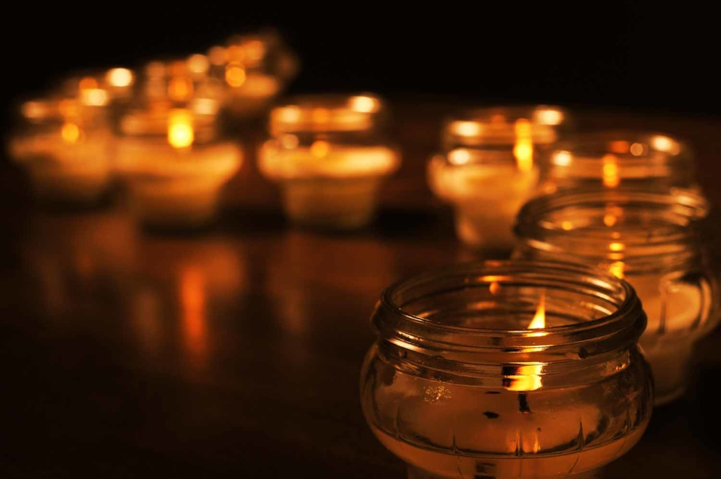
Autumn Holidays
In the period of Halloween Lithuanians celebrate two more dates - All Saints' Day (1st November) and All Souls' Day (2nd November).

Slide 8
Special Traditions
Vaiva Lenkšaitė and Jonas Žilionis

Slide 9
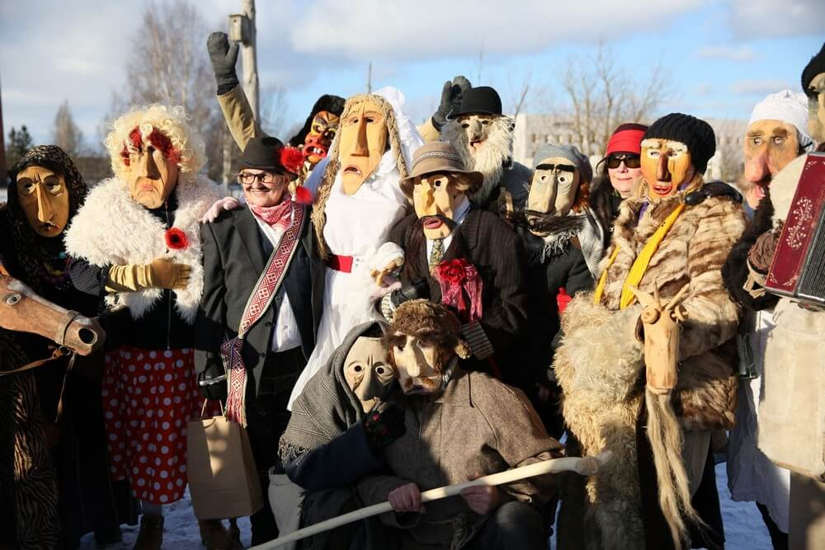
1. Užgavėnės
This day is traditionally full of fun, people enjoy eating a lot of pancakes, wear hand-carved wooden masks and burn straw sculptures. This is done to represent the female character and to chase away winter and encourage the arrival of spring!

Slide 10
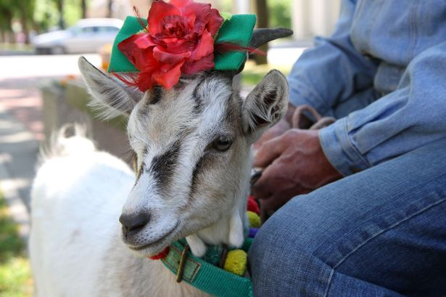
2. Goat Beauty Pageant
A small village in Ramygala, is hosting an annual goat beauty pageant. In preparation for the show, the goats are groomed, decorated with flowers and dressed.

Slide 11
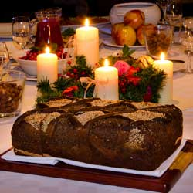
3. Christmas Eve Dinner
Lithuanians follow a rather specific tradition when it comes to dinner on Christmas Eve. The whole family gets together to eat at least 12 vegetarian dishes. The first dish must be wafers that are prepared using the same recipe as wafers that are received at Holy Communion in church. All other dishes must be meatless, although fish can be enjoyed.

Slide 12
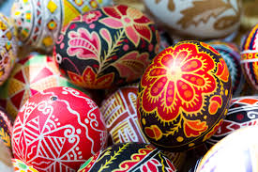
4. Easter traditions
Americans have their Easter Bunny and Lithuanians have an Easter Granny. The Easter Granny leaves Easter eggs and sweets to children when they leave a homemade nest outside their house. Prior to tucking into a delicious meal, one hard boiled Easter egg is cut into enough pieces for each of the family members present.

Slide 13
Lithuania as a multicultural country
Jokūbas Vainius and Mindaugas Milinavičius

Slide 14
4 main minority communities in Lithuania
1. Poles
2. Russians
3. Belarusians
4. Jews

Slide 15
The Polish
Total population: 200 317 people, 6,6%.

Slide 16
The Russians
Total population: 176 613 people, 5,8%.

Slide 17
The Byelorussians
Total population: 52 650 people, 1,7%.

Slide 18
The Jews
Total population: 3 050 people, 0,1%.

