Slide 1
Lithuania’s national food
By Smiltė Šukevičiūtė, Karina Beinoraitė, Kristupas Lapinskas, Rasa Danieliūtė, Teodoras Vyšniauskas

Slide 2
Lithuanian dishes are most of root vegetables (potatoes and beetroot), meat and dairy products, which can all be grown in Lithuania’s cold climate.
Here are some traditional Lithuanian dishes that must be tried

Slide 3
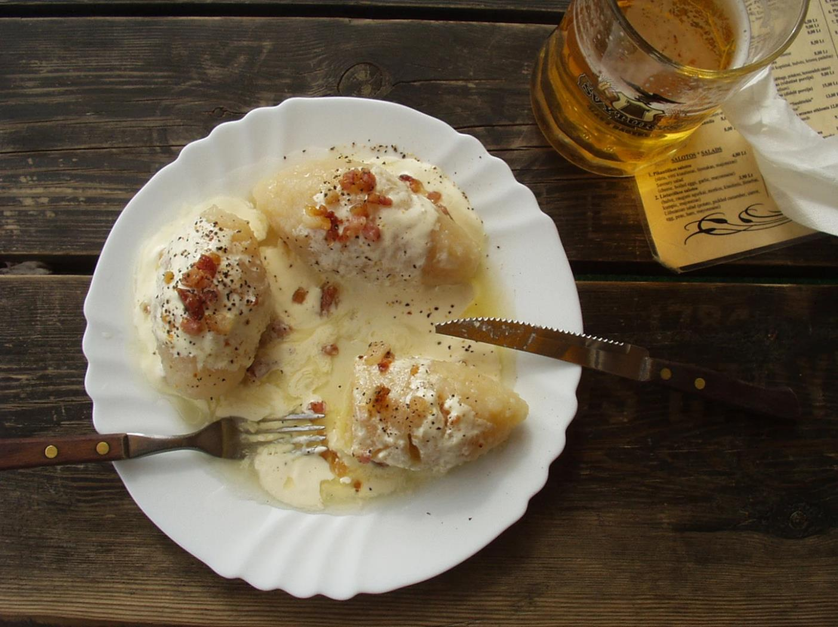
CEPELINAI
Starting off with Lithuania’s national dish, cepelinai are large dumplings made of a mixture of raw and cooked potato dough that is filled with pork and doused in a ladle of a sour cream and bacon sauce.

Slide 4
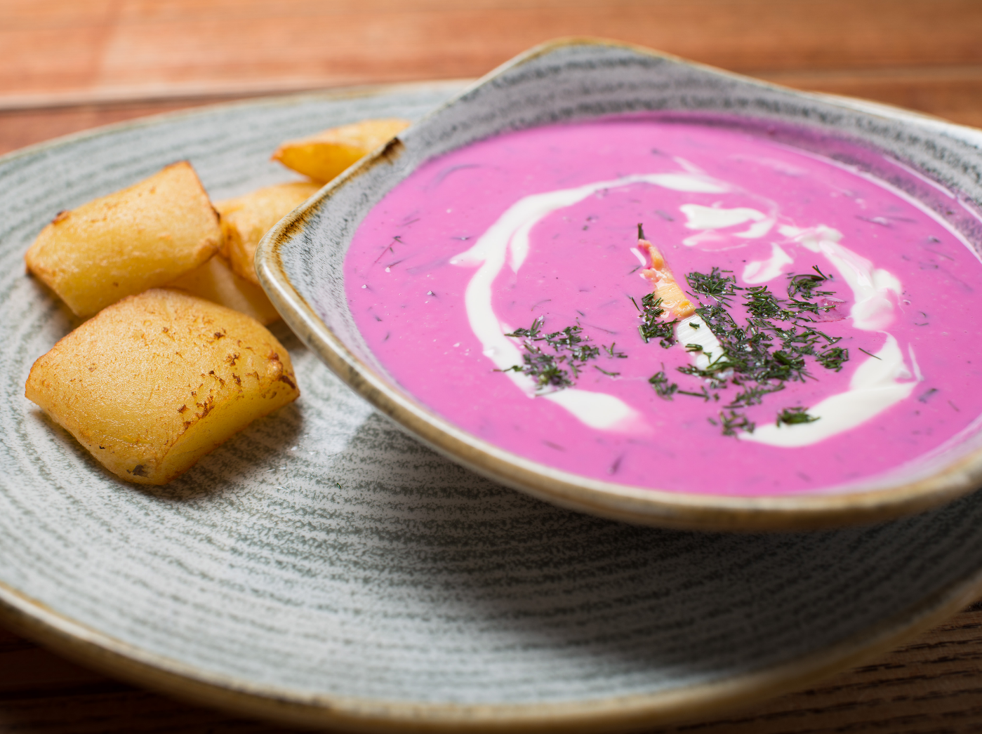
ŠALTIBARŠČIAI
Šaltibarščiai is a cold pink beetroot soup with hardboiled eggs and potatoes on the side and dill, onions and sour cream on top. This soup has a strange bright pink color, so some people are scared of trying it.

Slide 5
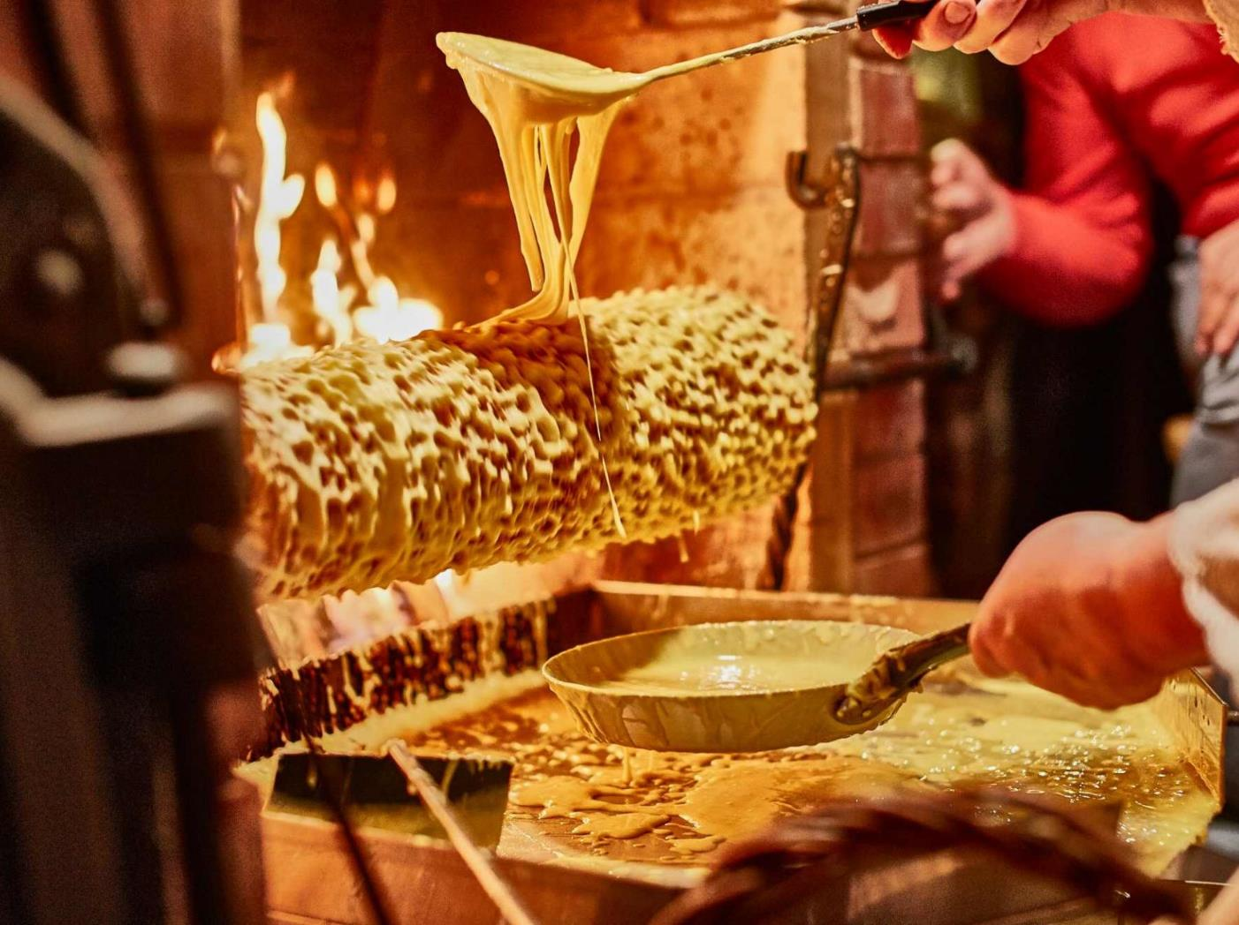
ŠAKOTIS
Raguolis, also called Šakotis, is a traditional Lithuanian cake that is frequently served during special occasions such as weddings, Christmas Eve and Easter. This cake is a large, hollow ring with what looks like horns or spines around the edges that are created from dripping batter as the cake is turned around and around on a spit-like cooker.

Slide 6
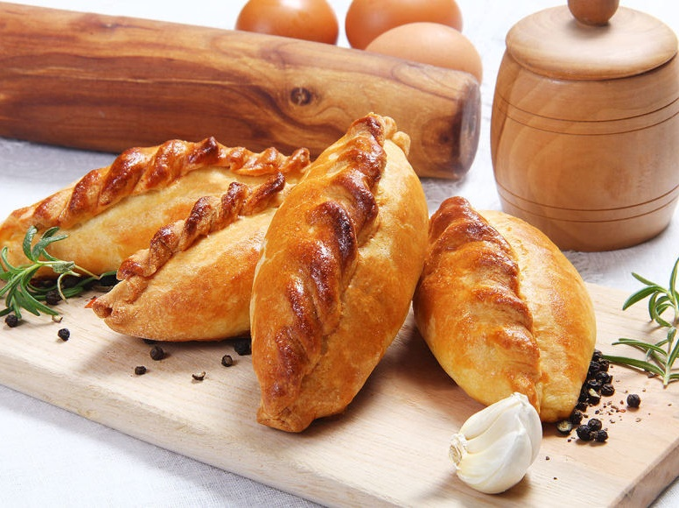
KIBINAI
These traditional Lithuanian pastries are made with dough that is enriched with butter, eggs and sour cream. The dough is hand-rolled, and it is traditionally filled with minced mutton that is flavored with onions and various herbs.

Slide 7
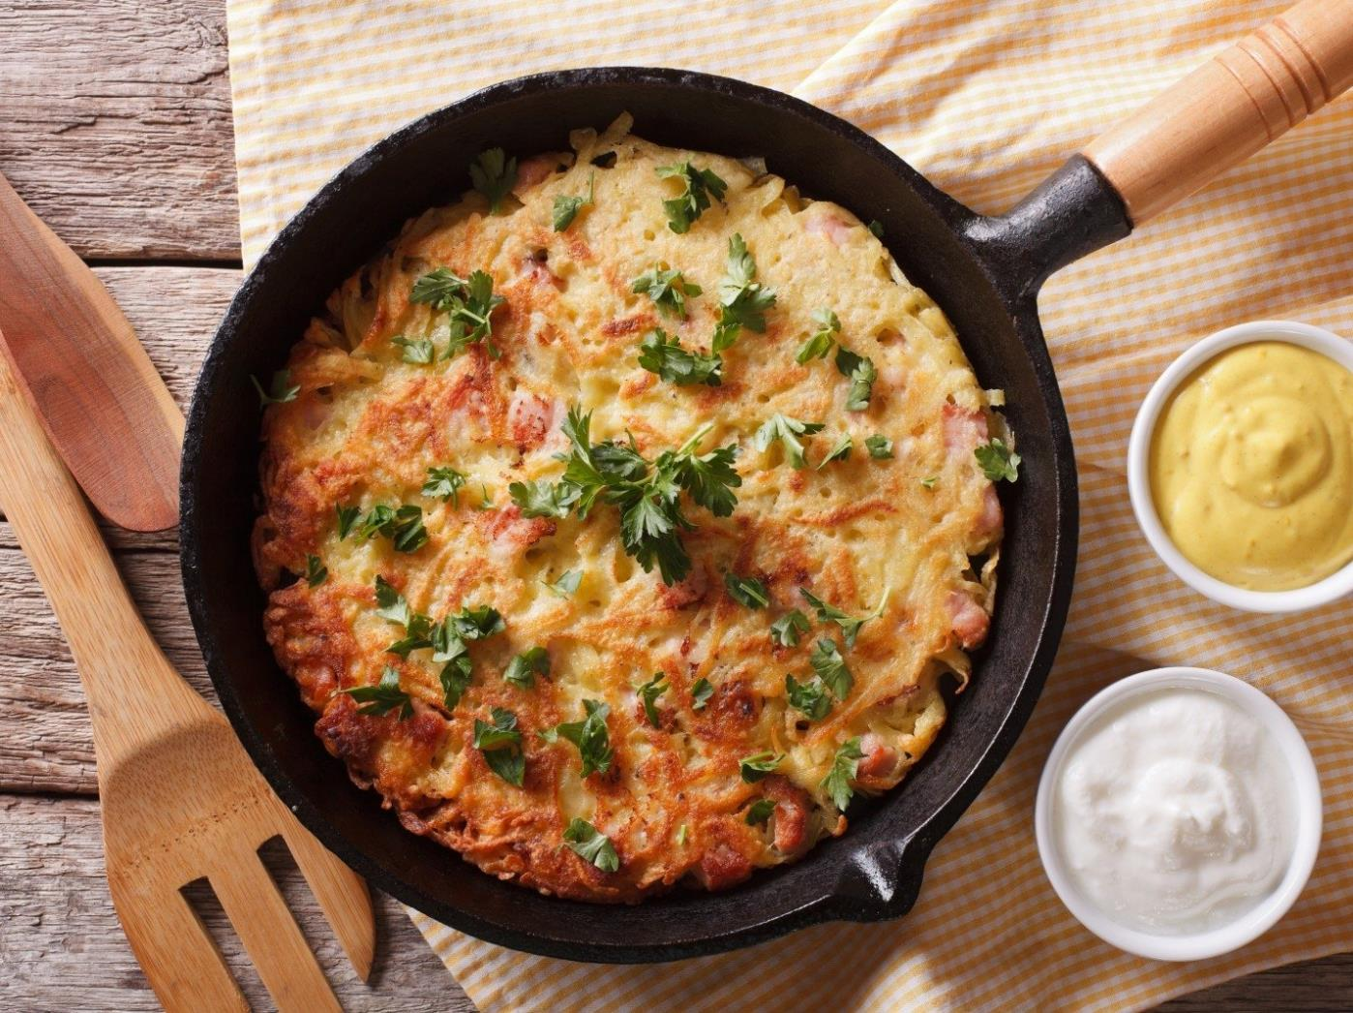
KUGELIS
Kugelis is a Lithuanian national dish in the form of a delicious potato cake. The recipe has survived for centuries without significant changes. It is traditionally made with potatoes, onions, milk, bacon, and eggs. This oven-baked dish is among the most appreciated traditional Christmas dishes and is best enjoyed when served with sour cream and chopped scallions.

Slide 8
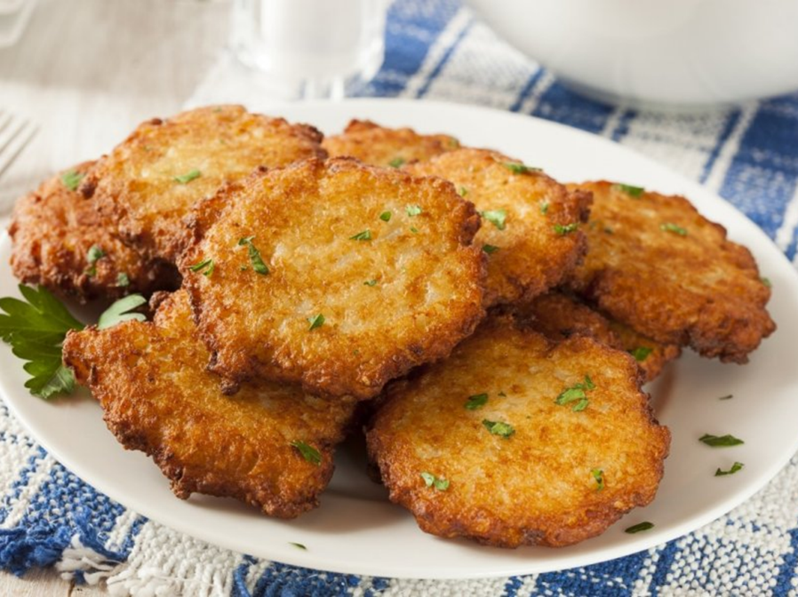
BULVINIAI BLYNAI
BULVINIAI BLYNAI
Bulviniai blynai are traditional, crispy and mouth-watering Lithuanian potato pancakes. The combination of grated potatoes, diced onions, eggs, and flour is seasoned with salt and pepper and sometimes flavored with lemon juice before being fried until it develops a beautiful, golden color. Bulviniai blynai are often served with sour cream.
(POTATO PANCAKES)

Slide 9
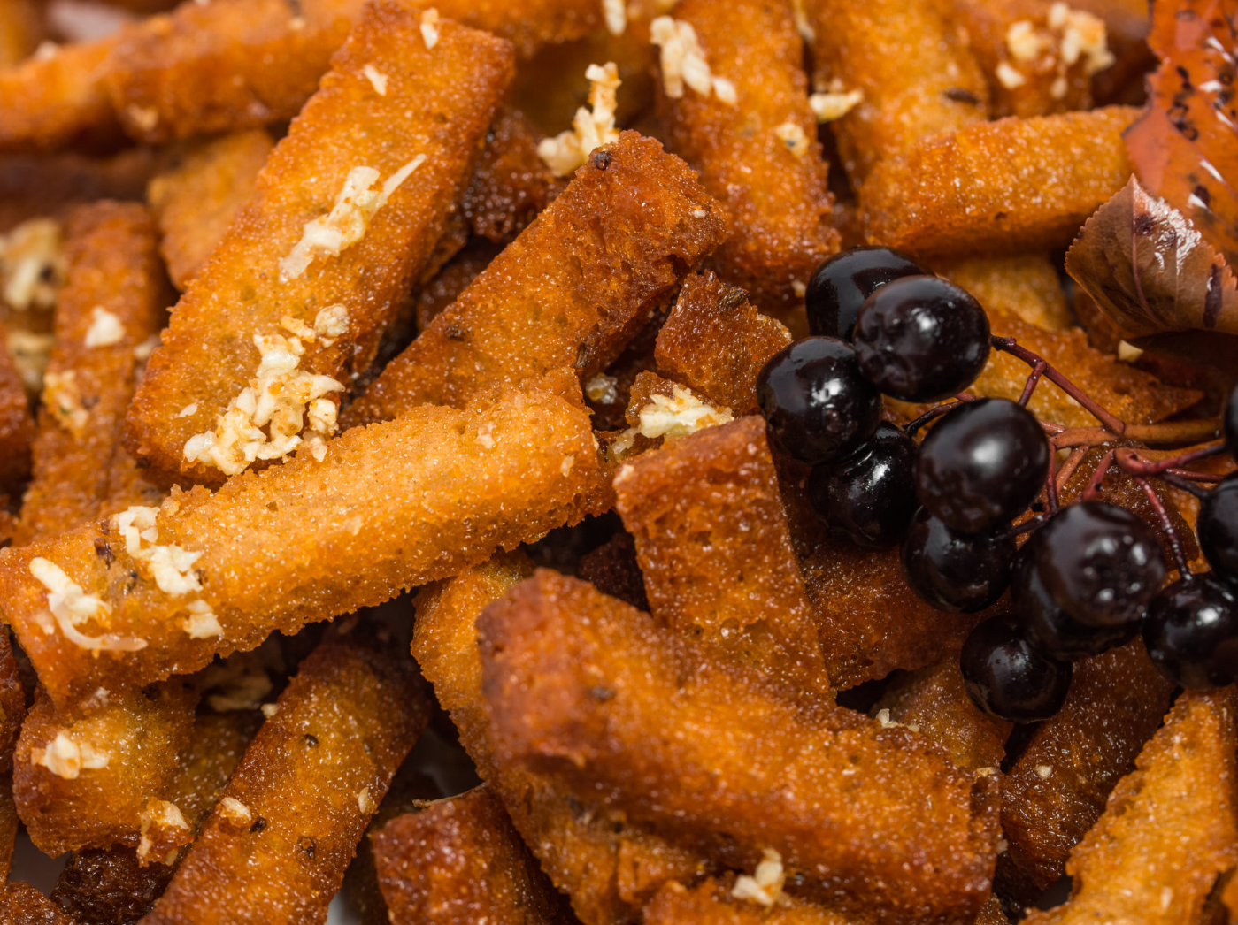
KEPTA DUONA
Kepta duona is a delicious calorie bomb made out of fried strips of Lithuanian dark or medium-dark bread, seasoned with salt and pepper and rubbed with garlic. Often served with melted cheese or a melted cheese-mayonnaise dipping sauce on top.

Slide 10
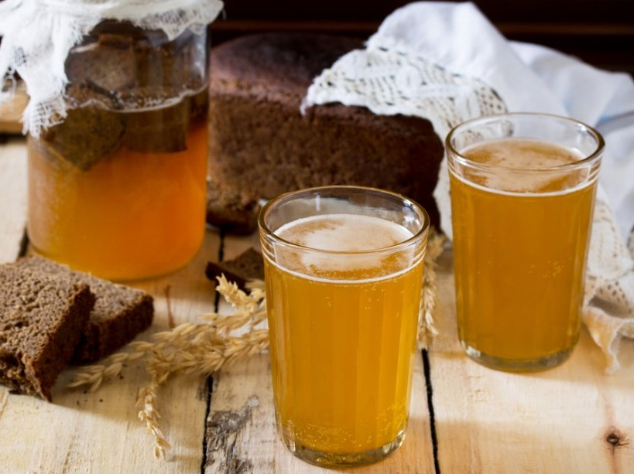
NAMINĖ GIRA
Lithuania also has various traditional non-alcoholic beverages to try. Naminė gira is homemade Lithuanian kvass – a drink made from rye bread. It does sometimes have a low alcohol content, usually not higher than 1% ABV. Its bready flavor is quite dry, but it is sometimes sweetened with fruity flavorings.

Slide 11
Where can you eat them?
Most of these foods are made in traditional Lithuanian food restaurants such as “Etno Dvaras” and “Katpėdėlė”
Kibinai can be bought in “Senoji Kibininė”
Šakočiai can be found in grocery stores such as “Maxima”. To pick out the tastiest one, you can push on the top of it and feel if it‘s soft or not. The soft ones are usually tastier.

