Slide 1
Food in Lithuania
Made by Smiltė Šukevičiūtė, Karina Beinoraitė, Kristupas Lapinskas, Rasa Danieliūtė and Teodoras Vyšniauskas

Slide 2
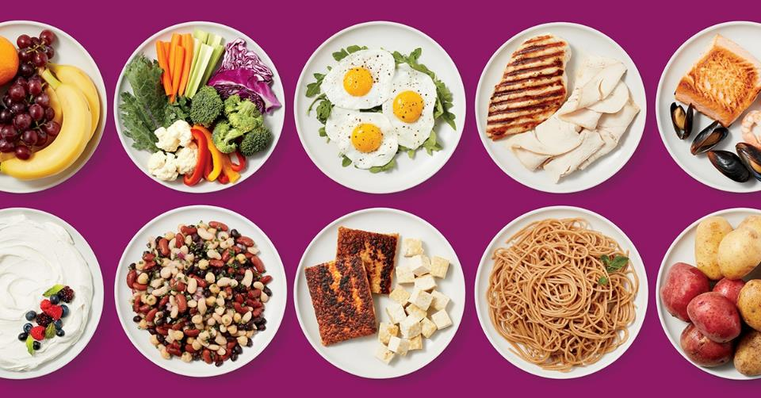
Favorite food

Slide 3
Research
“Saulė” private gymnasium‘s 1G students were questioned about their favorite dishes.
20 students participated in the survey.

Slide 4
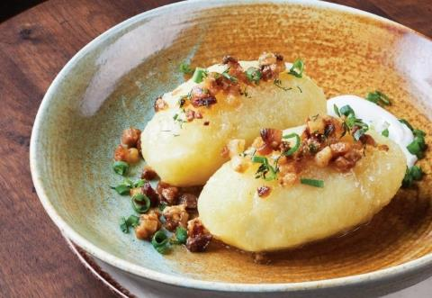
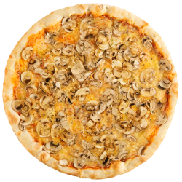
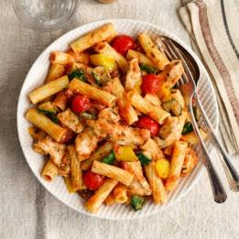
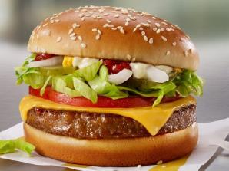
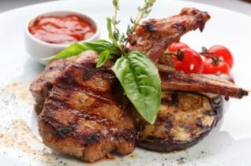
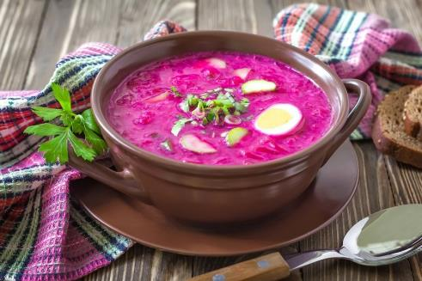
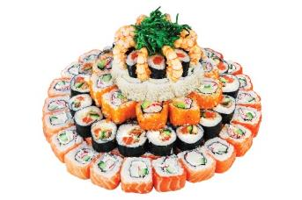
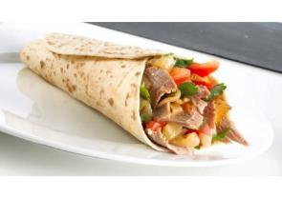
Are they national/regional dishes?
National dishes
Foreign dishes
Cepelinai
Šaltibarščiai

Slide 5
Is it different for parents and grandparents?
Parents‘ and grandparents‘ favorite food:
Fish
Meat
Bulviniai blynai (potato pancakes)
Salad
Soup
Cepelinai
Vėdarai
Parents and grandparents prefer national, traditional, regional food. Teenagers prefer foreign, fast-food dishes.

