Slide 1
LET’S DISCOVER OUR AREA!
I.C. VIA LAPARELLI 60 Middle School - 1^ A

Slide 2
HEY GUYS, WHAT ARE YOU DOING?

Slide 3
WE’RE DOING A SCHOOL PROJECT ABOUT CATACOMBS… YOU KNOW, CLOSE TO THIS AREA THERE ARE THE SS MARCELLINO AND PIETRO CATACOMBS

Slide 4
THEY ARE THE PLACES WHERE CHRISTIANS BURIED THEIR DEADS. WE’VE JUST VISITED THEM.
CATACOMBS ??? WHAT ARE THEY ?

Slide 5
THEY ARE UNDERGROUND TUNNELS . ON THEIR SIDES THERE ARE SOME SMALL ROOMS CALLED “CUBICOLA“. ALONG THE WALLS THERE ARE THE “LOCULI”, THE HOLES WHERE THE CORPSES WERE BURIED.
OH MY GOD ! WHAT ARE THEY LIKE?

Slide 6
YES, WE DID. THEY ARE NOT HORRIBLE AT ALL!
THEY’RE VERY INTERESTING, INSTEAD. ON THE WALLS THERE ARE A LOT OF BEAUTIFUL PAINTINGS AND… IT’S LIKE A LABYRINTH UNDER THERE!
HOW HORRIBLE! DID YOU LIKE THEM?

Slide 7
WHEN WE WENT THERE, WE FOUND OUT A LOT OF THINGS!
LIKE WHAT ?

Slide 8
WE’LL SHOW YOU!
FASTEN YOUR BELT!
ARE YOU READY?

Slide 9
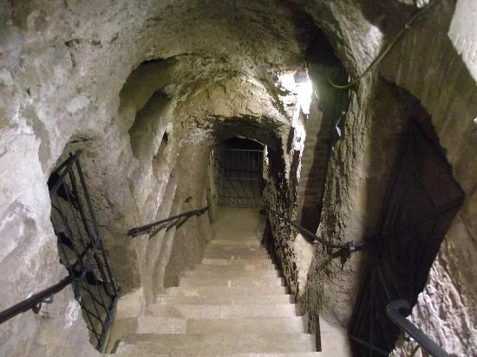
ONE
TWO
THREE…
LET’S GO!!!

Slide 10
THE SS. MARCELLINO E PIETRO CATACOMBS WERE DUG IN THE 2°-3° CENTURY A.D. IN ROME, IN TORPIGNATTARA AREA. IN ROME THERE ARE A LOT OF CATACOMBS, BUT ONLY SIX ARE OPEN TO THE PUBLIC.

Slide 11
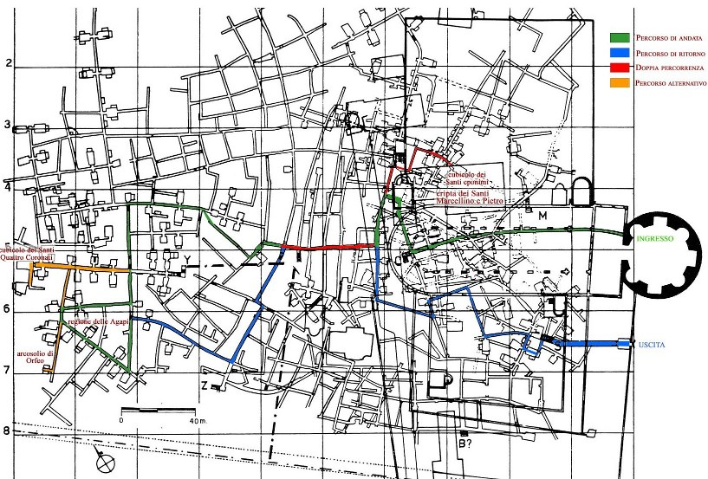
They are among the biggest ever built, the third ones in Rome. They are on different levels for about 20 km to a depth of nearly 16 m.

Slide 12
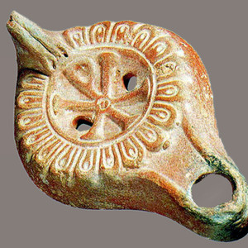
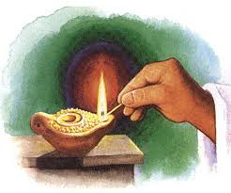
You couldn’t stay there for long because of the terrible smell.
Inside them it was very dark!
They were lighted only by a few lanterns.
LOCULI

Slide 13
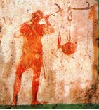
It was a dark labyirinth
AHHHHH....
Only the “fossori” weren’t afraid of getting lost
Fossore: a worker assigned to dig

Slide 14
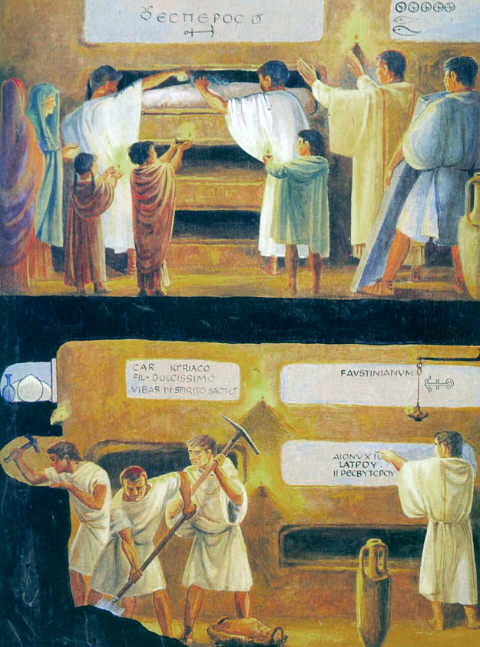
and in this one they are putting in a “loculo”a corpse wrapped in a sheet
The tomb was later closed with a marble slab.
paura!Chi non aveva paura di perdersi erano i
In this photo the “ fossori” are digging a tomb

Slide 15
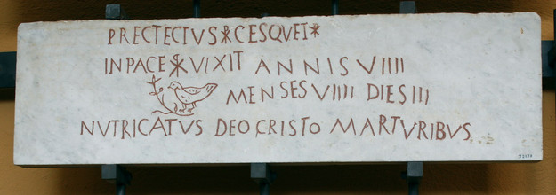
On the slabs there was the name of the dead
There were some strange symbols too
Do you want us to decipher them????

Slide 16
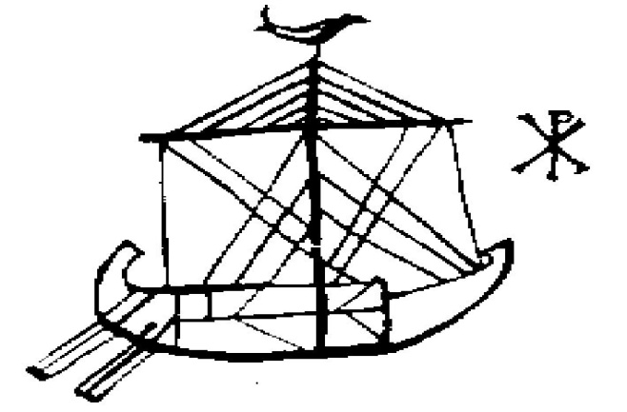
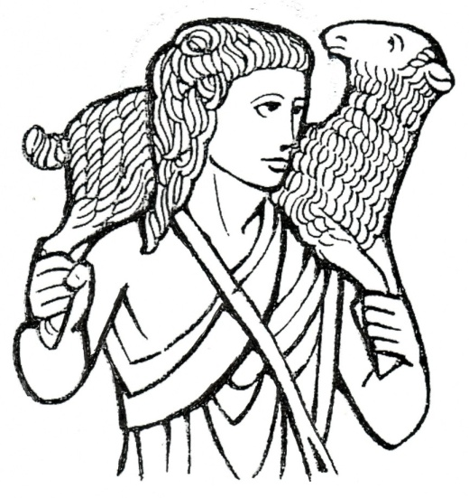
The Anchor
ICHTHYS
Dove
The Boat
The God Shepherd
Christ’s monograms

Slide 17
-The Anchor is the symbol of Salvation.
The Good Shepherd represents Christ Saviour.
The Dove is the symbol of peace .
-The Boat is the church boat.

Slide 18
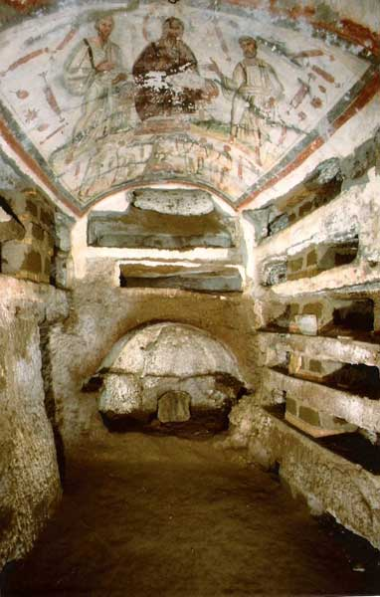
The tombs for very rich people were not holes but small rooms: the cubicola.
On their walls there are coloured frescos on a white background to give light.
They represents scenes based on the Bible or on their daily routine.
Look at them…

Slide 19
NOAH

Slide 20
BANQUET

Slide 21
ADAM AND EVA

Slide 22
JONAH AND THE WHALE

Slide 23
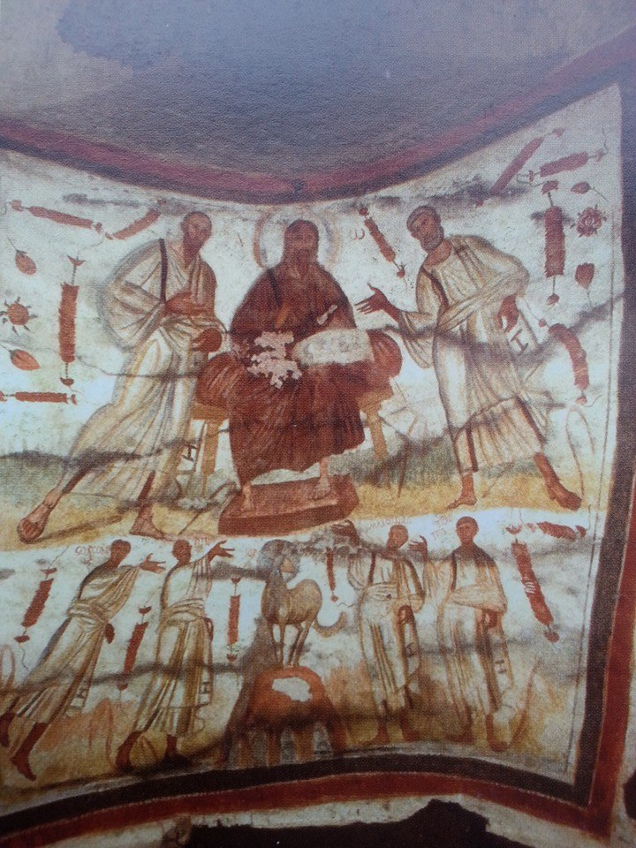
THE MARTYRS SS MARCELLINO AND PIETRO TO WHOM THESE CATACOMBS ARE DEDICATED, ARE RREPRESENTED TOO.
THEY WERE BURIED HERE AFTER THEIR DEATH. THEY WERE KILLED IN 304 A.D. BY EMPERIOR DIOCLETIAN WHO PERSECUTED CHRISTIANS …
AND THIS IS A LONG STORY!

Slide 24
THE CATACOMBS WERE DUG IN AN AREA WHICH LATER BELONGED TO HELEN, EMPERIOR CONSTANTINE’S MOTHER.
HERE STANDS HER MONUMENTAL TOMB: SAINT ELENA MAUSOLEUM

Slide 25
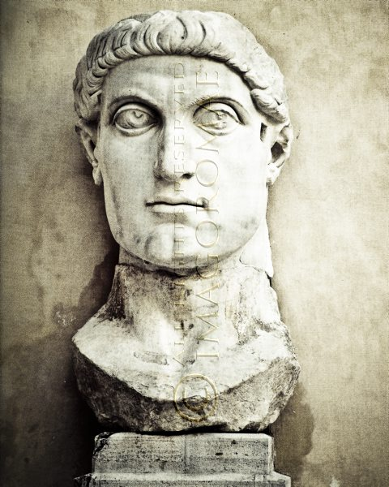
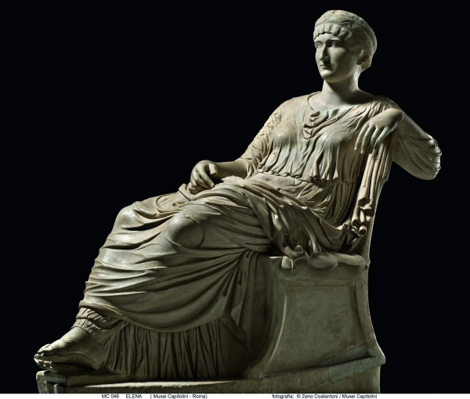
HELEN
CONSTANTINE
NOW IT LOOKS THIS WAY

Slide 26
IN THE PAST IT WAS LIKE THAT

Slide 27
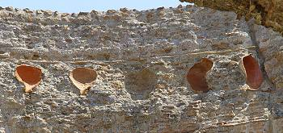
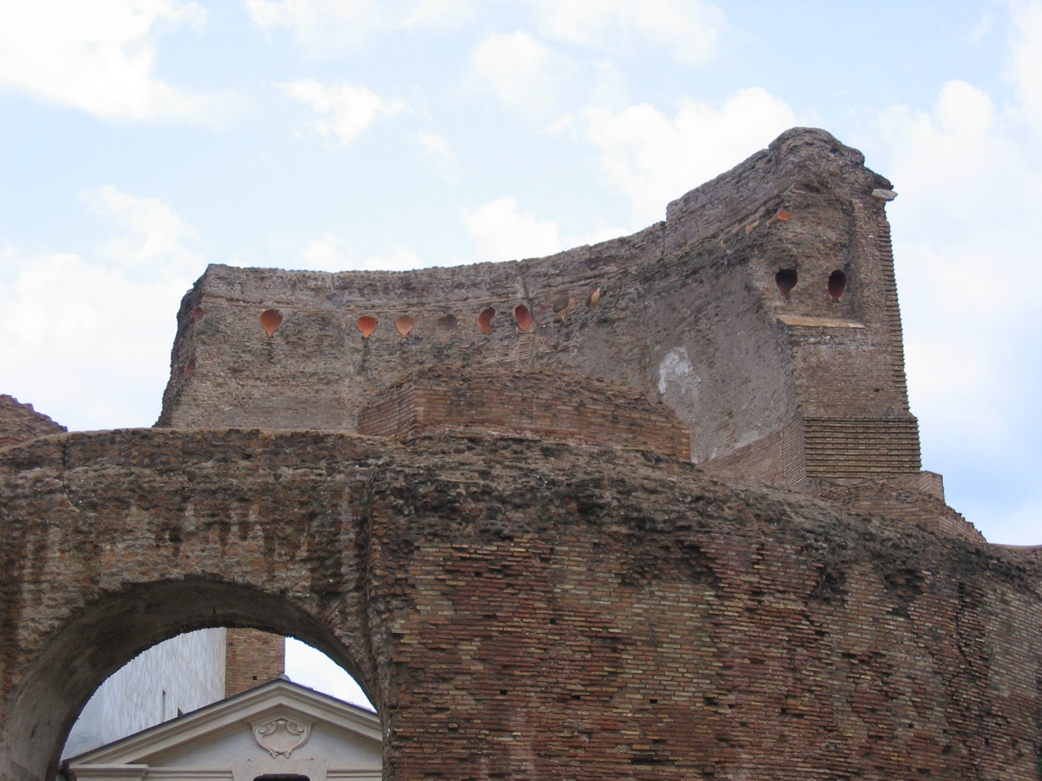
PIGNATTA
OUR AREA TAKES ITS NAME FROM THE “ PIGNATTE”, VASES PUT IN THE BUILDING TO LIGHTEN IT

Slide 28
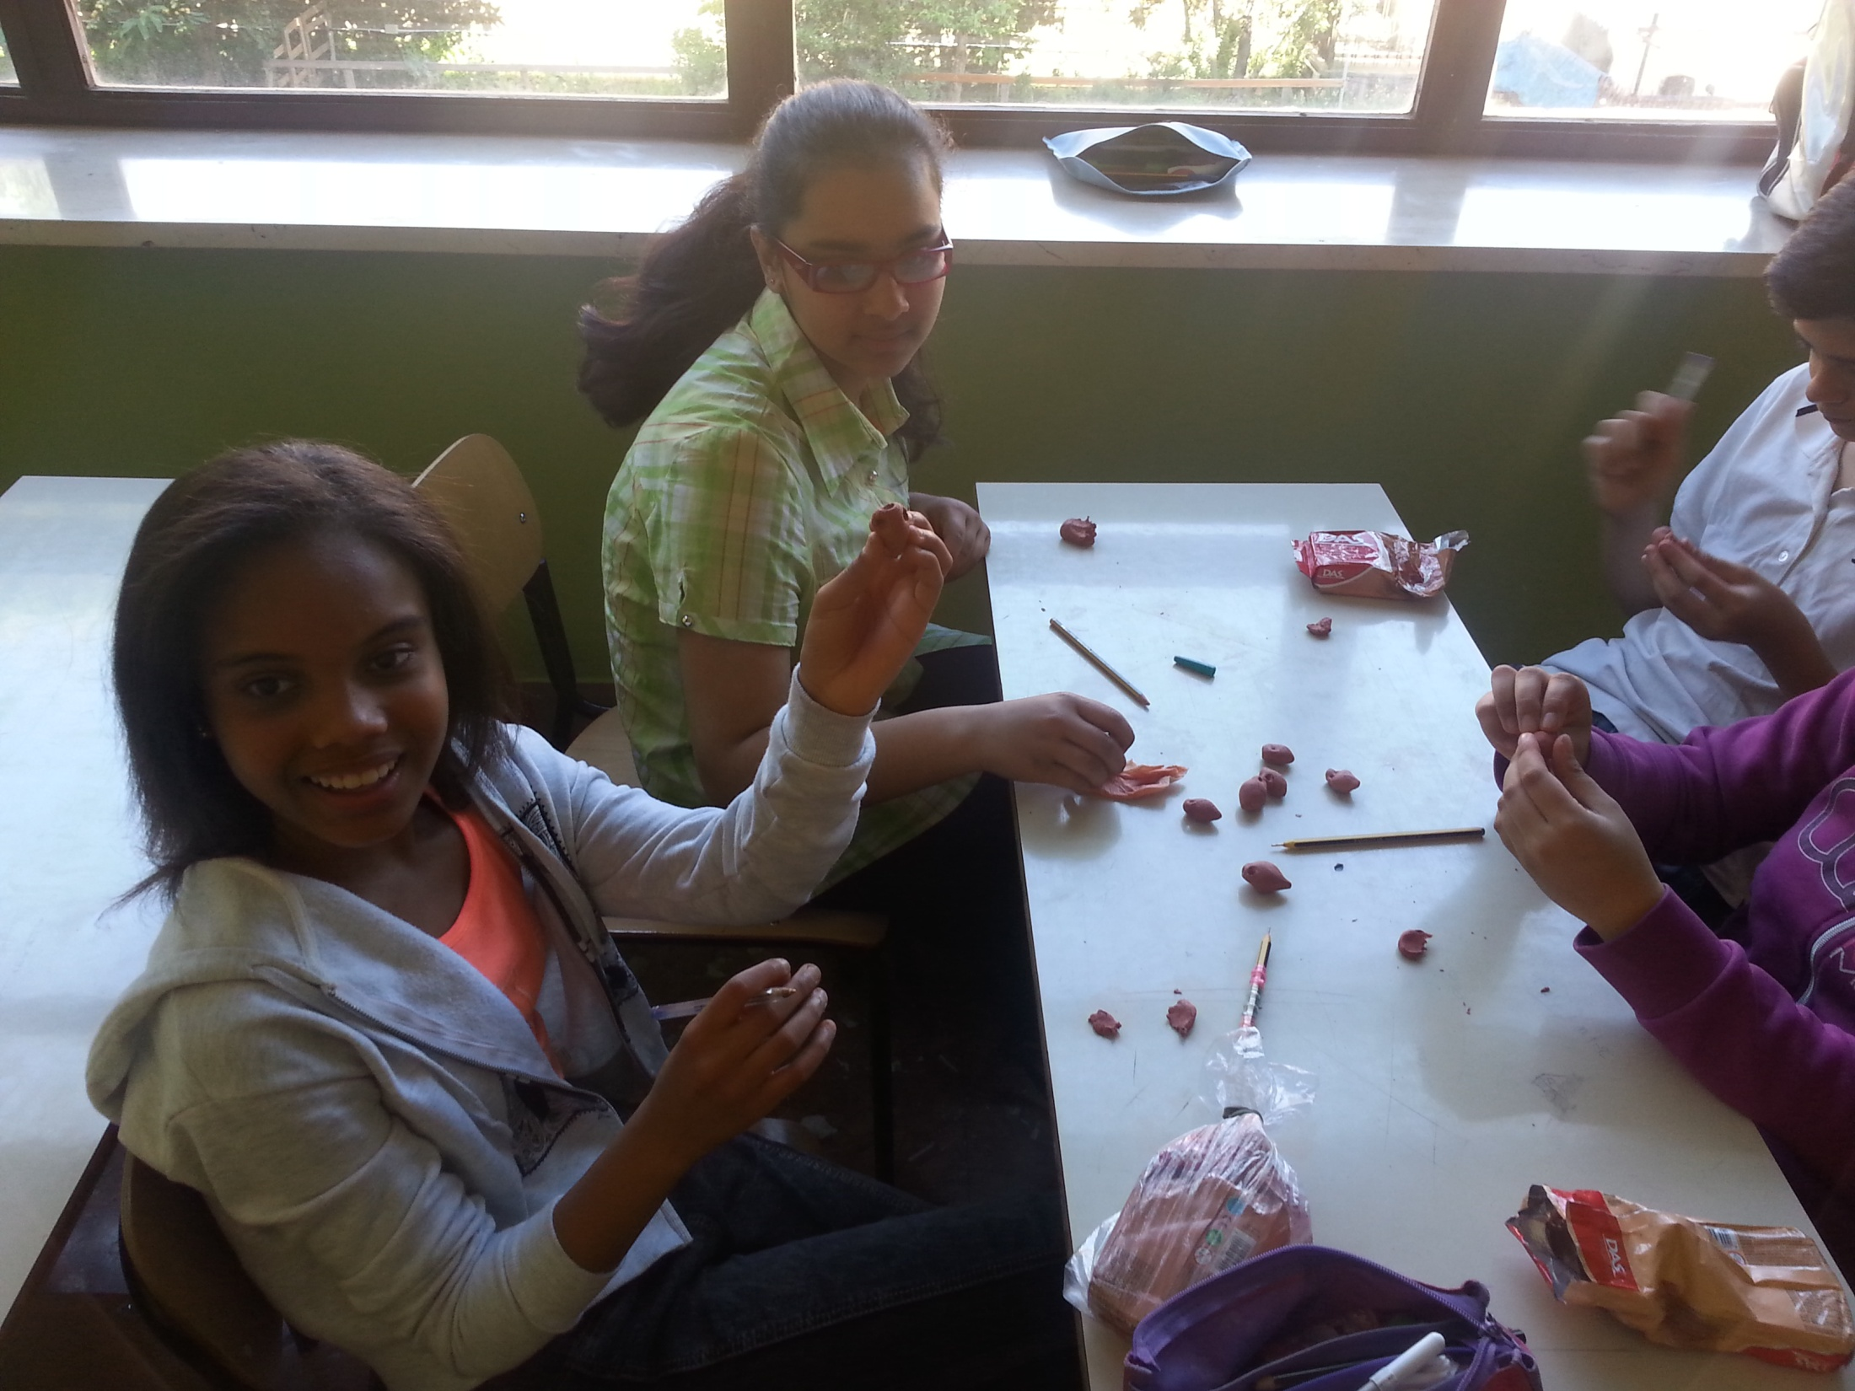
HERE WE ARE ! WORKING FOR OUR ERASMUS FRIENDS!
PIGNATTE!!!!

Slide 29
Ciao!

