Slide 1
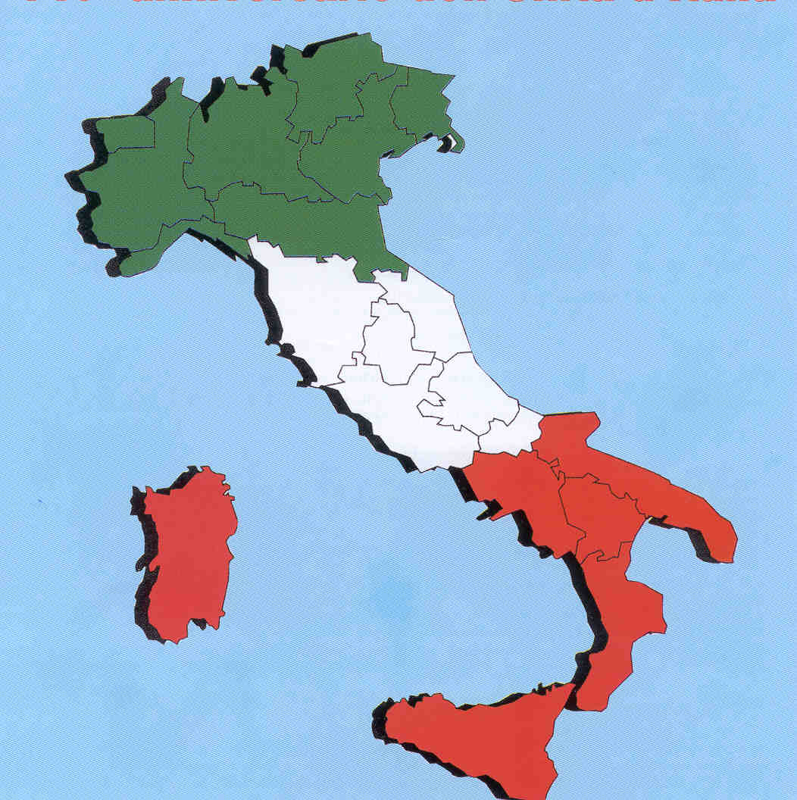
ITALIAN SCHOOL SYSTEM
I.C. LAPARELLI, ROME

Slide 2
The foundations for Italy’s current education system were established in 1946, when the country became a parliamentary republic. Since then, the state has provided free education for all, from nursery school to university.

Slide 3
The education system is divided into a number of stages:
pre-school,
primary school,
lower and upper secondary school,
and higher and further education.
State education is also free for the children of foreigners living in Italy, irrespective of whether they’re registered residents

Slide 4
The Italian educational system is currently based on the division between public school (which is based on subsidies) and private school. The levels are : — Kindergarten (3-5 years, non compulsory) — Primary school (6-10 years) — Middle School (11-13 years) — High school (14-18 years). The school is compulsory until the completion the first two years of high school. As part of high school, distinguished schools (classic, scientific, educational, artistic,language) and technical institutes professional.

Slide 5
After completing the higher secondary school, students must pass an exam in order to receive their “Diploma di Maturità”.
Once they have their diplomas, they either begin their careers in their professions or move on to the University

Slide 6
OUR SCHOOL
The Comprehensive School via Laparelli 60 is divided into : - A kindergarten : Don Gioacchino Rey - Three primary schools: Grazia Deledda
Don Gioacchino Rey Pietro Mancini - Three secondary schools : Lodovico Pavoni , Via Beccadelli , Via Sestio Menas .
These sites , together, span a wide geographical area between the Tuscolana and Casilina : Torpignattara , Quadraro Old and New, neighborhoods with a very high rate of immigration .

Slide 7
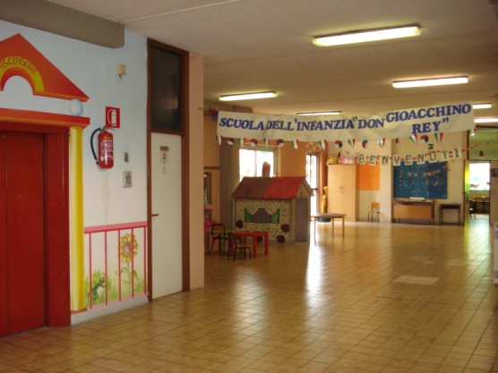
The kindergarten is located in the Don Gioacchino Rey building of primary school. It is located in Via Sestio Menas 125 . The 111 pupils are divided into 5 sections : n 2. Sections to 40 hours per week from 8.15 to 16.15 n .3 Sections to 25 hours per week from 8.15 to 13.15 . The school is spacious and welcoming : there’s a classroom equipped with material for physical activities , areas in front of the classrooms with playful material , audio-visual room , a large garden with playground in the size of the child , a canteen with kitchen , gym .

Slide 8
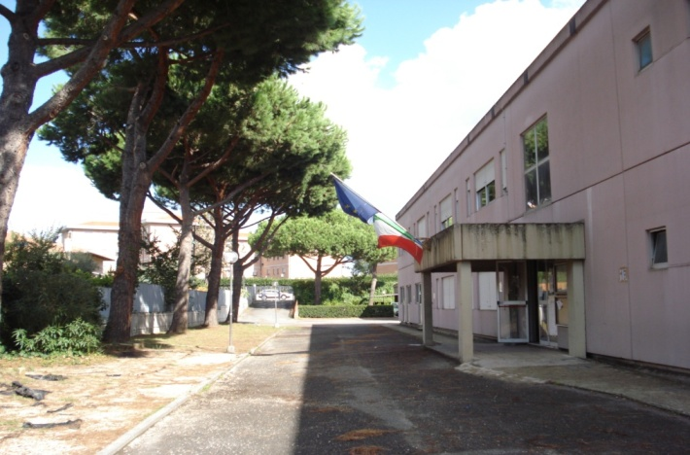
The primary school Don Gioacchino Rey is located in Via Sestio Menas 125 . It houses 196 students divided into 10 classes , of which 5 to 40 working hours per week, from 8.15 to 16.15 , 4 operating at 30 hours per week with two afternoons , Tuesdays and Thursdays , and a working 27- hours with a extension until 14.15 on Tuesday . The school has a well equipped gym, laboratories for teaching support , a library and a great room for the canteen. The hall is a large space that can host events . In many classrooms is an interactive whiteboard used in everyday teaching. In the school each year are triggered various projects implemented by the teachers and , sometimes , also in collaboration with external experts

Slide 9
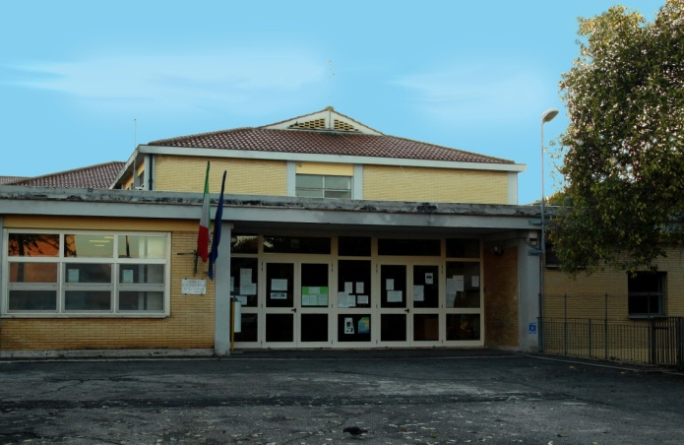
The school " Peter Mancini " , located in Via Camillo Manfroni n . 7 , is home to 11 primary school classes , 10 classes are working 40 hours per week from 8:20 to 16:20 and a class 27 hours a week with only one return on Tuesday . The school has a large gym , in excellent condition and equipped with sporting facilities in which are held every year, the Motor Activity Projects conducted by external experts in collaboration with the class teachers . It also has a newly expanded library with many books donated by the parents of each class . There is also a video room with TV, VCR, DVD player, and a media library . The Computer Lab was opened April 3, 2012 and houses 18 workstations for students and one for the teacher , as well as an interactive whiteboard ( IWB )

Slide 10
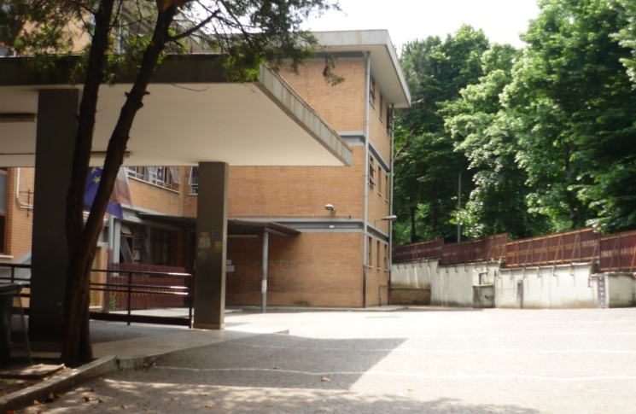
The primary school Grazia Deledda is located inTorpignattara , exactly in Via Filarete , 21. It houses 18 classes : 12 full-time from 8.30 to 16.30 and 6 from 8.30 to 13.30 with modular time and a weekly return in which pupils have lunch at school and leaving at 16.30 . The school has a large gym, a classroom used as a theater , a library a, classroom equipped with the IWB TV, VCR, DVD player, and finally a new and well-equipped computer lab with 11 workstations equipped with printer on a network , internet , wirless and a station for the disabled . The school is equipped with a laboratory for children with disabilities.

Slide 11
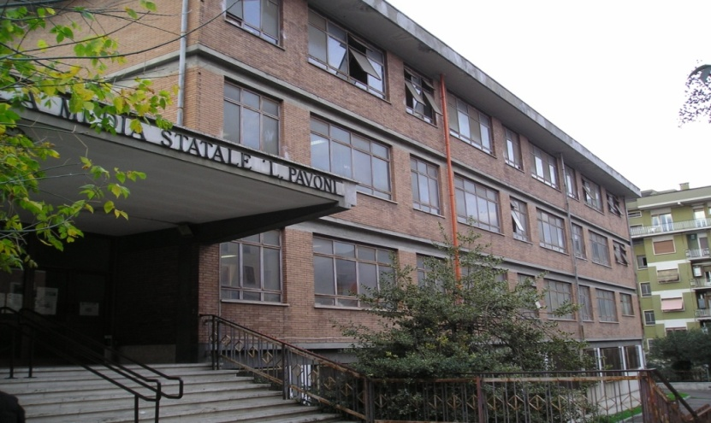
Secondary school level I Lodovico Pavoni , located in Via Laparelli 60 , is the headquarters of the Comprehensive Institute and includes the Office of Management and the Secretariat . It hosts 16 classes of lower secondary school degree. Provides a library , a gym with a climbing wall , n . 2 Laboratory of ICT established with the contribution of Regione Lazio and Rome Foundation , a spacious Great Hall venue for conferences and cultural and educational meetings for the students . There is a Laboratory for integration activities for disabled pupils , video classroom , music classroom , an artistic laboratory and a Scientific Laboratory . The school is equipped with IWB as teaching aids.

Slide 12
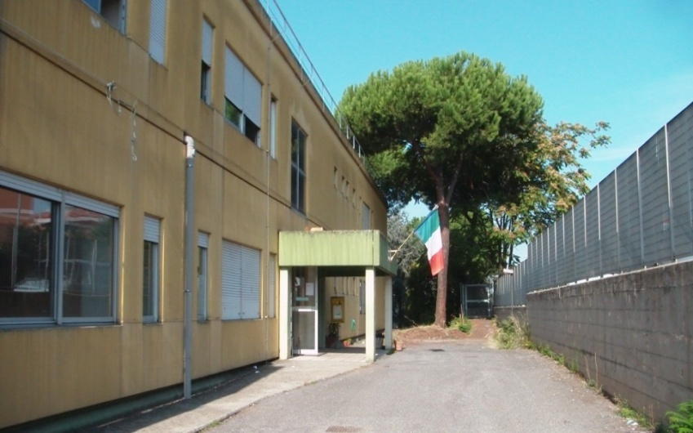
The complex of Via Sestio Menas has a thirty-year presence in the neighborhood Quadraro and is characterized by solid experience and active teachers . Accommodates 6 classes of secondary level school for a total of 126 pupils. It’s welcoming , with a computer lab , classrooms equipped with IWB , a gym, a theater

Slide 13
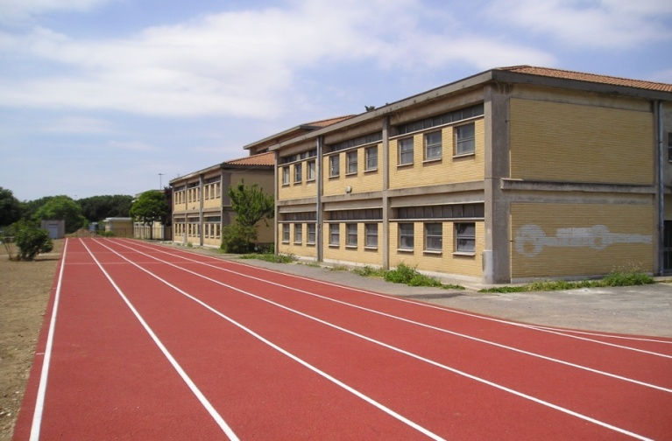
The complex of Via Beccadelli includes 5 classes of lower secondary school degree.It’s equipped with a track approved by FIDAL ,a Computer Lab, a spacious and well equipped Gym , audio visual room with IWB.

