Slide 1
Who am I?
Knowing me – Knowing You
Act 1
Here we are – Estonian team!

Slide 2
The Rõõmupesa Kindergarten in Tallinn
Our kindergarten was open 45 years ago in a subdistrict of Tallinn called Mustamäe (black hill).
This is one of the 8 administrative districts of Estonian capital.
We have 5-14 storeys high panel blocks of flats, built in the 1960-1970s around – a bedroom community.
It takes about 15 minutes to drive to the city centre from here.
We have 220-230 children in age 1,5-7 in our kindergarten, they are playing in 11 groups (classes).
We have 2 teachers and an assistant in each group.
We have a kitchen and a laundry in our kindergarten.

Slide 4
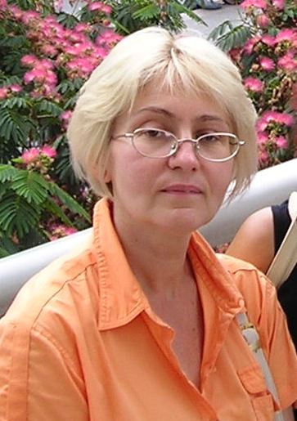
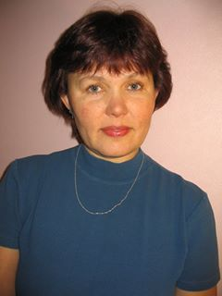
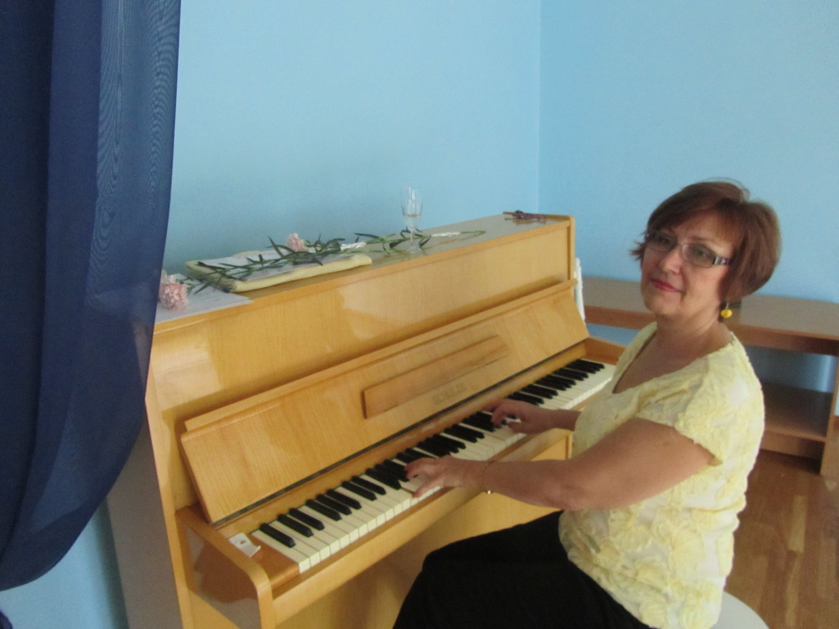
We have 30 pedagogical workers in our kindergarten, including:
Margarita -
music teacher
Leena -
teacher for special needs and speech therapist for Russian language
Tiiu -
speech and language therapist

Slide 5
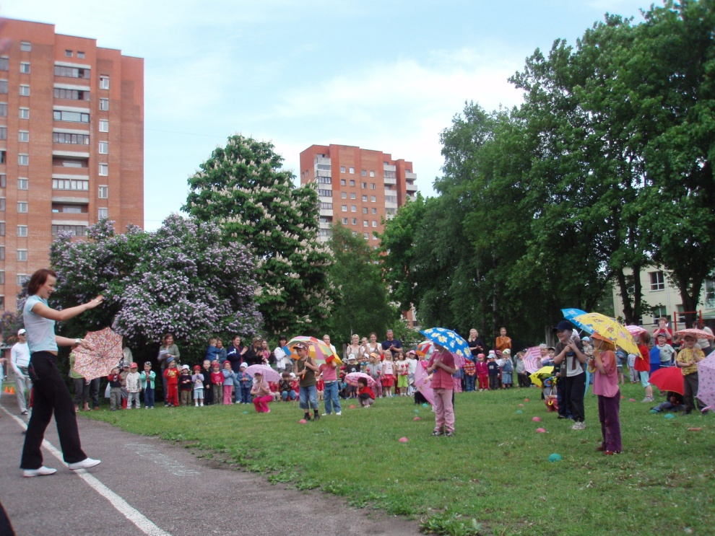
Eveli – physical education teacher
Raili – physical education teacher

Slide 6
We have 23 teachers working in the groups (classes)
The name of the group | teacher | teacher | teacher
Pesamunad | Evi | Margit
Pipila | Kairi | Triin | Kertu
Nupsikud | Heli | Liisbet
Rõõmupallid | Marge | Kai
Siilikesed | Jane | Anna-Liisa | Vive
Muumid | Kai | Marianne
Mesilinnud | Olga | Triin
Lepatriinud | Kirsti | Liivi | Gea
Päikesejänkud | Kertu | Epp | Maia
Silmaterad | Kadri | Indrek
Silmarõõmud | Anu | Liis

Slide 7
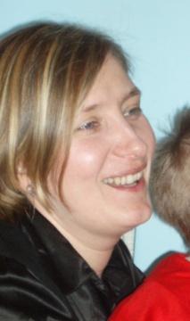
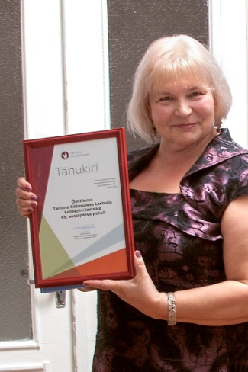
Our leading project team
KATRIN
headteacher
LEA
headmistress
OLGA
teacher
EVI
teacher
KAIRI
teacher
ANU
teacher
HELI
teacher
MARGE
teacher

Slide 8
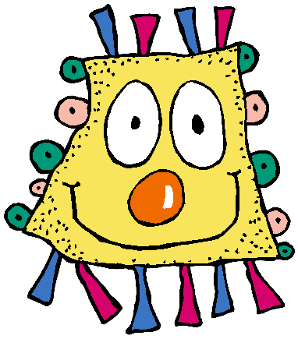
Thanks! Yours Rõõmupesa kindergarten in Tallinn
Knowing me – Knowing You
Act 1

