Slide 1
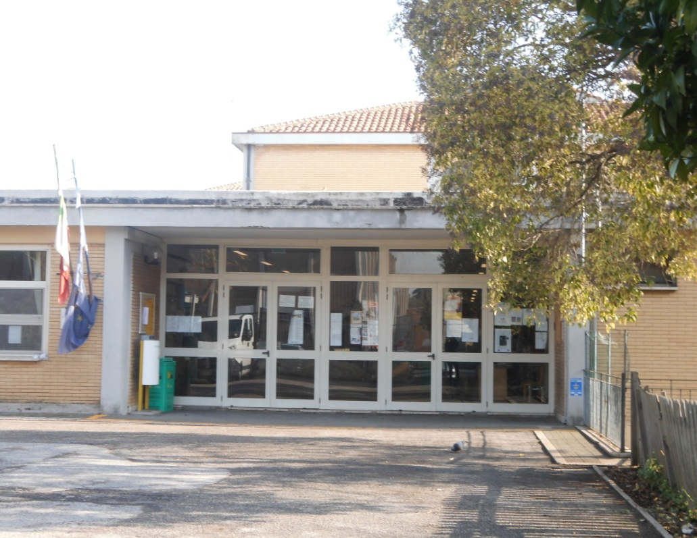
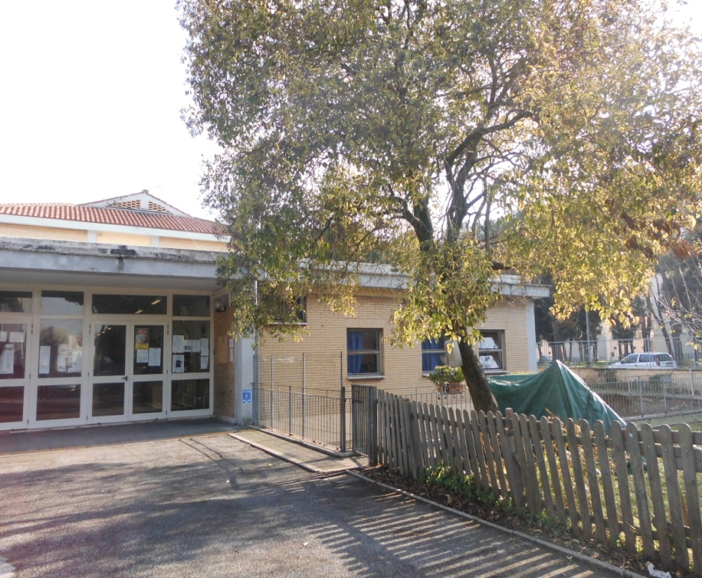
the primary school “P. Mancini” Rome

Slide 2
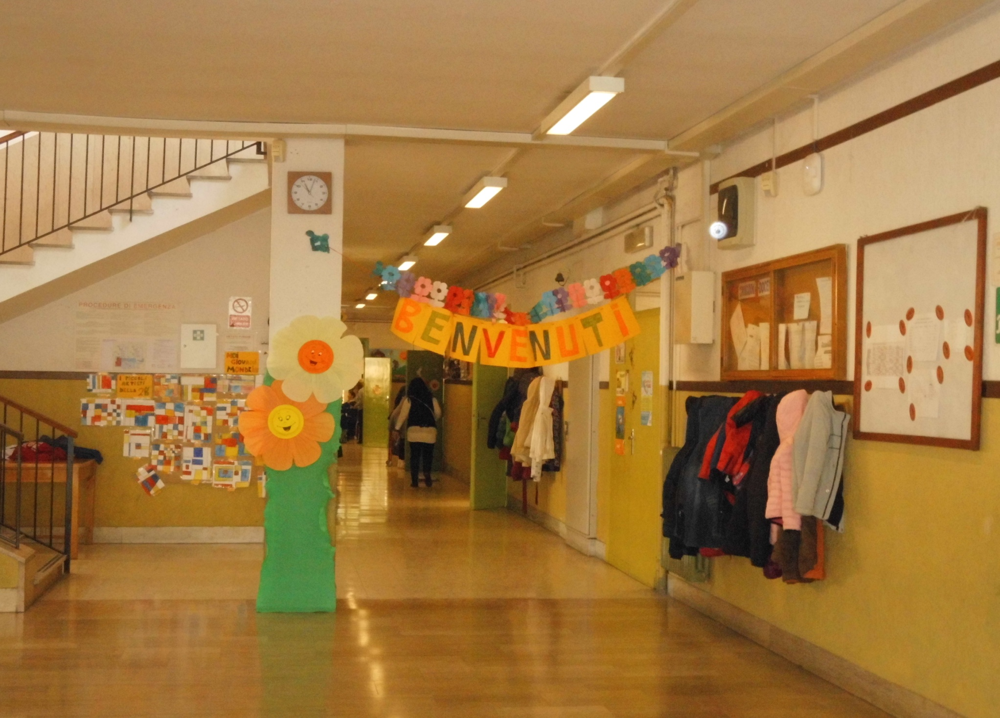

Slide 3
The primary school “Pietro Mancini” belongs to “Laparelli Comprehensive Institute” and is located in Rome at 27 Camillo Manfroni street. Nowadays, 238 pupils attend the school and they are divided into 11 classes. Ten classes operate from 8.20 am to 04.20 pm (40 hours per week Monday-Friday) and one class operates from 8.20 to 1.20 pm and only on Tuesday also from 8.20 to 04.20 pm (27 hours per week Monday-Friday). The school has got 27 teachers and 3 scholastic personnel .

Slide 4
On the ground floor of the building there is a large Gym, that is in excellent conditions with sport equipments used by pupils for the Phisical Activity Projects (pupils’ physical activity under control of external experts and teachers).

Slide 5
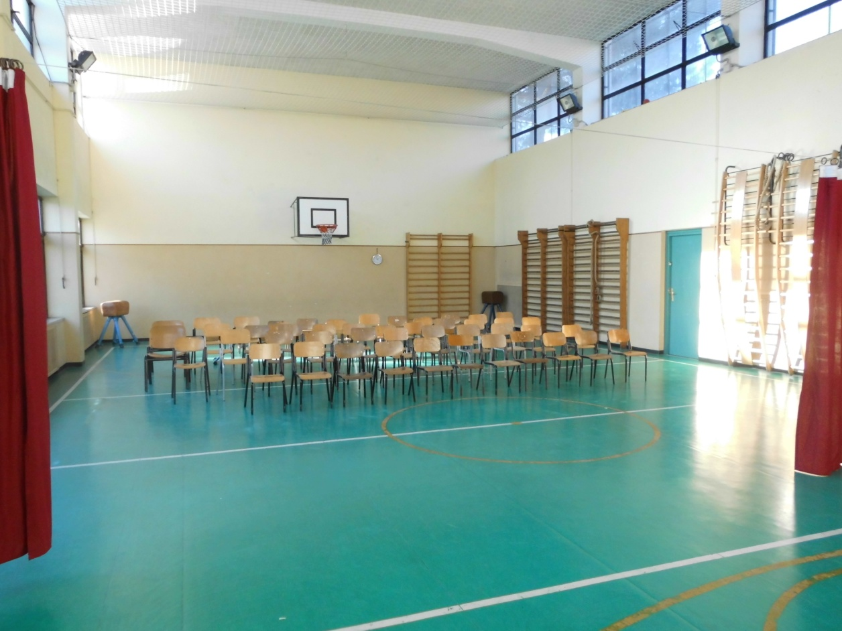
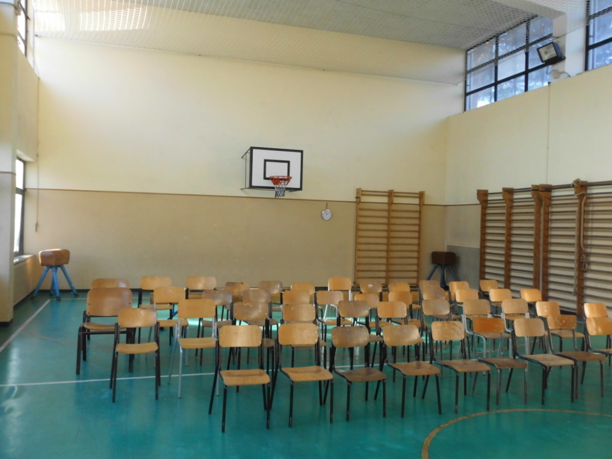

Slide 6
Next to the Gym there is the refectory, where kids eat by themselves meals made by the cooking staff in the school kitchen. Lunch-time in divided in two shifts (from 12.20 to 13.10 and from 13.20-to 14.10).

Slide 7
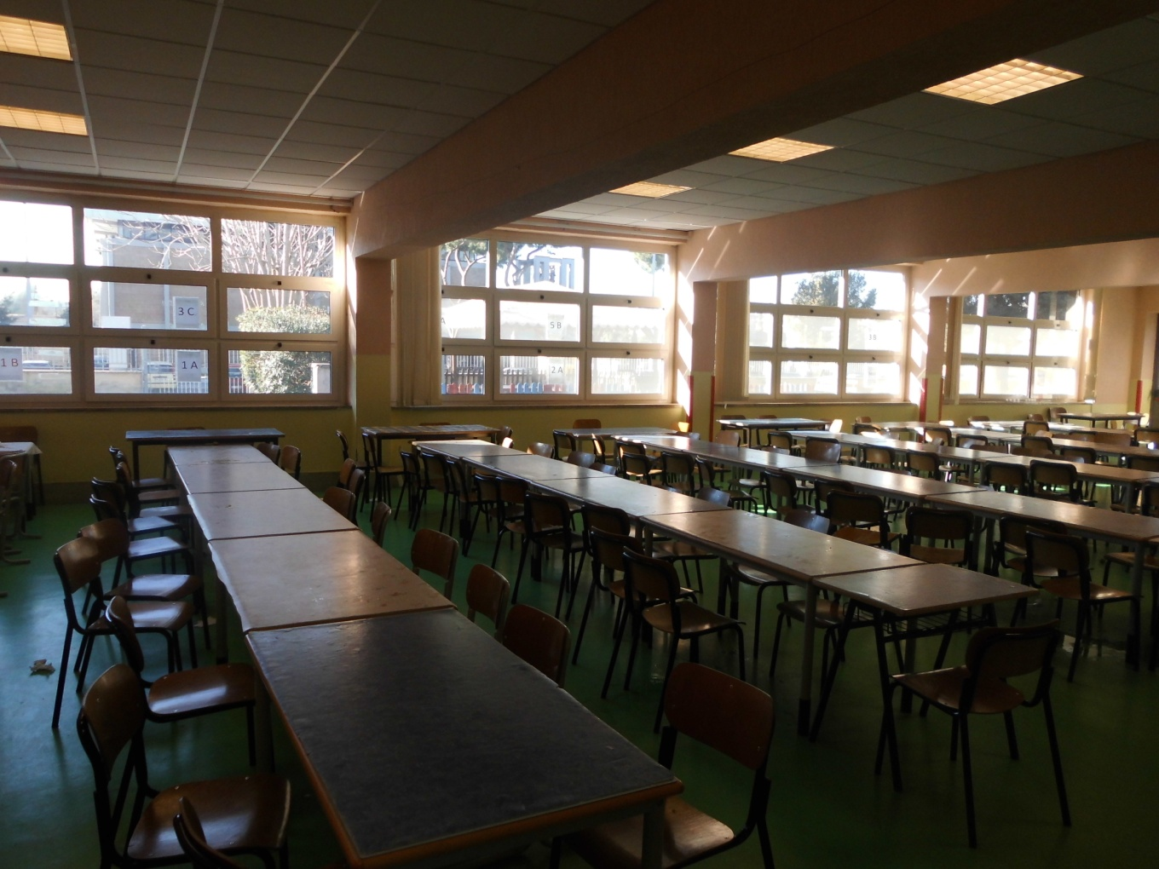
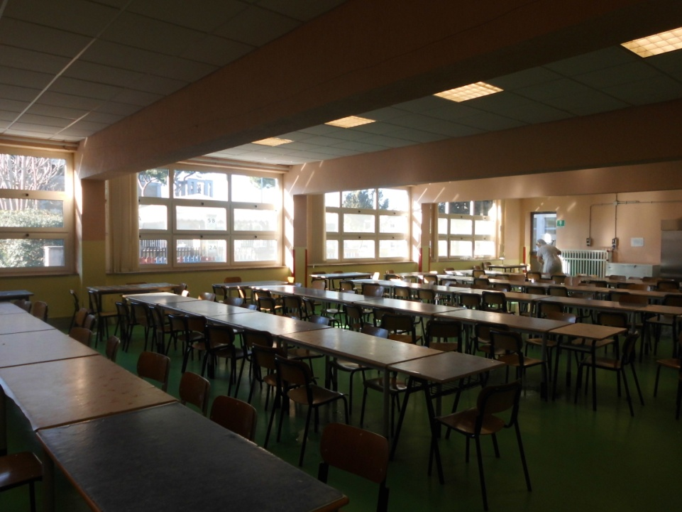

Slide 8
On the same floor there are some classrooms, where pupils attend activities for their recuperation, improvement or alternative to the teaching of the catholic religion.

Slide 9
On the first floor there is the school library, recently enlarged, with a big amount of books donated by the students’ parents. On this floor there is the media-room equipped by TV- DVD READER- VCR and a media library.

Slide 10
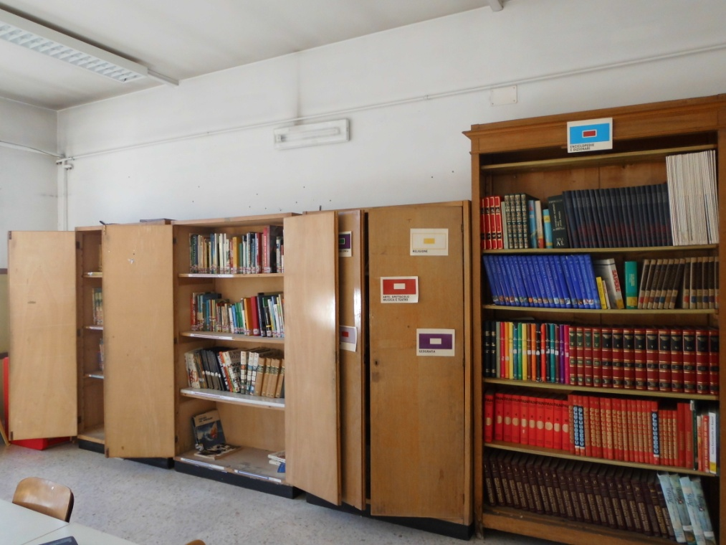
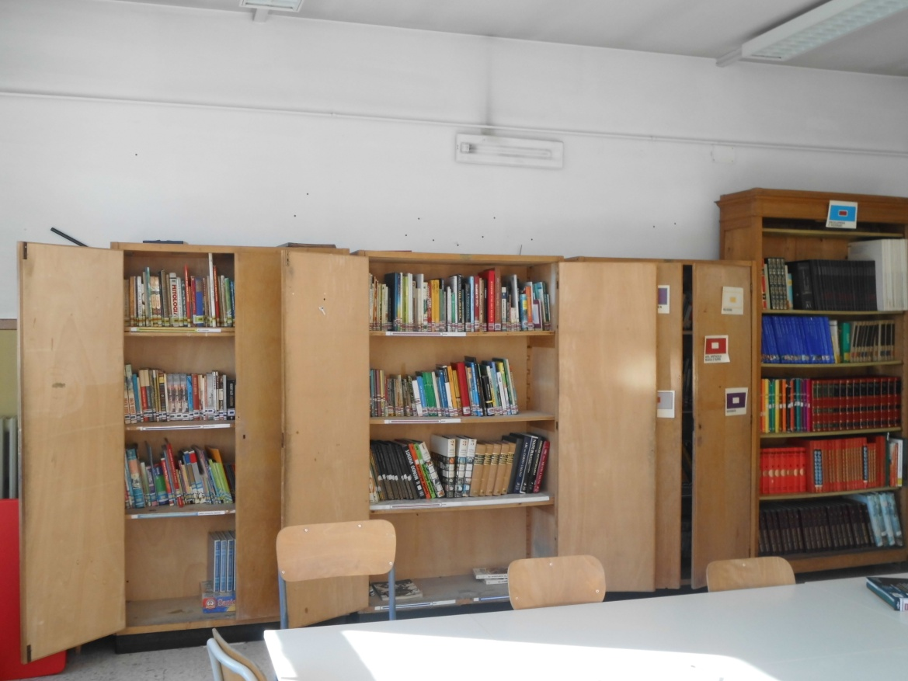

Slide 11
The computer lab, on the first floor, was opened in April 2012 and hosts 18 workstations ( each of them with a desktop pc and 15”monitor) for students and 01 for the teacher. There is also an interactive blackboard (L.I.M.)

Slide 12
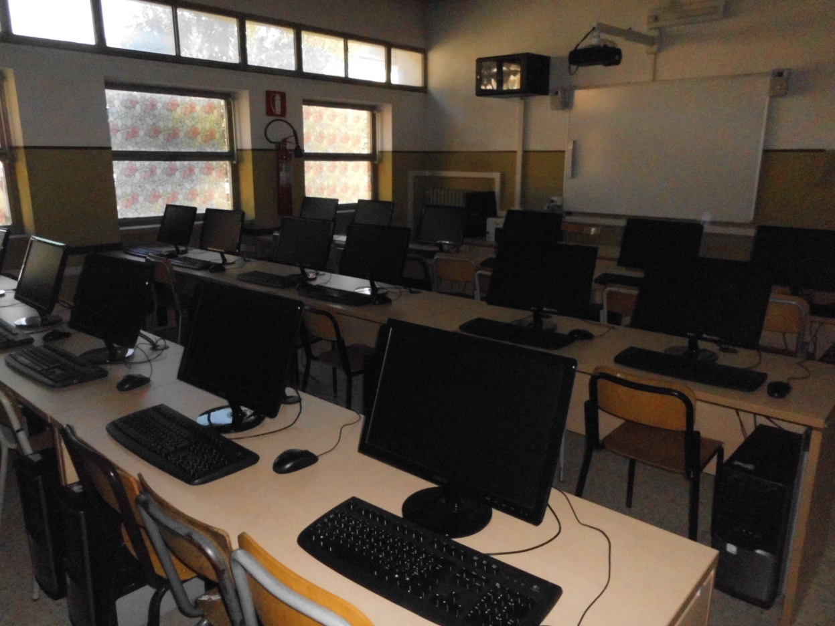
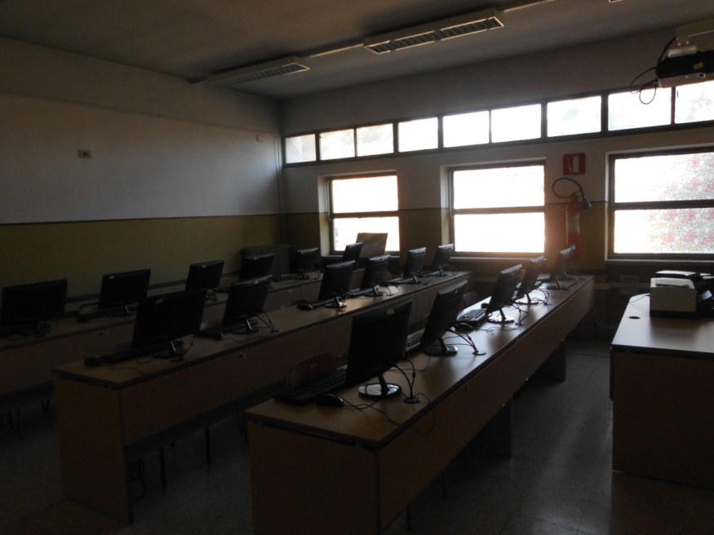

Slide 13
On the left of the main entrance, there is a gazebo with wooden tables and benches, used by pupils during the good condition-weather day, always under control of the teachers. It is important for the kids to be more in contact with nature.

Slide 14
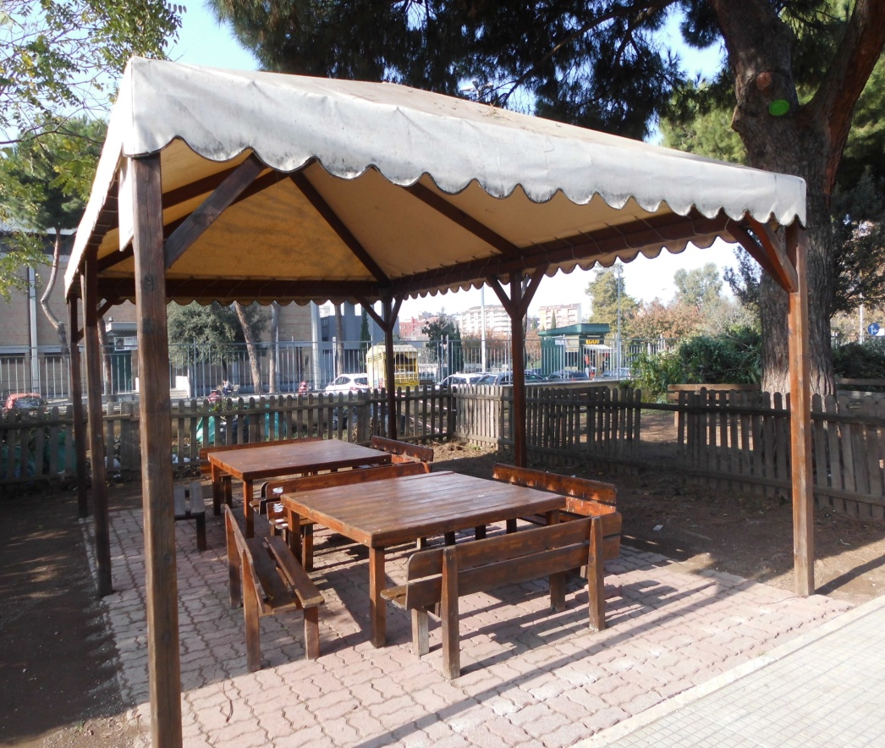
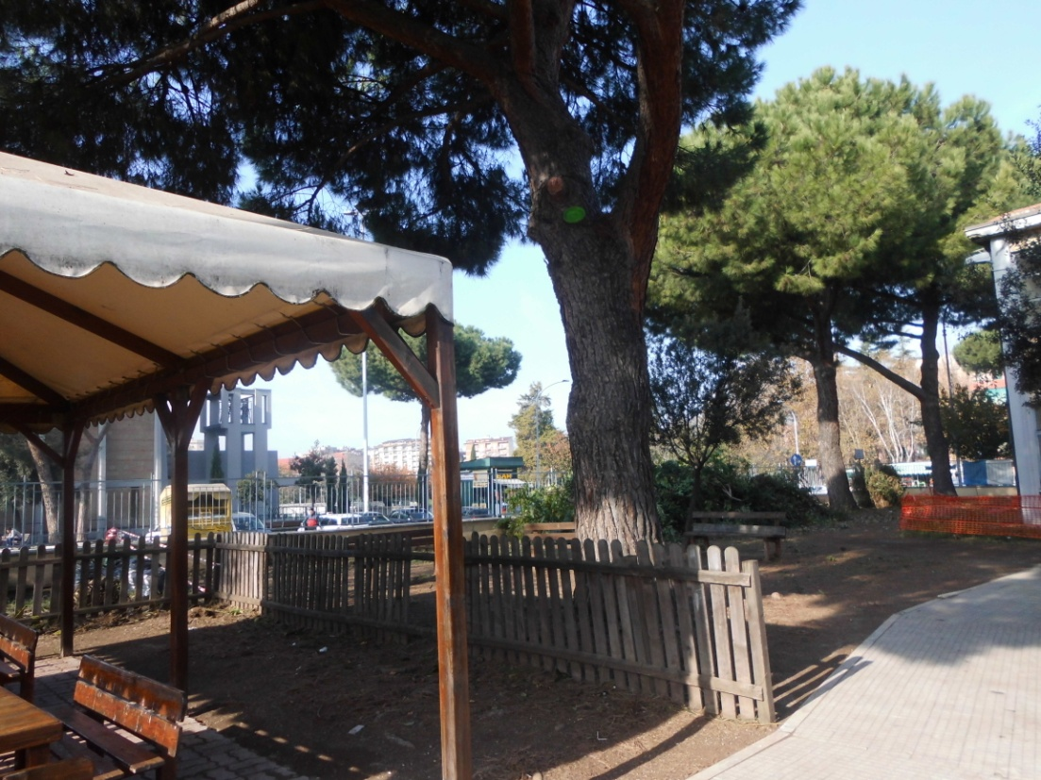

Slide 15
There is also a cute and quite big inside courtyard, with trees and an annex basketball court, where kids play during the recreation hours. Pupils of some classes, in cooperation with their parents and teachers, take care of maintaining clear the courtyard, and planting flowers and seeds that watering during the school year.

Slide 16
