Slide 1
PRIMARY SCHOOL ZVONIMIR FRANK
PAVLA SANTO I IRA VELEBIT 8.B

Slide 2
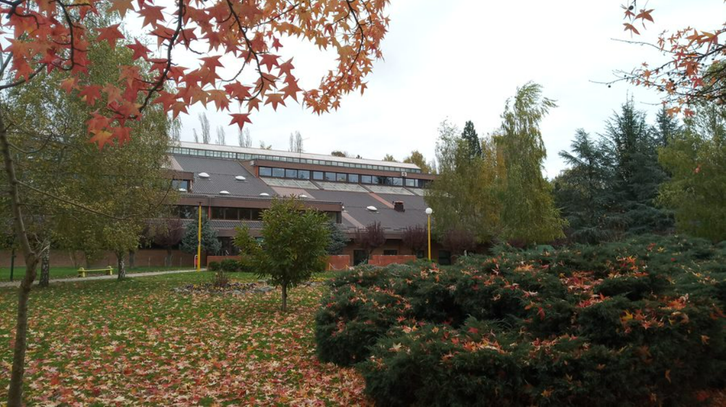
PICTURE OF OUR SCHOOL
Picture 1. - Primary school Zvonimir Frank (photo Marina Malnar)

Slide 3
Primary school Zvonimir Franka
the youngest school in Kutina
is located in the Street Silvija Strahimira Kranjčevića
was named after the national teacher Zvonimir Frank
the school has its own anthem

Slide 4
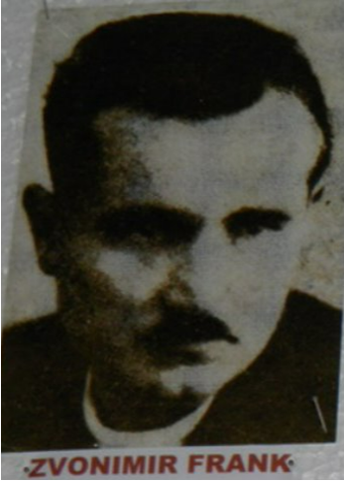
ZVONIMIR FRANK
was born in the year 1913.
was a teacher in the World War II
died in 1943.
Picture 2. – Zvonimir Frank

Slide 5
HISTORY OF SCHOOL
school was solemnly opend on 27th January, 1982.
on 1st February, 1982., it started with work
today school has 440 students
the first principal of the school was teacher Stjepan Tkalec

Slide 6
ECO SCHOOL
in 2002., school recived the status of International Eco School
we fulfilled the criteria and received Europan Green Flag with the Eco School logo as a prize
Picture 3. – logo of Eco School

Slide 7
YOUNG BIOLOGIST
extracurricular activity
teacher of biology and chemistry, Marina Malnar
we go to various field classes
we research and make interesting things (eco candles, lip balsam, soaps, lavander decorations...)

Slide 8
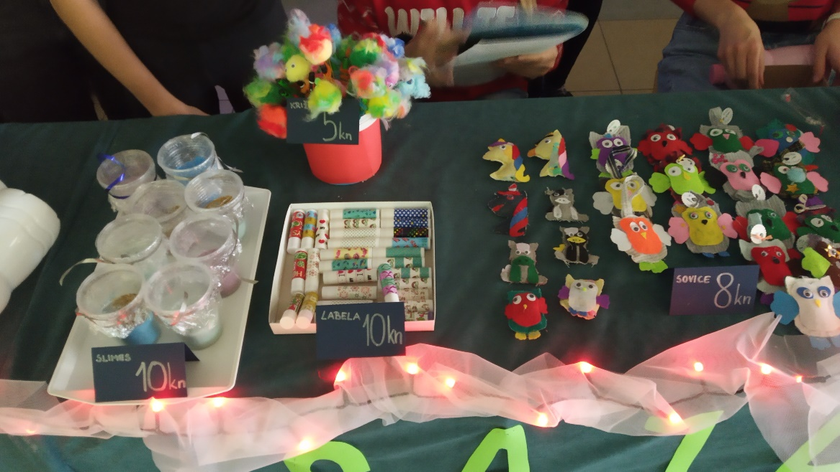
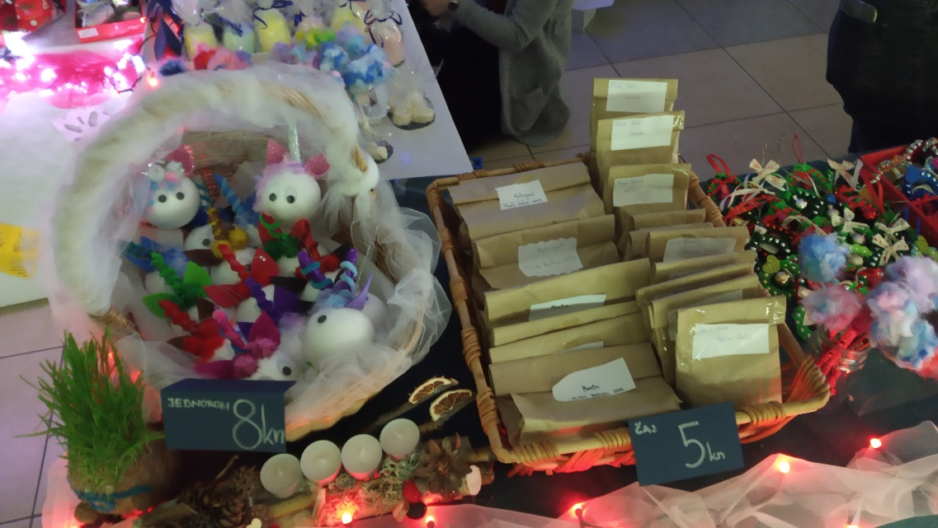
Picture 4. - soaps
Picture 5. – lavander owls
Picture 6. - unicorns

