Slide 1
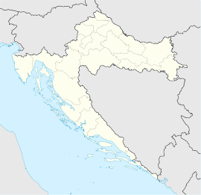
Čakovec
Čakovec

Slide 2
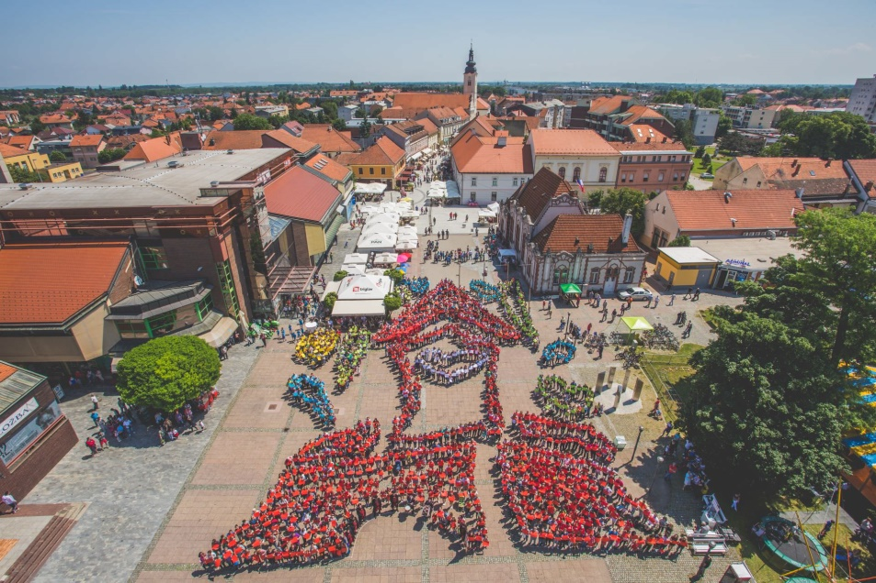
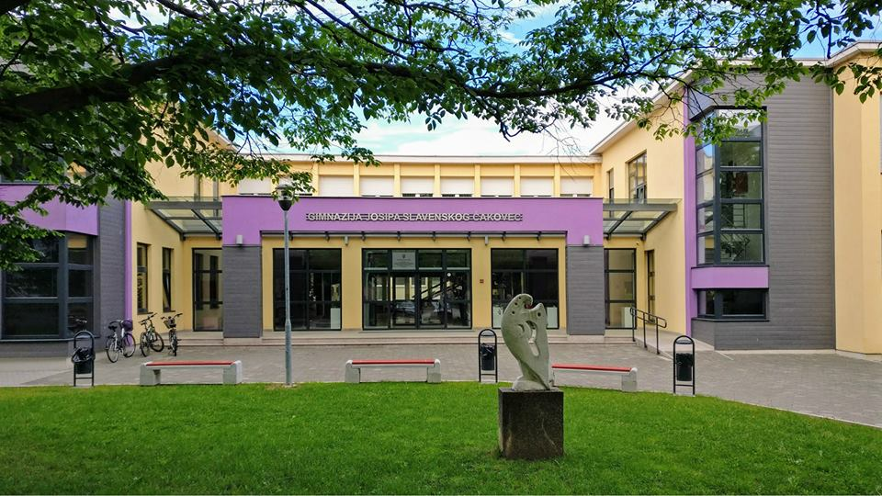
a town in the north of Croatia
capital town of Međimurje county
cca 27.000 residents
3 elementary schools
6 secondary schools
Čakovec
Gimnazija Josipa Slavenskog Čakovec

Slide 3
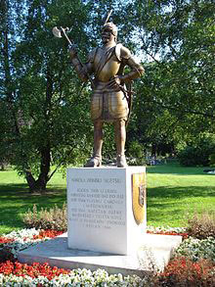
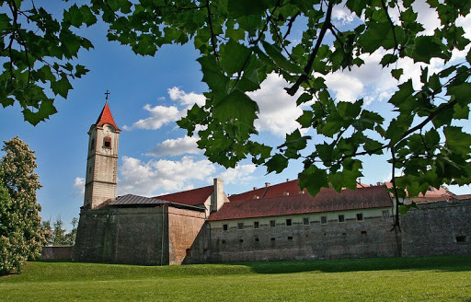
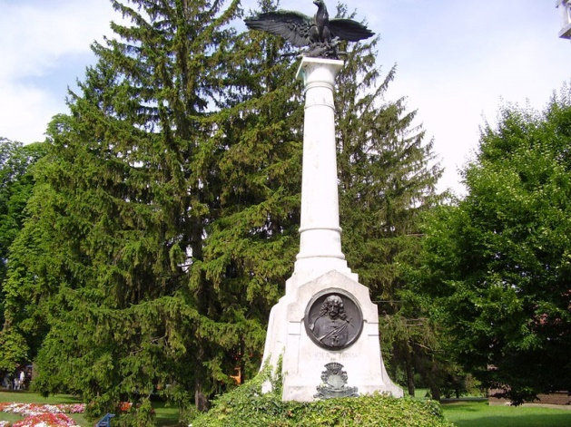
Famous places in Čakovec
Memorials to Nikola Zrinski
Old town Zrinski

Slide 4
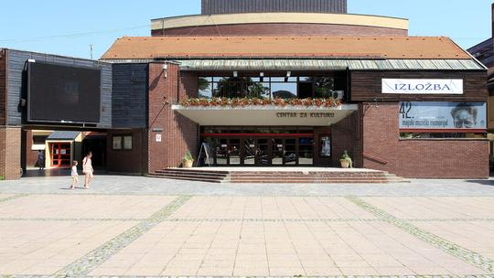
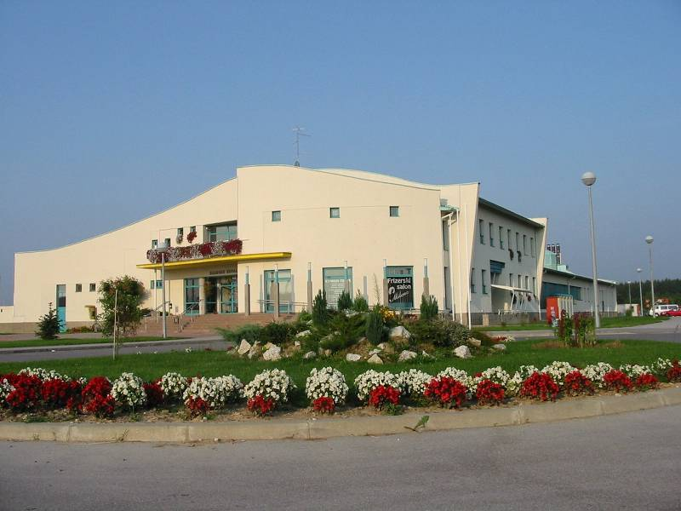
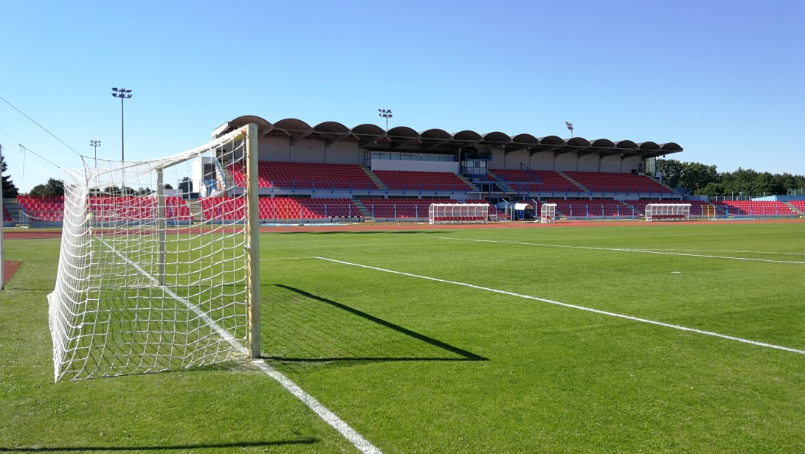
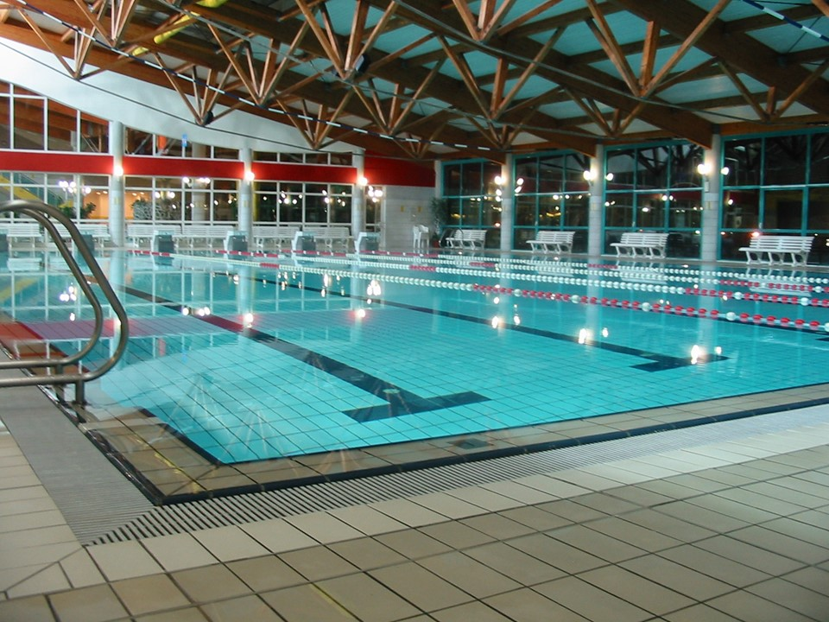
Centre of culture
Swimming pool
Stadium

Slide 5
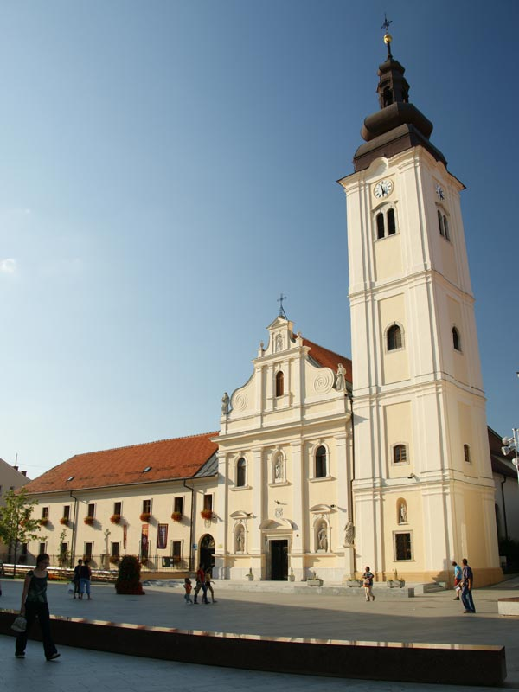
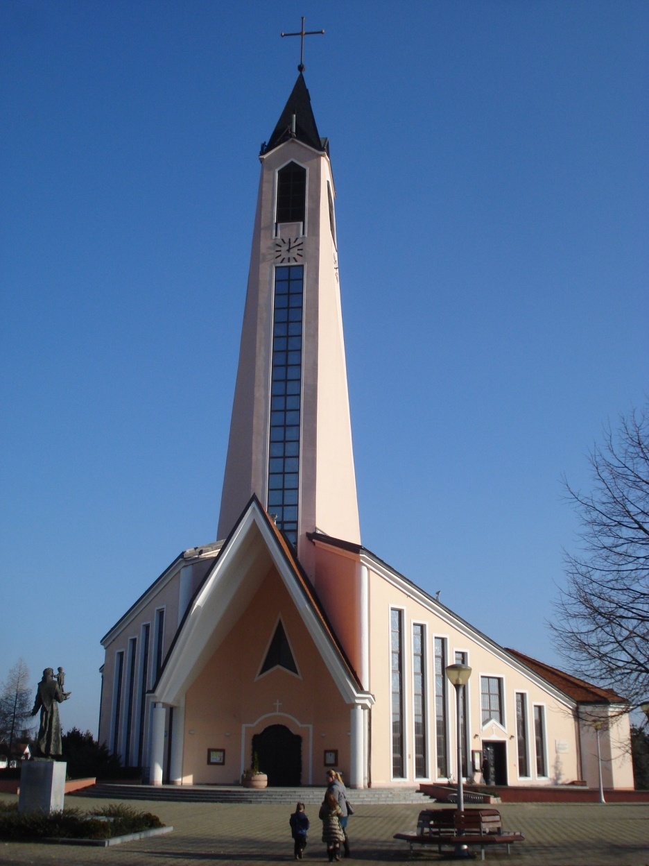
Church of St. Nicholas
Church of St. Anthony of Padua

Slide 6
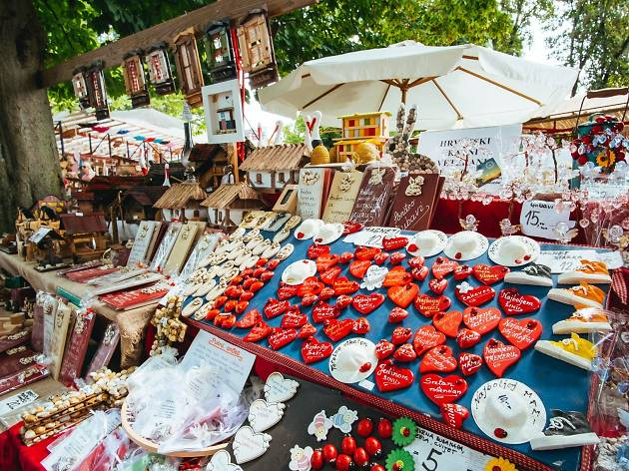
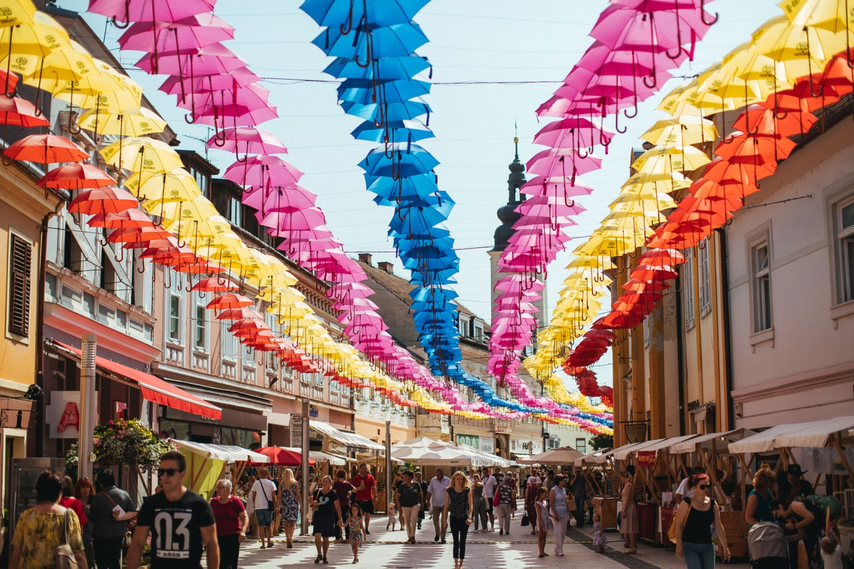
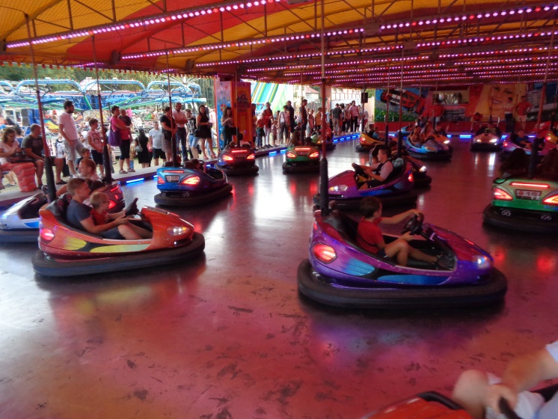
Events in Čakovec
Porcijunkulovo

Slide 7
Thank you for your attention!

