Slide 1
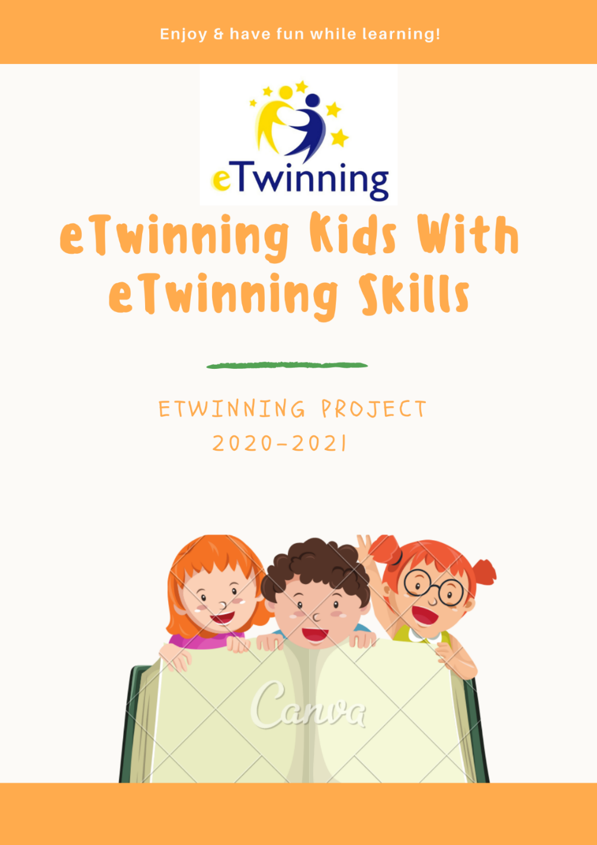
eTwinning Kids With eTwinning Skills
Online meeting for celebrating Safer Internet Day 2021
Together for the better Internet
Primary school Zlatar Bistrica, Croatia
&
Szkoła Podstawowa nr 1 im. Adama Mickiewicza w Radlinie, Poland
February 9th 2021

Slide 2
Group 1 Advantages of social networks | Group 2 Disadvantages of social networks | Group 3 Internet etiquette (Netiquette) - rules of conduct on the Internet | Group 4 Poster "Safer Internet Day 2021" - "Together for a safer Internet" | Group 5 How would the world look like without the internet?
Vanesa | Nino | Nikola | Karlo | Daniel
Maja | Dino | Ivano | Martin | Tesa
Mia | Marija | Magdalena | Matija | Maciek
Kacper | Zosia | Marta | Nadia | Jan B.
Jacek | Ania | Oliwia | Karol
Natalia | Zuzia | Nikola | Jan A.

Slide 3
Group 1- Advantages of social networks
In apps like Facebook or Instagram you can talk to your friends or family
there you can also post pictures of your adventures or trips
There is still a lot of chatting apps like Viber and WhatsApp
Also there is Electronic mail (E-Mail), there you can send informations about something important or an invitation to some special event
there is much more useful types of networks like charity websites.
And that's what I think are the advantages of social networks.
Maja
BENEFITS ON SOCIAL NETWORKS
1. We can learn online.
2. We can have fun online.
3. We don't have to send a message in the mail, but we can send it online.
4. We can solve homework the easy way.
5. We can hear from friends or relatives from other countries.
Vanesa and Mia

Slide 4
ADVANTAGES OF SOCIAL NETWORKS
You can talk with friends and meet new people.
You can communicate with different people who are far away.
You can share something with friends
You can shop quickly so you save time.
You can talk about hobbies and find new inspirations.
You can learn new languages and practise the ones you already know.
You can share your passions and learn about new things easily.
You can simple have fun by doing things which you are keen on, for ex ample: listening to your favourite music, watching gripping films and playing your favourite games.
You can sell things without leasing your Home.
You can know new locations.
You can find information about anything you what: you’ve got easy access to it.
Kacper, Jacek, Natalia

Slide 5
Group 2- Disadvantages of the Internet
Danger of virus
Various inappropriate content
Content can be created by anyone connected to the
Internet, it is difficult to discover truth and lies on the
Internet
In online communication you are never alone
Ontoday's popular chat it is easiest to present yourself
as someone else
The Internet is full of viruses and the like, so install your
digital programs if you can and update your antivirus
program
Made by: Nino Bradić, Marija Čukman, Dino Cavor

Slide 6
DISADVANTAGES OF SOCIAL NETWORKS
1. The Internet is addictive: you have little time for your family and friends.
2. When you trust somebody you don’t know it can be dangerous because you never know who
is on the other side
3. People can pretend to be someone else. In reality they are not so perfect.
4. Others can know a lot about you because we add too many personal information.
5. People can hate one another without a reason
6. Others can stalk and offend us because they often feel anonymous.
7. Our accounts can be hacked.
8. Because of other people’s negative comments we can feel depressed.
Zosia, Ania, Zuzia

Slide 7
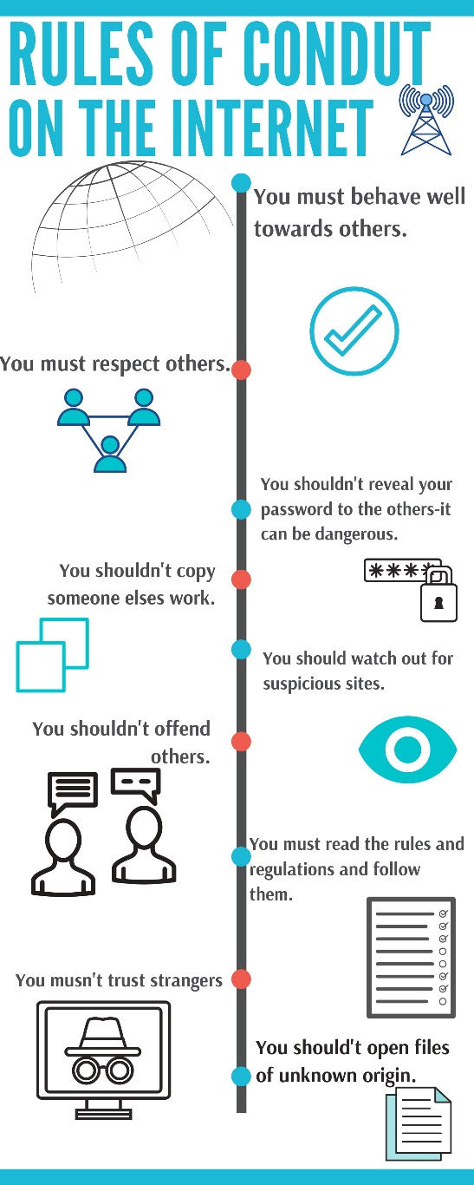
Group 3- Internet etiquette (Netiquette) - rules of conduct on the Internet
Nikola, Oliwia, Marta

Slide 8
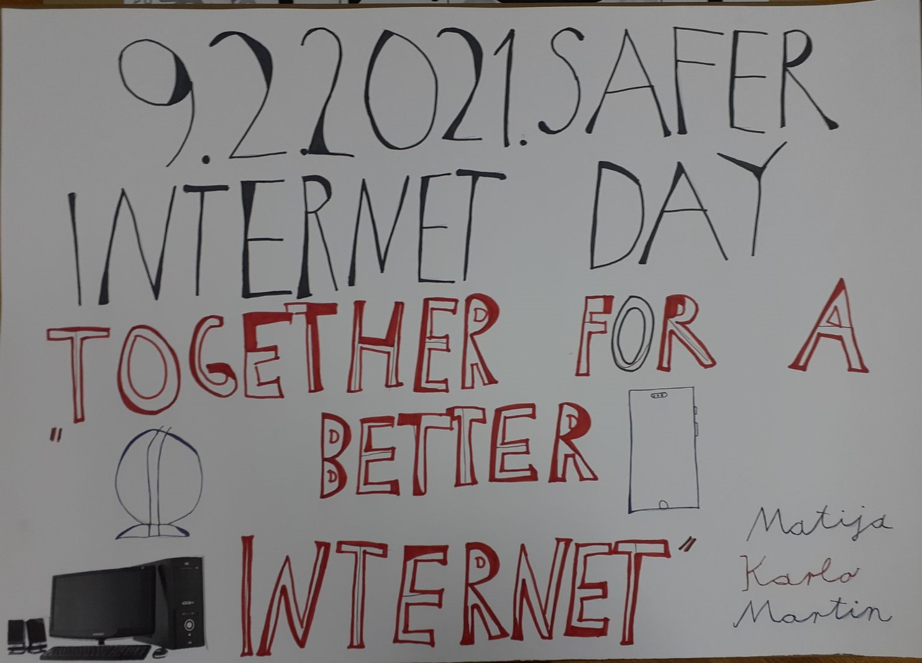
Group 4- Poster "Safer Internet Day 2021" - "Together for a safer Internet"

Slide 9
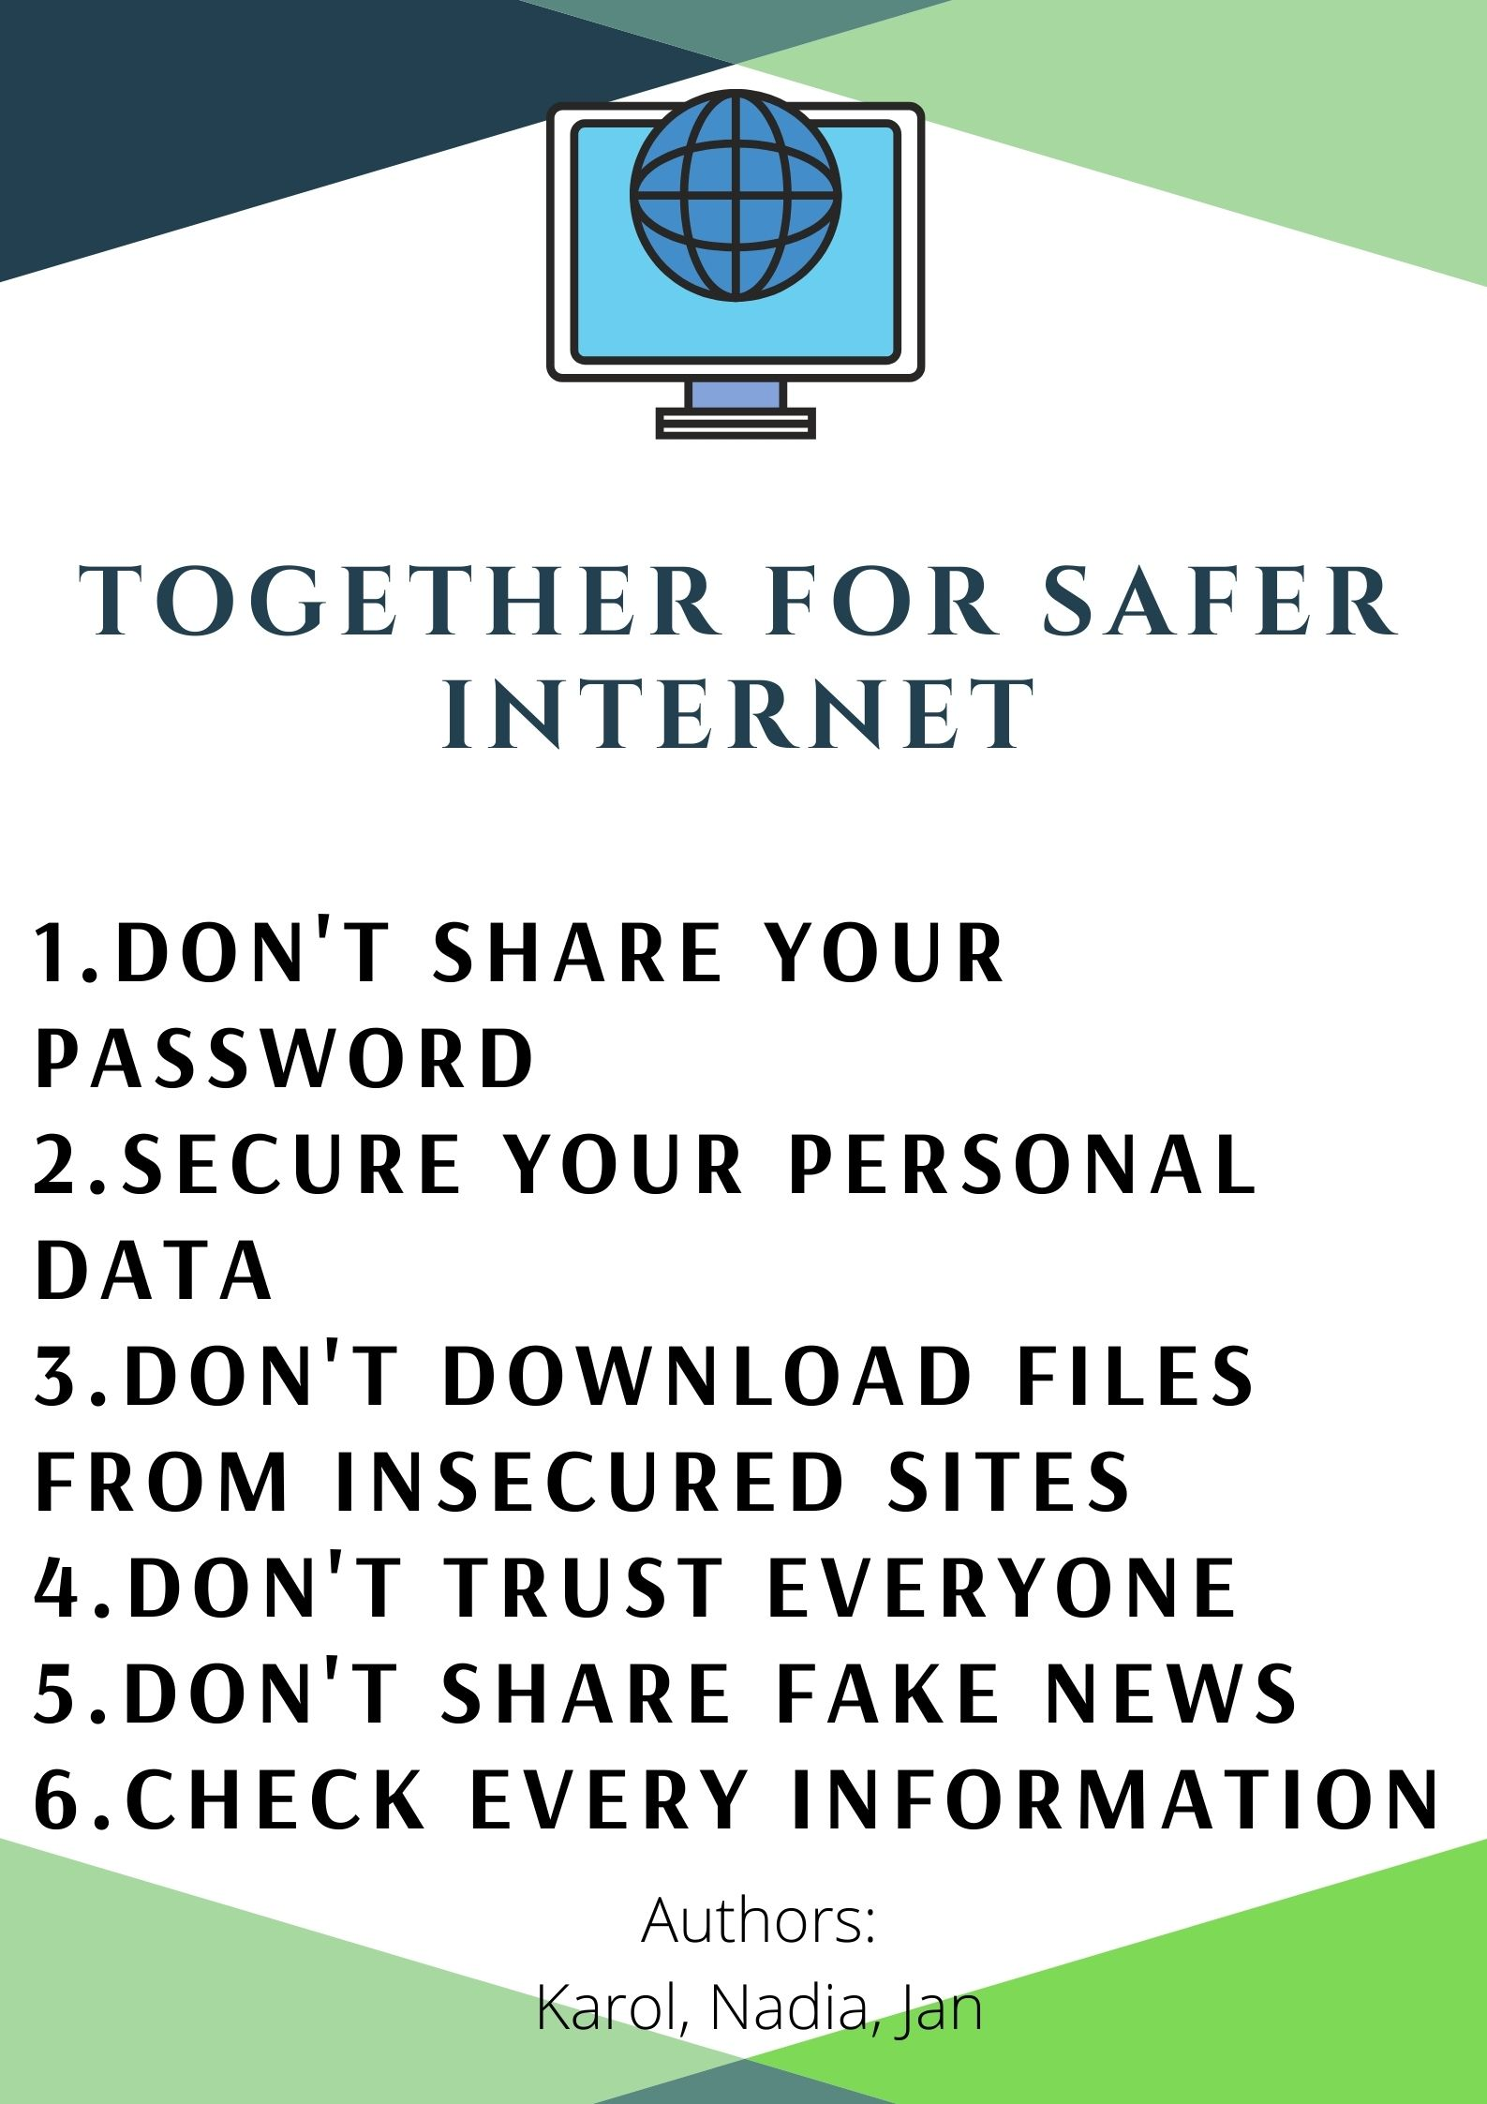

Slide 10
Group 5- How would a world look like without Internet

Slide 11
WHAT LIFE WOULD BE LIKE IF THERE WAS NO INTERNET
People would go outside more often.
People would talk more often
Life would be boring without the Internet
We wouldn’t have good source of information
It would be harder to do our homework
Learning would be harder, less effective without apps
We wouldn’t communicate today
We wouldn’t do online shopping
We wouldn’t play online games so our sight would not suffer so much
It would be impossible to book a room in a hotel - which is faster
We wouldn’t learn now because of coronavirus.
Thanks to the Internet we can study online
World wouldn’t be so developer.
There would be no cyber crimes
We wouldn’t know so many people
We wouldn’t be able to keep in touch with people, friends who are far away.
Maciej, Janek

Slide 12
Questions:
1. What social networks do you use?
2. Do you use the Internet in a safe way? Explain how.
3. How can you contribute to Internet security?
4. How much time a day do you spend online?
5. What content do you watch on the Internet, which pages do you visit?
6. Which useful sites on the Internet would you recommend / recommend to others?
7. Do you think you are safe enough while surfing the internet? Explain?

