Slide 1
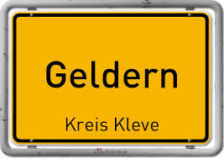
Welcome to

Slide 2
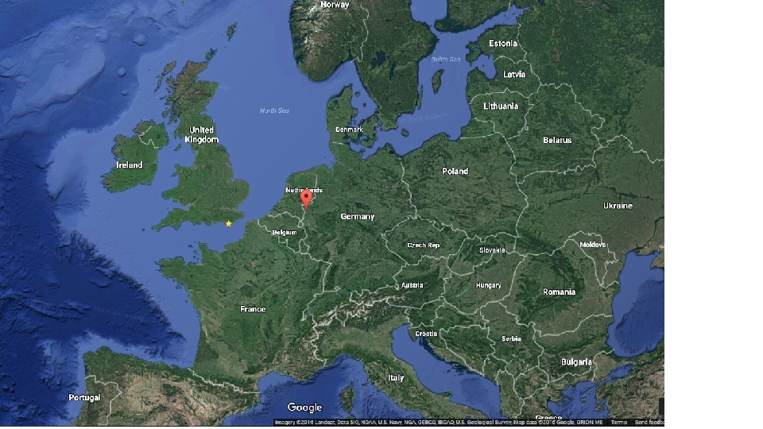
Geldern is a German–Dutch border city centered in the federal German state of North Rhine-Westphalia.
It is part of the district of Cleves, which is part of the Düsseldorf administrative region.

Slide 3
There is a folk legend, which tells the story of a fire-breathing dragon that was killed by local noblemen around 878.
Before the dragon died it shouted two or three times: Gelre! Gelre!
To remind people of the heroic fight, the city of Geldern was founded.
The Logo of Geldern

Slide 4
And welcome to
Sekundarschule
Niederrhein

Slide 5
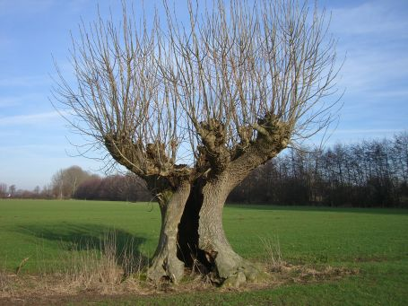
Our school logo
The logo shows the little river NIERS
which flows behind our school and trees that are typical for our landscape. These trees are called “Head Willow Trees“.

Slide 6
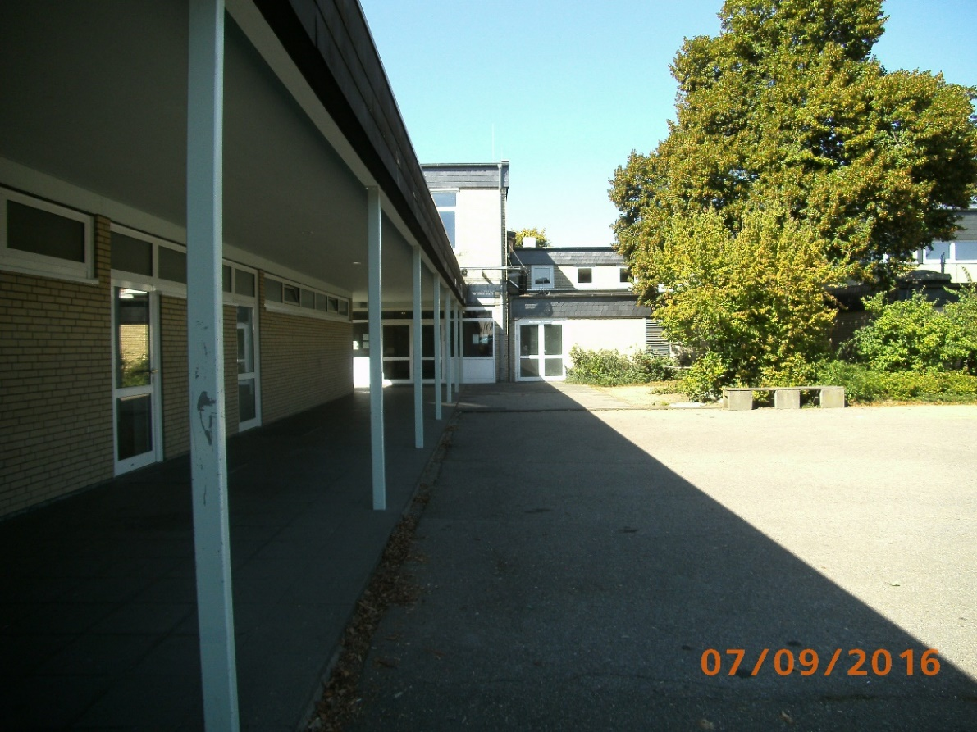
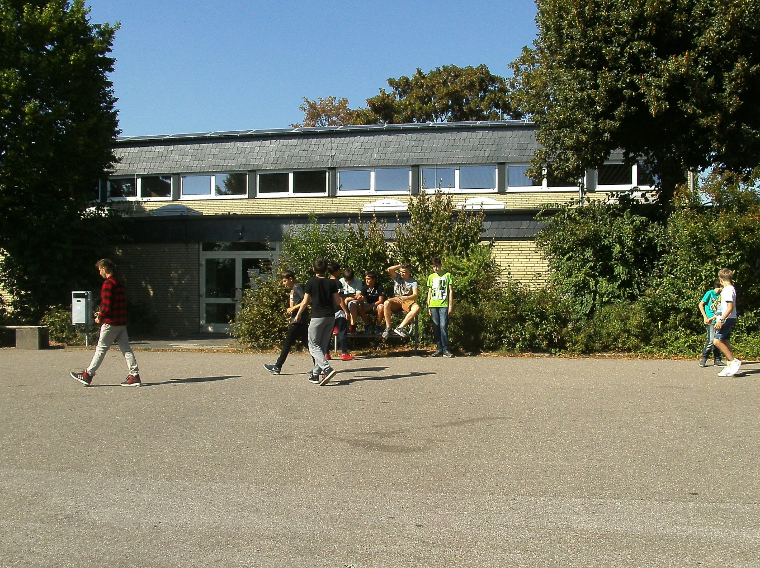
Our
schoolyard

Slide 7
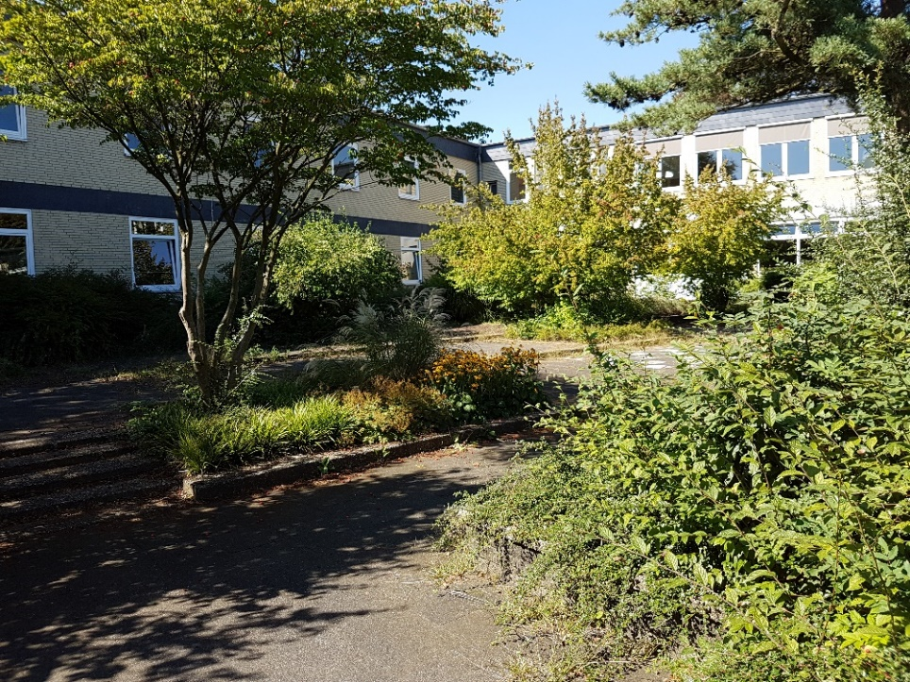
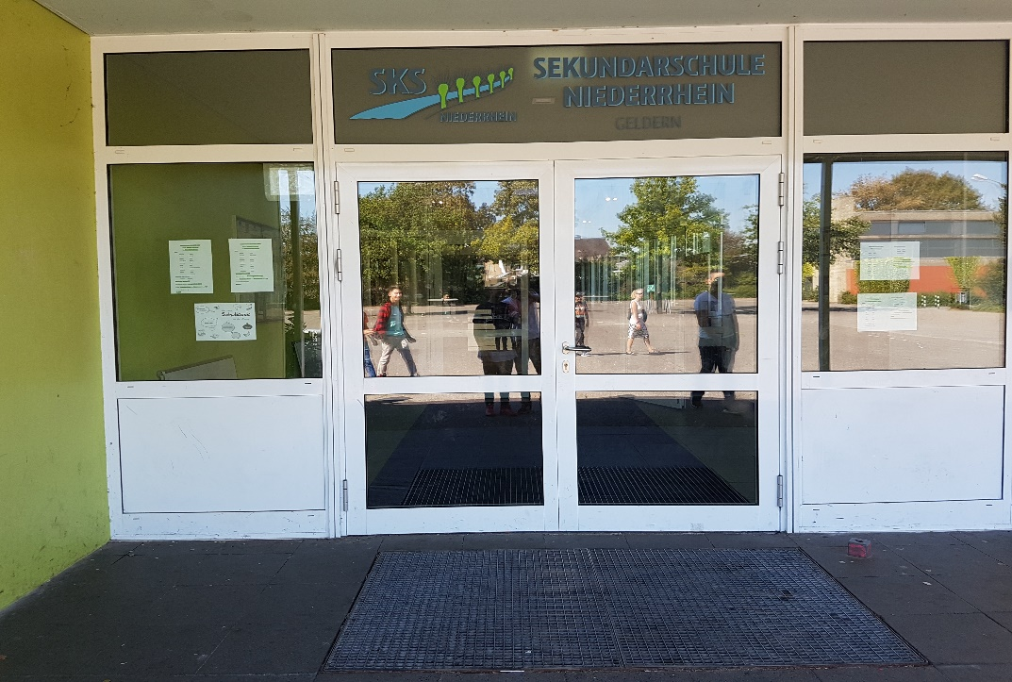
Let‘s go inside!
Main entrance

Slide 8
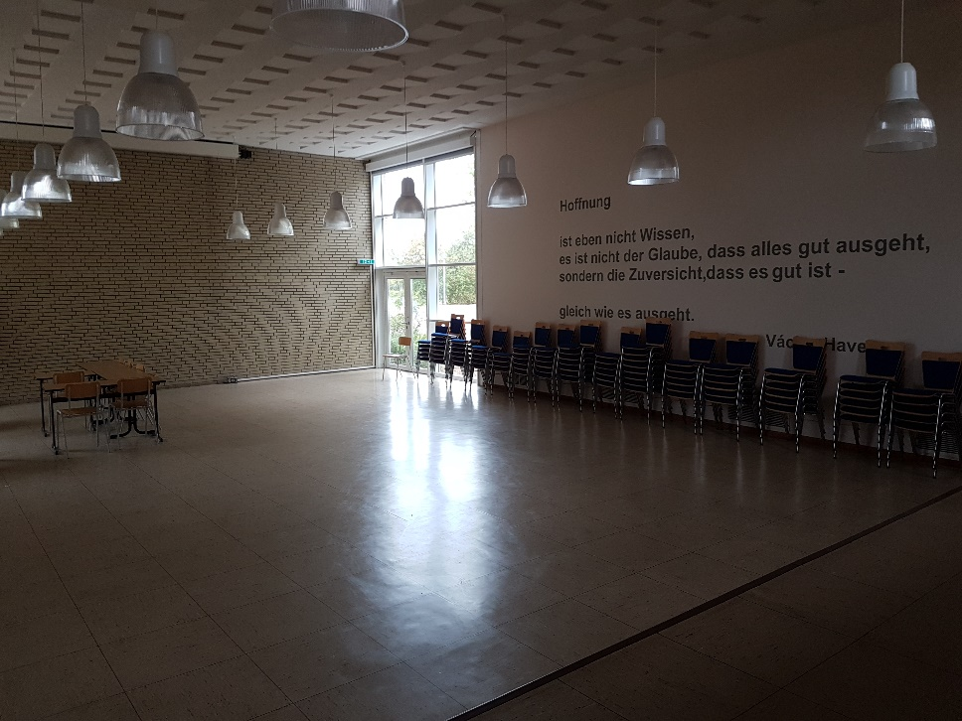
Our auditorium
This is our auditorium. Here we and our parents can listen to lectures from our head teacher.
Students have already put small performances on stage here as well.

Slide 9
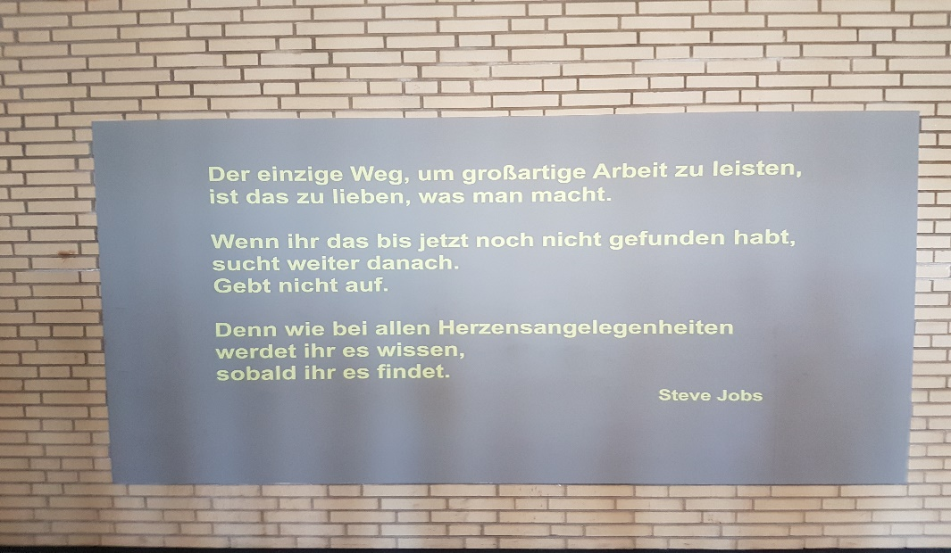
At various places in the school building you find quotes of famous people.
The only way to do great work is to love what you do.
If you haven‘t found it yet, keep looking. Don‘t settle.
As with all matters of the heart, you‘ll know when you find it.
Steve Jobs
“The only way to do great work is to love what you do.
If you haven‘t found it yet, keep looking. Don‘tsettle.
As with all matters of the heart, you‘ll know when you find it.“
Steve Jobs

Slide 10
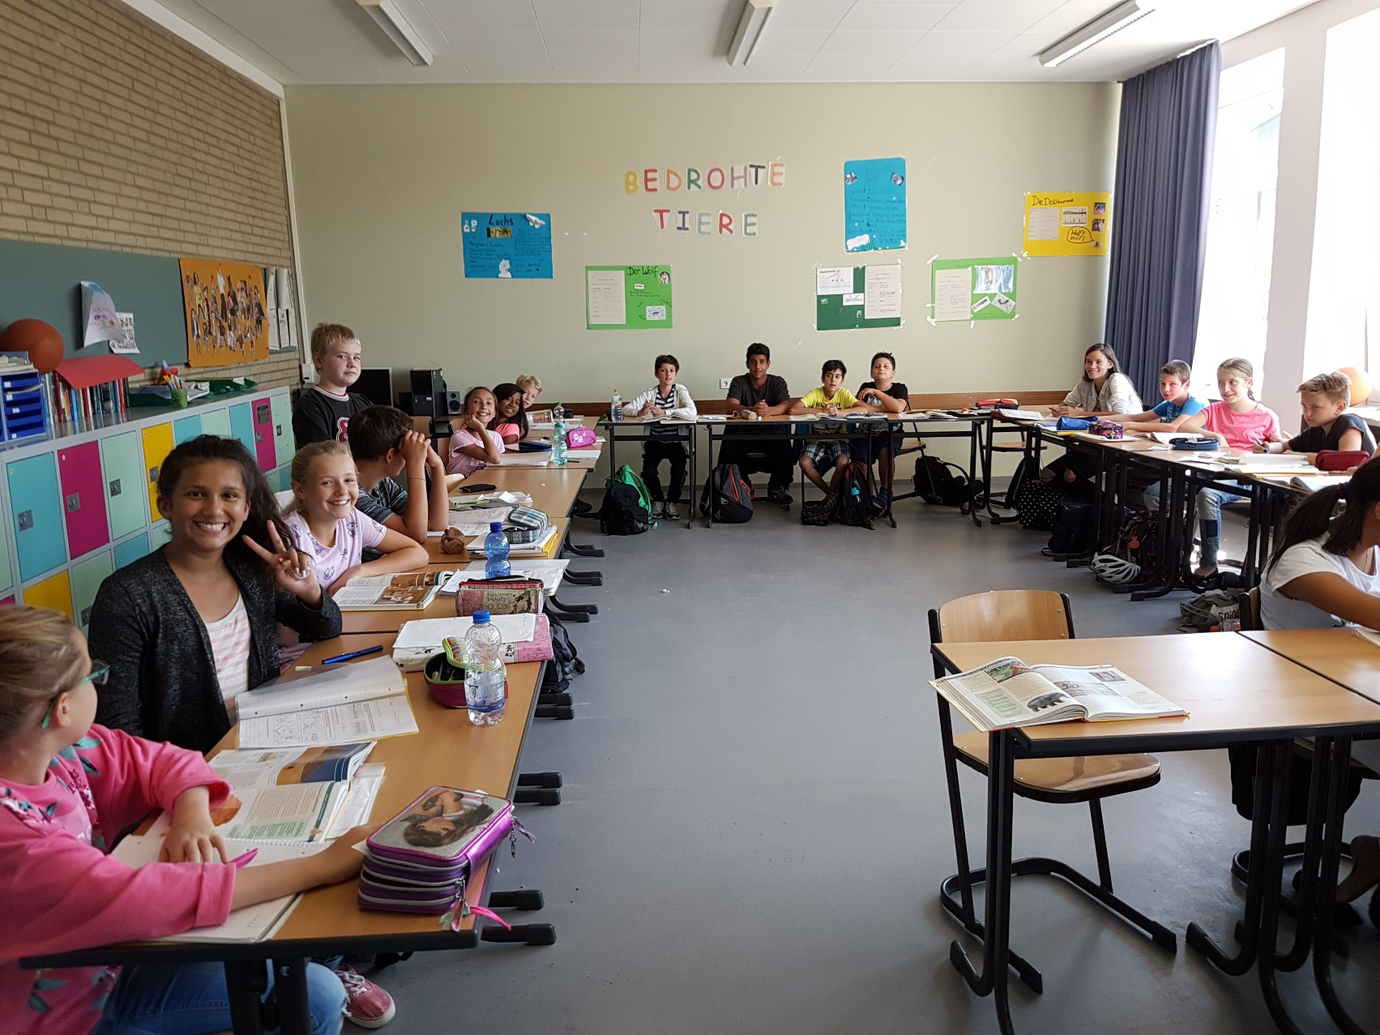
Our classrooms
Every class has two rooms, the classroom plus a smaller room next to it, where students can get extra help. We can also use it for group work.
On the left you see our colourful lockers, where we can leave our things.

Slide 11
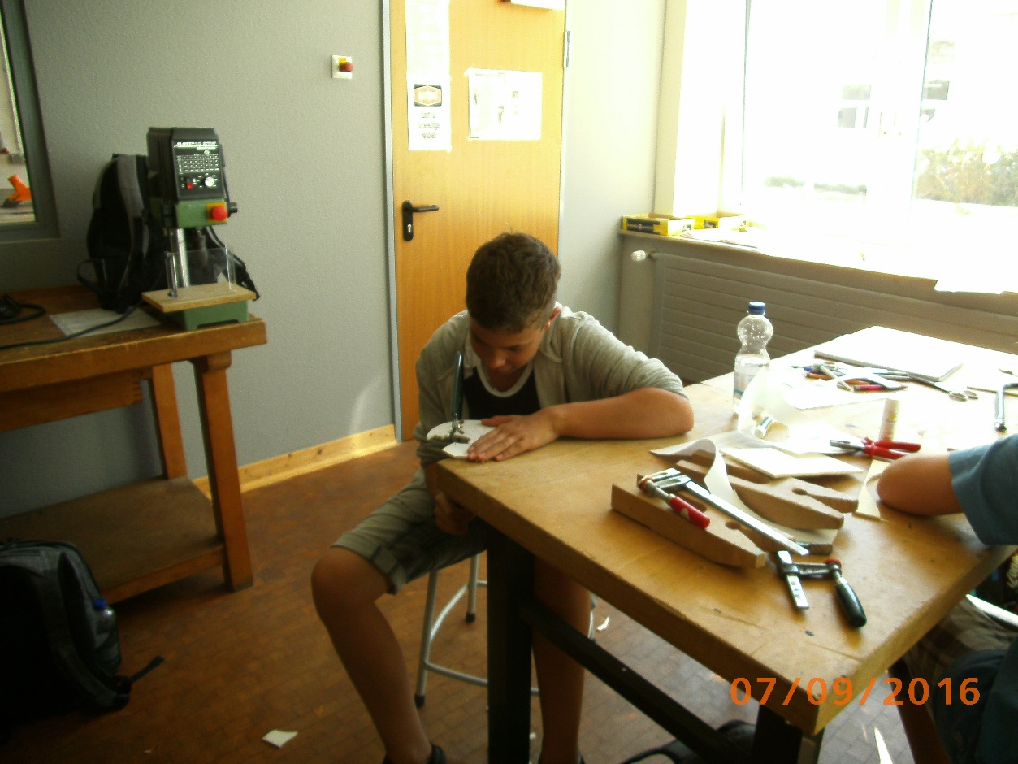
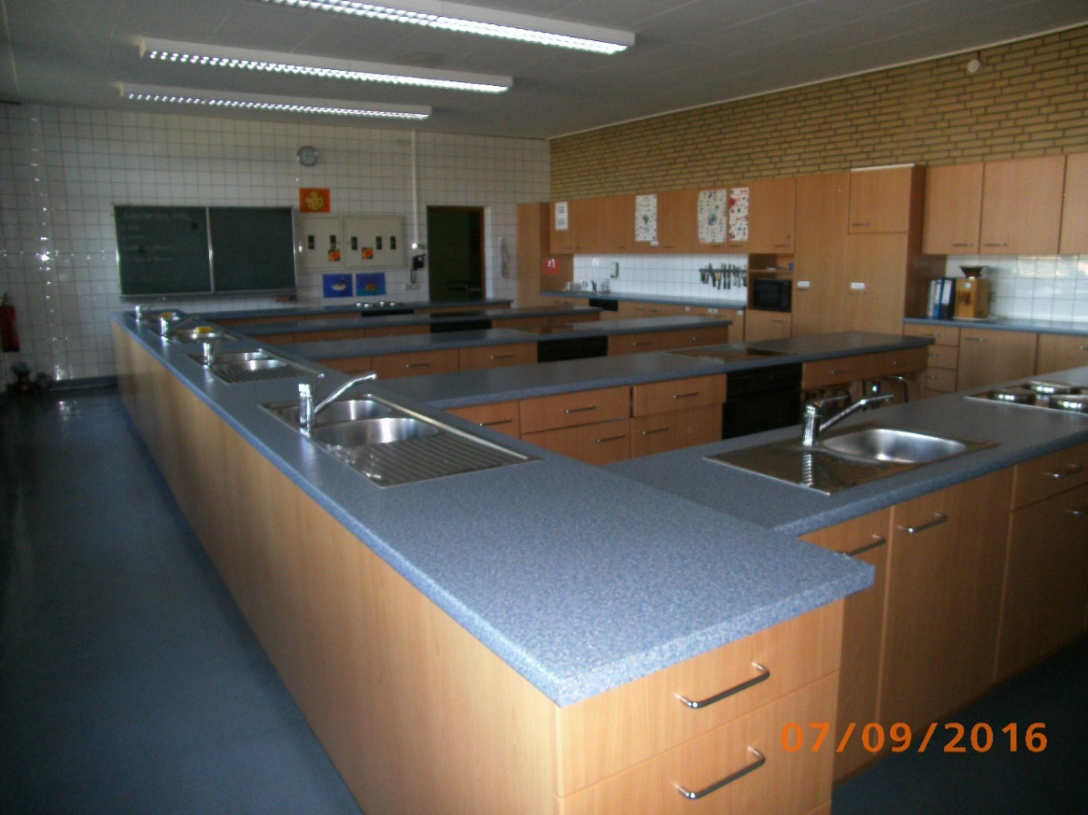
Kitchen and Woodwork Classroom
This is our kitchen. Here we learn how to prepare healthy meals. We cook and eat together.
Here we come for woodwork classes

Slide 12
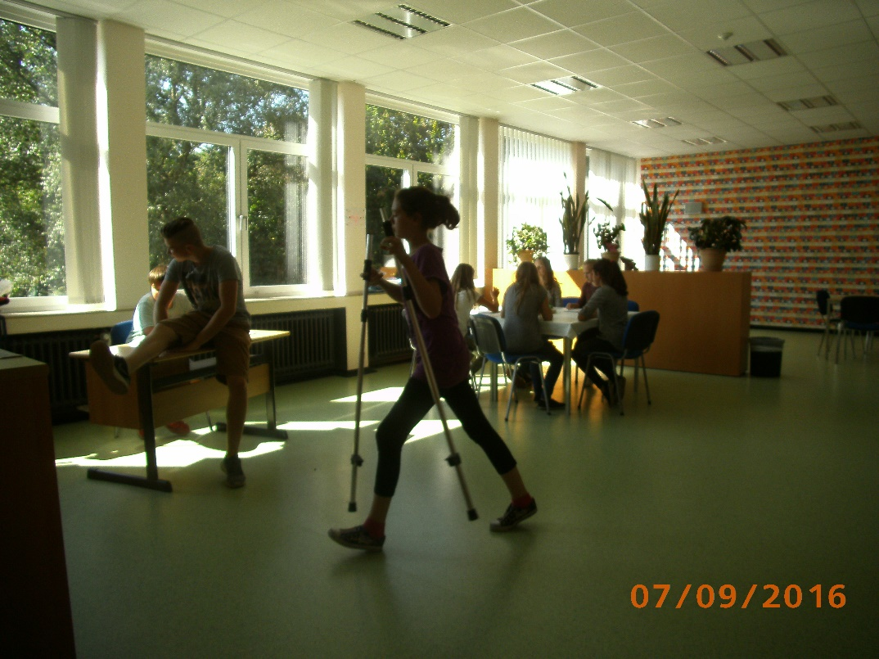
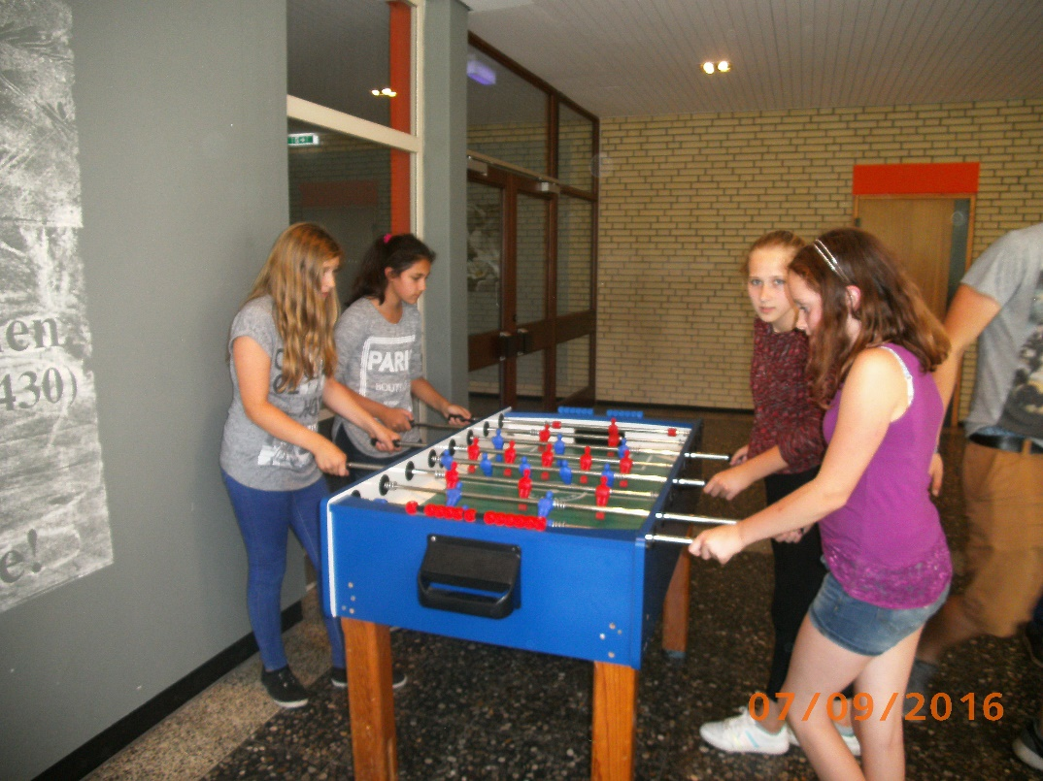
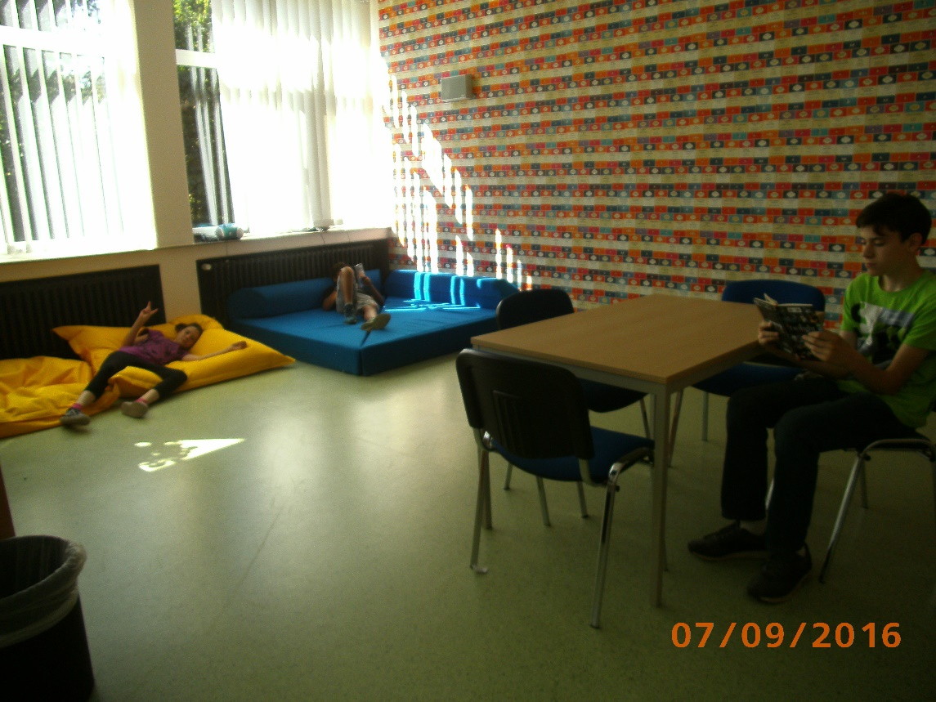
Our recreation rooms
Three days a week we stay at school from 7:45 am until 15:30 pm. On these long days we like to chill out during the lunch break.
This is our recreation hall, where you can stay when the weather is bad.

Slide 13
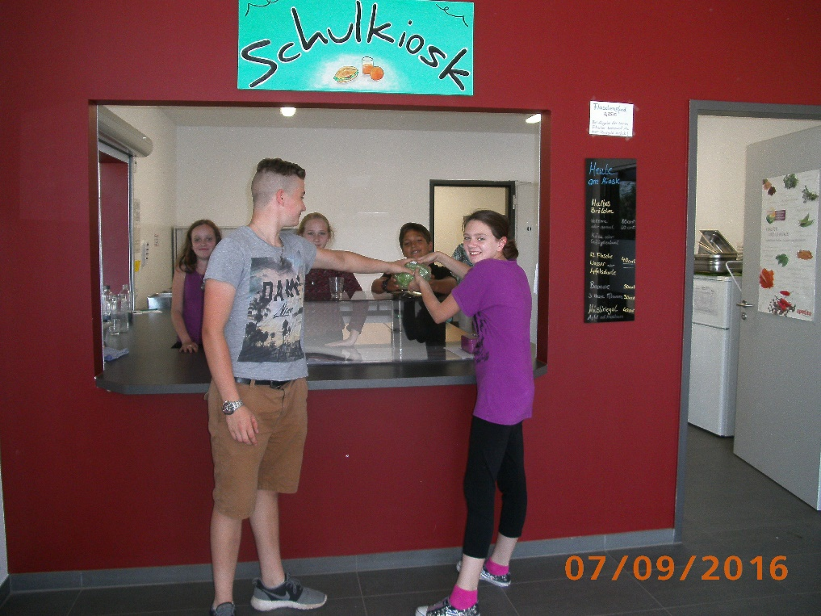
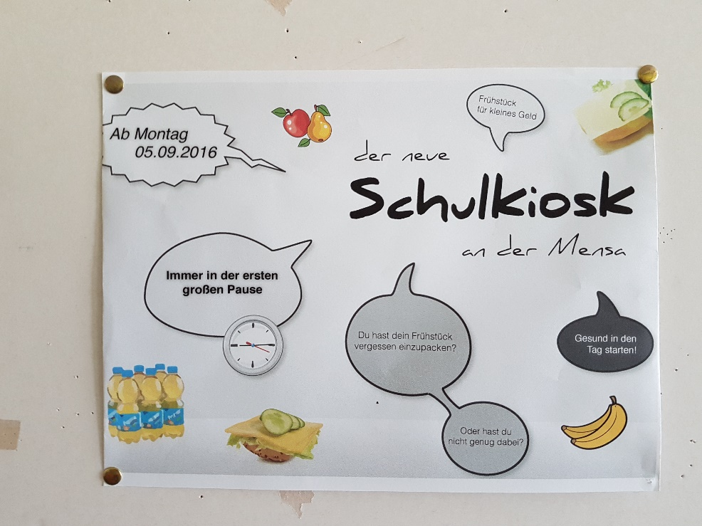
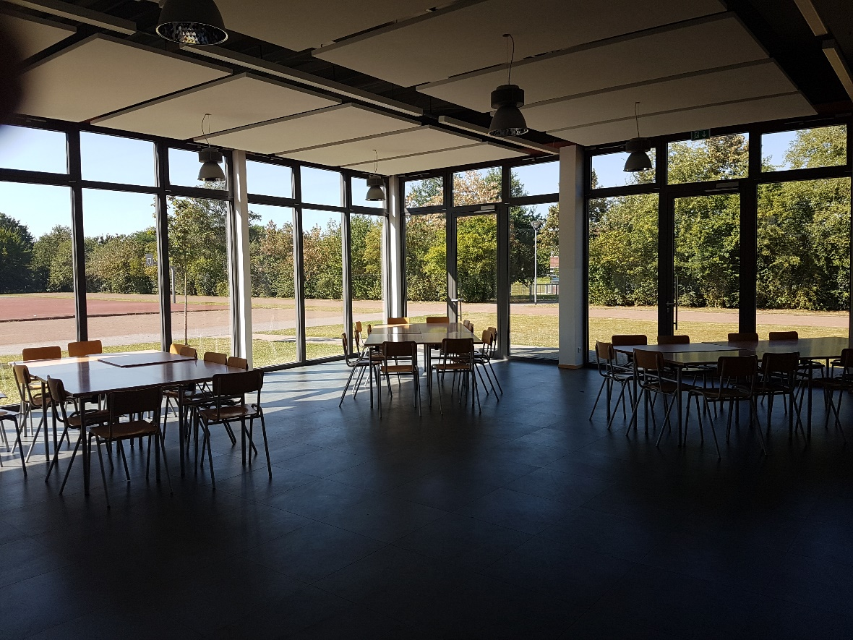
Our school canteen
The kiosk will soon be run by students of our school. It only opened last September.
Here we can get lunch.

Slide 14
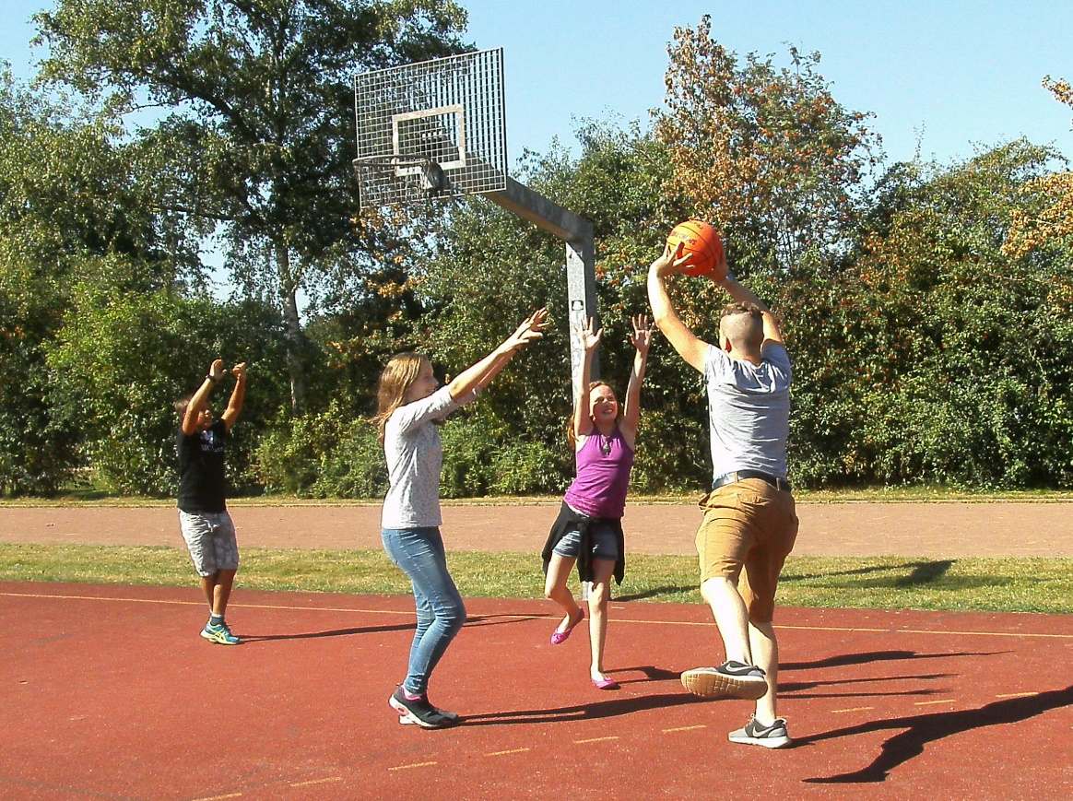
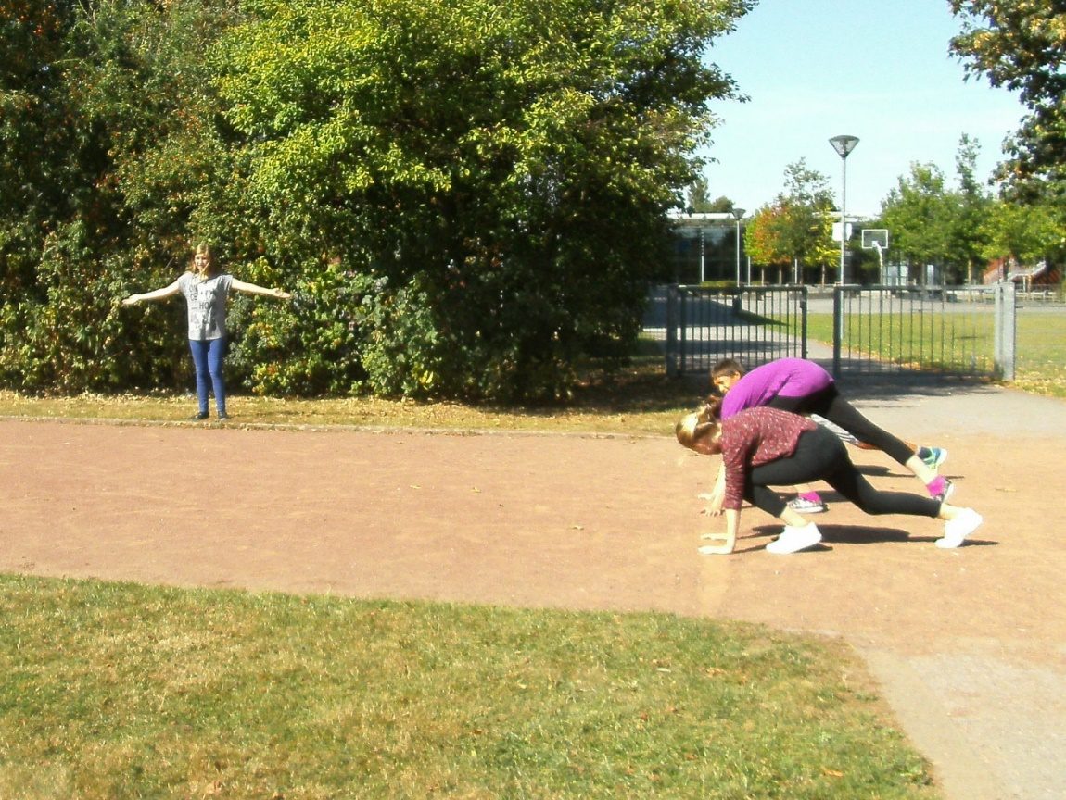
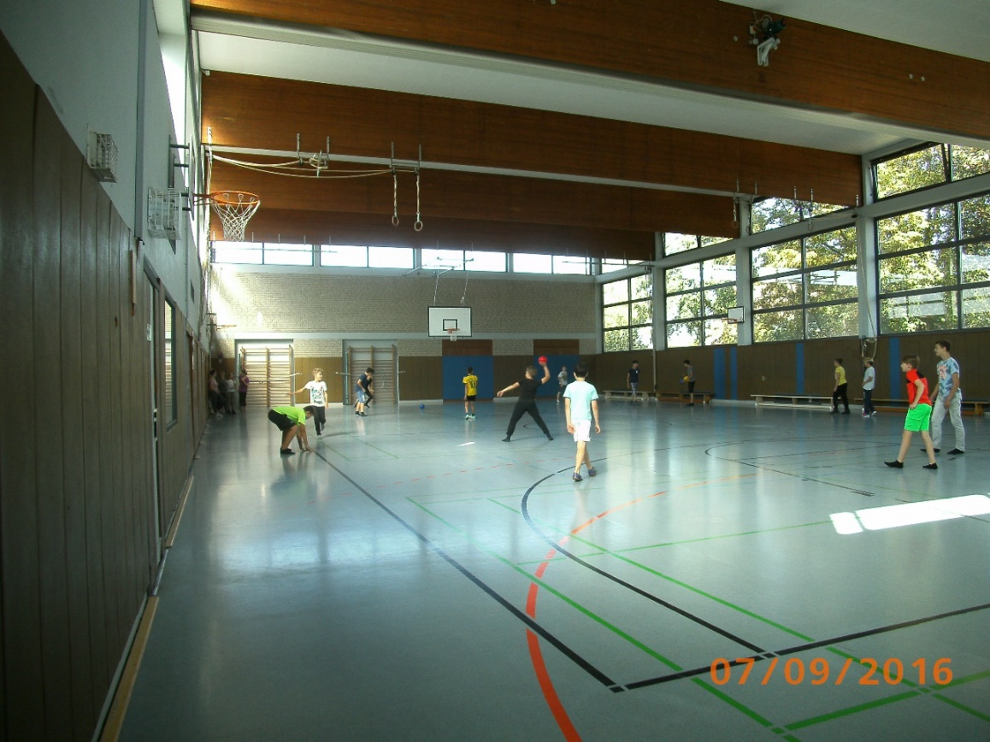
Our sports field and gymnasium

Slide 15
Our school was founded in 2014. At the moment we are 32 teachers and 280 pupils from 19 countries (Germany, Poland, Romania, Albania, Spain, Afghanistan, Macedonia, Syria, Serbia, Pakistan, Iraq, Ireland, Italy, Tadzhikistan, Thailand, Vietnam, Kosovo, Netherlands, Egypt). We are still growing and next year we will be more people.
School starts at 7:45 am and at 3:30 pm ends on Mondays, Wednesdays and Thursdays . Tuesdays and Fridays school ends at 1 pm. On longer school days we can eat in the school canteen or we can bring our own lunch. Every day the school kiosk is open during the first break.
Besides German, Math and English pupils can also learn Spanish and various other subjects. For the different religions of our pupils our school offers three different religious classes.

Slide 16
To see on a map where our students come from click here
on the link.
When you put the cursor on a country in the box on the left then the country should be highlighted on the map.
If you can‘t see all the countries, then zoom out using

Slide 17
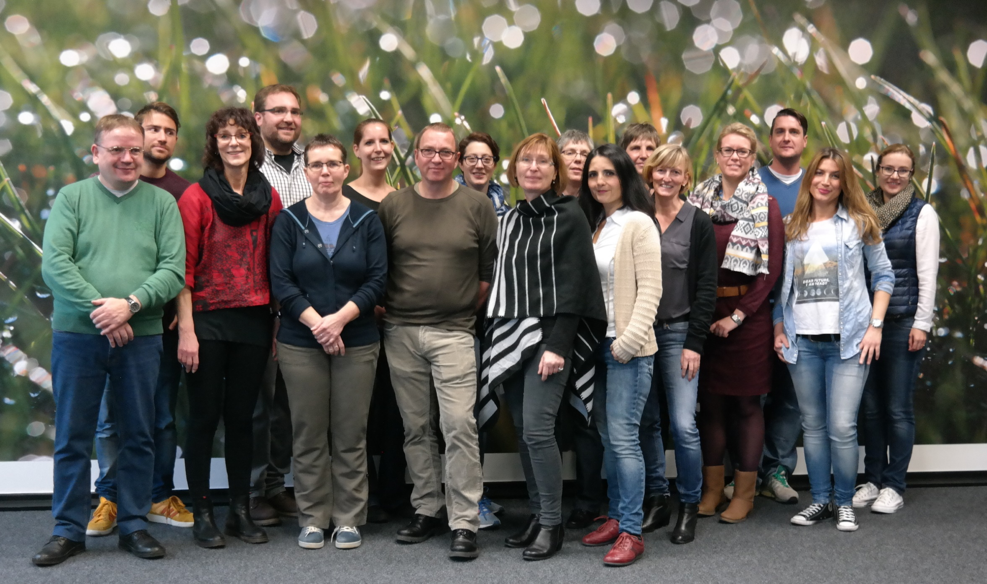
HERE ARE SOME OF OUR TEACHERS

