Slide 1
LET’S PLAY, LET’S ACT
FORUM THEATRE
Cyprus LTTA
16 - 20February, 2017

Slide 2
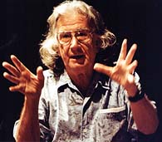
FOUNDER
Augusto Boal was a Brazilian theatre director, writer and politician. He was the founder of Theatre of the Oppressed
Born: March 16, 1931, Rio de Janeiro, Brazil
Died: May 2, 2009, Rio de Janeiro, Brazil
https://en.wikipedia.org
/wiki/Augusto_Boal

Slide 3
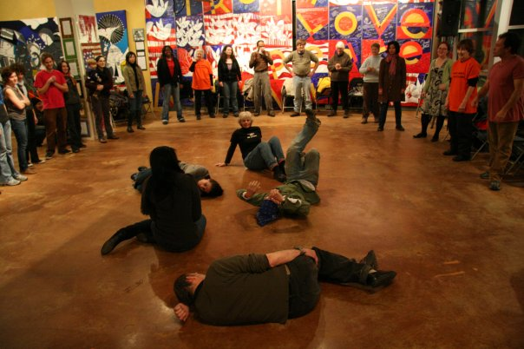
A play or scene, usually indicating some kind of oppression (negative situation), is shown twice. During the replay, any member of the audience (‘spect-actor’) is allowed to shout ‘Stop!’, step forward and take the place of one of the oppressed characters, showing how they could change the situation to enable a different outcome. Several alternatives may be explored by different spect-actors. The other actors remain in character, improvising their responses.
http://dramaresource.com/forum-theatre

Slide 4
So what did we do?
A scenario was formed so as to get in the same place as a migrant/refugee student.
A migrant student comes to Cyprus and wants to play with some kids. Unfortunately, these kids are not very friendly but they treat him in a racist way.
Frozen scene. How do you think kids welcome migrant student?

Slide 5
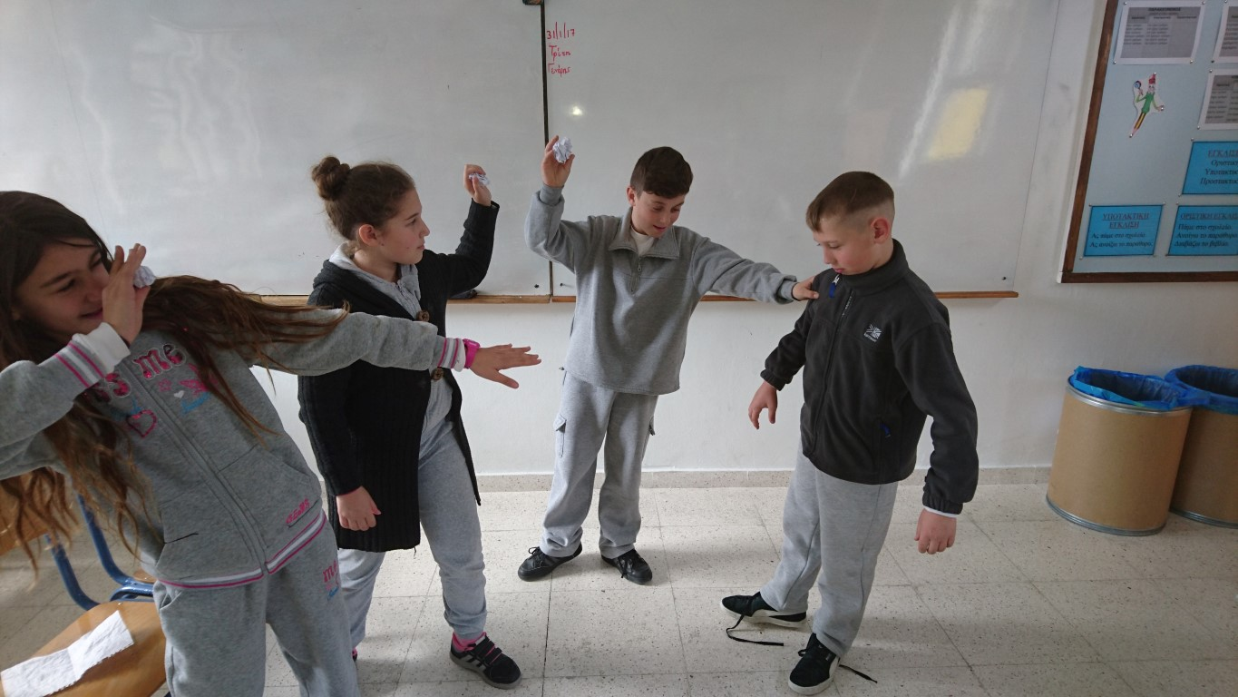
So what did actually happen?
Who is the migrant student? Why did you choose this particular kid?

Slide 6
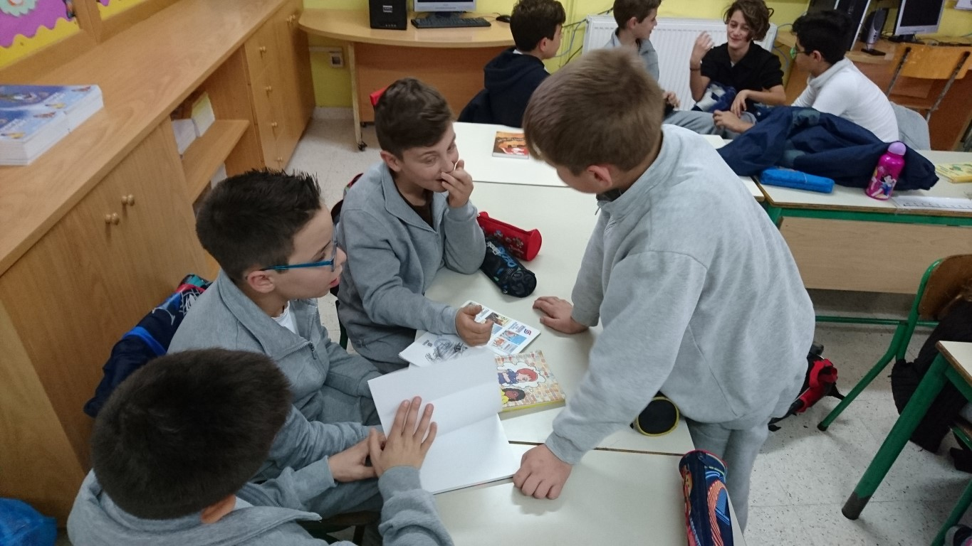
Next…
We had some group work on deciding what might have happened before and after this incident.

Slide 7
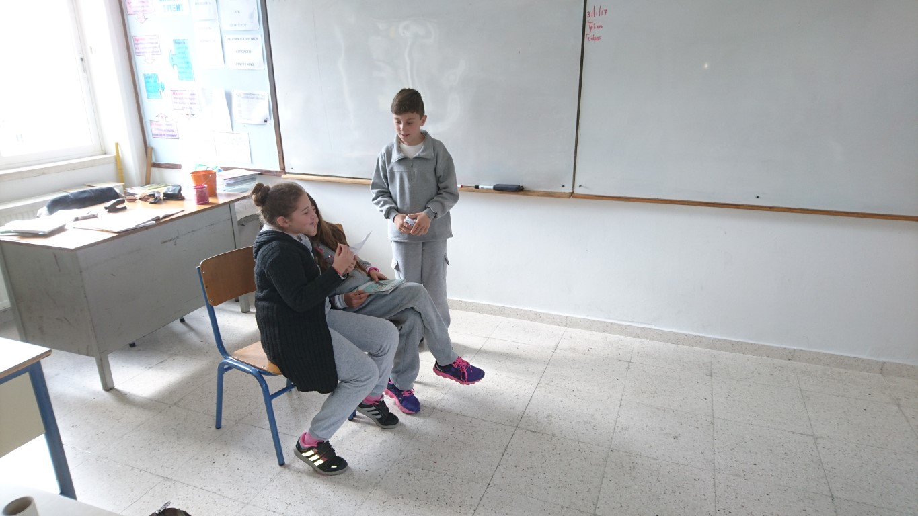
So…
Three friends were sitting and talking about what they would do on their weekend.

Slide 8
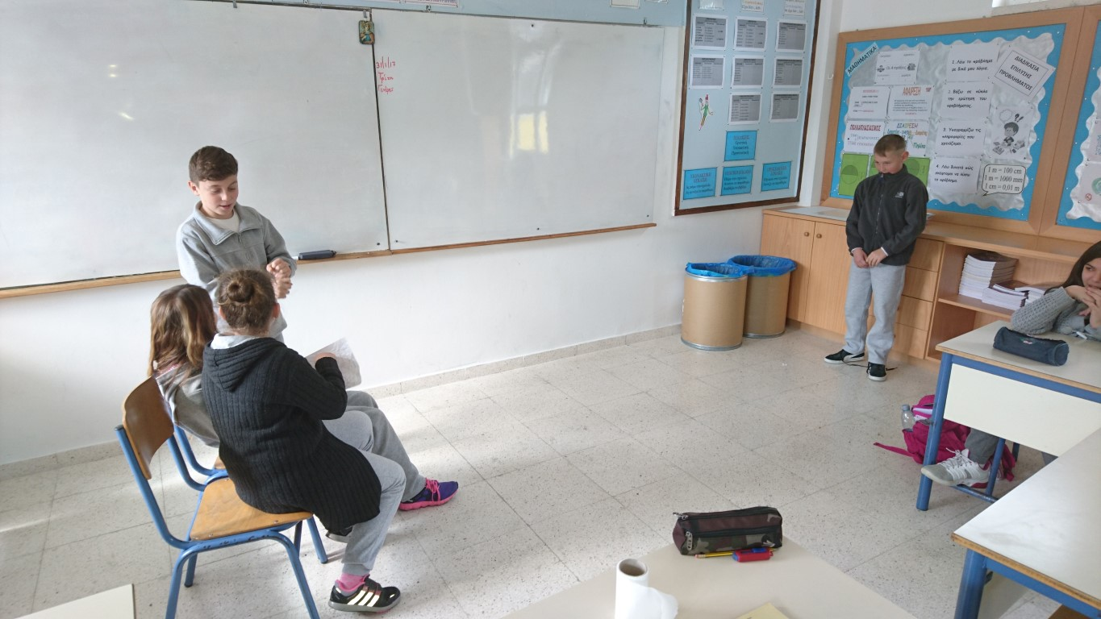
This boy sees the three friends and wonders if he can go close to them and ask them to play.

Slide 9
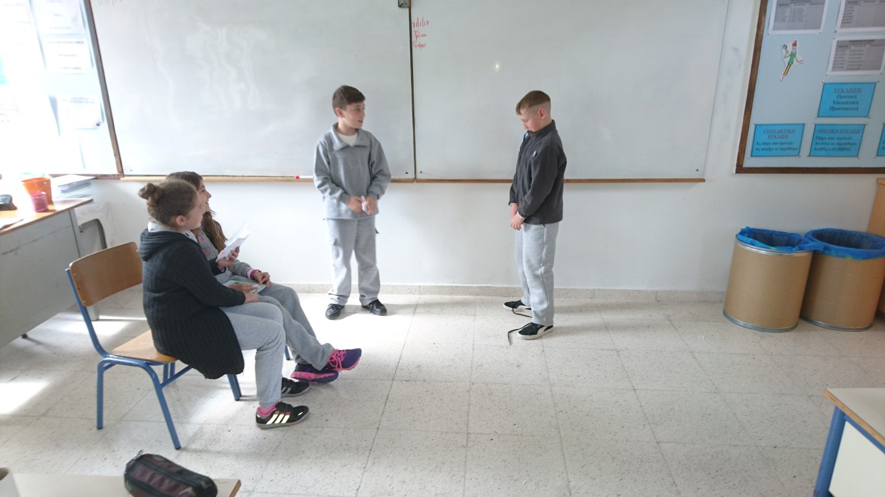
Finally, he decides to do it! “I will go and ask them to play”, he thinks.
Can I play with you?
How does the young boy look? Feelings ?

Slide 10
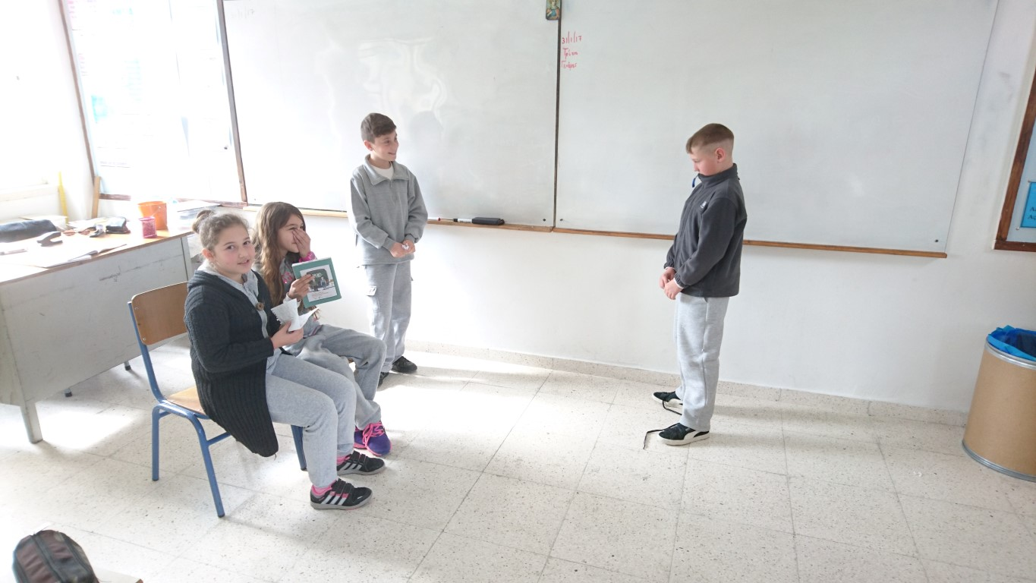
“Oh, he must be a migrant. He surely smells very bad. And look at that clothes. They are different from ours. These migrants eat our food. We must send him away”, the three friends say each other.

Slide 11
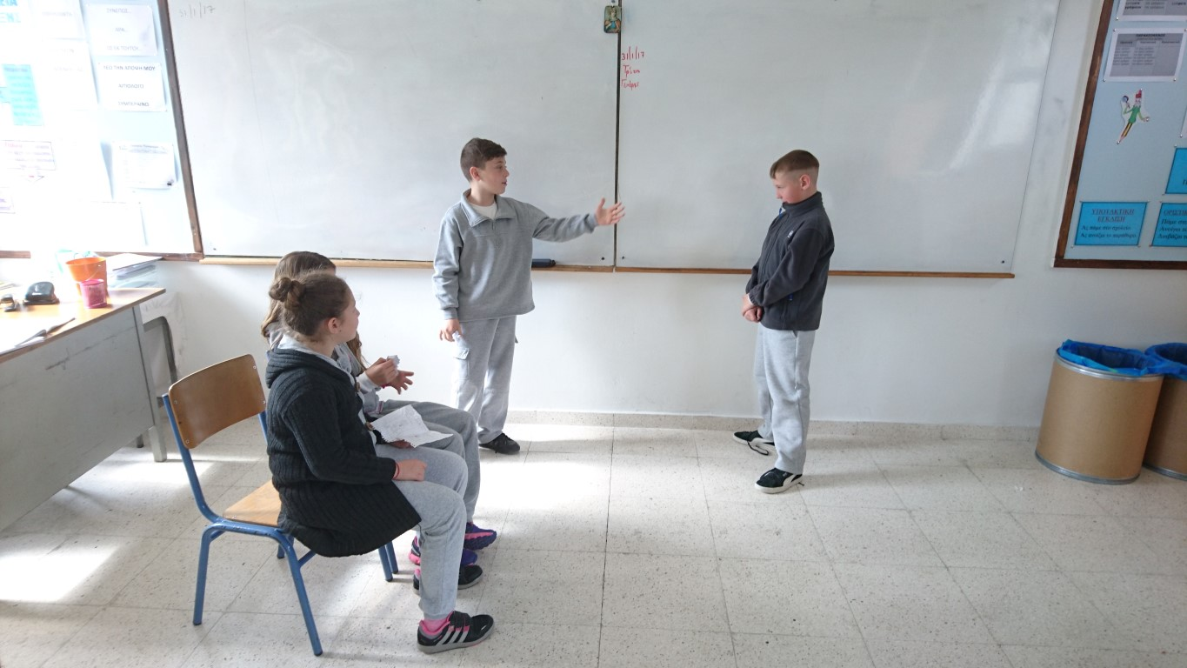
“We have to do something right now.”
“We don’t like you. Get out of here. Don’t you understand”?

Slide 12
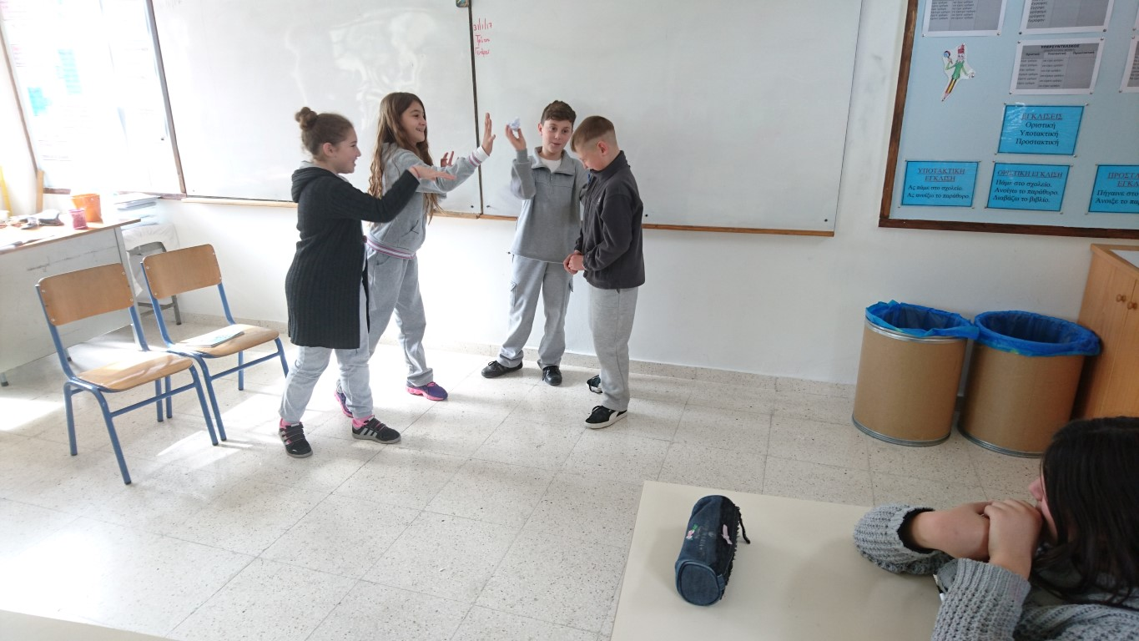
“Let’s throw stones at him. This will keep him away…”

Slide 13
“Don’t you dare come close to us again”!

Slide 14
Then …
SO at that time, the rest of the students had the chance to say “STOP” and get in the play so as to change things!

Slide 15
“Why do you treat him that way? He is just a boy!”

Slide 16
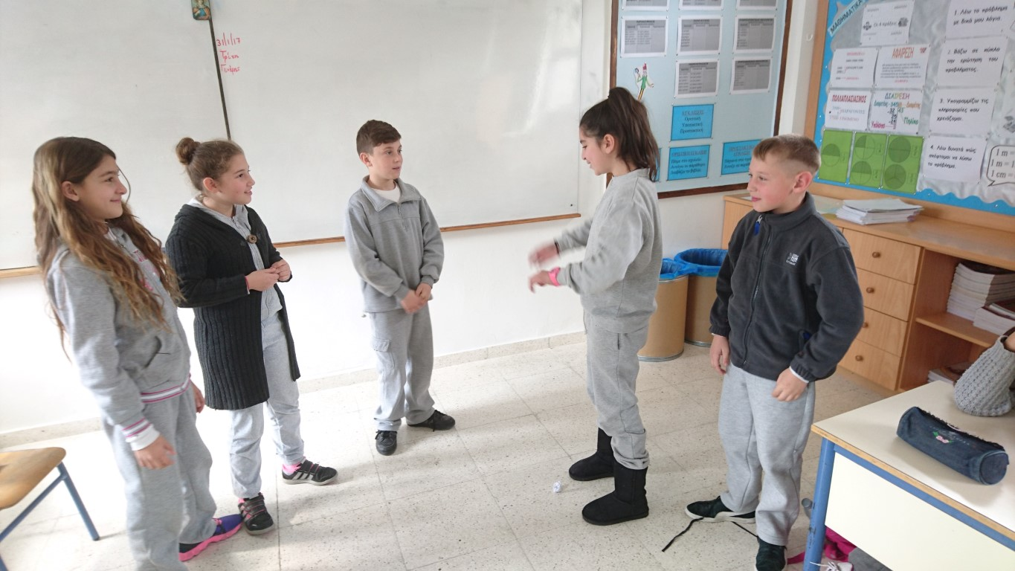
“Would you like to be treated the same way”?

Slide 17
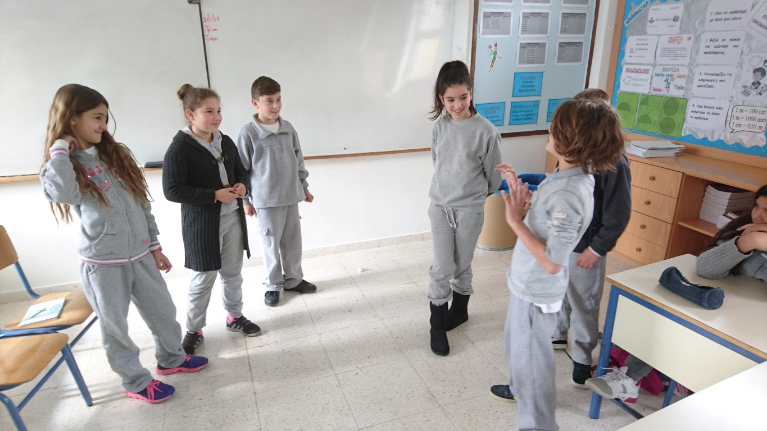
Then another student…
“We all are different between us. Nobody is the same with someone else”.

Slide 18
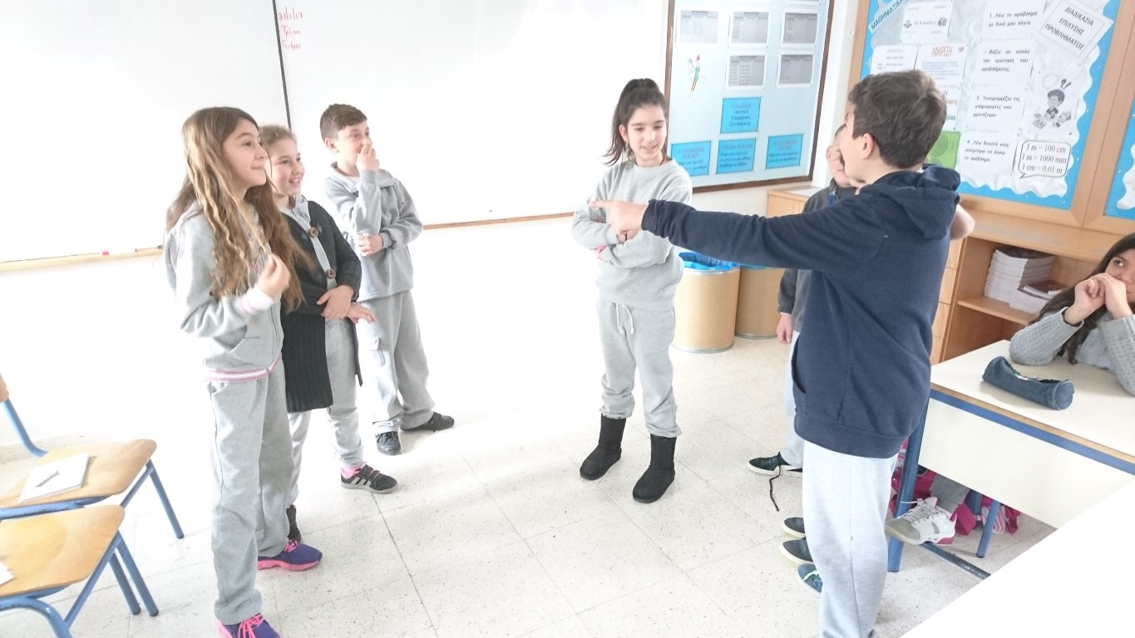
And another one …
“Just give him a chance to get to know him”

Slide 19
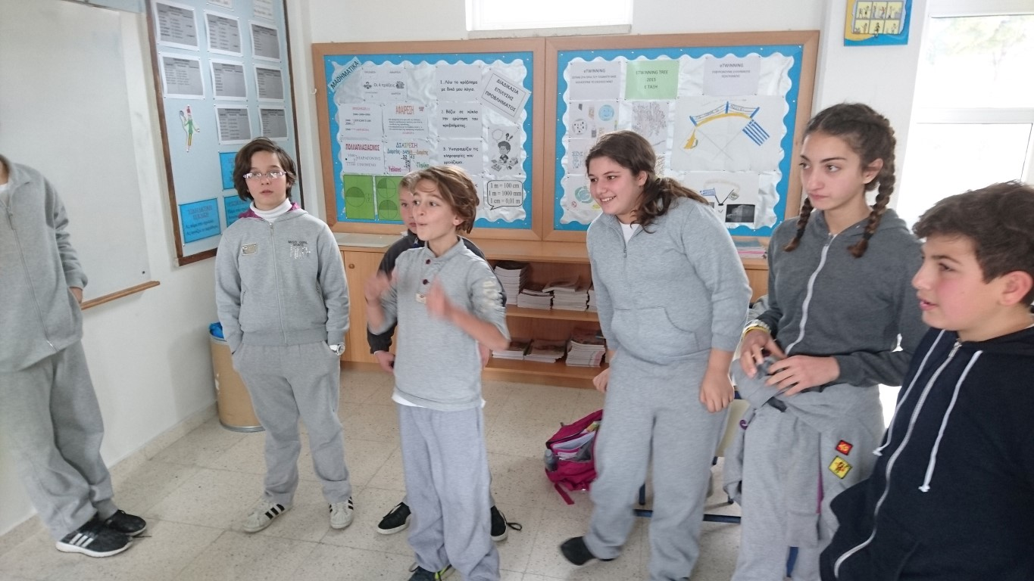
And more …
“We are all children. We deserve to be treated with respect. We just want to PLAY!!!”

Slide 20
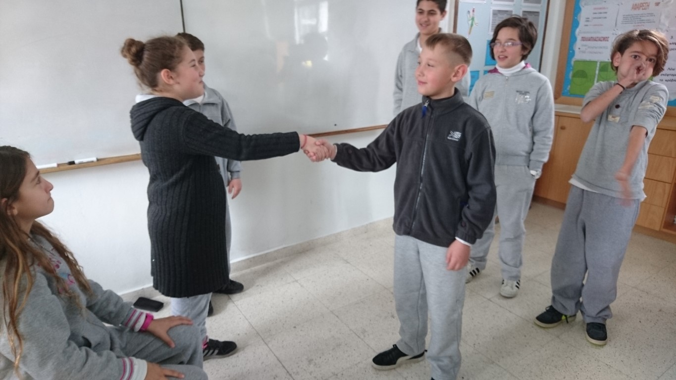
So finally …
“Sorry. Let’s start from the beginning”!

Slide 21
Thank you !!! You were excellent!

Slide 22
Let’s try to find out why?
“Why did you act like that to the migrant boy”?

Slide 23
Our turn!!!
Let’s try to do it!
We would like the help of our teachers.
We will be divided into four teams.
Each team will decide a similar scenario in which somebody is oppressed.
Write it down to your handout notebook.
Decide roles and actors.
The stage is yours!

