Slide 1
Anna’ s Cultural Identity Card
In this presentation
Anna (3^D)
tries to explain why she considers the following elements the most important and significant to define
her Cultural Identity Card

Slide 2
TV SERIES
My favourite TV series is Pretty
Little Liars because is dramatic
and real.
This is its theme song:

Slide 3
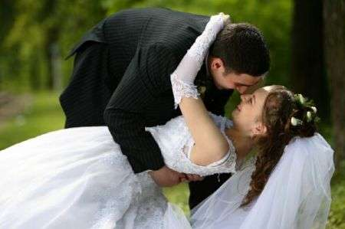
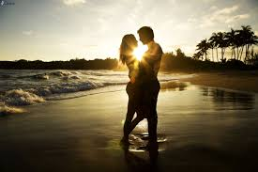
LOVE

Slide 4
INTERNET
In my opinion, the Internet helps us to study and to keep in touch with our friends.

Slide 5
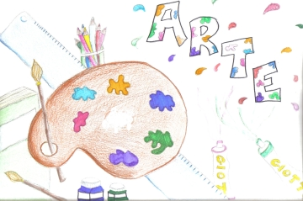
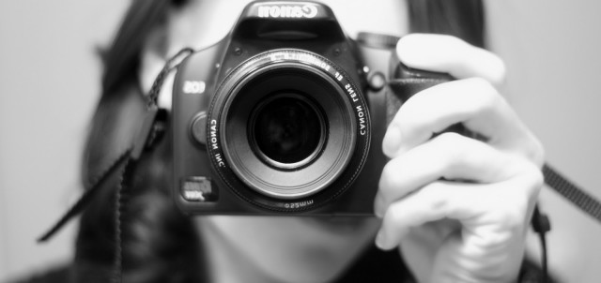
ART
I think art is important and fun.
I'm not very good at drawing but I like
it, especially with coloured
pencils.

Slide 6
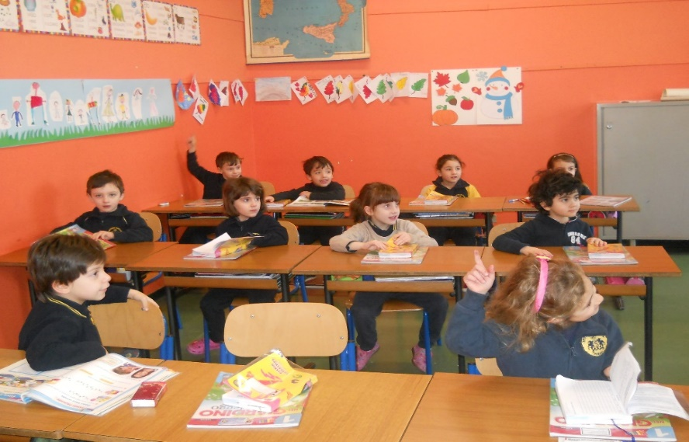
LANGUAGE
Languages are very important
for our future.
English is the most important because
it is spoken almost everywhere.

Slide 7
FILM
My favourite movie is “Don
Matteo” because when we went on
holiday in Umbria we could
see to the filming of it and I
usually watch it together with my
family.

Slide 8
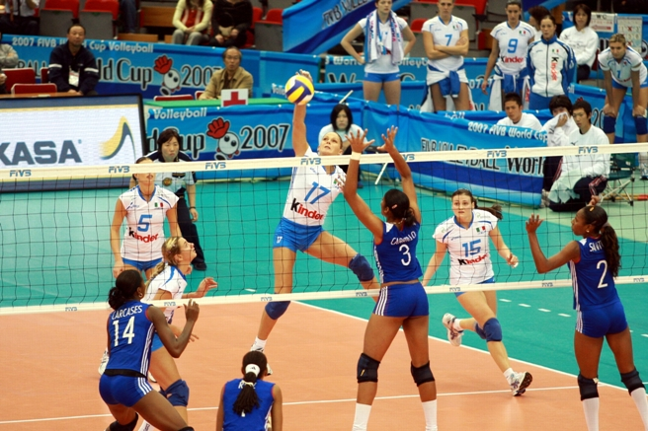
SPORT
My favourite sport is volleyball.
I have been practicing it for 8 years and I could never give it up.

Slide 9
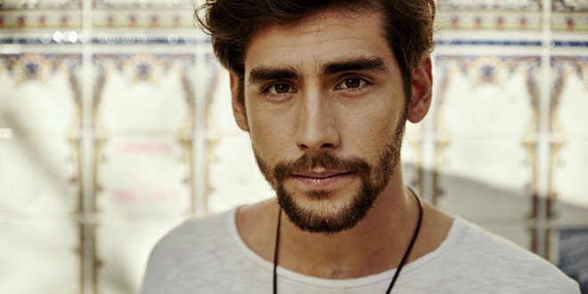
MUSIC
My favourite song is ‘’Sofia’’
because it’s so
catchy and exciting.

Slide 10
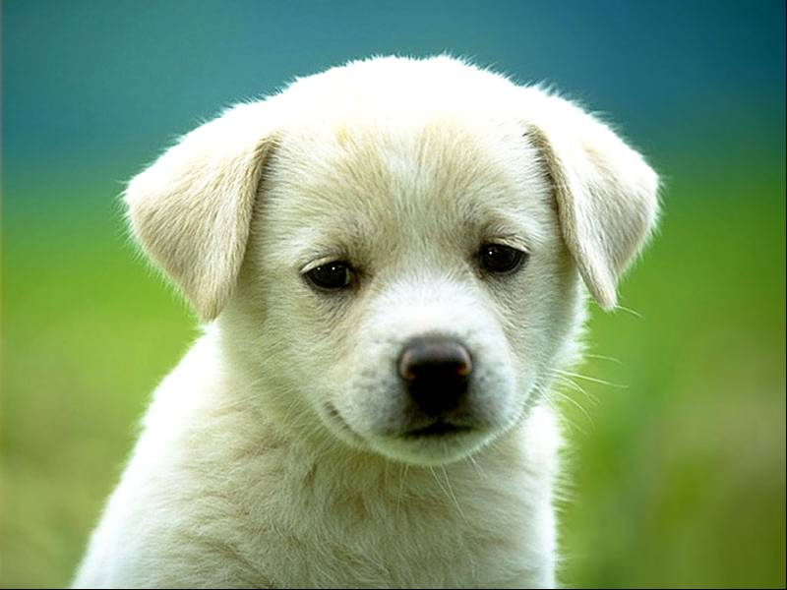
ANIMALS
My favourite animals are dogs, and I would really like to have one because they are so cute.

Slide 11
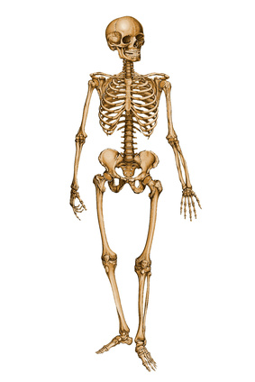
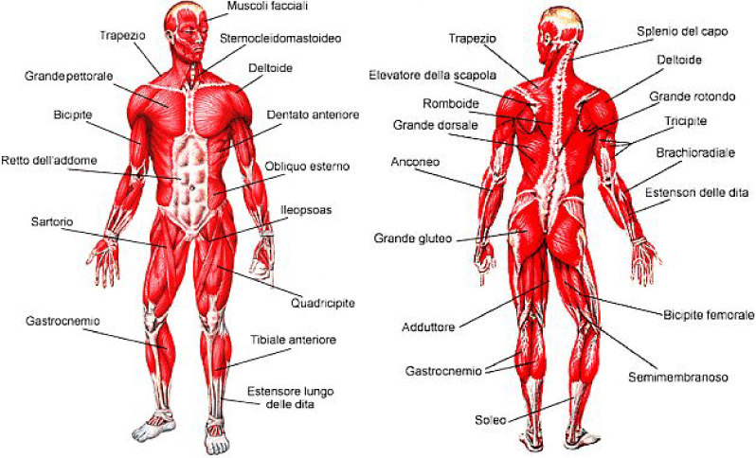
SCIENZE
I think science teaches
us lots of things useful
in everyday life.

Slide 12
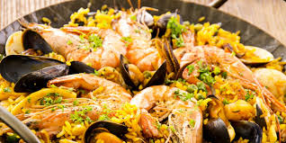
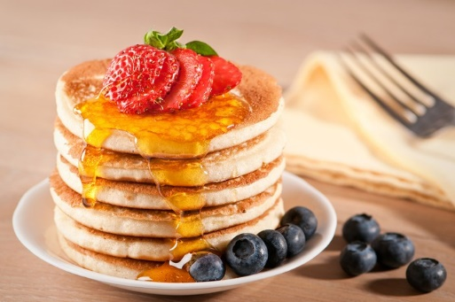
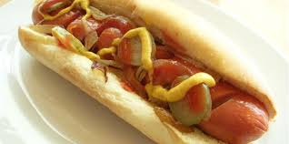
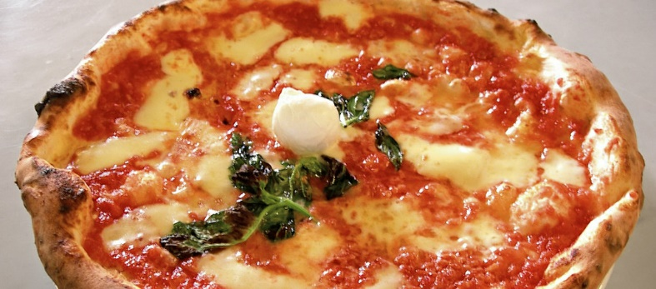
FOOD
Food provides us a lot of vitamins, proteins and energy, it is very important.

Slide 13
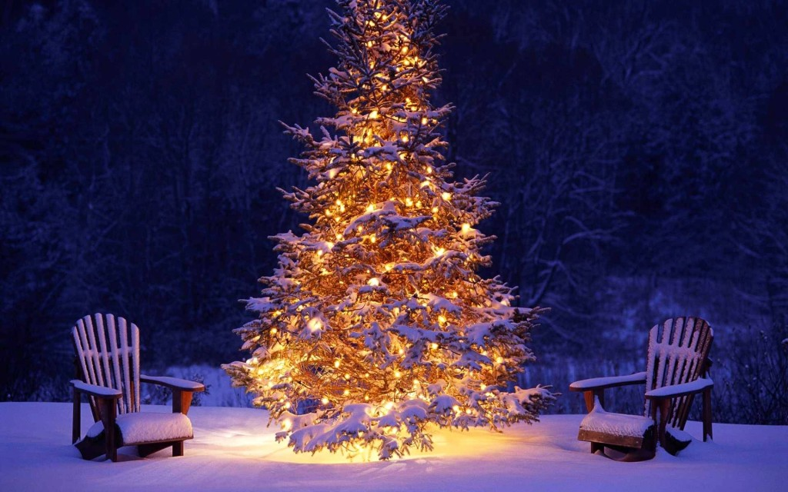
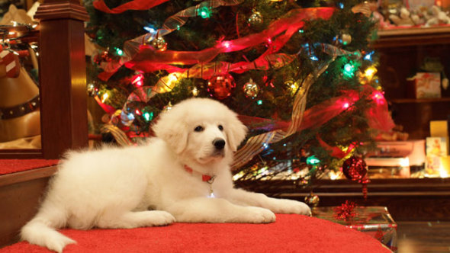
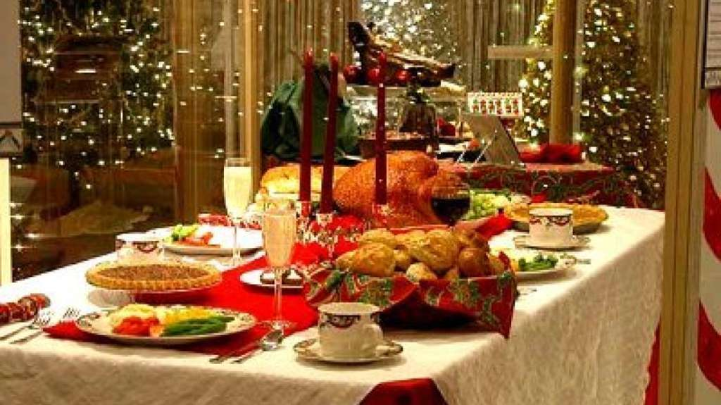
TRADITION
I’m very conservative, I love Christmas because in this period
It often snows and I celebrate it with my
Family.

Slide 14
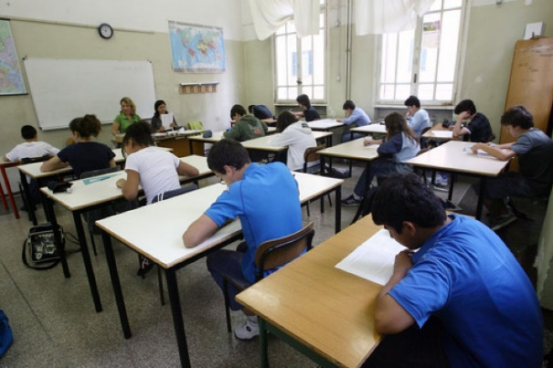
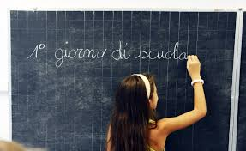
SCHOOL
School si very important for our present and
future life and it is an opportunity to meet
our friends.

Slide 15
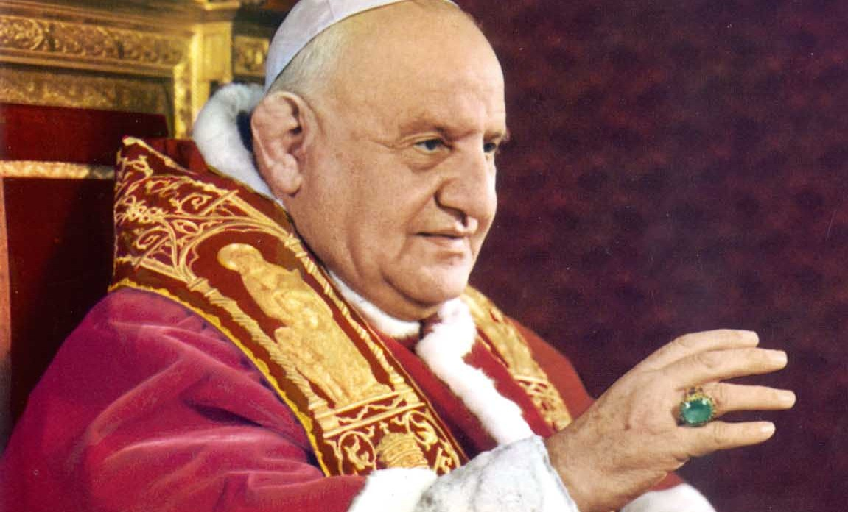
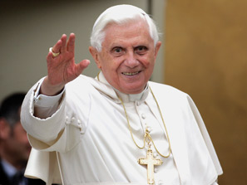
RELIGION

Slide 16
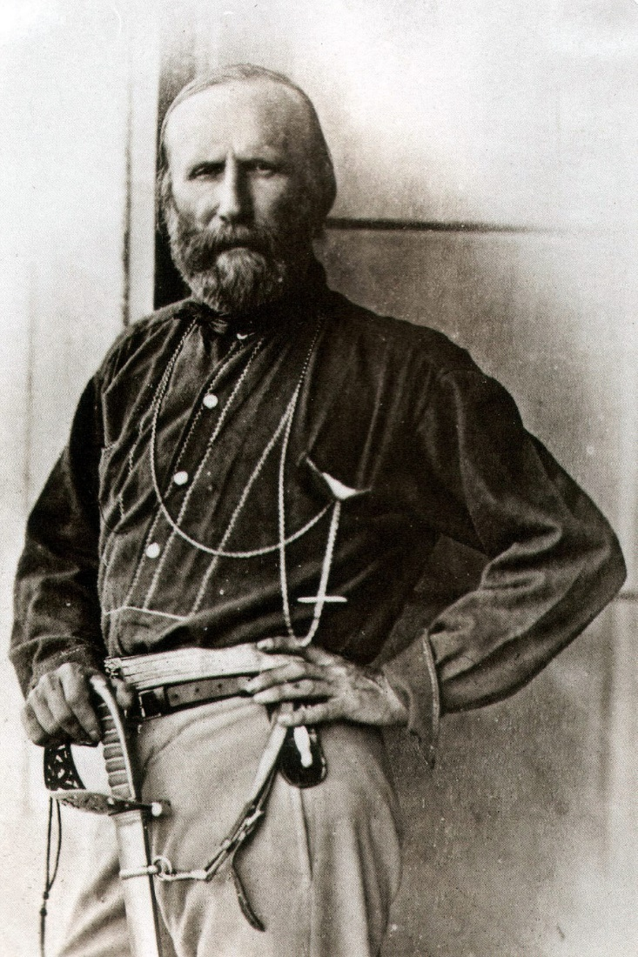
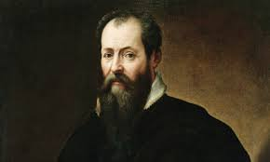
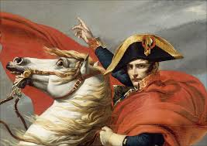
HISTORY
I don’t like studying history but
it is very important to know
what happened in the past.

