Slide 1
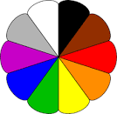
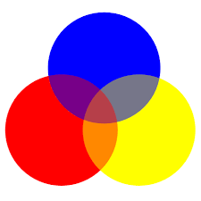
Colours

Slide 2
Red

Slide 3
White

Slide 4
yellow

Slide 5
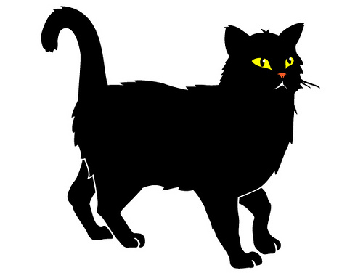
black

Slide 6
Pink

Slide 7
grey

Slide 8
Purple

