Slide 1
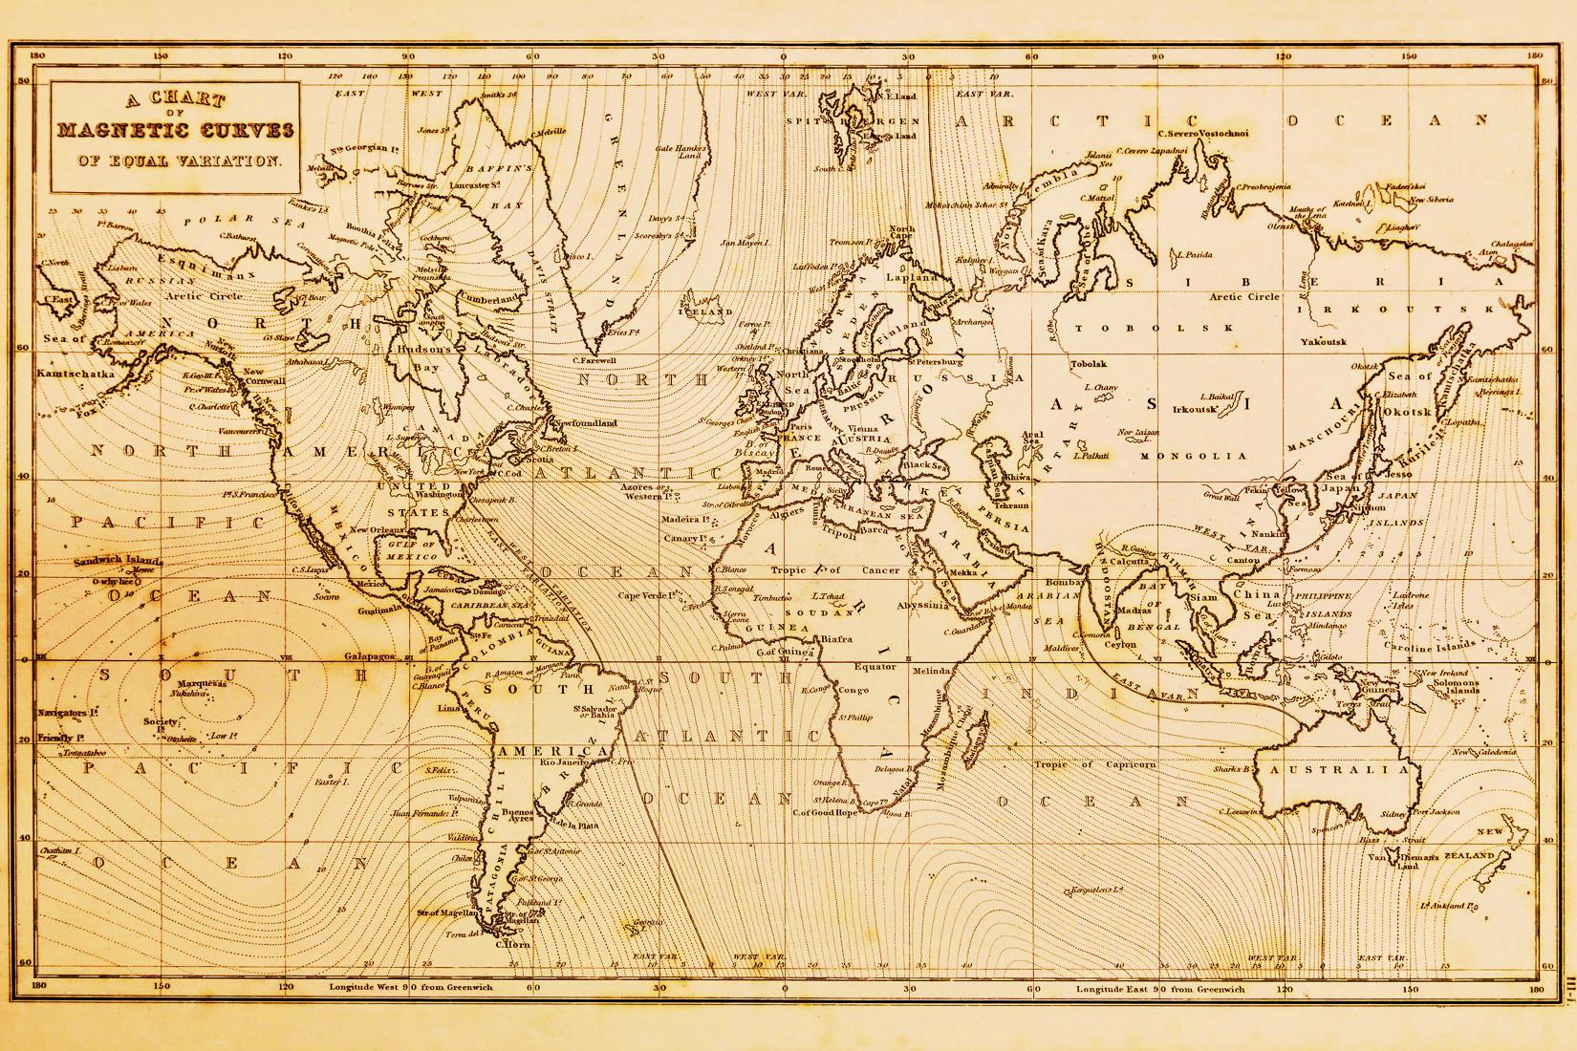
Odysseus, the first immigrant

Slide 2
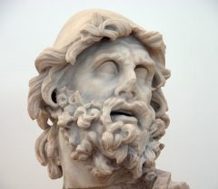
At first glance, one can say that the well-known epic of Homer, Odyssey it’s nothing but fiction and Odysseus just another fictional character.
Instead, if we change our viewpoint we could see that the story of Odysseus might have a lot in common with a modern society IMMIGRANT.

Slide 3
Odysseus’ route and the places where he came across with enemies, fictional characters etc.

Slide 4
By taking a close look at the map, we can see Odysseus’ journey across the Mediterranean Sea. Like all immigrants he also travelled through a plethora of different places and countries, having however as a main goal to return to his homeland. Throughout his journey, an immigrant might come across obstacles that prevent them from obtaining their main goal.

Slide 5
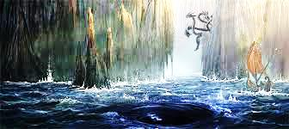
Such obstacles might be racism for example. When not being accepted in a society, it becomes instantly impossible for someone to achieve anything. It could be argued that these kind of problems also exist in Odyssey. All the mythological monsters that stand in Odysseus’ way could be a metaphor for all modern society’s issues that an immigrant has to deal with.

