Slide 1
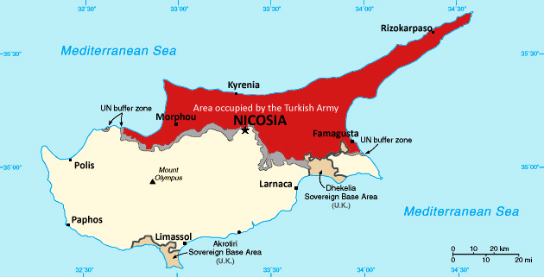
TURKISH INVASION 1974

Slide 2
20 July 1974 Turkish invasion divides Cyprus

Slide 3
200 000 REFUGEES

Slide 4
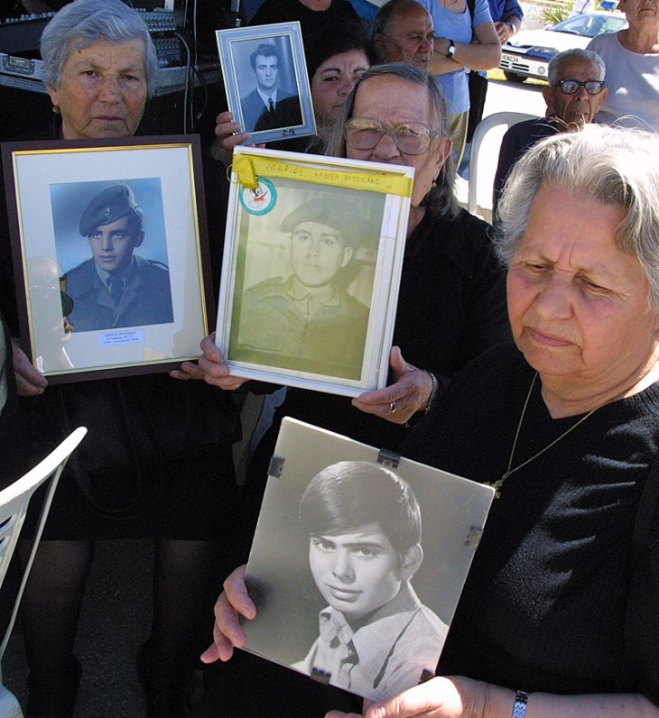
1619
MISSING PEOPLE

Slide 5
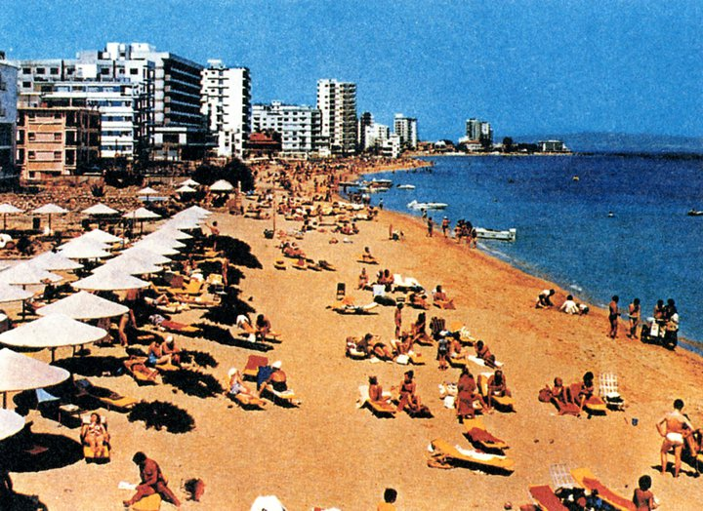
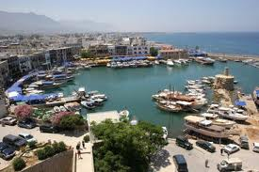
TWO BEAUTIFUL TOWNS
Famagusta
Kerynia
-*

Slide 6
Famagusta
“ Ghost City ” since 1974

Slide 7
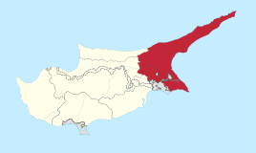
East side of Cyprus
It is called also the City of the windmills.
It was called Famagusta due to its reputation

Slide 8
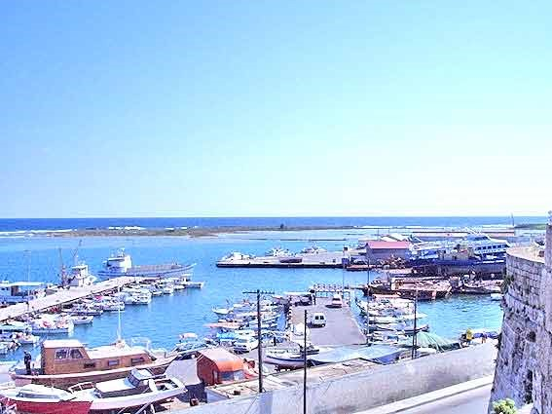
Λιμάνι της Αμμοχώστου
Famagusta Port
It was first built in 1932.
It helped in the development of the city and in general of the whole island.
The largest part of exports and imports as carried out through its port Famagusta.

Slide 9
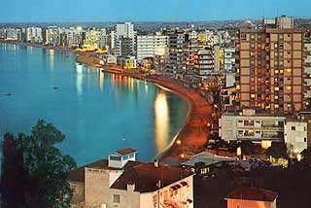
Τουρισμός
Tourism in 1974
Ο τουρισμός
ήταν η κυριότερη
πηγή πλούτου
για την πόλη
μετά που η Κύπρος κέρδισε την Ανεξαρτησία.
In 1974 the town had 10,331 tourist beds.

Slide 10
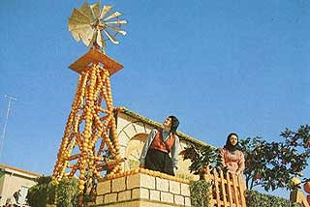
Orange Fiesta
It was done every spring and Famagusta was in joy.
You could see everywhere the orange trees and the green Flags swinging gracefully
At night the streets were lightened and decorated with arrangements made by oranges and lemons.

Slide 11
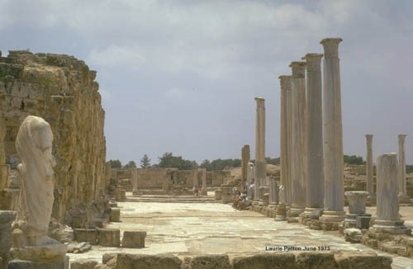
Ancient Salamina
The Founder of Ancient Salamina was Tefkros, who was coming from Salamina Island in Greece.
At the old times, Salamina was the Centre of Hellenism in Eastern Mediterranean
Many Tourists went there to admire its ancient monuments and the ancient tragedies that were coming up.

Slide 12
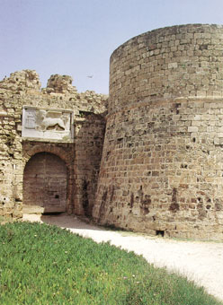
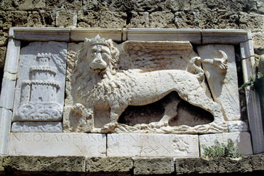
Othellos Tower
It dates back to the 14th century
It’s a square castle with four circular towers at its corners.
Above the gate is built-in marble plaque with the Venetian winged lion.
The castle is surrounded by a ditch.
From this castle a jetty began which protected the harbor.

Slide 13
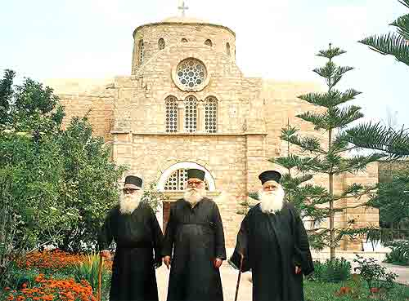
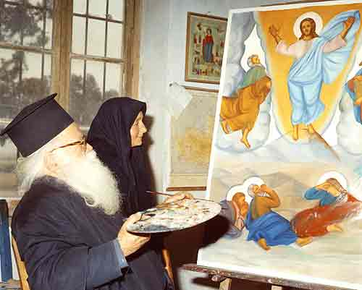
Saint Varnava Monastery
Three monk brothers were living at the monastery for many years: f. Stephanos, f. Varnavas and f. Charitonas.
They were taking care of the monastery and they were operating the church and cultivating their fields.
They were all very good hagiographers.

Slide 14
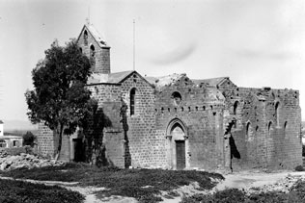
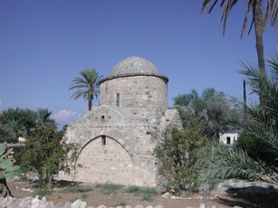
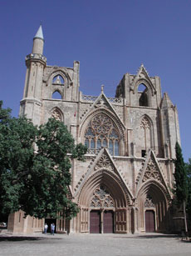
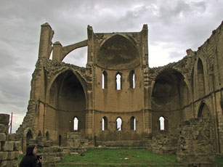
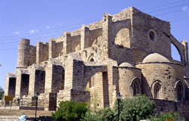
Churches of Famagusta
In Famagusta there were 365 churches that gave the opportunity to the people to visit each day a different church.
St. George Exorinou
St. Anna
St. Nicholas
St. George of the Greeks
St. Peter and Paul

Slide 15
KERYNIA
THE «BEAUTIFUL DAUGHTER» OF NORTH
Sunny beaches
Old pits
Monastery
castles
Narrow alleys

Slide 16
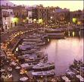
MOYNTAIN AND SEA
Sunny beaches
The Graphic Harbor

Slide 17
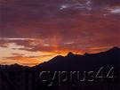
Pentadahtylos “Fivefinger” Mountain Range
It is the 2nd highest mountain Range in Cyprus after Troodos
It is connected with the legend of Digeni Akrita.

Slide 18
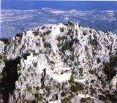
Voufavento
It is located in one of the mountain tips of Pentadaxtylos FiveFinger Mountain Range.
It is at 954 meters above sea level and at the top is the castle Voufavento or Koutsoventis or Leontos castle.
The castle was built during the 11th century from the emperor Alexio Momnino.

Slide 19
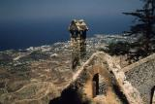
Saint Ilarionas
Saint Ilarionas castle was built by a queen of Cyprus who was the most beautiful woman of Cyprus but at the same time also the most heartless.
It is built at a 735 meter height at a place where Saint. Ilarionas the great was a monk during the 6th century a.c

Slide 20
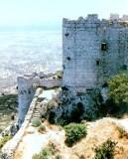
kantara
It is located in one of the mountain tips of Pentadahtylos Mountain Range.
It was built by the Byzantine.
The first time we heard about this castle was in 1191 a.c and it as used during many battles. From the castle you can see the north coast of Cyprus, the east Mesaoria and the Famagusta bay.

Slide 21
Kerynia Castle
It was built in 1208 from the Franks.
In the castle you can find the temple of Saint George.
There as well one can find the “Kerynia Boat” and many other archeological treasures of Cyprus.

Slide 22
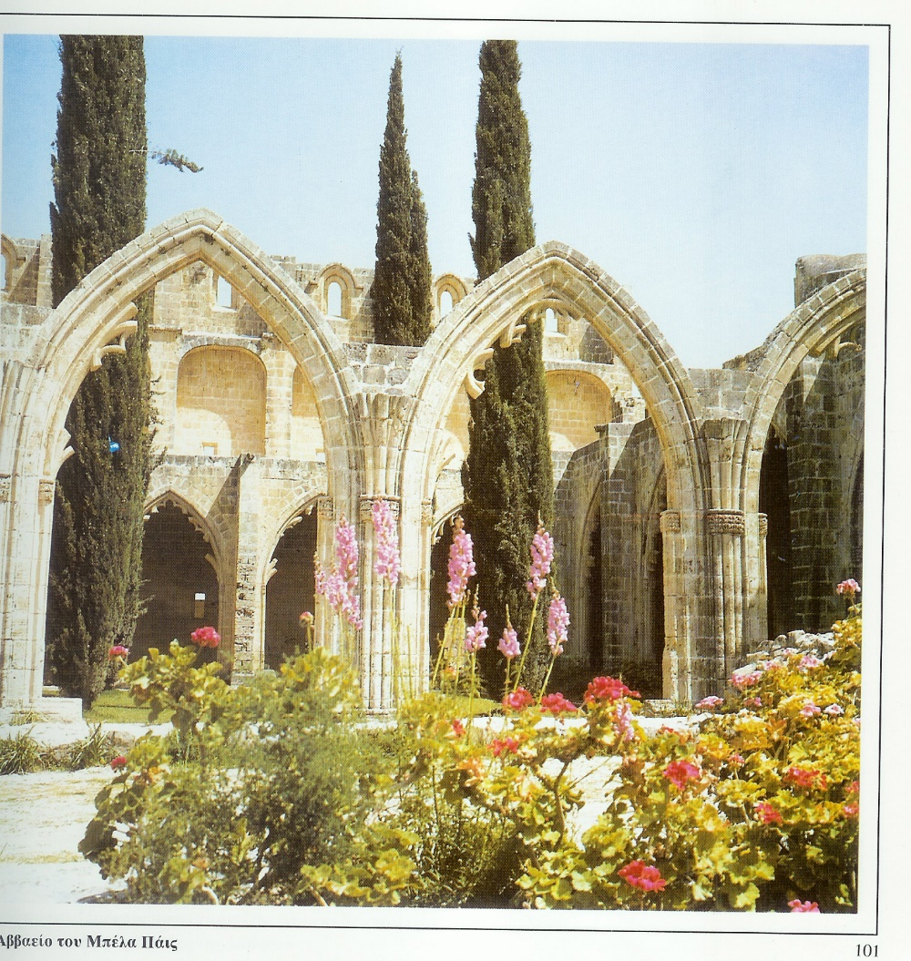
The Monastery of Bella Bais
The monastery of Irene was built in 13th Century during the Franks’ stay on the island.
The Church which is in the Monastery is dedicated to Saint Mary of Mount.
The Monastery is at the north side of the village on a high cliff. From that point the view is one of the kind.

