Slide 1
Personal trainer
Darwin Diaz Alvares
Pol Gutiérrez Casamián
Kevin Sanchez
Andreu Senent

Slide 2
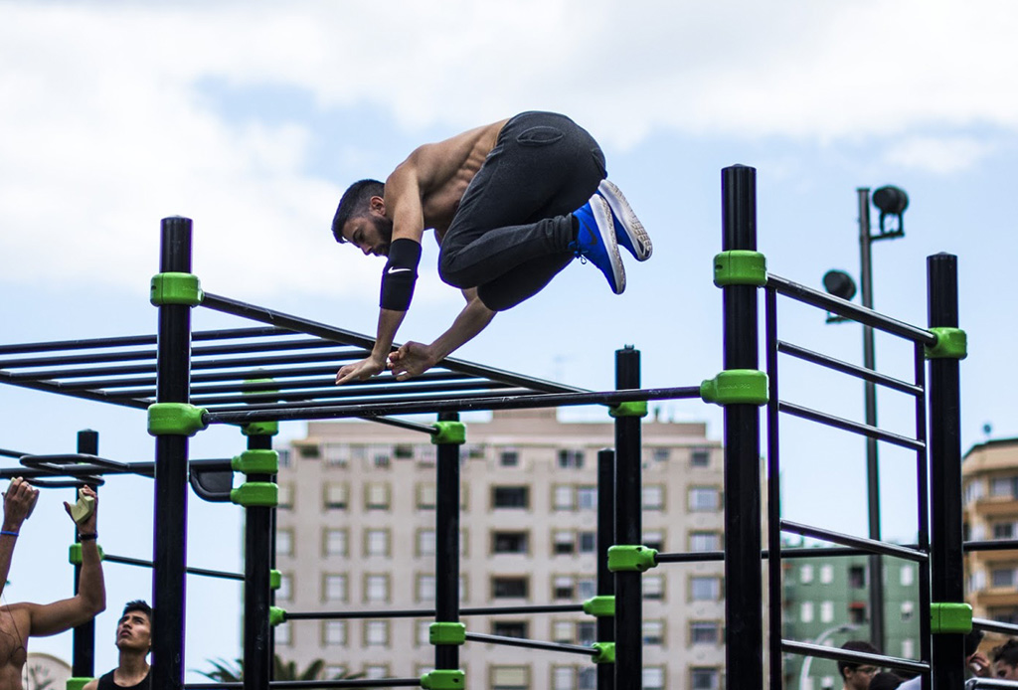
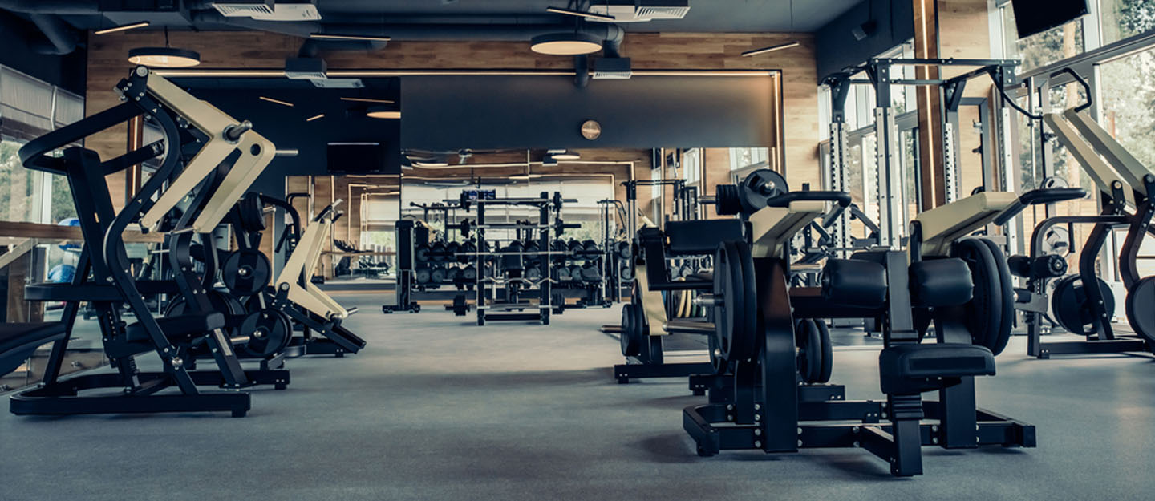
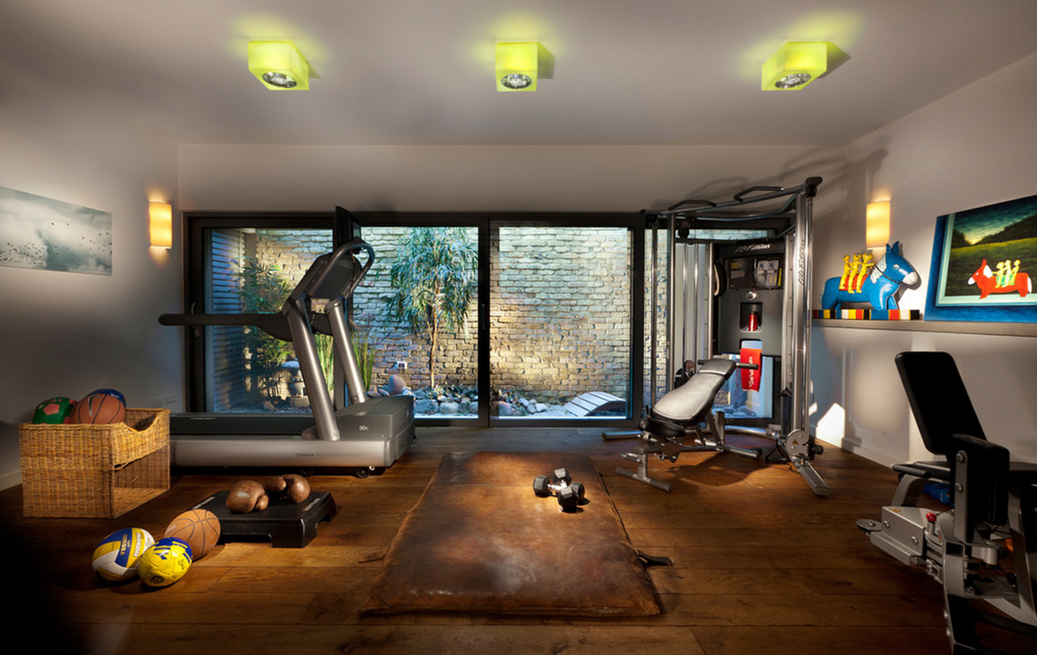
What and Where do we do?
on the street
in the gym
in your house

Slide 3
Why do we choose?
cardio Problem
busy people
without motivation
shy people
unexperimentated
nutritional counsery

Slide 4
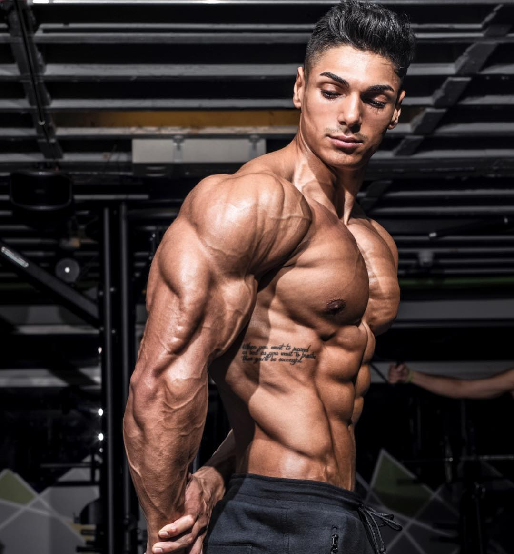
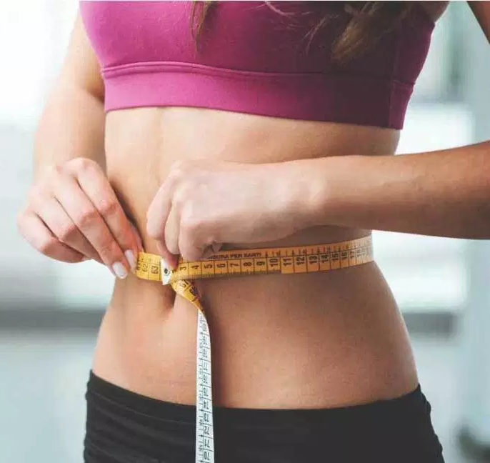
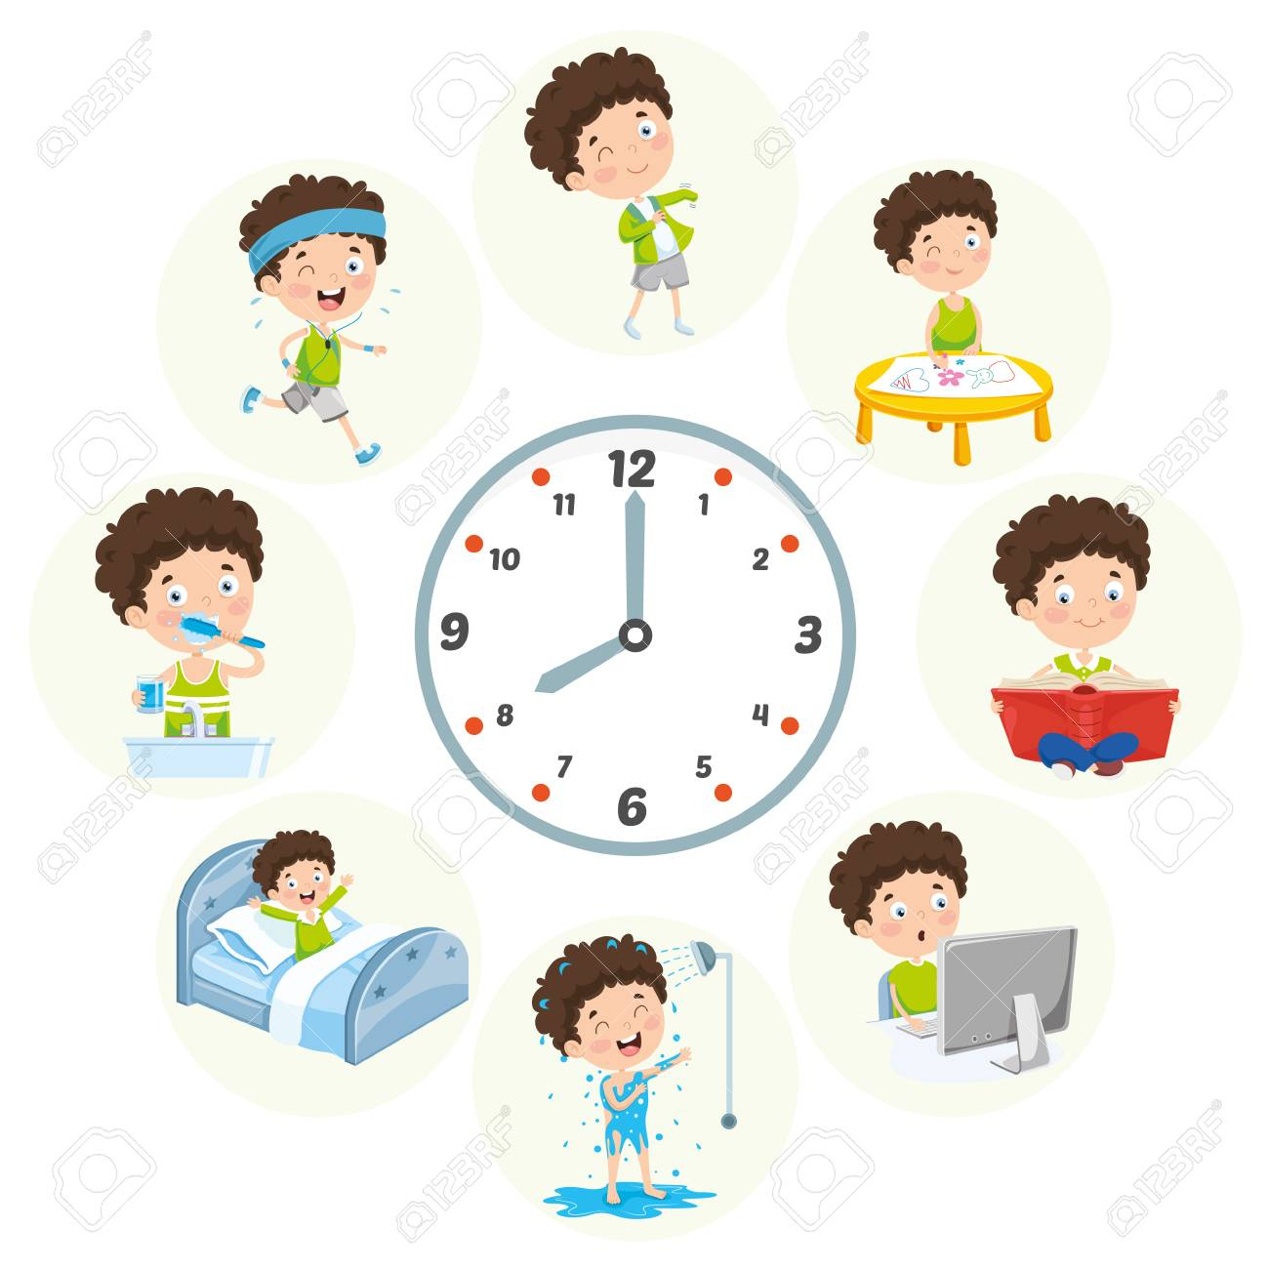
How do we help?
people many healthier
bodybuild
lose weight
routine
Notes:
Darwin

Slide 5
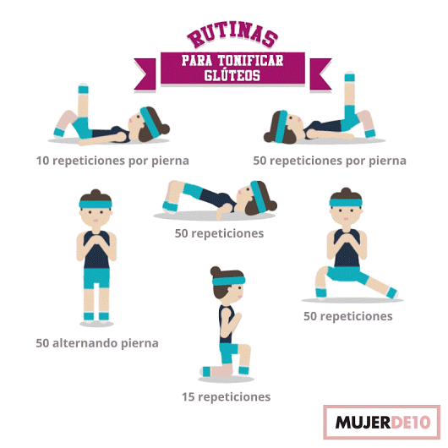
What is my service?
Nutricional Counsery
Table of exercise
Motivation

