Slide 1
Retail store of the future
Andrea Del Rio, Laura Aricapa, Ainhoa Argüello, Cristina Gonzalez, Samuel López.

Slide 2
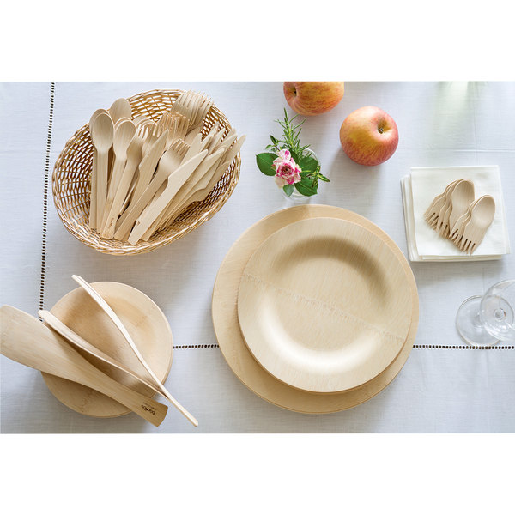
What?
BAMBU TABLEWARE

Slide 3
How?

Slide 4
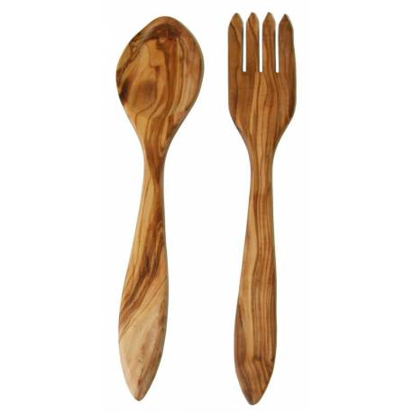
Why?

Slide 5
Where?

Slide 6
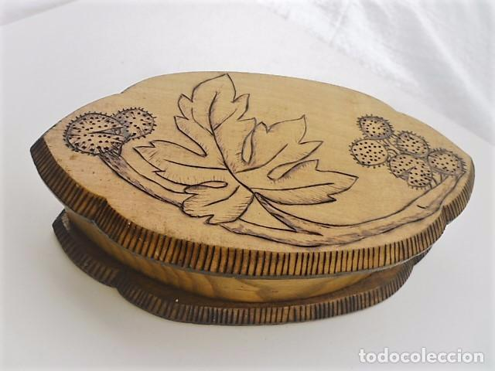
Others..

