Slide 1
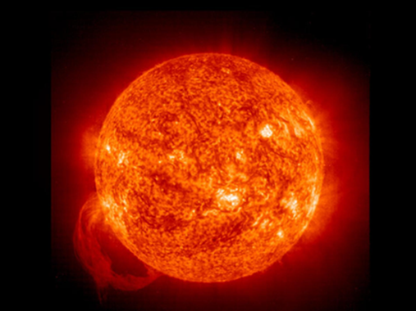

Slide 2
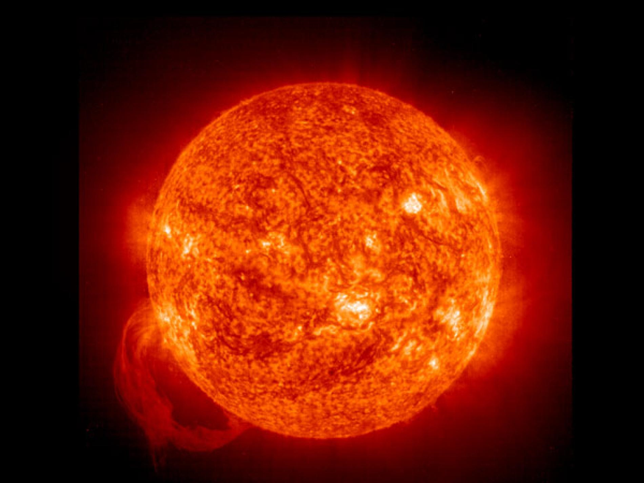
‘Mmmm,ıt is the Sun that gives out all that heat.But ıt seems very tiny.And How can it be possible that tiny thing can heat and light that huge Earth,He thought ’ It was after that day ,He started to observe the Sun.
The seasons followed each other.Summer ended,Autumn came;Autumn ended ,Winter came.It was getting colder and colder.And He was on the balcony again on a cold winter day.He looked at the Sun.
‘How can it be possible that the Sun which heats the Earth that much in the summer,cools it later,He thought’
After his observations,his interest in the Sun arised higher and higher.That’s why He started to search for it.
’In fact,The Sun doesn’t cool but just heats and it is not as tiny as I thought before.Even,it is 332.946 times bigger than the Earth.’Till here all these information was enough.But maybe later on He could be looking for some more.
‘The Sun is not a Planet but just a Star.He got very surprised for that.The Stars are the source of heat and light.Consequently,The Sun is counted as a Star.’He wanted to get more and more information about the Sun.So He decided to make a research about it in detail

Slide 3
.
The facts He got about the Sun
‘The Sun turns around its own orbit and completes its turning in 27 days.There are Stars bigger than The Sun.The Sun is the closest star to the Earth.It is 149 million km.away from The Earth.Its heat difference between inner and outer part is too much.Outer heat is 6.000 C and Inner heat is 15-20 million C …‘
He awared that He hadn’t known anything about the Sun before. He got ashamed of him.Because all these was short and to the point knowledge.He thought that He should have known about it.
Many years passed by,He grew up and He was on the 4th grade of Secondary school.He was very sucessful in his lessons,though.One day,their school manager called some students to come into his room and Adam Bright was one of them

Slide 4
He started his speech:
‘Well,You are all very successful students.So I want to award your success.You will all be visiting America for a month.There,You will visit the NASA or some other instıtudes alike.Please talk about it to your parents.’
He got so happy about that and He thought that He should have persuaded his mum and dad.Maybe ,He wouldn’t have a chance like that any more. The journey would be the next week. While He was looking out of the window to the moon, He thought how the Moon was so beautiful. He knew that the Moon reflected the Sun’s lights.The Sun was a fantastic star as a lantern that brightened his life.Before long,He was fast in sleep with all those things in his mind
They went to America a week later.They visited the NASA in America,first.And They had a lot of information about the Sun and the Planets,there.

Slide 6
PART 2 SOMETHING IS GOING WRONG
Adam Bright found an apartment close to the Nasa in a week and settled in a 2 + 1 house . In the meantime, it was two days before he started work. He did not know what to do. He was constantly facing the mirror, and He was preparing for speaking to the scientists.He spent his following two days talking and researching. In the end, He started to work. But He was disappointed. The conversation He had been working for days had gone wasted. Someone working there introduced the work place. He learned that his name was Jeffry and He called him Jeff in short. He was a friendly, nice man. His days were passing through searching other planets and searching what He was very curious about the Sun. He was learning more about the Sun every day.One day, Jeff called me. And He was very anxious, and said;

Slide 8
-‘Adam, you should come to the Big Telescope right now, hurry up!
-‘What’s going on? Won’t we have breakfast together , did you forget about it?’
The tone of his voice had thickened;
-‘Adam , it is not the order of the breakfast right now, come here quickly.’
He was very worried. He ran all the way and arrived at the Big Telescope. Jeff was also there. He looked too worried too. He already understood that there was something bad. Jeff, without giving him a chance to ask;
_‘Adam, something strange happens to the Sun. Help me, I don’t understand what is happening.
He looked straight into the Sun from the telescope.

Slide 9
_“Oh, my God!” “What’s that?” He said to himself.” The Sun is much closer to the World than ever. This can be even seen with the naked eyes. But no one could look at the Sun with sunglasses. Because the Sun looks brighter and the closer it gets to the world and the warmer the world gets.” Adam got in the car to get home right away. The inner of the car was too hot. He also couldn’t work his car. He was in a hurry. Adam talked to Jeff again. And He told him;
-‘We should start our research immediately ,the World is in danger.’
Jeff:

Slide 10
’-I know.This was because of the decrease in t2he life span of the Sun and a Supernova explotation somewhere around us
In fact,Jeff’s talk was not illogical to him.Because The Sun was 4.57 billion years old.The decrease in the life span of the Sun may have occured.Because It was too old.They made researches all year round.In the end,They observed that some gases in the Sun increased immediately and tried to find solutions for that.
One day,He got up again and heard screams coming outside.Besides,it was too hot. He suddenly went out.And saw that the houses,the cars were all in flames and the people were fast in running……
_“Oh, my God!” “What’s that?” He said to himself.” The Sun is much closer to the World than ever. This can be even seen with the naked eyes. But no one could look at the Sun with sunglasses. Because the Sun looks brighter and the closer it gets to the world and the warmer the world was.” Adam got in the car to get home right away. The interior of the car was very hot. He also couldn’t work his car. He was in a hurry. Adam talked to Jeff again. And He told him;
-‘We should start our research immediately ,the World is in danger.’
Jeff:

