Slide 1
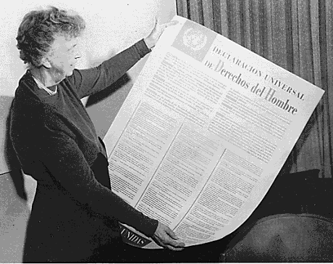
Human Rights Day by Jan W. 6d
10 December
72 anniversary of
In 1948 the United Nations General Assembly adopted the Universal Declaration of Human Rights.

Slide 2
72 anniversary of
Human Rights Day
The document proclaimed the rights which everyone is inherently entitled to as a human being - regardless of race, colour, religion, sex, language, political or other opinion, national or social origin, property, birth or other status.

Slide 3
72 anniversary of
Human Rights Day
We need to stand up for our own rights and those of others.
We can take action in our own daily lives, to protect us all and promote the kinship of all human beings.

Slide 4
Main Human Rights
WE HAVE THE RIGHT TO
FREEDOM EQUALITY PEACE
DIGNITY JUSTICE RELIGION
EDUCATION LEISURE

Slide 5
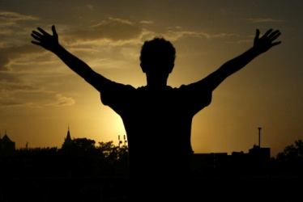
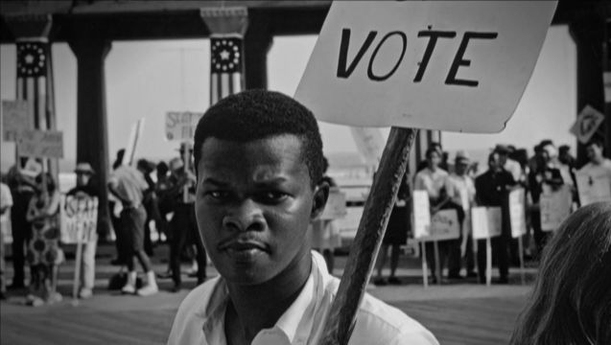
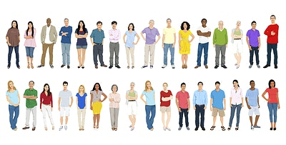
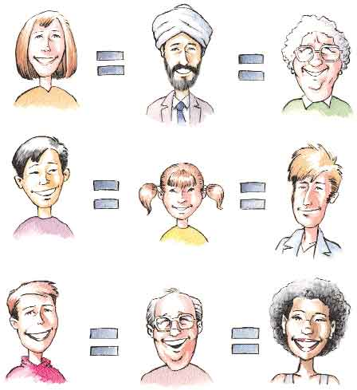
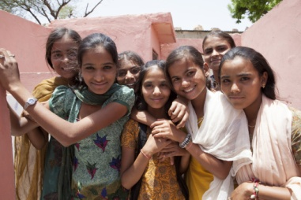
FREEDOM and EQUALITY
We are all born free with equal rights. No one has the right to hold us in slavery. We have the rights to:
- be free from discrimination - live in freedom and safety
- freedom of opinion and expression.

Slide 6
PEACE
Everyone has the right to seek and to enjoy in other countries asylum from persecution.

Slide 7
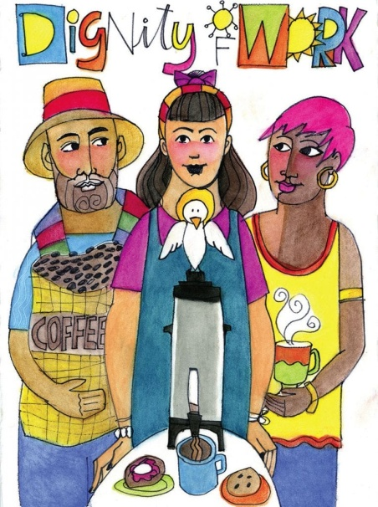
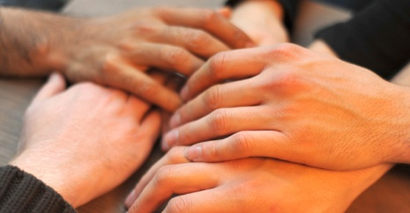
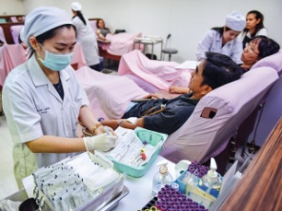
DIGNITY
Everyone has the right to a standard of living and well-being including foods, clothing, housing, medical care and social services. The right to security in the event of unemployment, sickness, disability, age or other lack of livelihood in circumstances beyond his control.

Slide 8
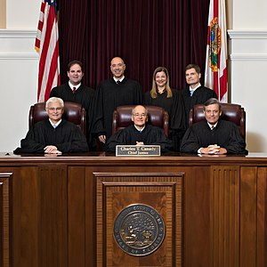
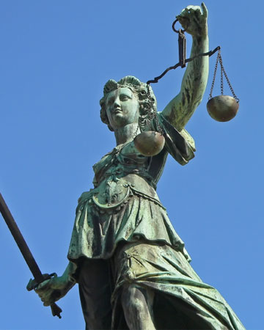
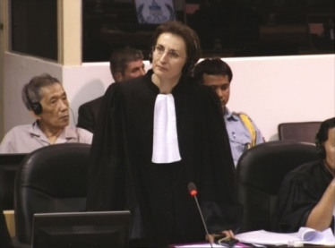
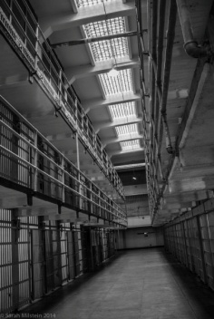
JUSTICE
We have the right to equal protection under the law. No one has the right to torture you. Everyone is innocent until proven guilty.

Slide 9
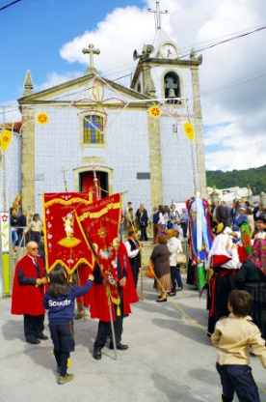
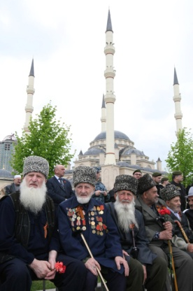
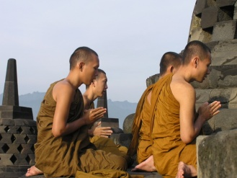
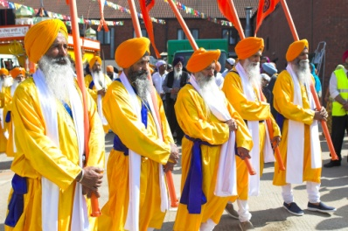
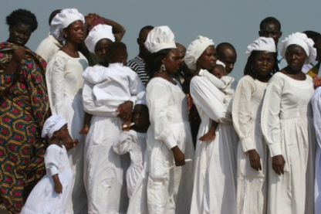
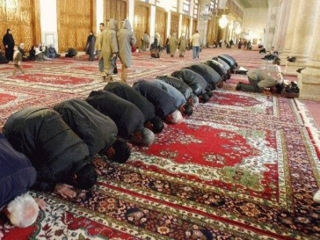
RELIGION
Everyone has the right to belong to a religion and freedom of thought. This right includes freedom to change his religion or belief or to manifest his religion in teaching, practice, worship.

Slide 10
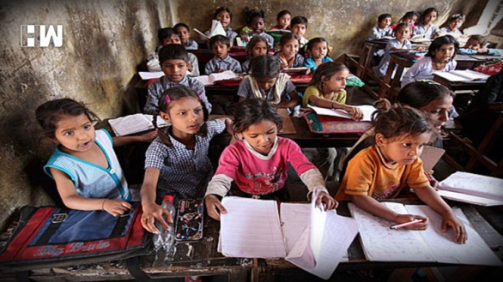
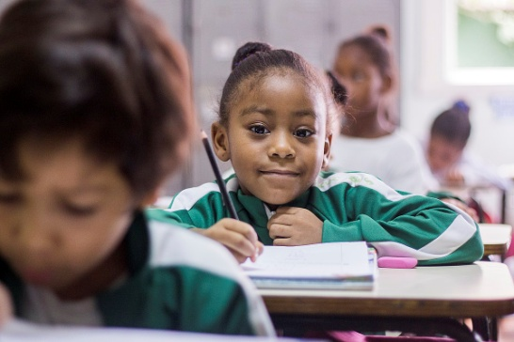
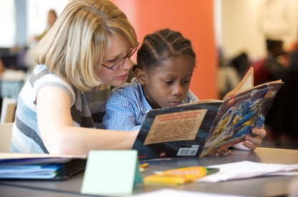
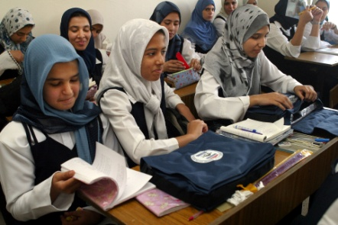
EDUCATION
Everyone has the right to education. It shall be free, at least in the elementary and fundamental stages. Elementary education shall be compulsory. Technical and professional education shall be made generally available and higher education shall be equally accessible to all.

Slide 11
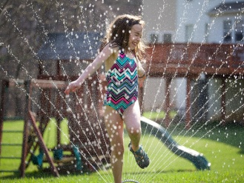
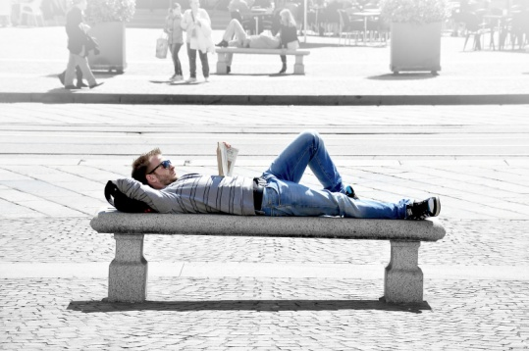
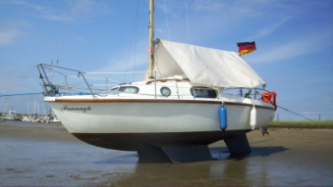
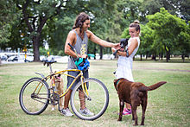
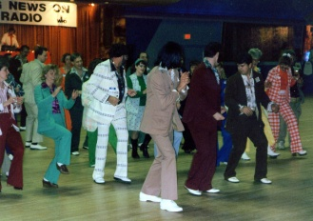
LEISURE
We have the right to rest from work and play.

