Slide 1
Human Rights Day
10th of December

Slide 2
The history of the Human Rights
The first document that we can define as a form of declaration of human rights was the Hammurabi Code. The Codex is considered one of the oldest codes in the world. It was written during the reign of King Hammurabi of Babylon around the 17th/17th century BC.
The first human rights were enshrined in the Rome Code, but only for selected (free) Citizens of Rome. This problem was also dealt with by Roman philosophers Aristotle and Cyeron.
The concept of human rights first appeared in the Normative Act in 1776, in virginia's Bill of Rights,
In 1215 the "Great Charter of Freedoms" was issued, signed by the English King John without Earth. According to its provisions, no one could be convicted or imprisoned without a court order
In 1948, the Universal Declaration of Human Rights (PDPC) was adopted. It initiated the codification process development of international human rights law. At the same time, the 'Declaration of Human and Citizen's Rights' was issued in France
On May 3, 1791, the first European Constitution was issued in Poland. It introduced freedom of religion, personal and property inviolability for the townspeople. All have been equated before the law.
At the San Francisco Conference, where the Charter of the United Nations was signed on June 26, 1945, nearly 40 National Organizations called for greater attention to be paid to respect for human rights.

Slide 3
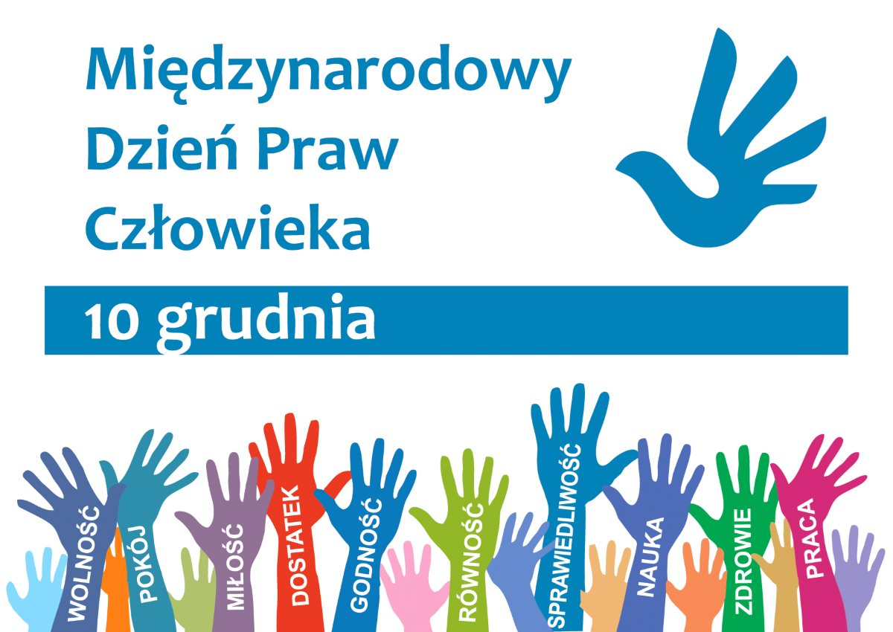
Divisions of the Human Rights
Individual rights
Inalienable rights
Natural rights
Universal rights
Fundamental rights
Non-transferable rights

Slide 4
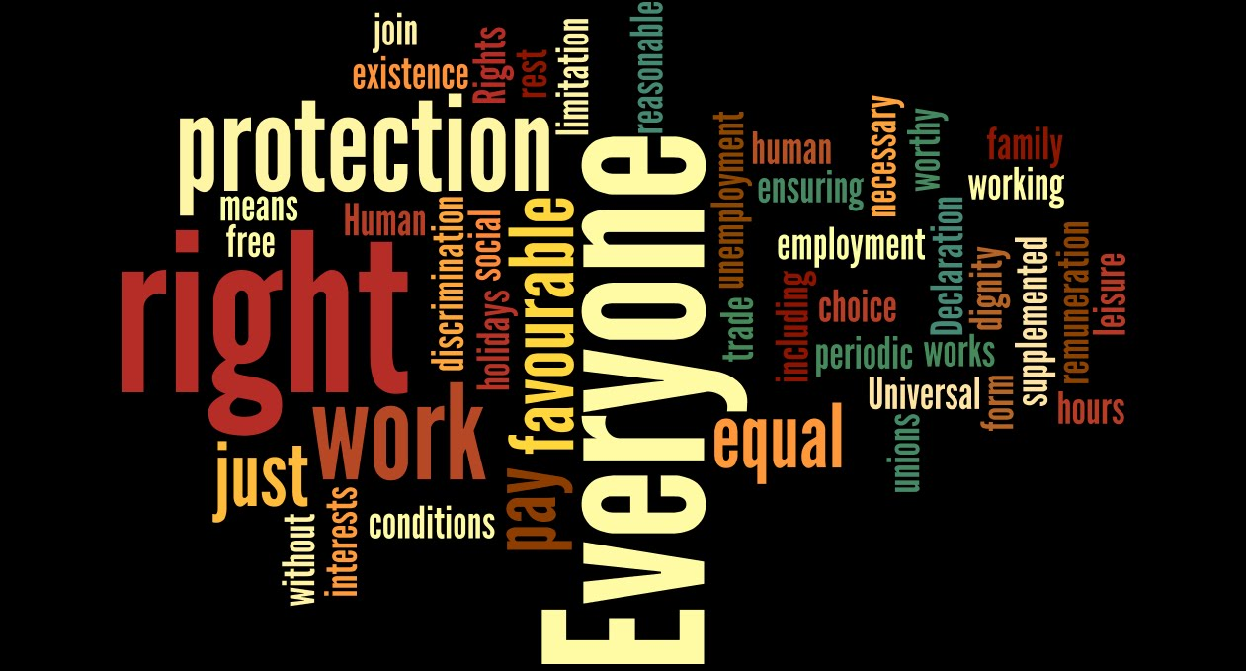
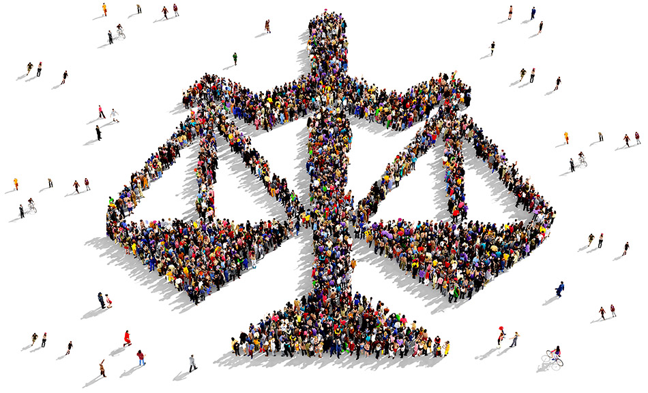
Basic human rights
I. Right to life.
II. Right to be free from torture.
III. Right to be free from slavery, servitude and forced labor.
IV. Right to property and security.
V. Right to privacy.
VI. Right to freedom of religion, thought and conscience.
VII. Right to a fair trial .
VIII. Right of association.

Slide 5
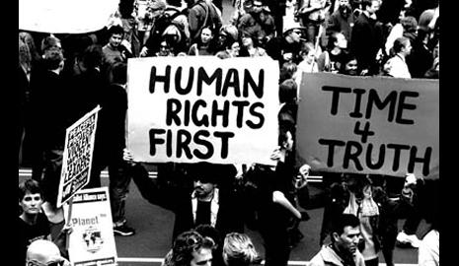
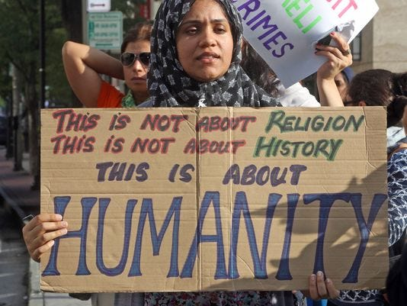
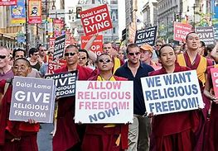
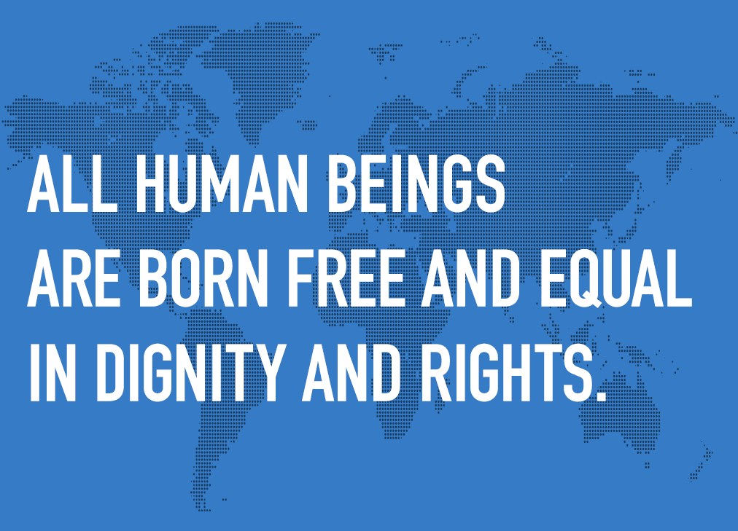
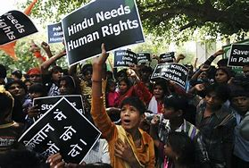
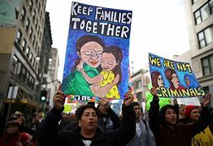
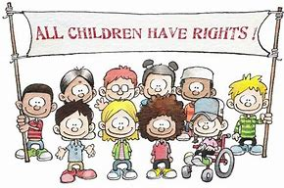
Fight for human rights

Slide 6
Human Rights Organizations
Amnesty International - investigates, documents and publishes reports on human rights violations around the world, take practical and effective action to stop violations and help victims;
International Human Rights Commission – organization dedicated to implementing the Universal Declaration of Human Rights at, regional, national and international levels organization;
Human Rights Watch - defence of freedom of expression and belief, combating censorship, ensuring the right of defendants to a fair trial and possible asylum, tackling political assassinations, protection of women's rights (including the right to abortion) and the rights of the child;
Helsinki Foundation for Human Rights - conducts educational programmes in the field of human rights protection, monitors the activities of the various institutions on which the level of the rule of law depends, conducts or joins legal proceedings, legal advice;
International Red Cross and Red Crescent Movement - 97 million volunteers in nearly every country in the world, protection of life and health, developing social assistance, constant willingness to provide assistance;
Council of Europe - promoting and protecting human rights, democracy and cooperation between Member States in the field of culture; Its seat is in Strasbourg;
European Convention on Human Rights - an international agreement on the protection of human rights concluded by the Member States of the Council of Europe.

Slide 7
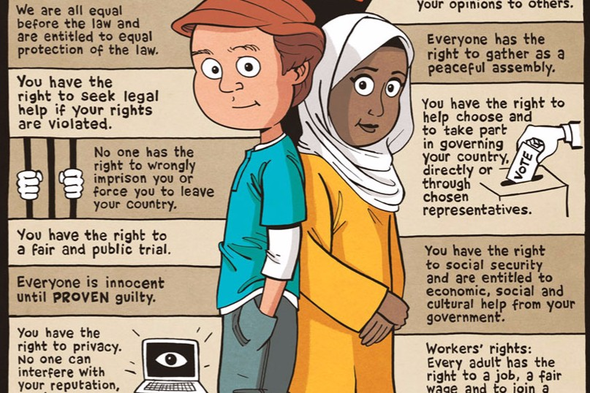

Slide 8
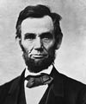
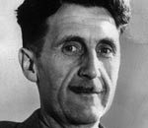
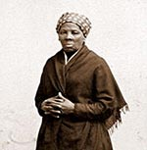
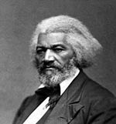
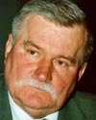
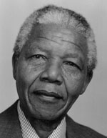
Famous human rights defenders
Abraham Lincoln
Harriet Tubman
Frederick Douglass
Nelson Mandela
Martin Luther King
Mikgail Gorbachev
William Wilberforce
Lech Wałęsa
Olaudach Equiano
George Orwell

Slide 9
Humans Rights Day
Human Rights Day is celebrated annually on 10 December. It is established by the UN General Assembly (Resolution 423 (V) of 1950) on the anniversary of the signing of the Universal Declaration of Human Rights in 1948.
This day is dedicated to human rights defenders around the world.
Many of them are persecuted, deprived of their jobs or wrongly imprisoned for their actions.
„When the lives of human rights defenders are threatened, the sense of security of all people is diminished.
When the voices of human rights defenders are drowned out, justice suffers”.
Ban Ki-moon - UN Secretary-General, 2010

Slide 10
Thank you
Zuzanna S. kl. 7d

