Slide 1
Human Rights Day
Bartosz C. kl. 7d

Slide 2
What are human rights?
Human rights are basic rights which we have because we exist as a human beings. For example freedom of speech.

Slide 3
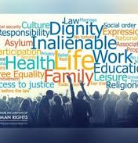
classification of human rights
Civil rights- pertains to rights belonging to a person by reason of citizenship for example right to name
Political rights- enables the people to particiapte in running the administration of teh governemt for example to right to vote
Economic rights- pertains to access to resources like money for exmaple right to work
Social rights- pertains to living together for example rights to social security
Cultural rights- the enjoyment of culture and its components in conditions of equality, human dignity for example right to take part in the cultura life

Slide 4
When we started to celebrate Human Rights Day?
We started celebrating human rights day in 1950 on the anniversary of the signing of the Universal Declaration of Human Rights in 1948. We celebrate it every year on December 10.

Slide 5
History of Human Rights Day
In 1948 the United Nations General Assembly entacted the Universal Declaration of Human Rights.
The formal begining of Human Rights Day dates in 1950, after the Assembly passed resolution 423(V) inviting all States and interested organisations to adopt 10 December of each year as Human Rights Day.

Slide 6
History of Human Rights (Ancient eras)
Some notions of human rights present in ancient law and religion are sometimes retrospectively included under the term "human rights".
The Northeast African civilization of Ancient Egypt supported basic human rights.

Slide 7
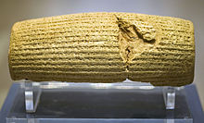
History of Human rights (antiquity)
Some historians suggest that the Achaemenid Persian EmpirE of ancient Iran established unprecedented principles of human rights in the 6th century BC under Cyrus the Great. After his conquest of the Neo-Babylonian Empire in 539 BC, the king issued the Cyrus cylinder, discovered in 1879 and seen by some today as the first human rights document.
The Cyrus Cilinder

