Slide 1
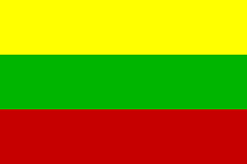
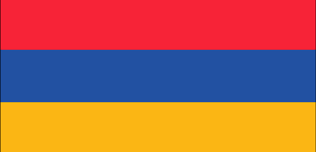
Maths around us eTwinning project
Historical Monuments of Greece
Junior High School of Simandra

Slide 2
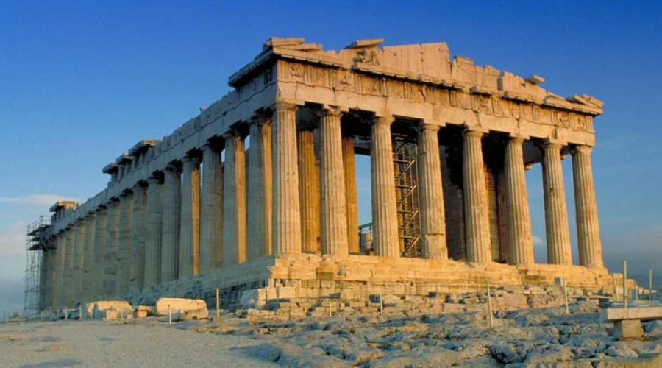
The Parthenon

Slide 3
The Parthenon
The Parthenon is a former temple on the Athenian Acropolis, Greece, dedicated to the goddess Athena, whom the people of Athens considered their patroness. Construction started in 447 BC when the Delian League was at the peak of its power. It was completed in 438 BC, although decoration of the building continued until 432 BC. It is the most important surviving building of Classical Greece, generally considered the zenith of the Doric order.
Source: https://en.wikipedia.org/wiki/Parthenon

Slide 4
Geometrical features

Slide 5
Lion Gate in Mycenae

Slide 6
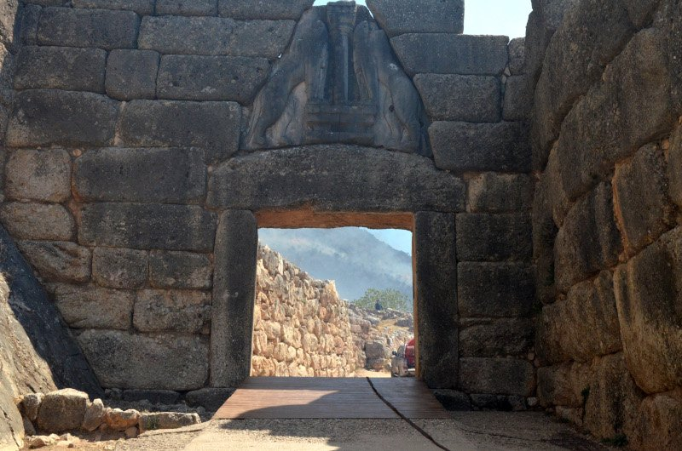
Mycenae

Slide 7
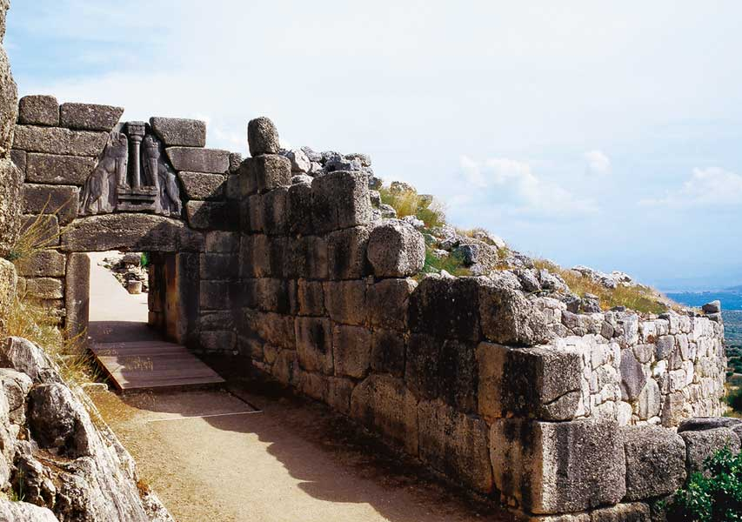
Lion Gate is the popular modern name for the main entrance of Mycenae in southern Greece. It was erected around 1250 BC in the northwestern side of the acropolis. In modern times, it was named after the relief sculpture of two lionesses in a heraldic pose that stands above the entrance.
Source: wikipedia

Slide 8
Geometrical features
The height EH is also
a median for the base DZ
and a bisector for the angle E.

Slide 9
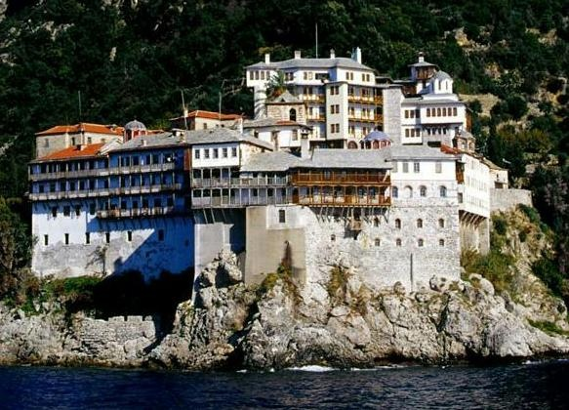
Gregoriou Monastery in Mount Athos

Slide 10
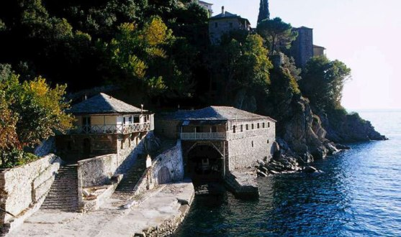
The Holy Monastery of Saint Gregory, also known as Gregoriou Monastery is an Orthodox Christian monastery in the monastic state of Mount Athos in Greece. The Monastery ranks seventeenth in the hierarchy of the Athonite monasteries. It is built by the sea, on the southeastern side of the peninsula. Gregoriou is very much a pilgrim friendly monastery with a strong sense of pastoral care. The Monastery is completely girt by the sea, built on a corner of land jutting into the sea, with only steep craggy rocks backed up behind it.
Source: wikipedia

Slide 11
Geometrical features

Slide 12
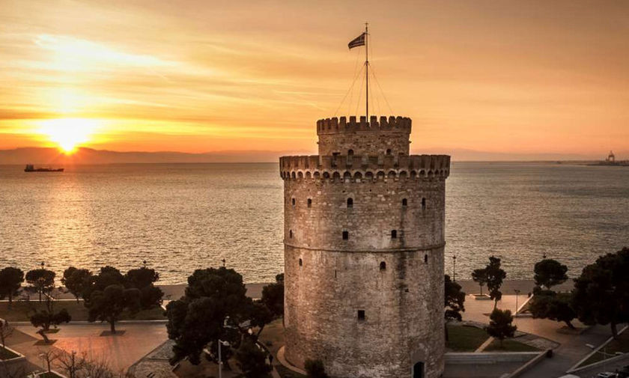
Τhe White Tower

Slide 13
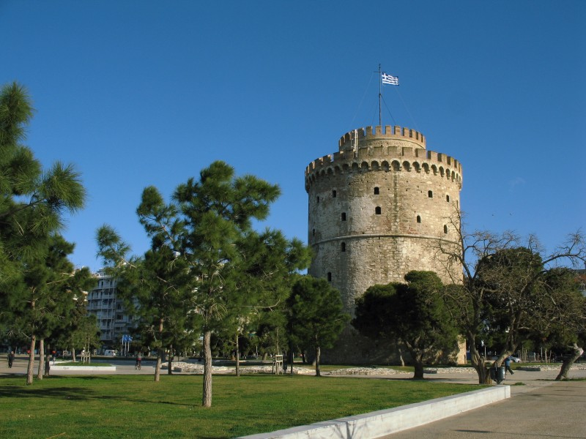
The White Tower of Thessaloniki is a monument and museum on the waterfront of the city of Thessaloniki, capital of the region of Macedonia in northern Greece. The present tower replaced an old Byzantine fortification, known to have been mentioned around the 12th century, that the Ottoman Empire reconstructed to fortify the city's harbour.
Source: wikipedia

Slide 14
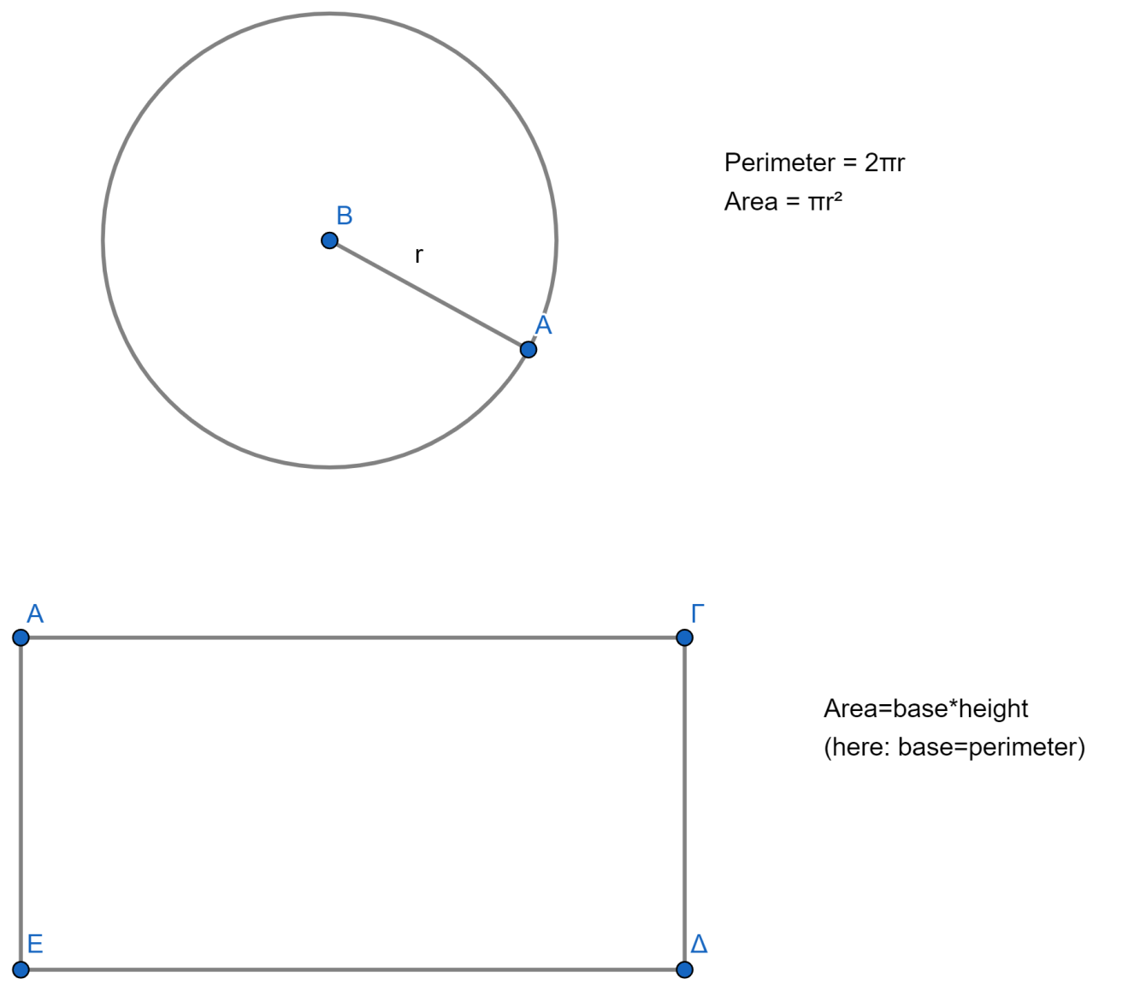
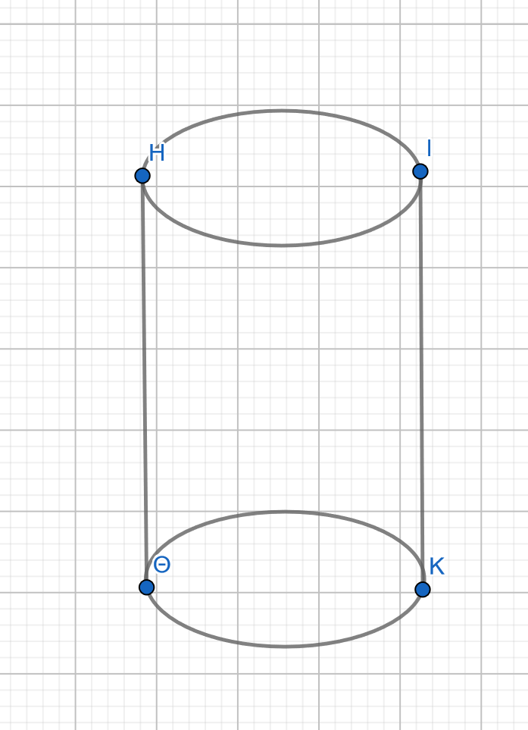
Geometrical features
Volume of a cylinder
V =π r² h

Slide 15
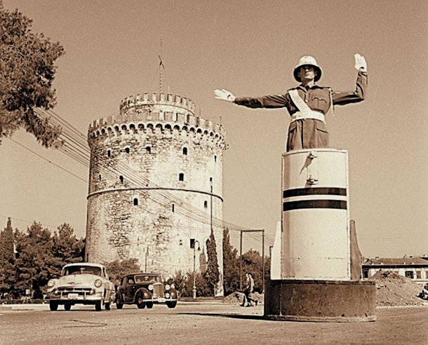

Slide 16
Rotunda

Slide 17
Rotunda
The Rotunda was a massive circular structure with a masonry core that had an oculus like the Pantheon in Rome. It has gone through multiple periods of use and modification as a polytheist temple, a Christian basilica, a Muslim mosque, and again a Christian church (and archaeological site). A minaret is preserved from its use as a mosque, and ancient remains are displayed on its southern side.
Source: wikipedia

Slide 18
Layout of the building

Slide 19
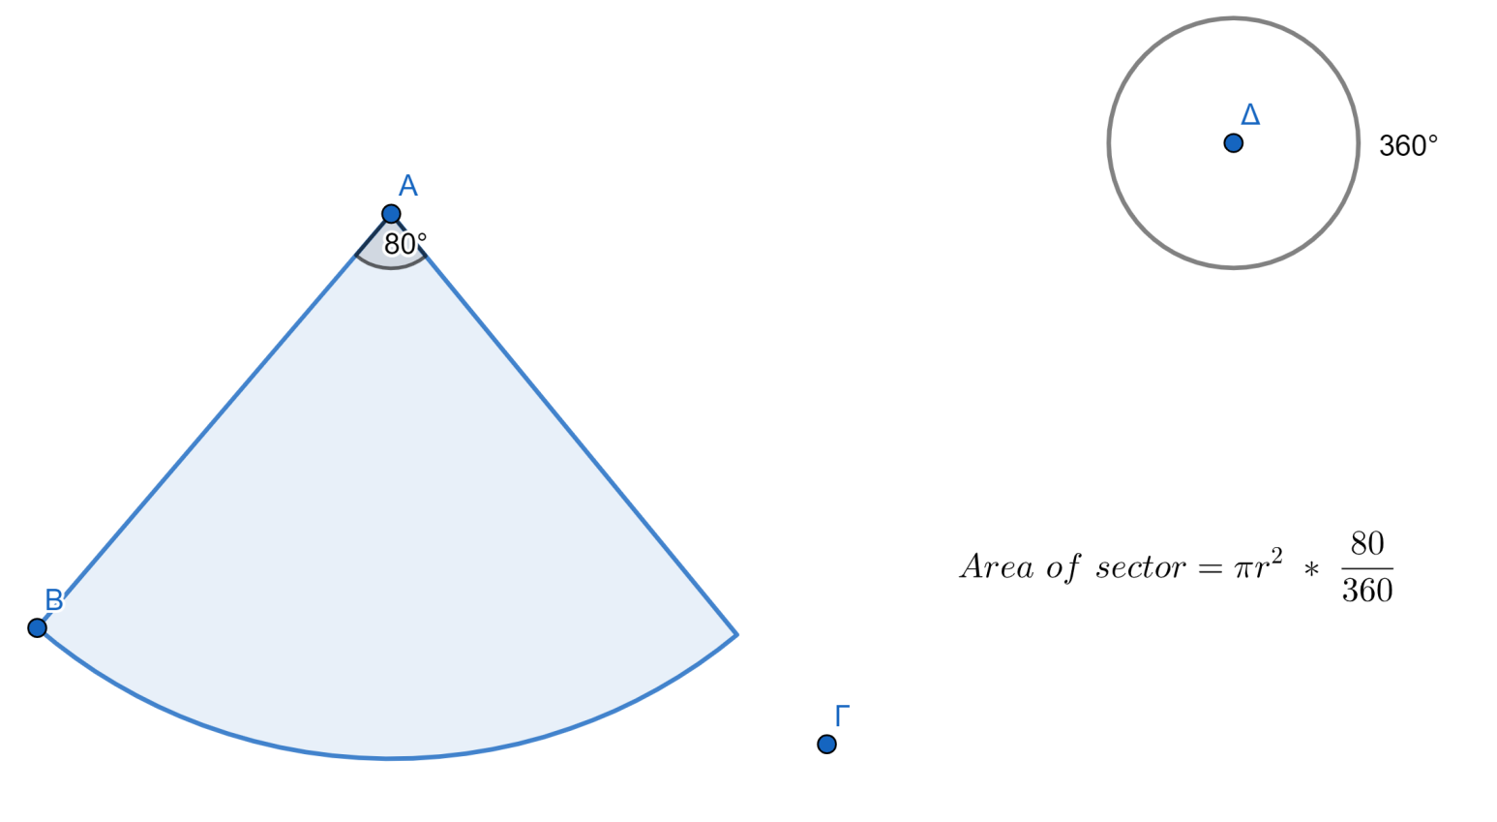
Geometrical features

Slide 20
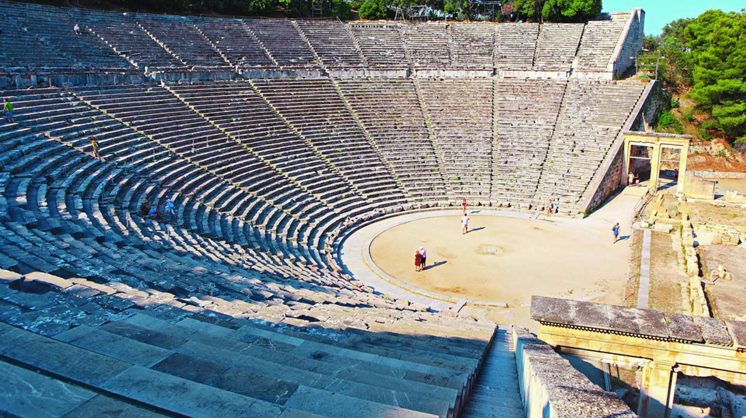
The Ancient Theatre of Epidaurus

Slide 21
The theatre of Epidaurus stands on a slope of Mount Kynortion in Argolis. The theatre was built in two phases: the first phase is dated to the late 4th c. BC and the second to the mid-2nd c. BC. As it is preserved today, the theatre presents the characteristic tripartite layout of Hellenistic theaters: cavea, orchestra and stage building. With a maximum capacity of 13,000 to 14,000 spectators, the theatre of Epidaurus hosted music competitions and performances of ancient drama.
Source: diazoma.gr

Slide 22
Layout of the theatre
cavea
orchestra
Stage building
Geometrical features:
of the orchestra: circle
of the stage building: rectangle
of the cavea: concentric semi-circles

Slide 23
Historical Monuments of Greece
Junior High School of Simandra
Thank you for watching!

