Slide 1
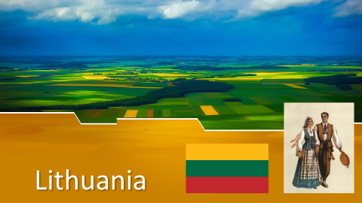

Slide 2
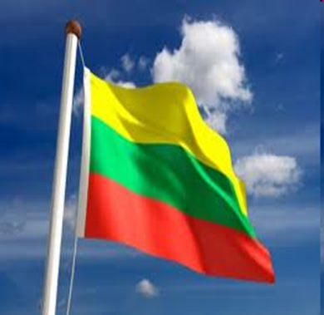
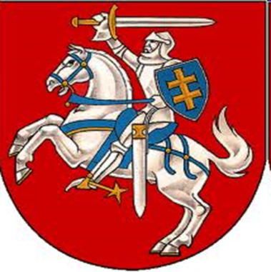
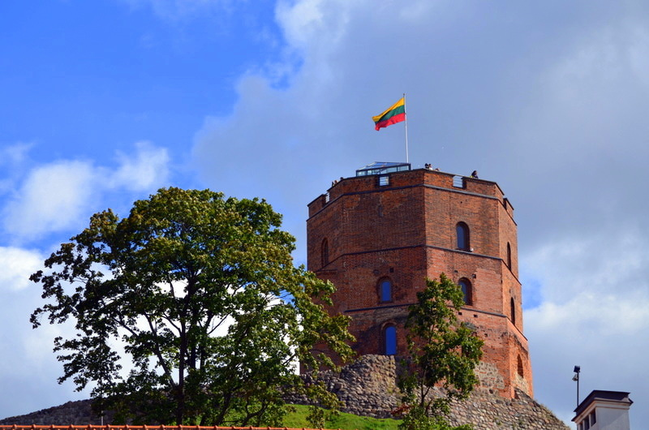
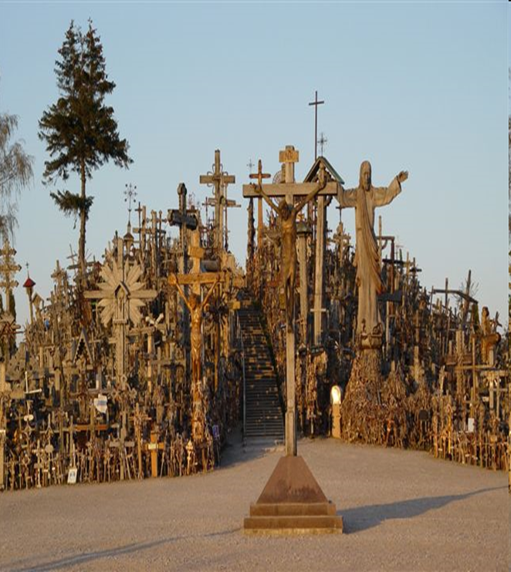
Facts about Lithuania
Lithuania (LIETUVA) – rain (LIETUS). As the name suggests, LIETUVA means “the place where it rains, rains and rains…”
Population: 2.8 million
Capital: Vilnius.
The Geographical Centre of Europe is 26 km to the North of Vilnius as it was found by The National Institute of Geography in France.
Lithuania was the first Soviet republic to declare independence from the Soviet Union, in 1990.
Gediminas Castle
The Hill of Crosses

Slide 3
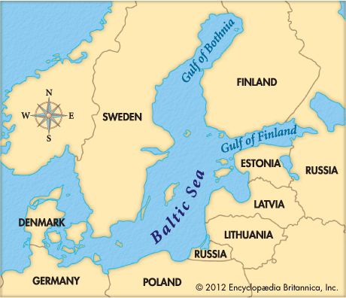
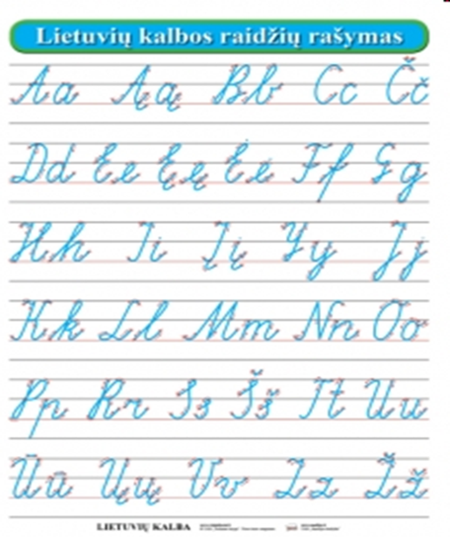
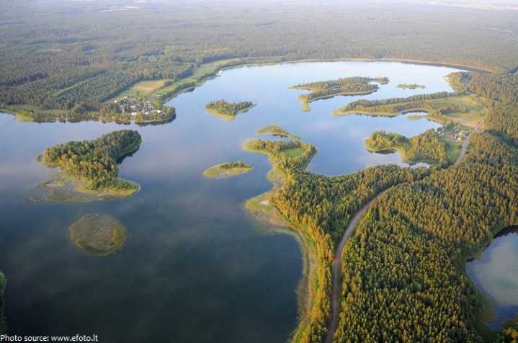
Lithuania joined the European Union on 1st May, 2004.
Lithuanian belongs to the family of Baltic languages. Currently there are only two Baltic languages spoken in the world: Lithuanian and Latvian. It is considered to be the oldest surviving Indo-European language and the nearest to Sanscrit.
Forests in Lithuania cover approximately 1/3 of the territory and there are over 4,000 lakes in the country.
Lithuania has 99 kilometers of sandy coastline.
Basketball is the most popular sport in Lithuania, called the second religion of the country.

