Slide 1
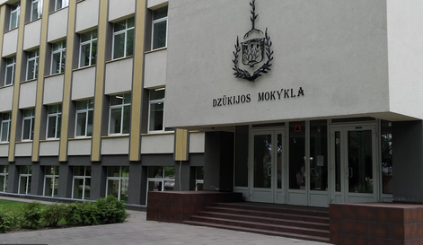
Alytus Dzūkija School
by Smiltė Jieznytė

Slide 2
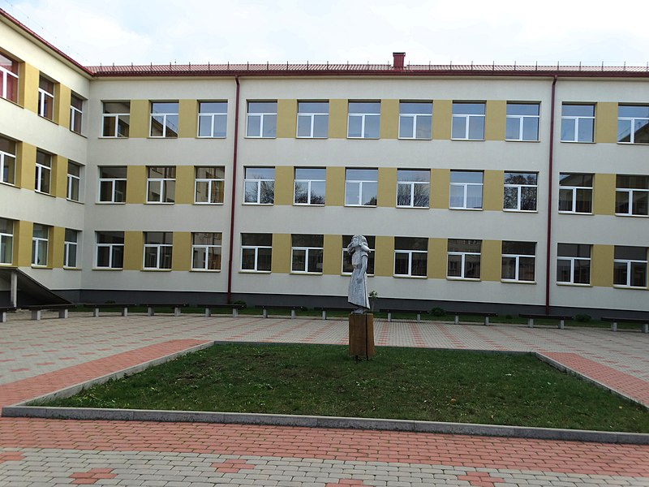
Facts about school
The school is 102 years old.
The school has got about 600 students.
In the school you can learn 4 languages: Lithuanian, English, French and Russian.
The school has got primary and lower-secondary classes.
There are 3 floors.

Slide 3
Building
Our school has got:
a lot of classrooms,
a library,
a canteen
an assembly hall,
a gym,
a football field,
playgrounds

Slide 4
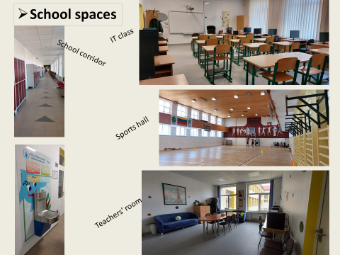

Slide 5
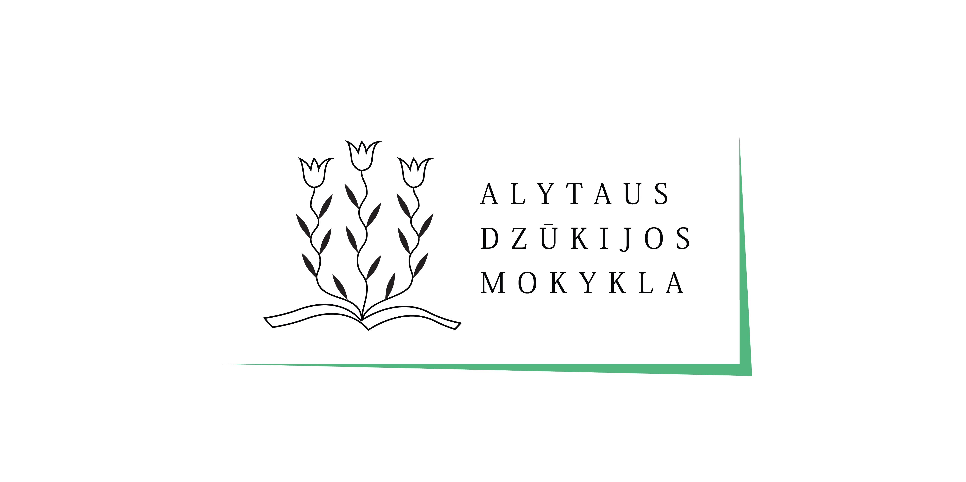
Alytus Dzūkija School is a good place to study!

