Slide 1
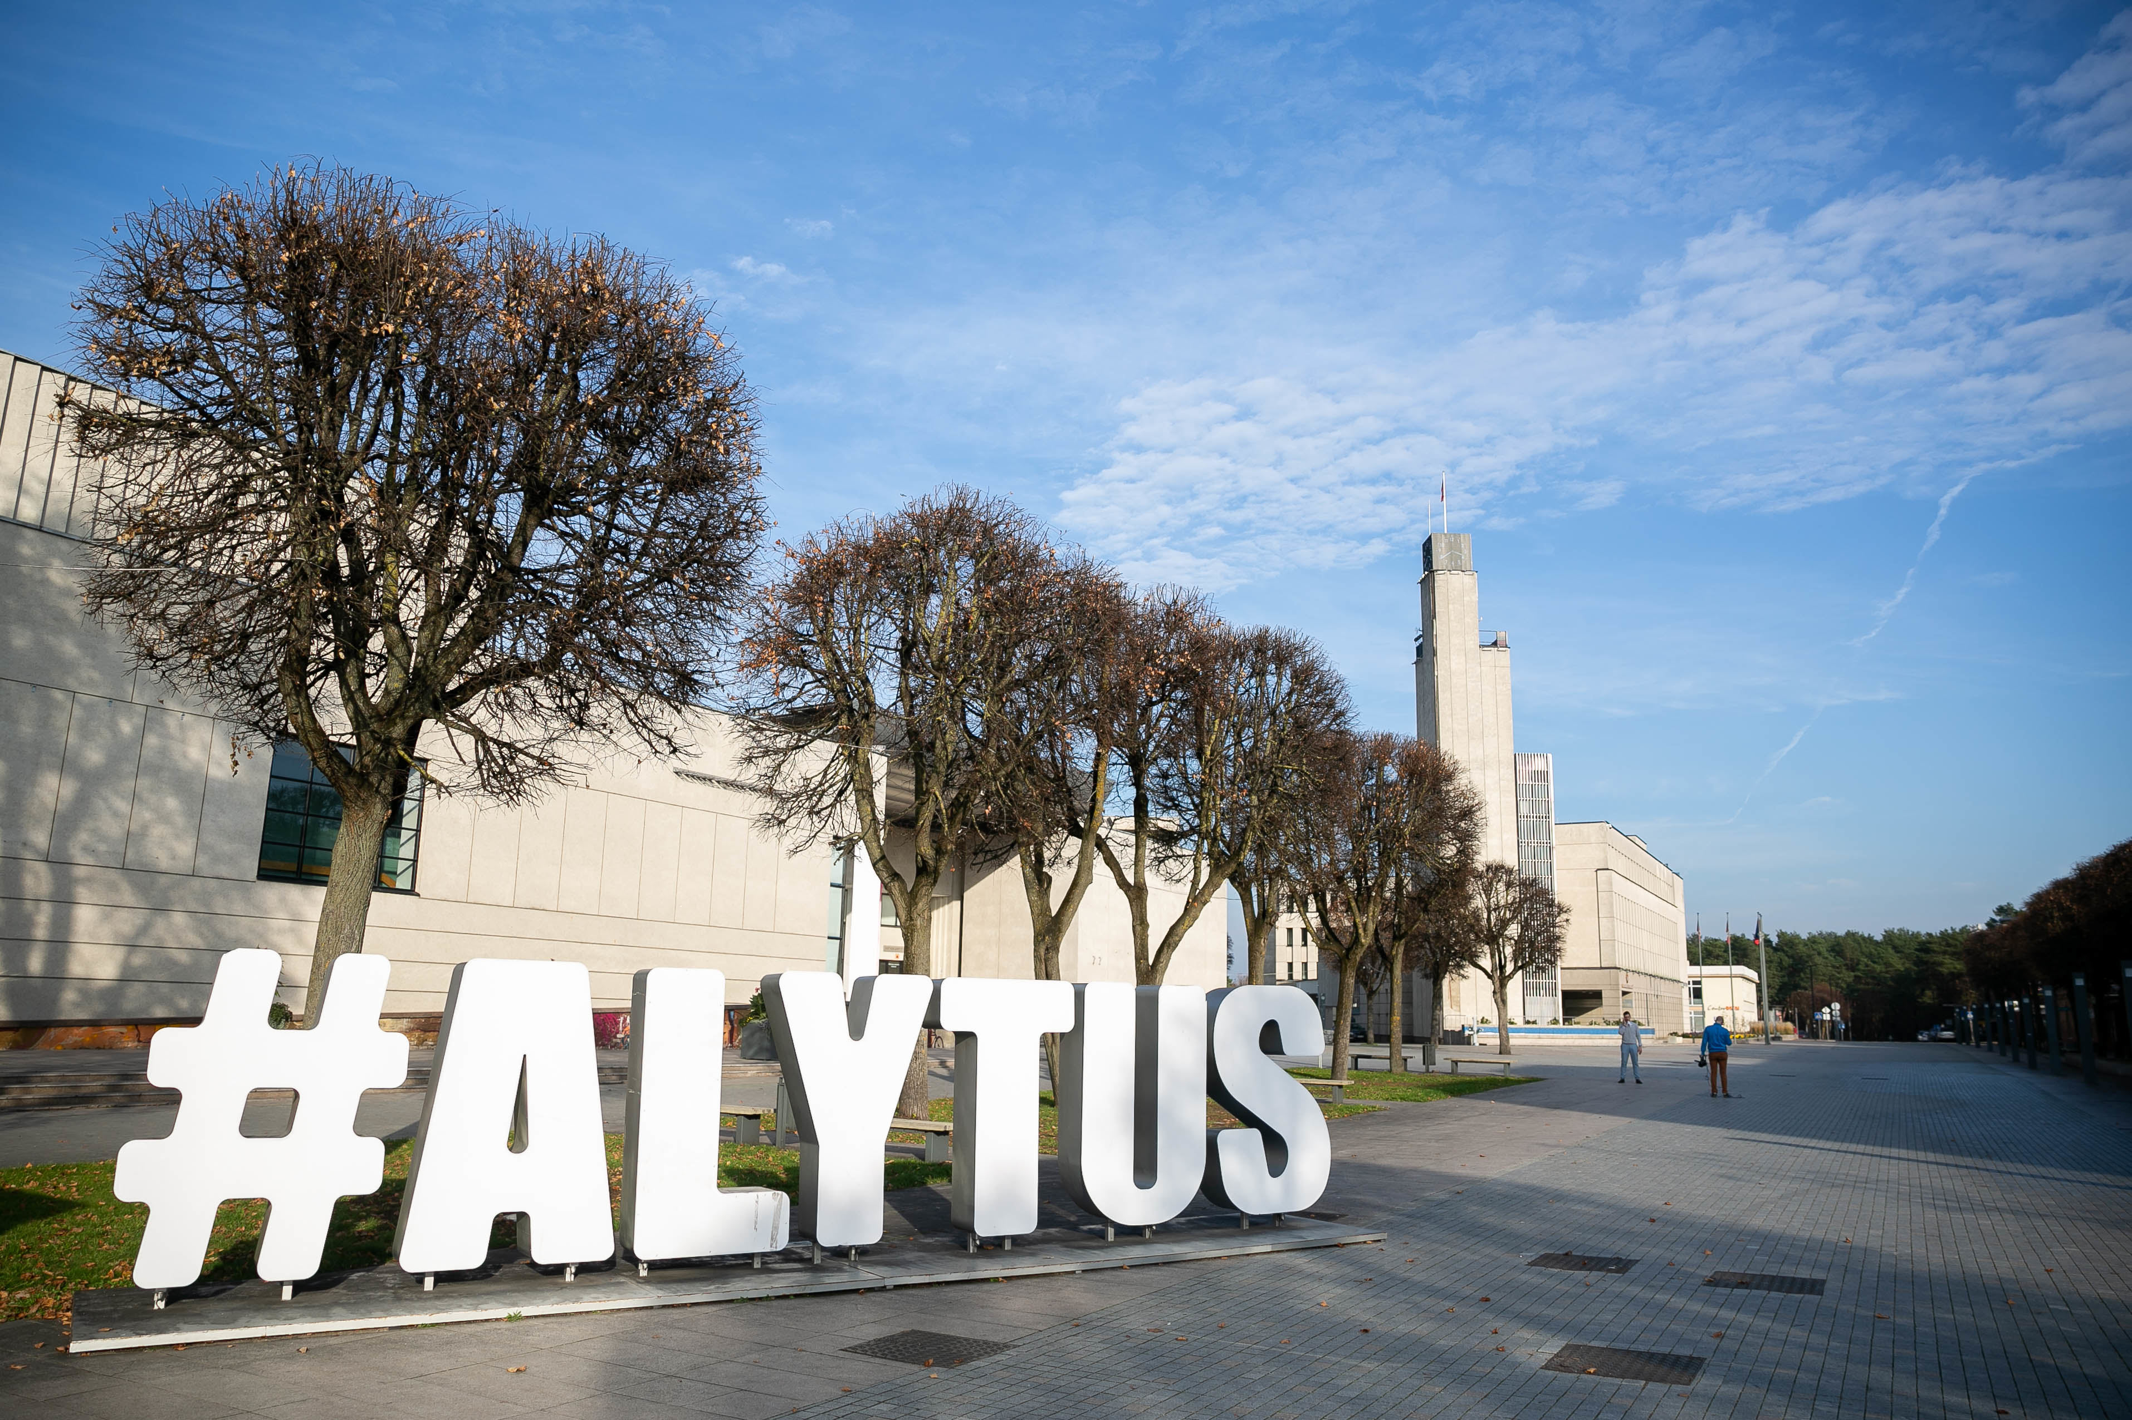
Alytus
by Grėtė Gaulytė

Slide 2
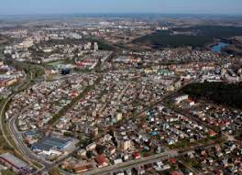
Facts about Alytus
Alytus is in the south of Lithuania, 100 km from the capital Vilnius.
It is the 6th largest city of Lithuania.
It has a population of 50,000.

Slide 3
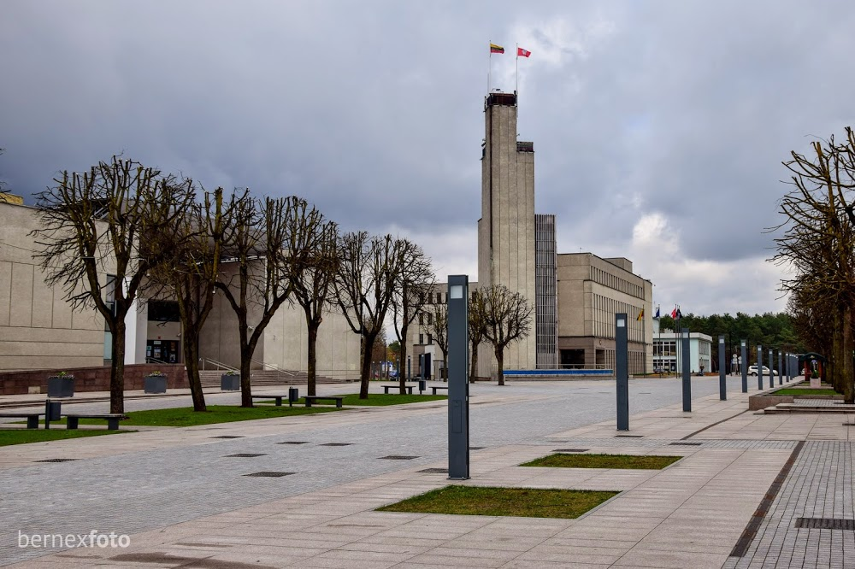
Town Hall Square
This is the Town Hall Square. You can see a lot of people here every day. The most important celebrations take place here. There are some cafes and shops around it.

Slide 4
The Angel of Freedom
The monument was built nearly 100 years ago.
It is one of the symbols of Alytus.

Slide 5
White Rose Bridge
This pedestrian and bicycle bridge was built in Alytus across the Nemunas, the biggest river in Lithuania. We like going for a walk or cycling there.
The bridge is 260 m long,
14 m wide and 25 m high.

Slide 6
Alytus Mound
A legend tells us that Alytus started here.
This place is perfect for free time with family or friends.

