Slide 1
Monuments in Lithuania
Alytus Dzukija School

Slide 2
Gediminas Castle Tower (Vilnius)
Gediminas Tower is an important state and historic symbol of the city of Vilnius and of Lithuania itself.
It is the remaining part of a Castle built in 1409.
According to a legend, Vilnius started with that castle on the hill. Lithuanian Grand Duke Gediminas dreamt of an Iron Wolf howling at the top of this hill. The dream was later interpreted as a sign of a place for a strong capital city.

Slide 3
Gediminas Castle Tower ( Vilnius)
LINE
RECTANGLE
OCTAGONAL

Slide 4
Vilnius Cathedral
Vilnius Cathedral stands in the center of the city.
The Cathedral was built in the middle of the XIII century.
The roof of the building is decorated with three sculptures of saints.
The Cathedral underground crypts and tunnels.

Slide 5
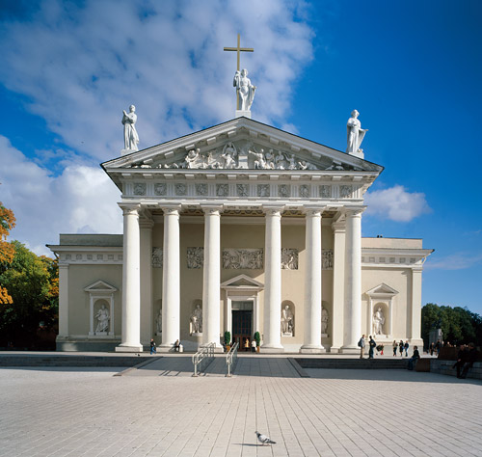
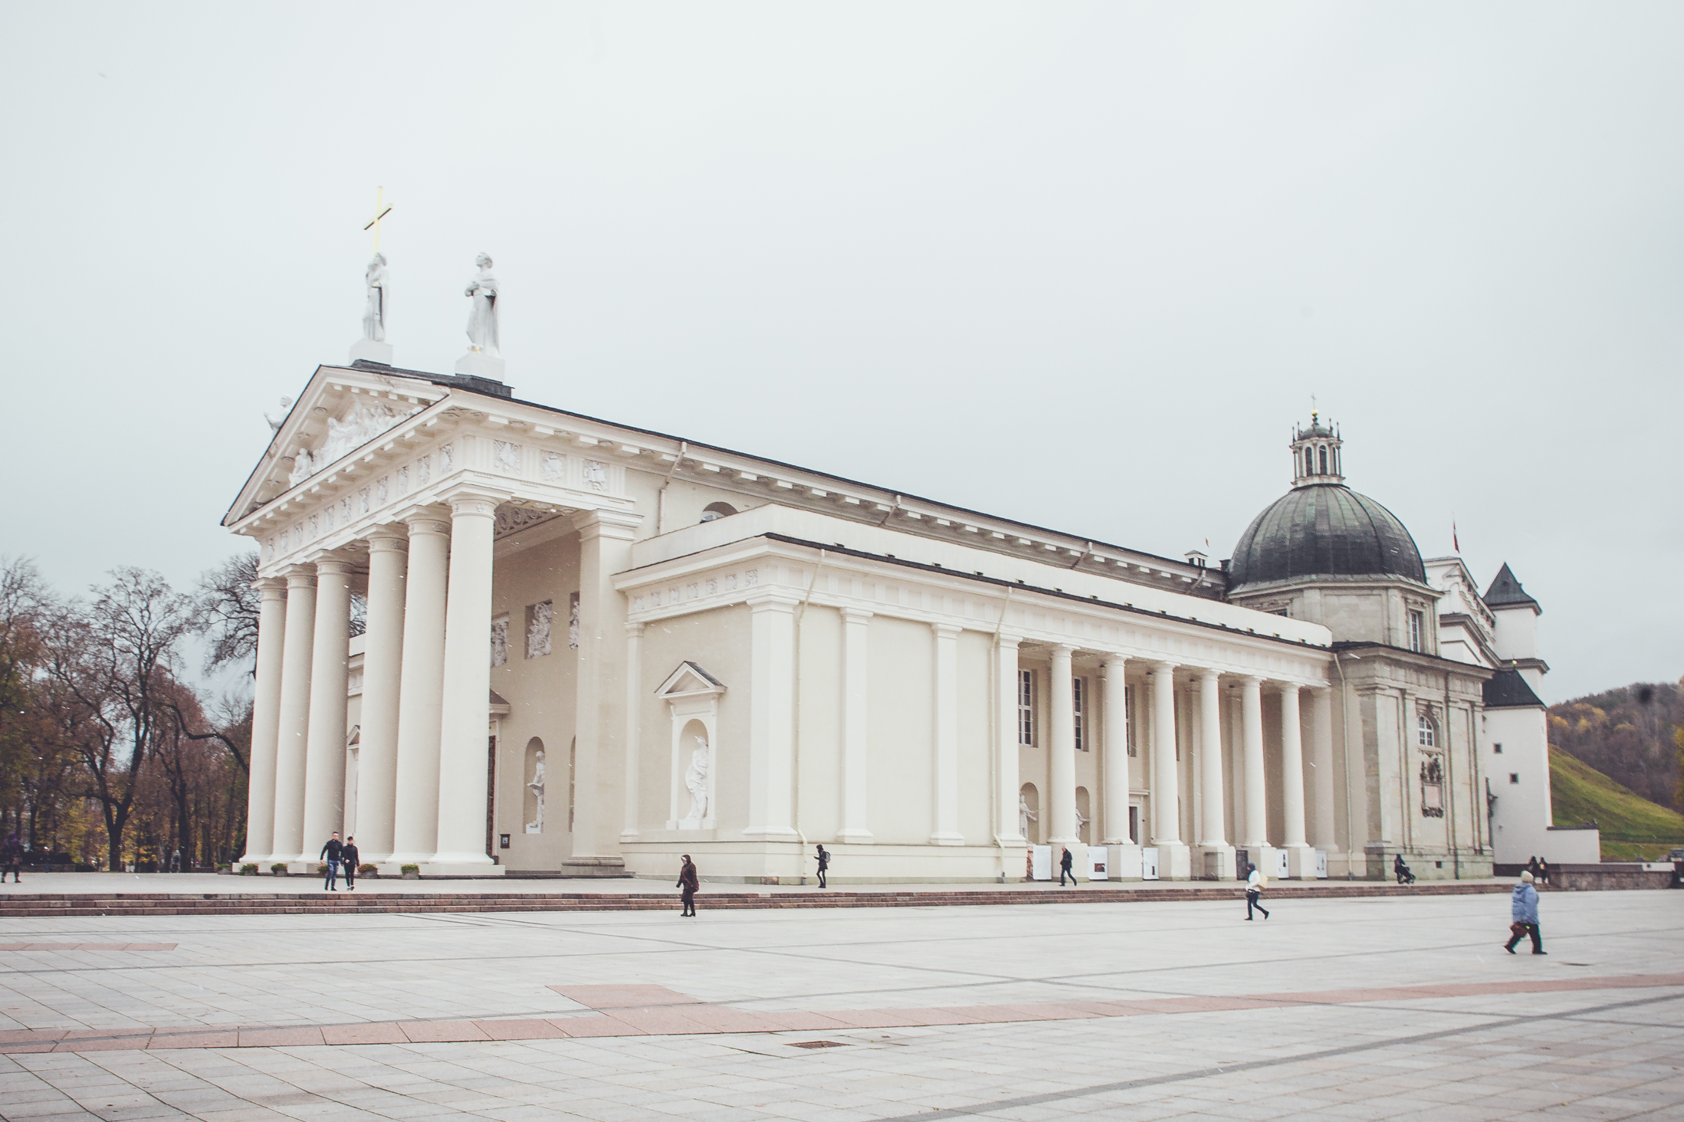
Vilnius Cathedral
Triangle
Half circle
Roll
Rectangle

Slide 6
Bell Tower of Vilnius Cathedral
The Bell Tower of Vilnius Cathedral is one of the most popular symbols of the city. It‘s the main meeting spot in the capital city.
The tower is 57 meters high. It was built in the XIII century as a defensive tower of the castle.
The Tower has the oldest and the most important city clock.

Slide 7
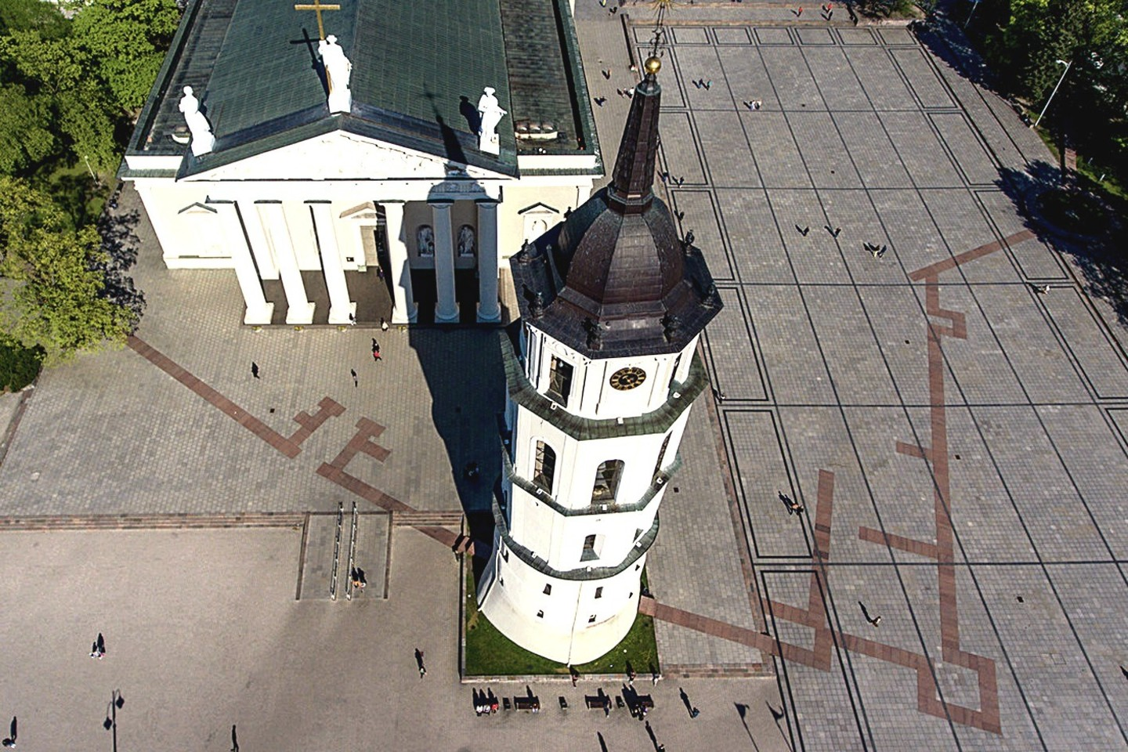
Bell Tower of Vilnius Cathedral
Octagone

