Slide 1
Monuments in Lithuania
Alytus Dzukija School

Slide 2
White Rose Bridge (Alytus)
The tallest pedestrian and bicycle bridge in Lithuania was built in 2015.The bridge connects two important areas of our city and is convenient for pedestrians and cyclists who want to visit the the other side of the Nemunas River.

Slide 3
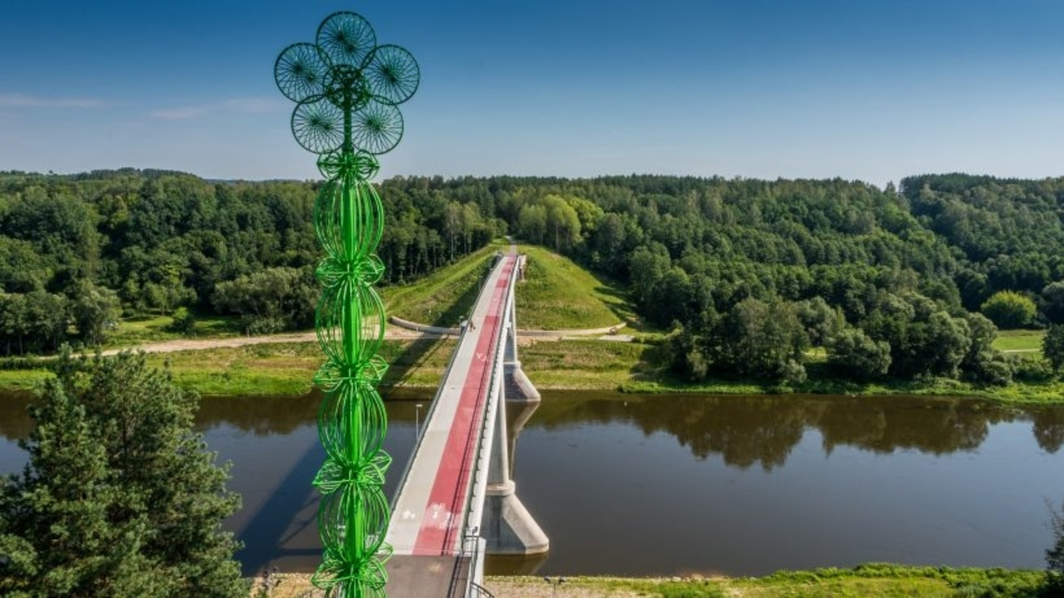
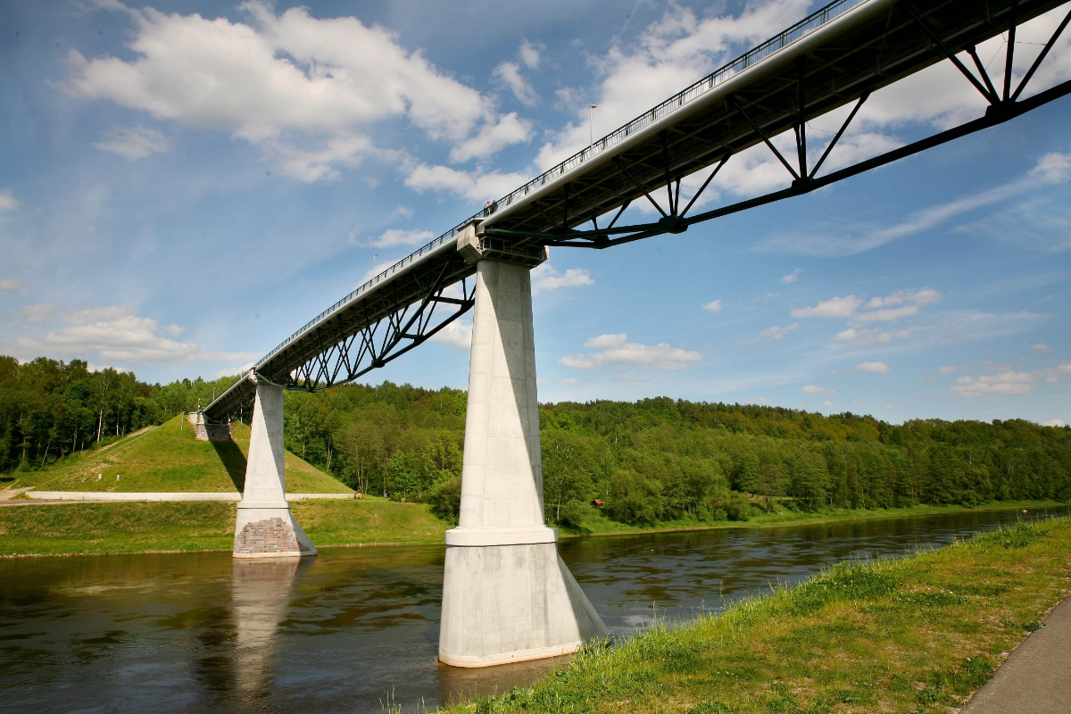
White Rose Bridge
Circle
rectangle

Slide 4
White Rose Bridge
Rectangle
Circle
Oval

Slide 5
Angel of Freedom (Alytus)
The monument was built in 1929.It is 13 meters high. The Angel of Freedom is a sign of respect for those who died for Lithuania's independence.

Slide 6
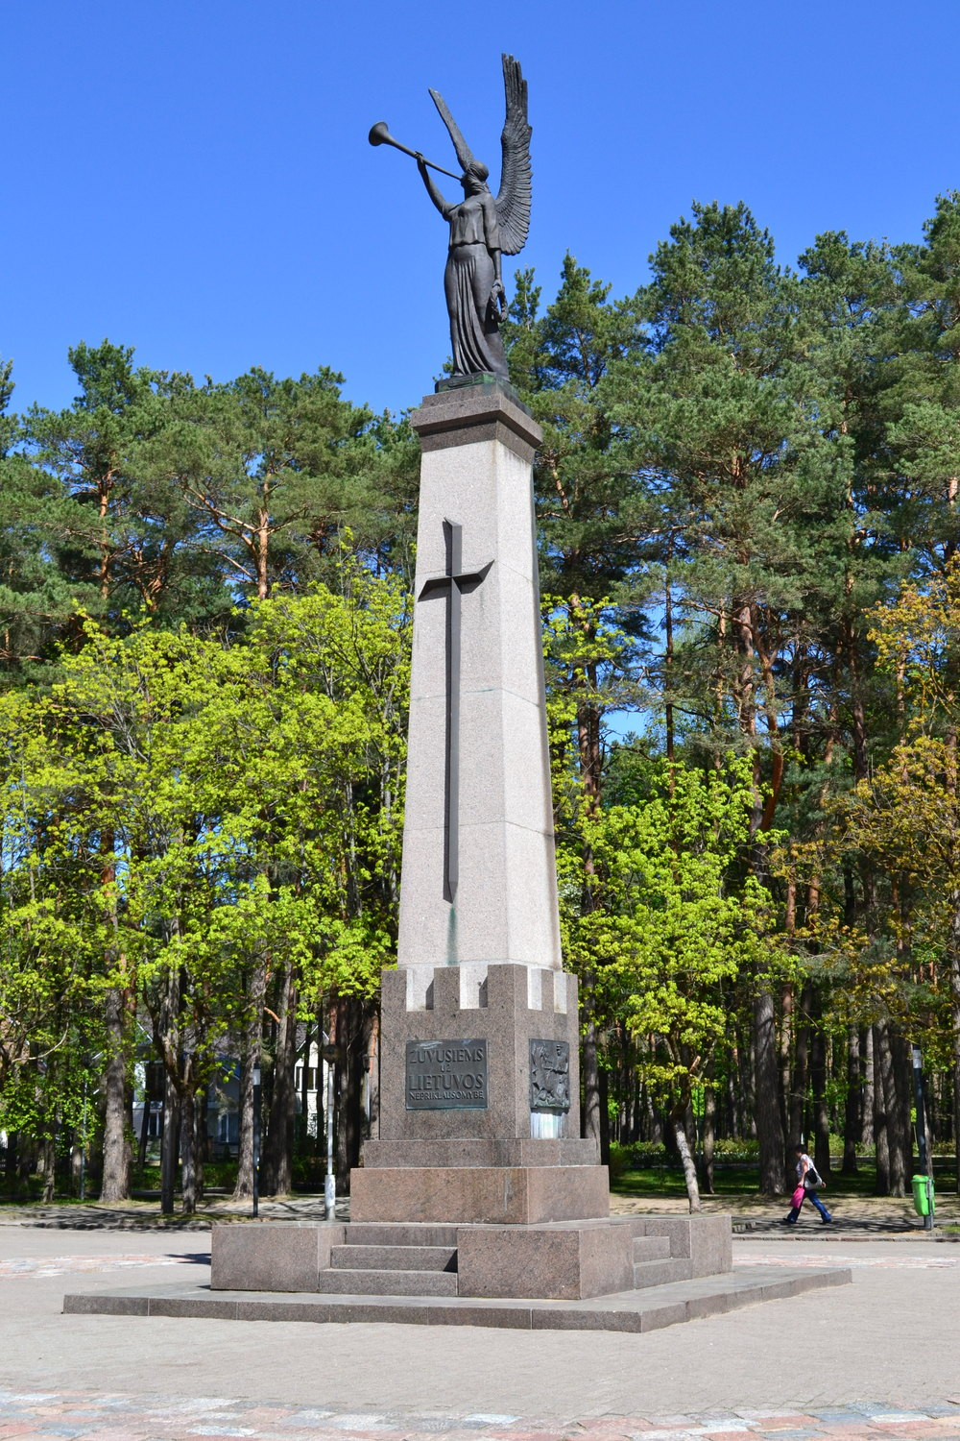
Angel of Freedom
Rectangle

Slide 7
Alytus Synagogue
It was built at the end of the 19th century when the Jewish community accounted for nearly 30 percent of Alytus population. The Alytus Jewish community was murdered in the Holocaust and the building was abandoned for many years.
Some years ago it was restored to become an Arts Centre.

Slide 8
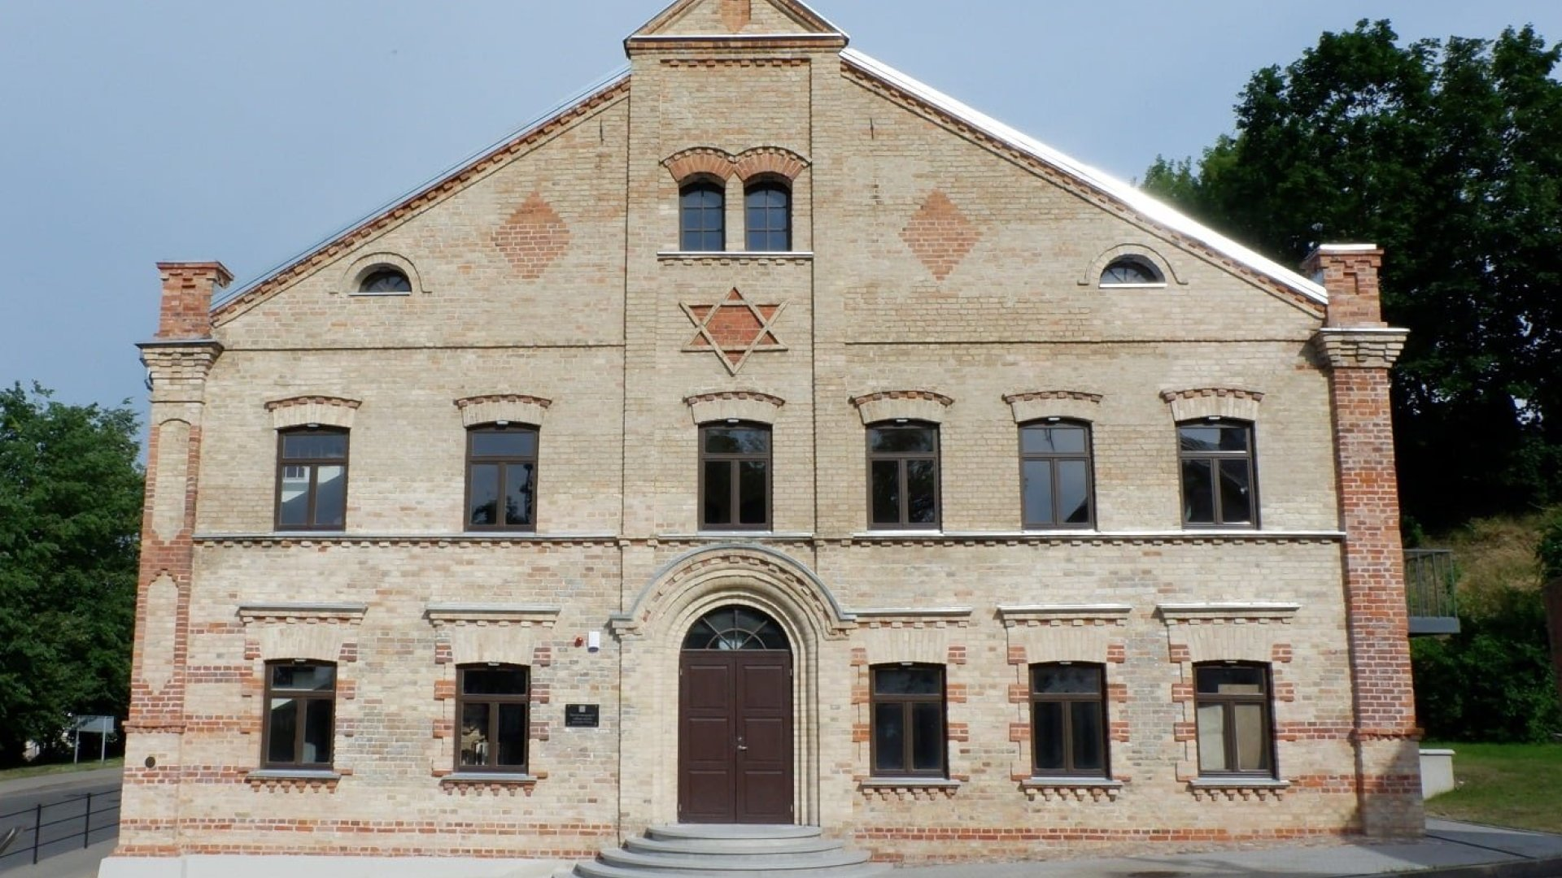
Alytus Synagogue
Rectangle
Hexagone

