Slide 1
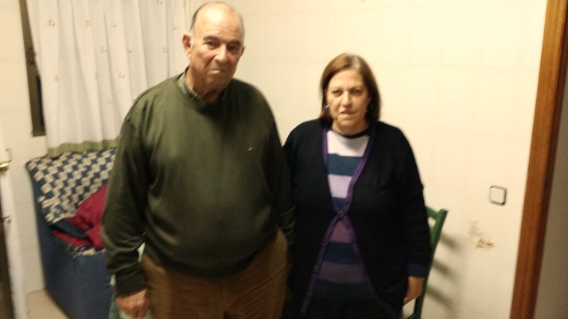
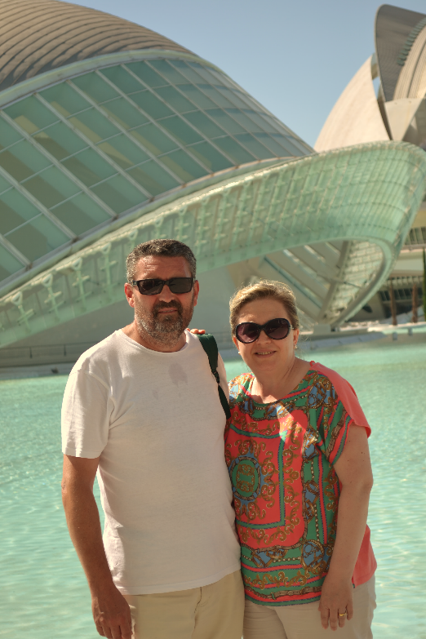
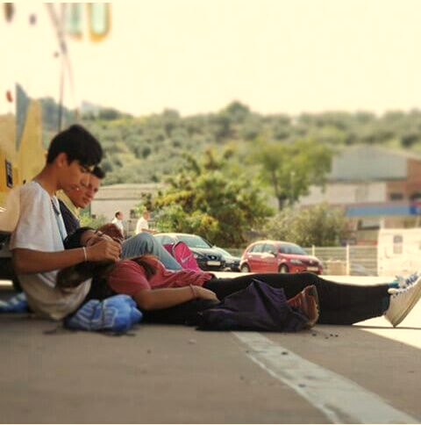
CHEMISTRY OF LOVE
SPAIN
Andrea Benítez Quintana
Violeta Carvajal Muñoz
Javier Flores Sánchez
María Iciarra García
Daniel Josué Lizardo

Slide 2
We have investigated about love and that is what we have learnt:
Love is a human´s intense feeling that look for the encounter and union with other person.
The states of love are:
LUST
ATTRACTION
ATTACHMENT
DOPAMINE
ADRENALINE
SEROTONIN
TESTOSTERONENE
ESTROGEN
OXYTOCIN
VAROPRESSIN

Slide 3
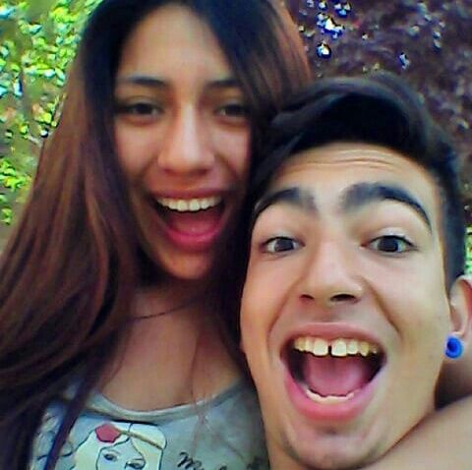
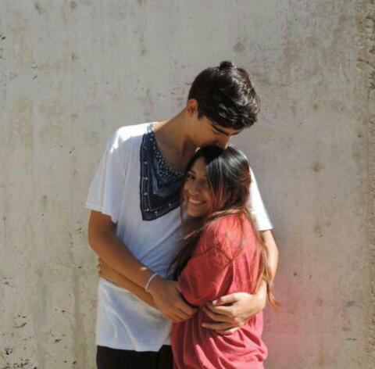
1. Young couple
Mario Cuadrado and Lizbeth Redondo Triángulo
This couple has been together since 2 years and 4 months.

Slide 4
THE BOY
For him love is…
Being together with someone, sharing things, moments and experiences, visiting new places, laughing a lot, being happy all day , doing new things, and also understanding her, and the things that happened to us.
SHARE THINGS
LAUGH
UNDERSTANDING
HAPPINESS

Slide 5
THE GIRL
For her love is….
Understanding each other, knowing the good things of him and appreciate that, but also knowing the bad things and even that, love him. Also, respecting the other person, and sharing the little things of the day by day.
GOOD THINGS
LOVE HIM
RESPECT

Slide 6
¿How do we fall in love?
First, they didn’t know each other, and they only talked a little, because Liz was very shy and Mario was the person that did the first step and passed the friend-zone to became into the boyfriend-zone. The best of it was that Liz is not shy anymore and Mario knew how to win over her.
They do a very cute couple and they love each other a lot and they would like to be together in the future.

Slide 7
Our relationship
1. First, physic attraction
2. Then, meeting each other
3. Third, becoming steady
4. Being together

Slide 8
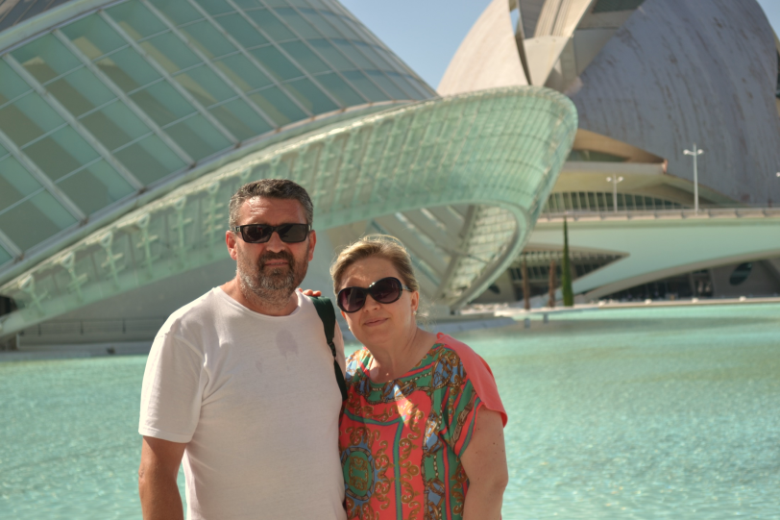
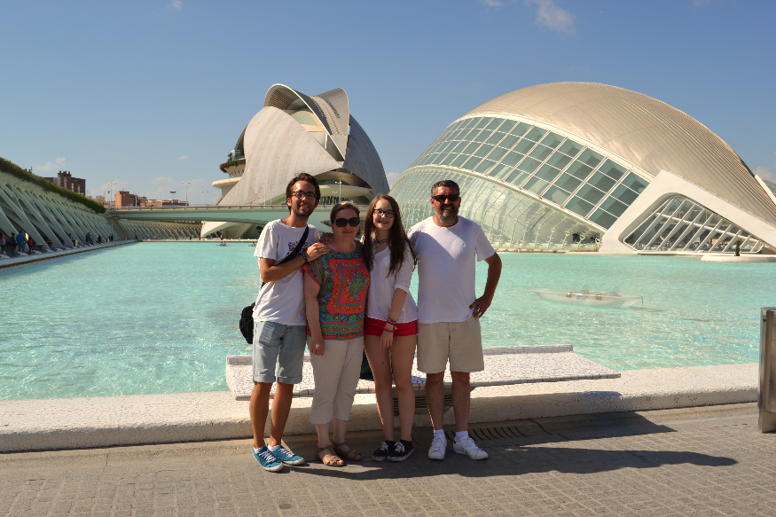
Medium-age couple
Jose María Carvajal and Consolación Muñoz.
They have been together 31 years together. 24 years married and 7 years engaged.

Slide 9
THE MAN
For him love is…
He can’t express with words how he feels love. Love is a welfare state in where you are almost always happy. You want the best for the other person and you do the best for her, and you feel very special.
CAN’T EXPRESS WITH WORDS
YOU FEEL SPECIAL
LOVE IS A WELFARE STATE

Slide 10
THE WOMAN
For her love is…
It is a state that make us crazy and silly. It’s something that you don’t look for, because you find it. Love is sharing things, want to be with the other person, and with the pass of the years, raise a family.
RAISE A FAMILY
CRAZY
SHARE THINGS

Slide 11
¿How do we fall in love?
They went to the same school. First they didn´t talk but then the started to look at each other and with the pass of the years they fell in love. Now they are married and they have a daughter of 15 years and a son of 22 years.

Slide 12
OUR RELATIONSHIP
1. First, physic attraction and then you become to love the personality of the other person.
2. After that, we started to meet each other.
3. Then, we fell in love.
4. Finally, we raised a family.

Slide 13
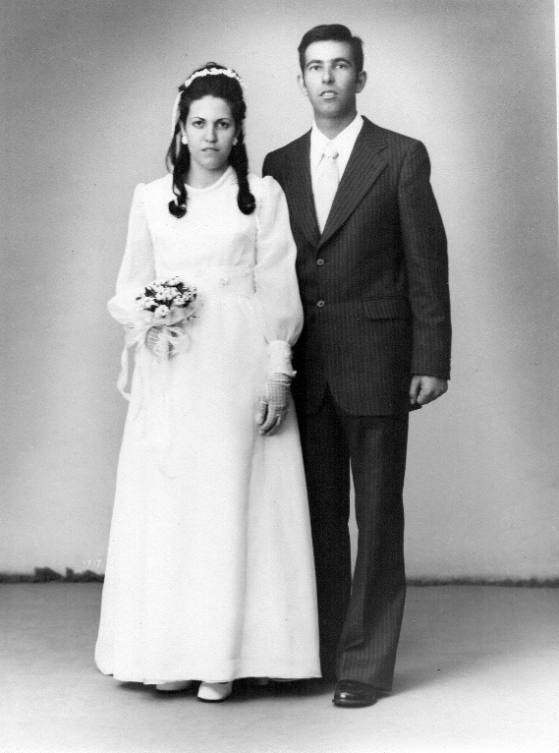
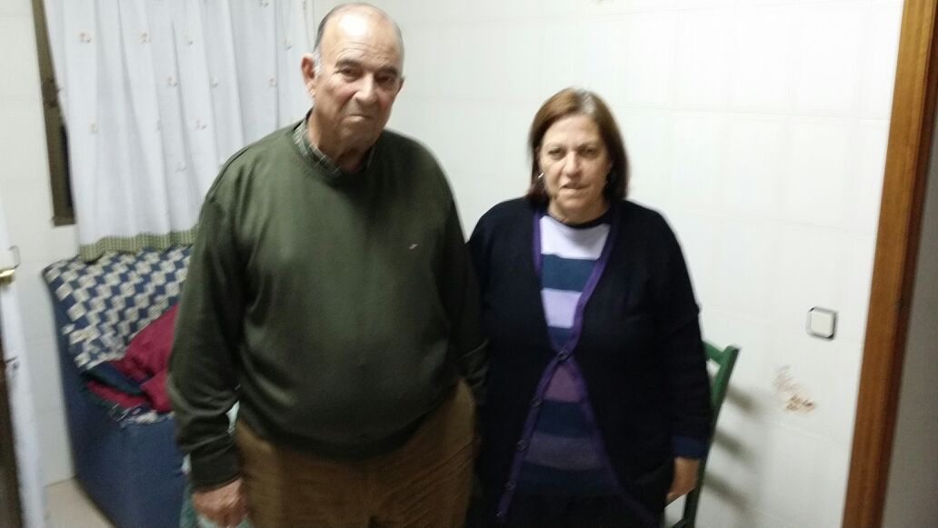
Old couple
María Soledad García and Miguel Donaire
This couple has been together 46 years engaged and 42 married.

Slide 14
THE MAN
For him love is…
Being together, having children, and giving your all to a person. The main thing in love is taking care of her and making her happy.
BE TOGETHER
GIVE YOUR ALL TO A PERSON
MAKE HER HAPPY

Slide 15
THE WOMAN
For her love is…
Love is all, is the salt of the life, without love there is nothing, is something beautiful and special when you feel it.
LOVE IS EVERYTING
BEAUTIFUL AND SPECIAL
WITHOUT LOVE THERE IS NO NOTHING

Slide 16
How do we fall in love?
They met each other in the village’s square. With the past of the years, they started to talk and meet, and they became very good Friends. Then, they fall in love very quickly and they got married. Then, they had 2 children, of 41 and 39 years old.

Slide 17
OUR RELATIONSHIP
1. First, meet together. They had a ‘’heart-attack’’.
2. They started to like each other.
3. They fell in love.
4. They married, and had children.
5. Be together.

Slide 18
QUESTIONS | YOUNG COUPLE Mario and Liz | MIDDLE AGE COUPLE Consoli and Jose María | OLD COUPLE María Soledad and Miguel
How many years have they been together? | 2 years and 5 months | Married: 24 years Engaged: 31 years | Married: 42 years Engaged: 46 years
What is love for them? | Happiness, respect, share things, laugh and understanding | Is something crazy, special, share things, welfare state and raise a family | There is nothing without love, love is everything, is beautiful and special
How is their relationship? | They do a very cute couple and they love each other a lot | They are married and they have 2 children | They are married and they have 2 children
What are their stages? | Attraction, meet each other, become steady and be together | Attraction, love the personality, meet each other, fell in love and raise a family | Meet, like each other, fell in love, be married, be together
Where did they meet at first time? | In the highschool | In the school | In the village
Plans of future | Be together until they can | Be together until death | Be together until death

Slide 19
THE END
The greatest thing you'll ever learn is just to love and be loved in return. -Mouline Rouge.

Slide 20
AND NOW, HERE WE HACE A
CUTE VIDEO
https://www.youtube.com/watch?v=BwsFo3Gty4A

