Slide 1
Survey on studying

Slide 2
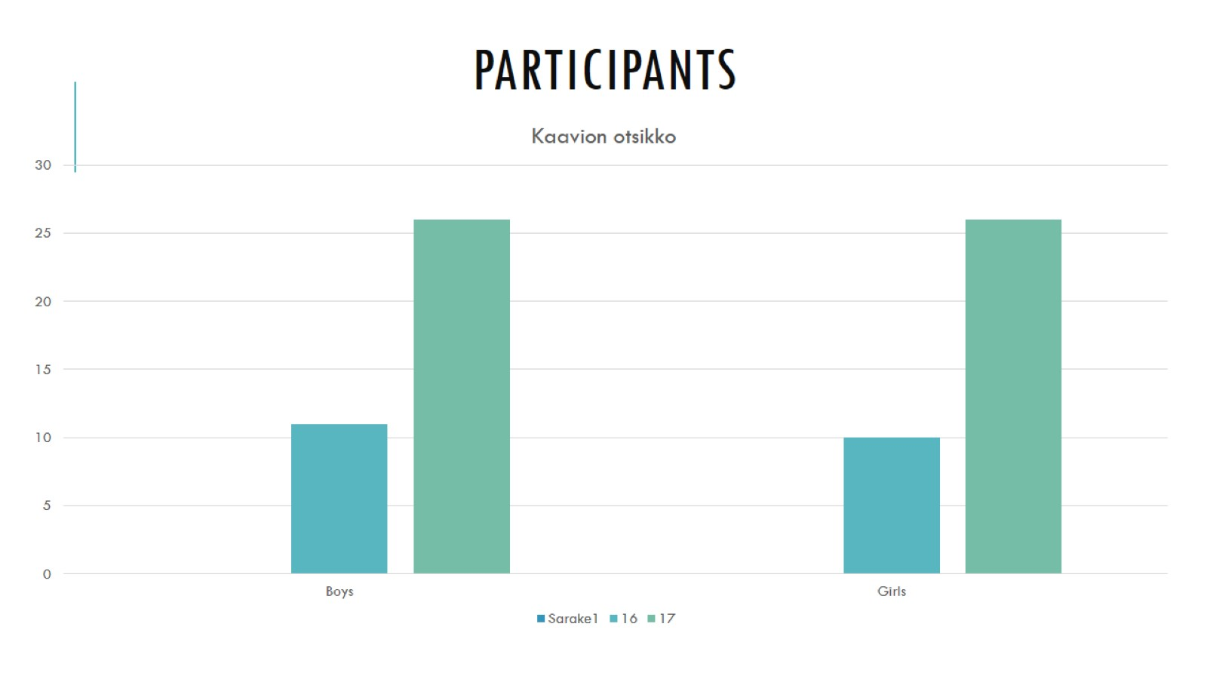
participants

Slide 3
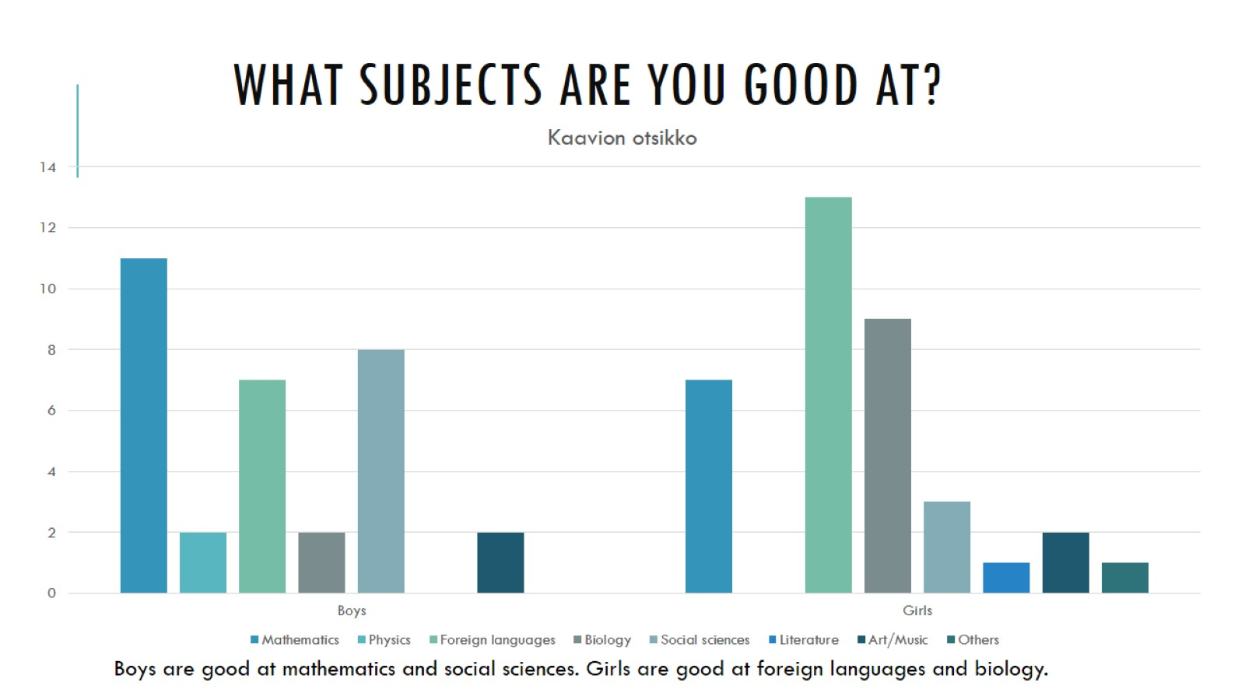
What subjects are you good at?

Slide 4
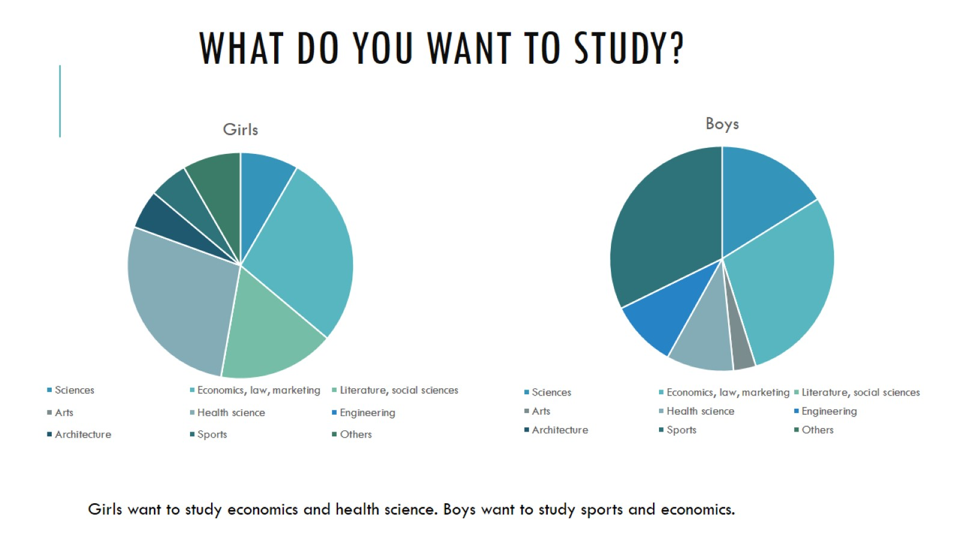
What do you want to study?

Slide 5
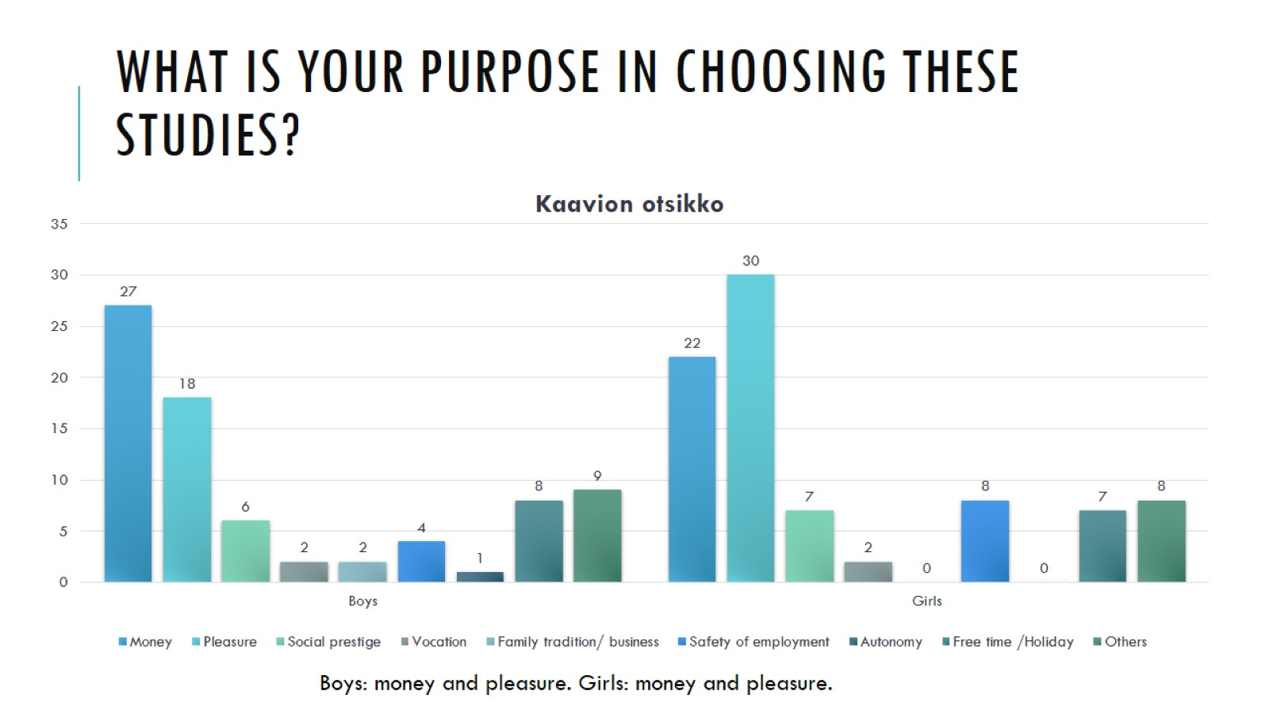
What is your purpose in choosing these studies?

Slide 6
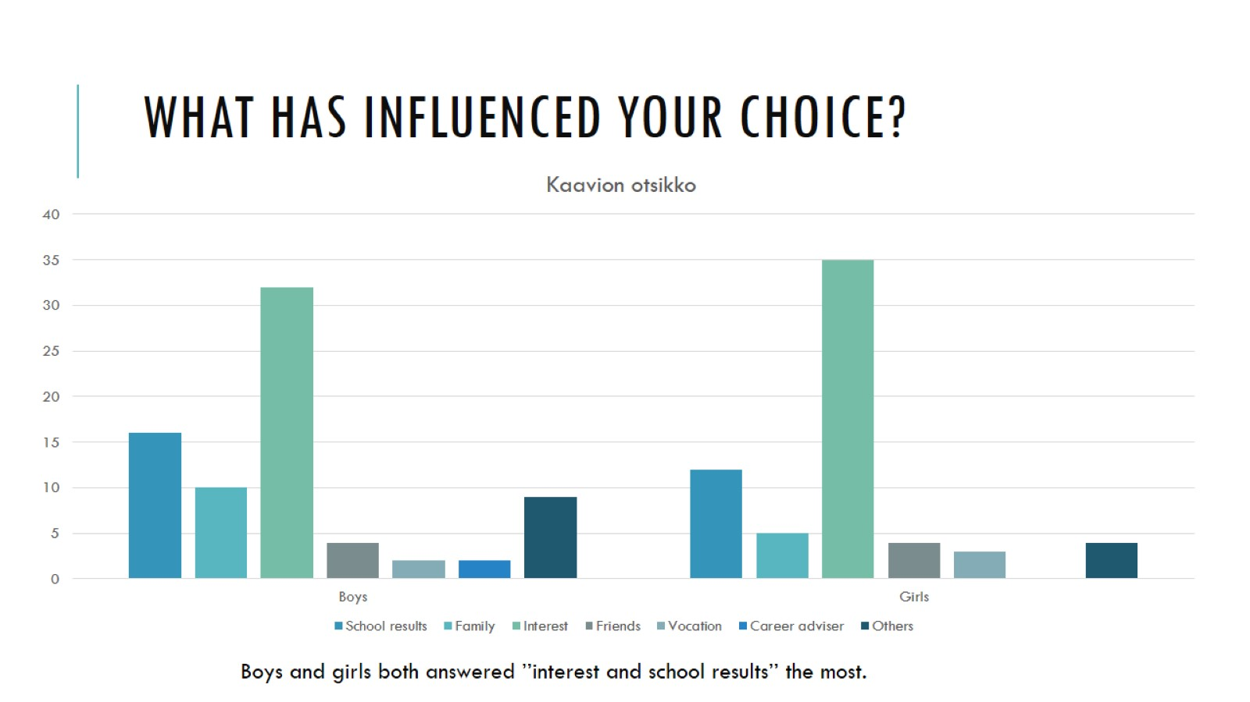
What has influenced your choice?

