Slide 1
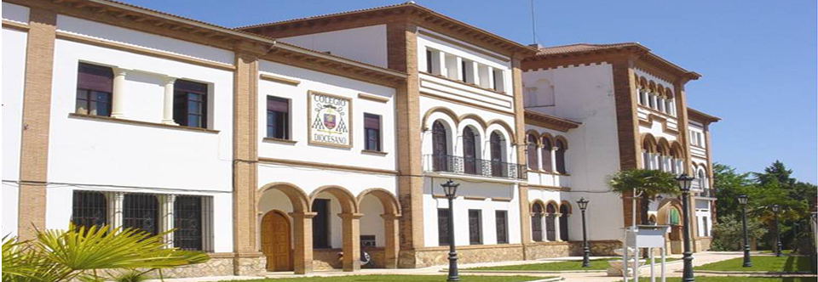
COLEGIO DIOCESANO SAN ATÓN

Slide 2
A.6. YOUNG WOMEN REALITY IN FIGURES.
1. Are you a boy or a girl?
2. How old are you?
3. What subject are you good at?
4. What do you want to study?
5.What is your purpose in choosing these studies?
6.What has influenced your choice?

Slide 4
How old are you?

Slide 5
What subject are you good at?

Slide 6
What do you want to study?

Slide 7
What is your purpose in choosing these
studies?

Slide 8
What has influenced your
choice?

Slide 9
Thank you for your attention

