Slide 1
A7 A Sound Mind In A Sound Body

Slide 2
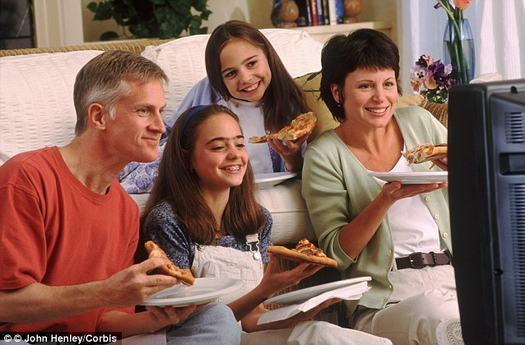
1. I eat in front of television

Slide 3
2. You nibble between meals

Slide 4
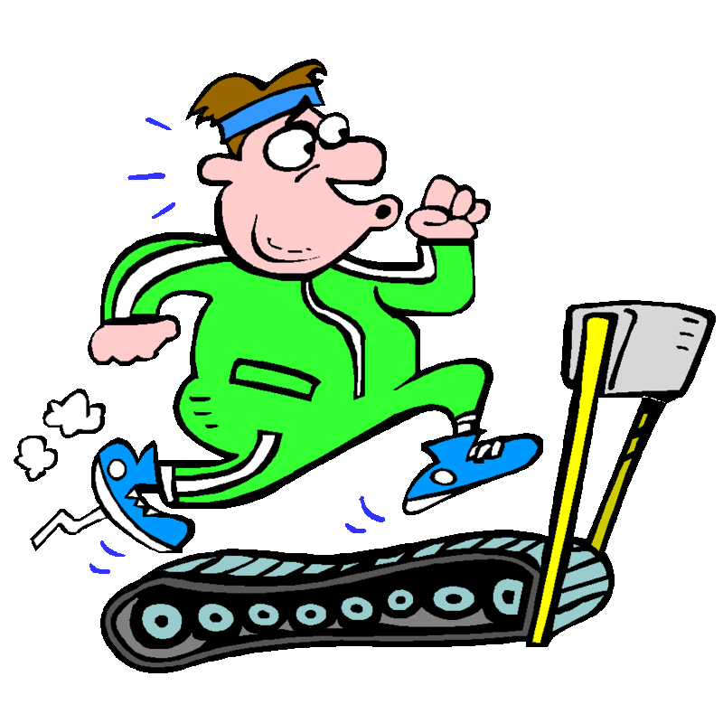
3. You practice a physical activity

Slide 5
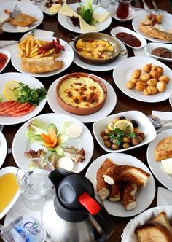
4. Do you take breakfast before school ?
If no why ?

Slide 6
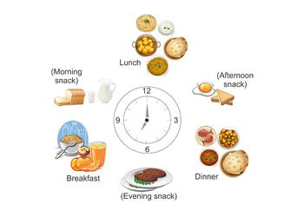
5. Do you eat at set times
If no why ?

Slide 7
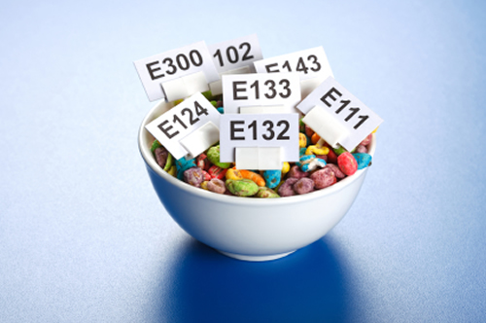
6. Do you know what a food additive is ?

Slide 8
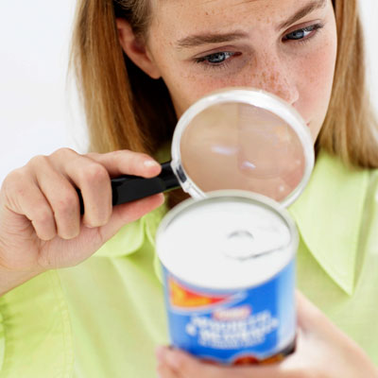
7. Do you watch the labels to find out what food additive is present in the products you buy ?

Slide 9
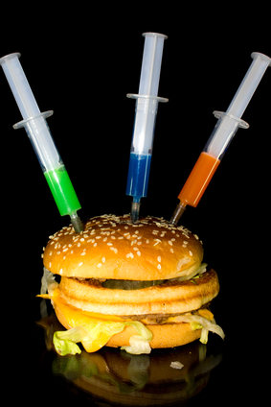
8. Do you think you consume additives regularly in your foods ?

Slide 10
9. Do you think that additives are good for you ?

Slide 11
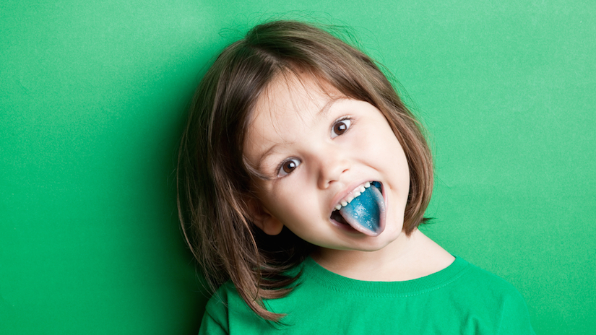
10. Do you feel well enough informed about their effect and roles ?

