Slide 1
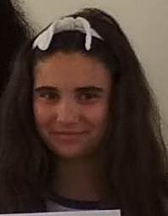
Young People in Europe
Vasilena Nankova – 9-th grade
Foreign Language School – Pleven, Bulgaria

Slide 2
The world is changing rapidly while stereotypes are collapsing. The new generation is seeking new roles and identity, beyond conservative determination and assumptions. In addition, emerging challenges such as climate change and economic inequality are rapidly growing and exceeding expectations.

Slide 3
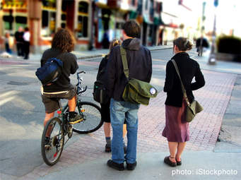
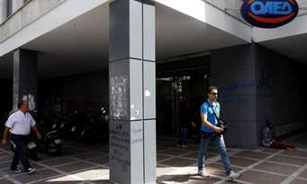
Certain surveys, such as theEurobarometer-EY2016, emphasize that although young people are not actively involved in politics, they do have a profound political perception. This suggests that while they are concerned with political issues, they do not find fitting political channels of expression.

Slide 4
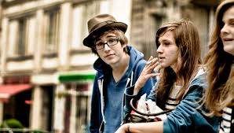
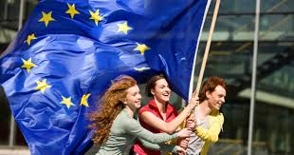
The FNF project office in Greece understood the call of many young people for proper means of conduct for a broad, open, mature and permanent political discourse that will enlighten and educate democratic, progressive and liberal citizens.

Slide 5
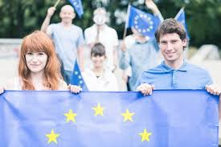
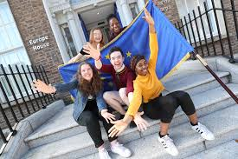
At this event, we will be presenting the main findings and policy reforms from the publication, discuss the current situation of youth in Europe and elaborate on ways in which they can be promoted and heard as active citizens.

Slide 6
The Congress of Young Europeans, organized and hosted by the Heinrich Böll Foundation, among others, was a unique gathering of 70 young activists and future politicians from across Europe. Held in Prague, Czech Republic, between August 30 and September 2, the event provided participants with a chance to discuss their concerns for the future of democratic institutions in Europe, as well as education, immigration and climate change.

Slide 7
The four-day summit was an opportunity for young activists, mostly working with green parties in their respective countries, to engage in networking, debates, workshops, film screenings, Q&A sessions and talks with artists, politicians, authors, influencers and like-minded youths from the continent.

Slide 8
I think one of the most pressing issues for young people in Europe today is how we relate as Europeans to the rest of the world — in terms of other people, individuals and communities, but also in terms of other countries, states and governments.

Slide 9
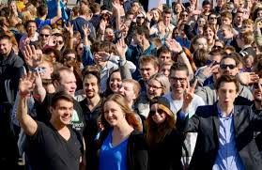
It’s really crucial to be aware that there is a lot of movement in the world, and these movements are not necessarily going to stop. We are not going to stop migration patterns by closing down the borders.

Slide 10
Thank you for your attention!

