Slide 1
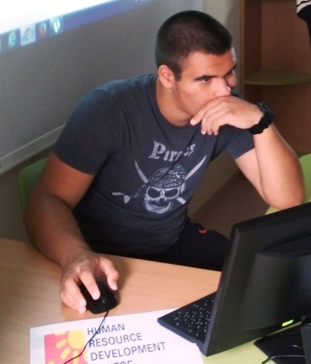
9th may – Europe day
Borislav Stefanov -9-^{th} grade
Foreign Language School
Pleven, bulgaria

Slide 2
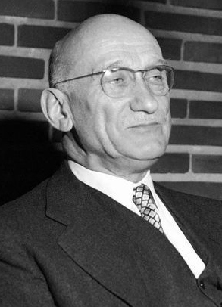
The founder
At a speech in Paris in 1950, Robert Schuman, the then French foreign minister, set out his idea for a new form of political cooperation in Europe, which would make war between Europe's nations unthinkable.

Slide 3
EU institutions celebrate Europe Day
To celebrate Europe Day, the EU institutions open their doors to the public in early May in Brussels and Strasbourg. Local EU offices in Europe and all over the world organise a variety of activities and events for all ages.Each year thousands of people take part in visits, debates, concerts and other events to mark the day and raise awareness about the EU.

Slide 4
Europe Day 2019
A look back on the 2019 Europe Day celebrations.

Slide 5
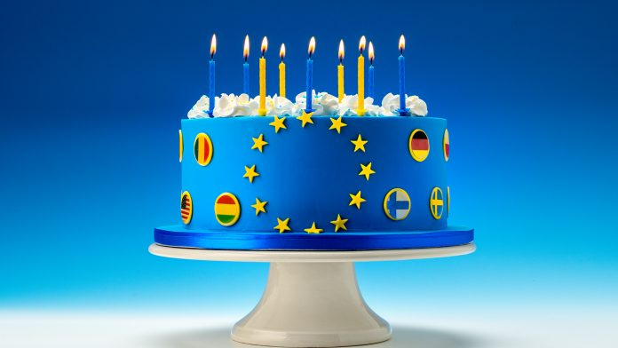
On Europe Day 2020
Europe Day held on 9 May every year celebrates peace and unity in Europe. On Europe Day 2020, the EU institutions want to pay tribute through numerous online activities to the many Europeans who, in a spirit of solidarity, are helping our Union get through the coronavirus crisis.

Slide 6
EUROPE IS IN OUR HEARTS

