Slide 1
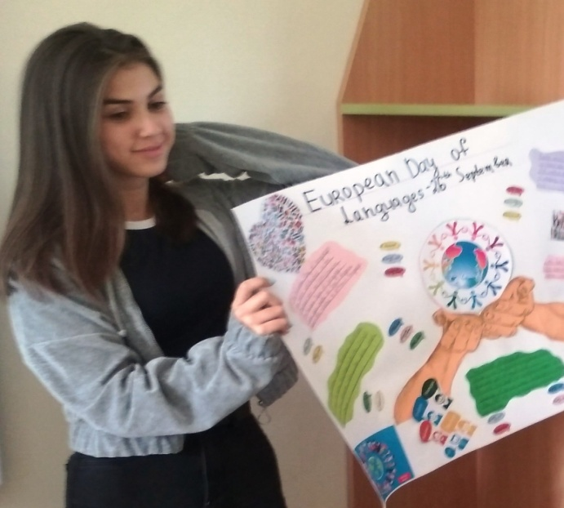
What is Europe for me?
Alexandra Ivanova – 9-th grade
Foreign Language School – Pleven, Bulgaria

Slide 2
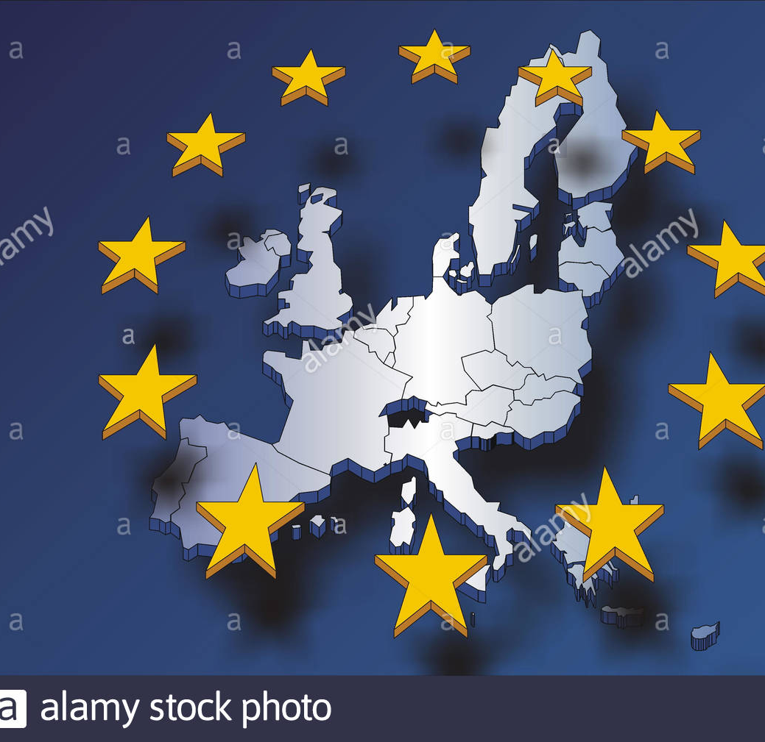
The meaning of Europe for me
The days are gone when we could stand against the universe, on your own . We need to be part of a greater community of nations, for our protection as well as to get into our stride.

Slide 3
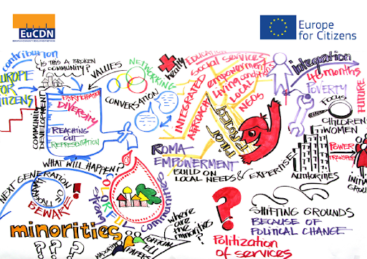
The meaning of Europe for me
For me Europe means peace. We are all better together. It means a lot of civil freedoms and human rights.
Europe needs us all to keep and maintain peace – it is so much more fragile than we realize or want to acknowledge.

Slide 4
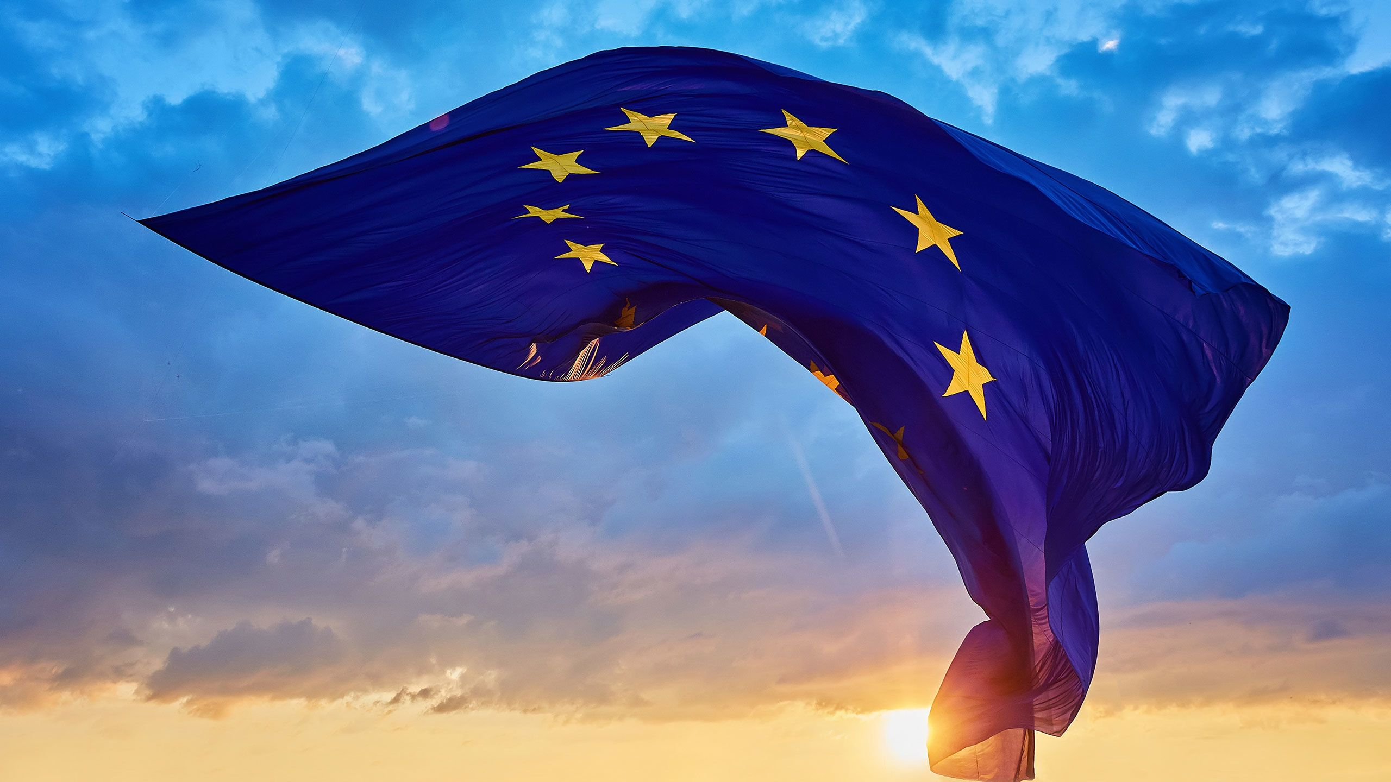
The meaning of Europe for me
Given the relatively small size of Europe, it is for me a place of immense diversity, where a unique and ambitious project has begun with the advent of the European Union. Europe is far more than Europe Union, of course, but it affects all countries on the continent.

Slide 5
Happy Europe day! Love and support others! Together we are better!

