Slide 1
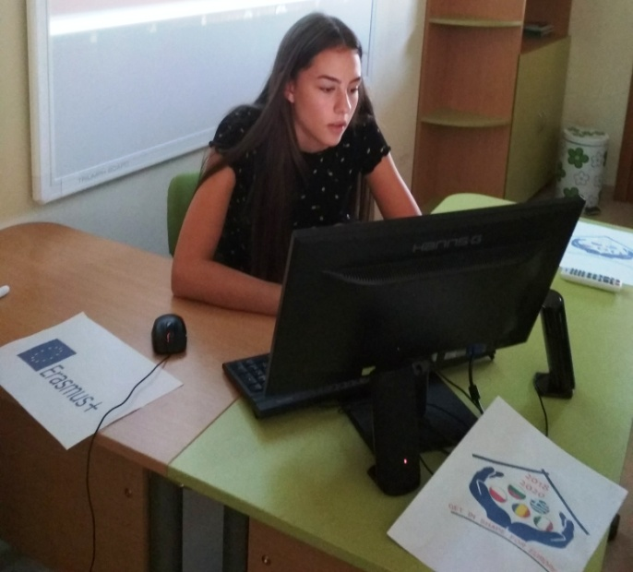
MY EUROPE
Alexandra Genova - 9-th grade
Foreign language School – pleven, bulgaria

Slide 2
Content
What do I like about Europe and the European Union?
How these things will help me in the future?
What are the benefits of Europe and the EU?
Why do I feel like my Europe?

Slide 3
What do I like about Europe and the European Union?
possibility of realization in other countries
the ability to be world-class
Europe invests in our development
Opportunities for traveling and exploring other traditions and nations are offered

Slide 4
How these things will help me in the future?
The implementation and the various training programs will be of great benefit to me in building a career. We all have a better chance of growing up to be successful and already great educated people. Also the opportunity to travel freely and achieve our goals.

Slide 5
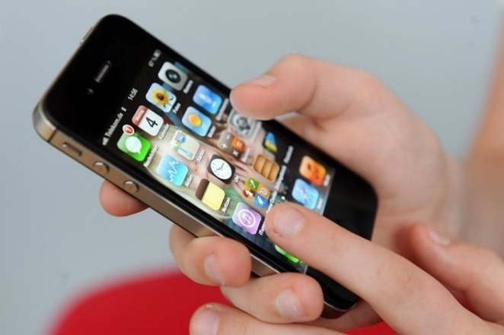
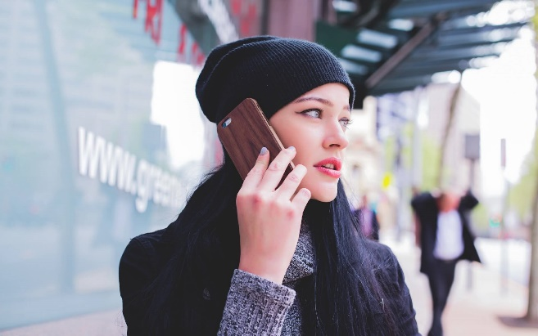
What are the benefits of Europe and the EU?
You can use your phone and online services at no extra cost wherever you are in the EU. You can also access your online video and music streaming services across the EU, safe in the knowledge that your personal data is protected under EU law.
Your rights are protected while you're travelling: EU rules protect your rights in the event of delays or cancellations. Whether travelling by plane, train, boat or bus, you are entitled to fair treatment.

Slide 6
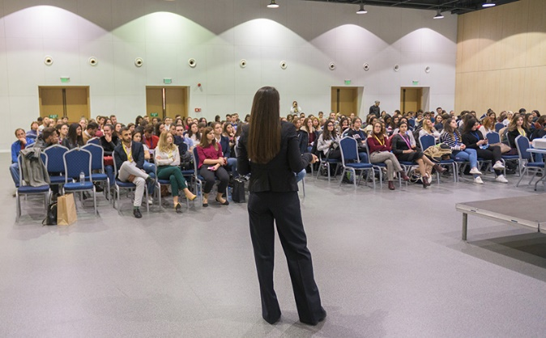
You can benefit from training and support for your business: EU programmes like Erasmus+ help you get training to make the most of your career. The EU also helps you get the most out of your business – from finance to coaching, and from business networks to exchange schemes.
As a worker, you're protected from unfair treatment in the workplace under the EU Charter of Fundamental Rights. This bans discrimination, including in the areas of pay and dismissals.
As an EU citizen, you're protected against the downsides of globalisation by EU support for small businesses and rules to make sure that big companies pay their fair share of tax.

Slide 7
Why do I feel like my Europe?
Because we are part of Europe and it is one that gives us a chance to develop. There is equality between countries and support that makes us feel at ease and have self-confidence and motivation for our future.

Slide 8
Thank you for your attention!

