Slide 1
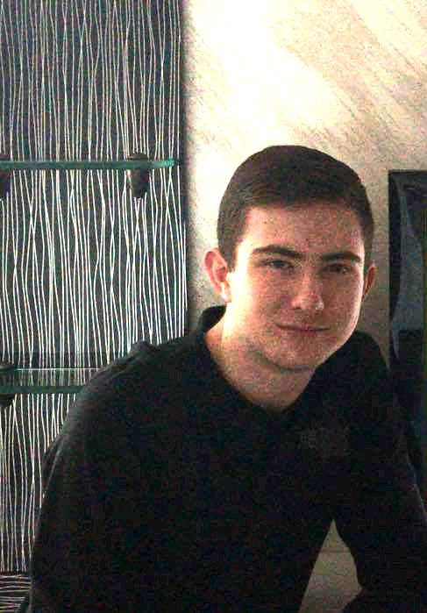
European culture
Simeon Ignatov - 9-th grade
Foreign Language School
Pleven, Bulgaria

Slide 2
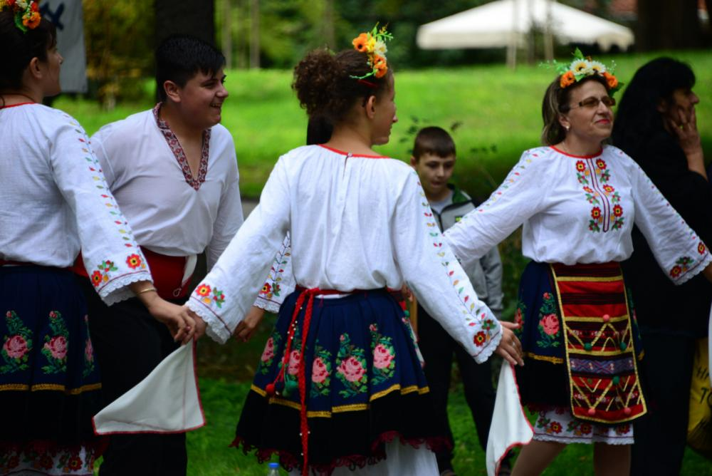
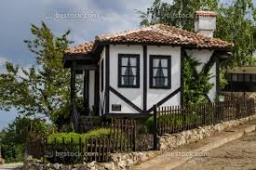
Bulgaria
Cultural life
Contemporary Bulgarian culture is a lively blend of millennium-old folk traditions and a more formal culture that played a vital role in the emergence of national consciousness under Ottoman rule and in the development of a modern state.
Because Bulgaria’s population is largely homogeneous, the degree of cultural variation even at the regional level is small. The state encourages cultural development at all levels of society and supports the dissemination of culture, particularly through schools, libraries, museums, publishing, and state radio and television. Bulgaria’s numerous theatre troupes, opera companies, and orchestras.

Slide 3
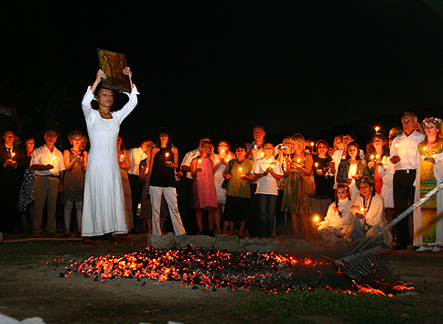
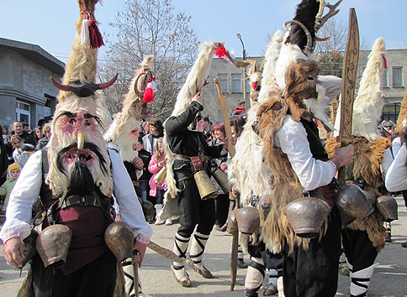
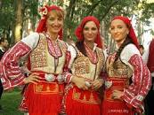
Festivals
Bulgarians participate in many festivals, including the International Folklore Festival, held early in August in Burgas; the Varna Summer International Festival, primarily a music festivals, held in July; and Sofia Musical Weeks, a springtime celebration of classical music.
Historical plays are popular, particularly when staged outdoors in summer against the backdrop of important monuments or buildings associated with events in the country`s history. Local festivals provide an opportunity for new musical and literary works to be performed.

Slide 4
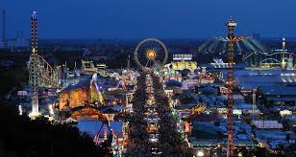
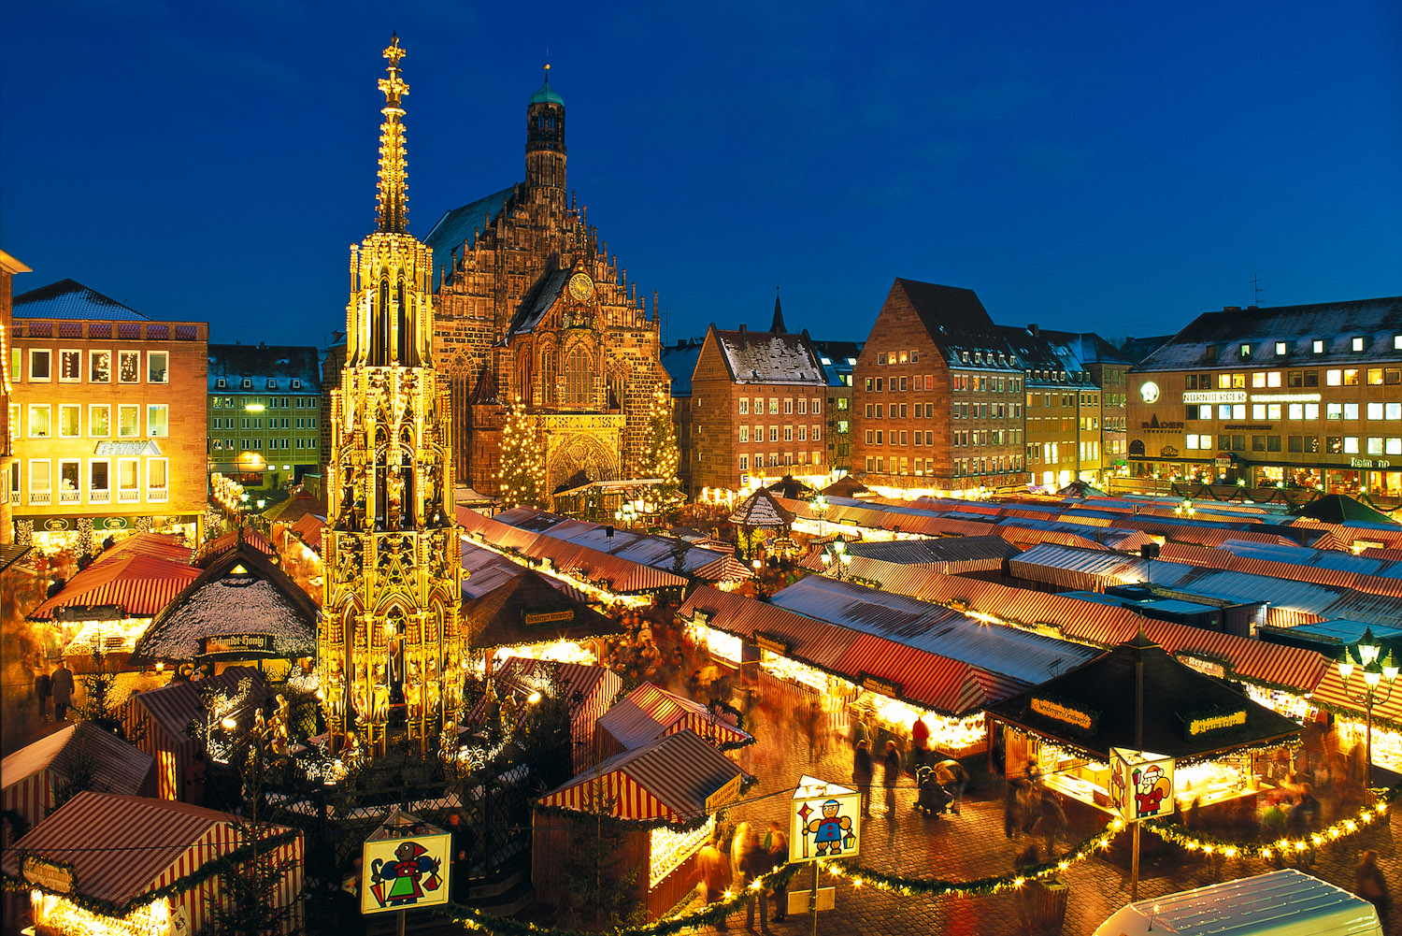
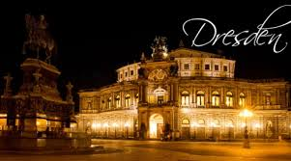
Germany
German culture
Germany is at the center of Europe, not only geographically, but also in terms of politics and economics. The country is Europe's second most populous after Russia, with more than 80 million people, according to the World Factbook. The German economy is the largest on the continent and the fifth largest in the world.
Christianity is the dominant religion, with 65% to 70% of the population identifying themselves as Christian. That number is 29 percent Catholics. Muslims make up 4.4 percent of the population, while 36 percent are unaffiliated or have a religion other than Christianity or Muslim.

Slide 5
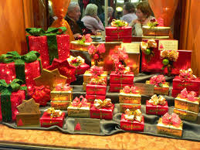
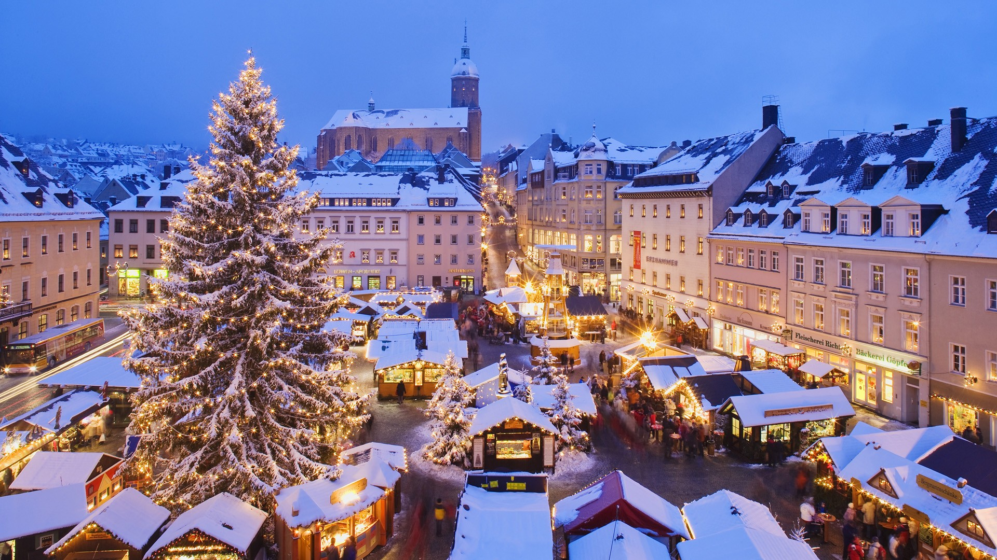
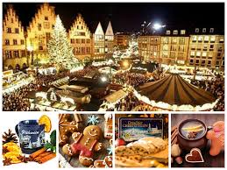
Holidays and celebrations
Germany celebrates many of the traditional Christian holidays, including Christmas and Easter. German Unification Day on October 3 marks the reuniting of East and West Germany and is the only federal holiday.
While the country's big beer bash is called "Oktoberfest," its starts each year on a Saturday in September and ends 16 to 18 days later, on the first Sunday in October. The tradition started in 1810, with the wedding of Crown Prince Ludwig of Bavaria to Princess Therese von Sachsen-Hildburghausen, according to the city of Munich.

Slide 6
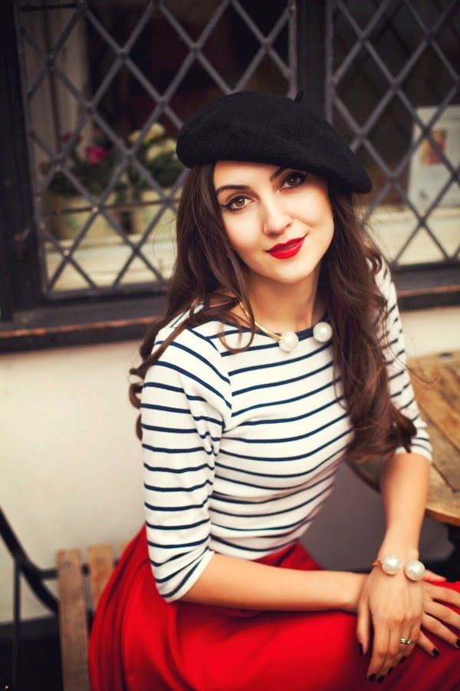
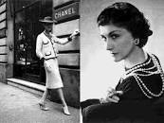
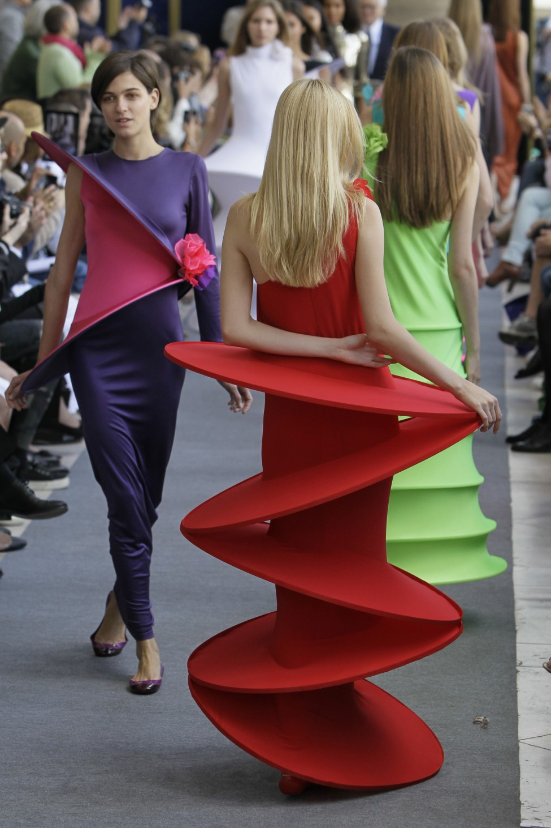
France
Clothing — Fashion Hub
Clothing is fundamental facts about French culture that describe their thoughts. Most of the renowned fashion houses like Dior, Hermes, Louis Vuitton and Chanel are part of Paris, known as the center of fashion in all over the country. French people dress in a decent, professional and fashionable style, but not at all cranky. The term that is greatly known for French clothing “haute couture” primarily means the fancy garments that are handmade and reflects the French culture or made on demand of the customer.

Slide 7
Thanks for your time

