Slide 1
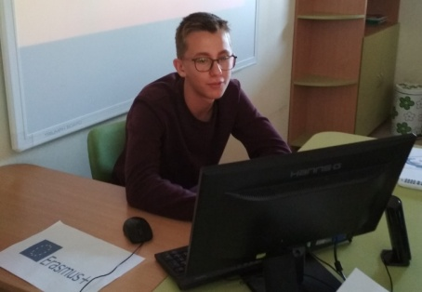
Оформление на заглавие
13 YEARS BULGARIA IN EUROPE
Подзаглавие
Martin Todorov - 9-th grade Foreign Language School Pleven, Bulgaria

Slide 2
Bulgaria is a part of the EU since 1 January 2007, but whether she has undergone any changes during her time in European Union.

Slide 3
The membership of Bulgaria in EU isn’t a failure because the country has delivered enormous economic benefits: increased growth, expanded safety nets in times of recession (especially after 2008), improved economic competitiveness, new opportunities for entrepreneurship, cross-border labor and educational mobility, and transfer of knowledge and skills.

Slide 4
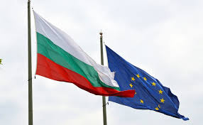
Ten years after the accession of our country as a full member of the EU, Bulgarians remain one of the greatest Euro-optimists, more consciously perceive the benefits and commitments arising from membership and have a more rational attitude to pan-European solutions to current problems. The experience also unlocks some Eurosceptic sentiments, but for the time being they remain in the shadow of positive attitudes.

Slide 5
Since Bulgaria's accession to the EU in 2007. so far, membership approval remains within 50 percent, against 16 percent disapproval and 34 percent neutral ratings. Throughout the ten-year period, the strongest Euro-optimists are the younger Bulgarian citizens, with higher education, activity and mobility, who have taken full advantage of the benefits of membership: the residents of the capital and major urban centers, the generations up to 40- age, highly educated, economically active, and above-average income earners. Conversely, older residents of small settlements, the less educated, the economically inactive or the unskilled are more skeptical.

Slide 6
Since 2014the labor market of various EU countries is open
to Bulgarian citizens without restrictions.
56%
Bulgarians are winning from
the membership
26%
Bulgarians are losing from
the membership

Slide 7
Thank you for your attention!

