Slide 1
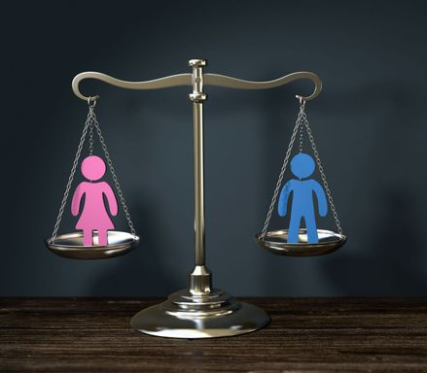
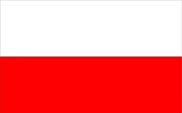
Gender equality
and
equal opportunities
Project Erasmus+ Get in shape for Europe-
The High School of Economics and Gastronomy,
Tarnów, Poland

Slide 2
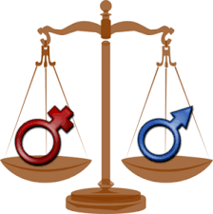
Equality between women and men is one of the fundamental principles of the European Union. The EU has made significant progress on gender equality in recent decades. However, there are still differences in the treatment of women and men and in the labour market it is mainly women who are still employed in lower paid sectors. Nor are they sufficiently represented in positions that require decision making.

Slide 3
First, let's focus on equality in education. Although women and men have the same chances when it comes to access to education and women are often more motivated than men to obtain higher education, the advantage of men grows along with the subsequent stages of education. Women constitute a minority of doctors and university professors.

Slide 4
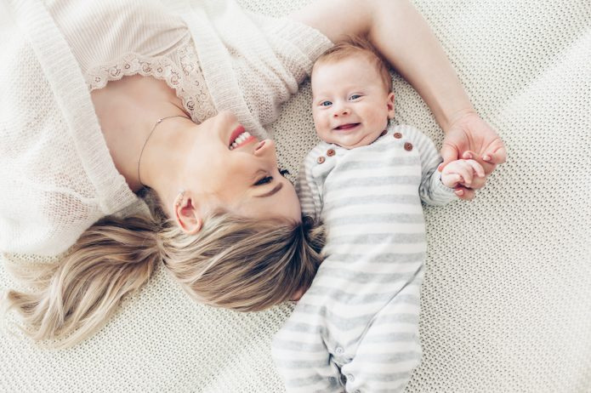
What could this be the result of? Ladies with a high school diploma, bachelor's or master's degree often have limited time for further education. This applies especially to women who take care of young children or are on maternity leave.

Slide 5
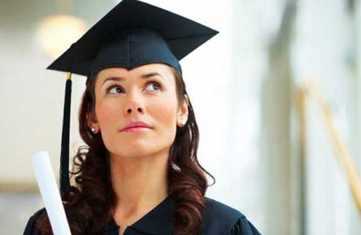
At this point, it is worth mentioning the success of the ladies working at the Medical University of Lublin. The Dutch Center for Science and Technology Studies at the University of Leiden conducts research of universities every year assessing the number and quality of scientific publications of their employees. In 2019, the gender of the authors was taken into account for the first time. The Medical University of Lublin took first place in the world in terms of the rate of scientific publications written by women (56%). The University of Gdańsk was ranked 4th, and the Medical University of Poznań came 7th.

Slide 6
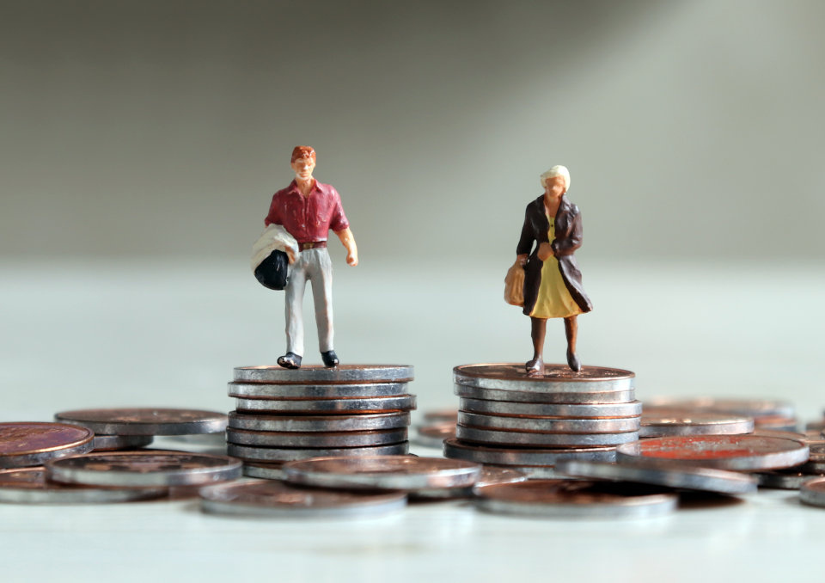
Are women at work treated in the same way as their male colleagues? Unfortunately, equality in many cases is still just a wish. In many companies, it can be seen that the majority of managerial positions are held by men, while women are neglected for promotions despite the fact that they have the same or often even higher qualifications and longer work experience.

Slide 7
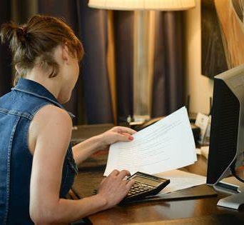
This is due to the attitude of women and their lack of self-confidence. At job interviews, men are more likely to mention higher wages, while women are ready to work for lower wages. Although employers should provide equal pay, they often take advantage of this fact and simply pay women less.

Slide 8
Although equality at work should be natural and undisputed, many companies still discriminate against female employees, for example in financial matters. The wage gap, i.e. the difference between the salaries of men and women holding the same positions in one company, is a big problem both in Poland and the entire European Union.

Slide 9
Every two years, the Central Statistical Office carries out a study of the pay gap in respect of the gender of employees. The last published report contains an analysis of data from 2016. And so: "the average monthly gross salary of men was higher than the average gross monthly salary of women by 18.5 %." The largest disproportions in wages are characteristic of financial and insurance industries.

Slide 10
The gender pay gap index for Poland in 2016 was 7.2%. This value means that women earned on average 7.2% less per hour than men. This is still a good result compared to other member states. Eurostat data shows that the difference in the Union is 16.2% to the disadvantage of women.

Slide 11
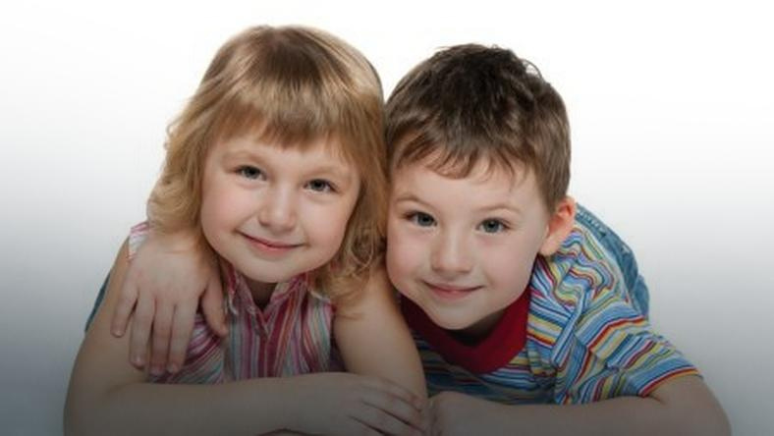
Both Poland and the EU undertake a number of measures to improve the situation of women in the labour market. Gender equality is one of the important goals in the policy of the European community. It implements the "Rights, Equality and Citizenship" programme by financing projects aimed at promoting equal treatment of both genders and eliminating discrimination and violence against women. However, we still have a long and bumpy road to full equality.

Slide 12
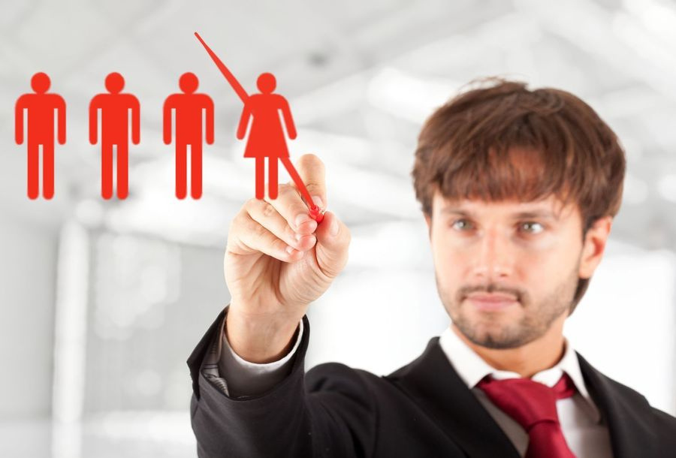
By law, women at work must be treated like men. The prohibition of discrimination of employees is provided for in Art. 18 of the Labour Code: "Employees should be treated equally in terms of entering into and terminating employment, terms of employment, promotion and access to training in order to improve professional qualifications, in particular regardless of sex, age, disability, race, religion, nationality, political beliefs, trade union membership, ethnic origin, religion, sexual orientation, and regardless of employment for a fixed or indefinite period, or full-time or part-time work. "

Slide 13
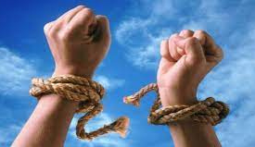
Gender, therefore, cannot be the basis for unequal treatment and a criterion for granting promotion, sending employees to training or determining employment conditions. What is worth emphasizing once again, according to the code: "Employees have the right to equal remuneration for the same work or for work of equal value".

Slide 14
The principle of equal opportunities for women and men
- applies to both women and men,
- means the assessment of the situation of women and men in various spheres of social life,
- involves breaking negative stereotypes
- consists in planning activities aimed at reducing and counteracting the deepening of inequalities in various areas of life (education, services, access to power and decision making, employment and self-employment).

Slide 15
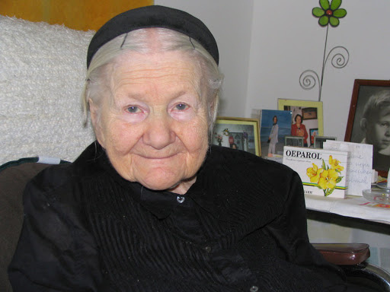
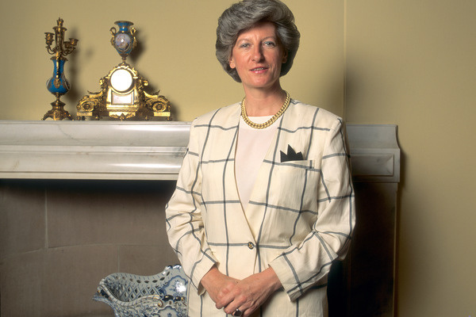
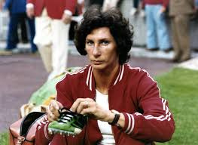
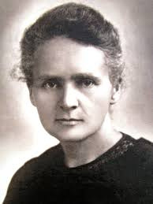
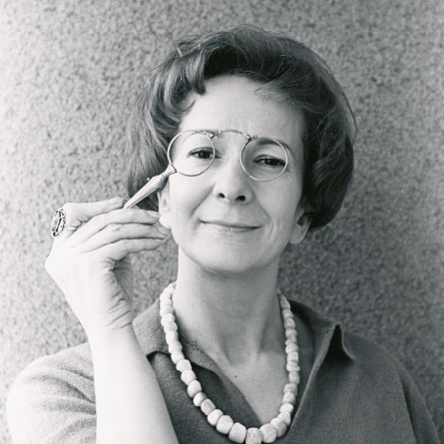
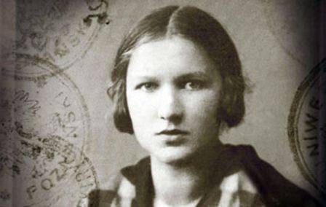
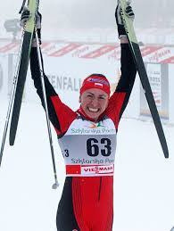
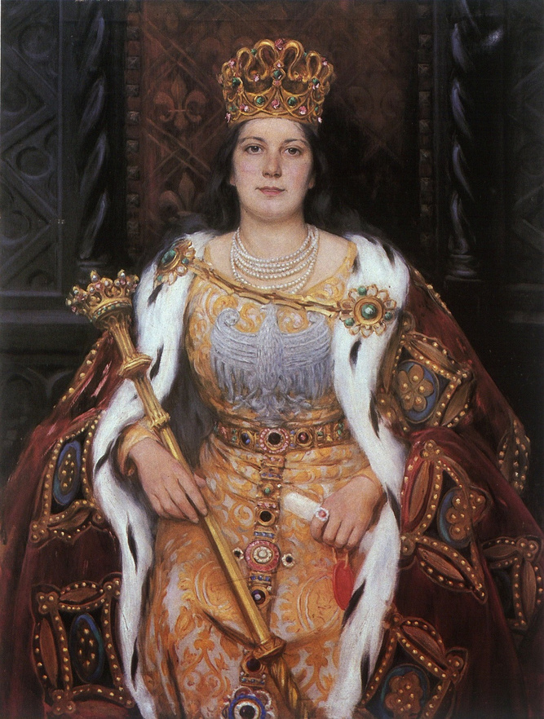
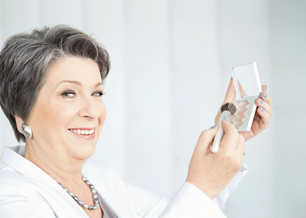
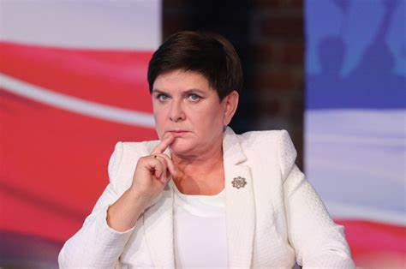
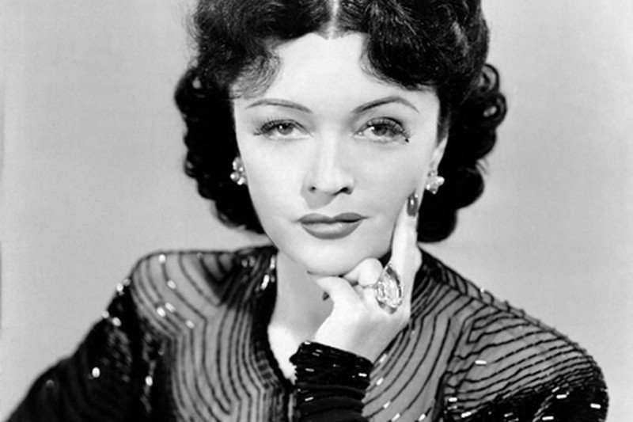
Poland's most successful women
Brave and strong. They have changed history, promoted Poland in the international arena and built their business. Often supported by men on their way to success.

Slide 16
Maria Skłodowska- Curie(born November 7, 1867 in Warsaw, died July 4, 1934 in Passy) - Polish physicist and chemist, two-time Nobel laureate,
In 1891, Maria Skłodowska left the Kingdom of Poland for Paris to study at the Sorbonne (in the 19th century women could not study in Poland). Then she developed her scientific career there. She was a precursor of a new branch of chemistry - radiochemistry. Her achievements include: developing the theory of radioactivity. , techniques for separating radioactive isotopes and the discovery of two new elements - radium and polonium. On her initiative, research was also carried out on the treatment of cancer with the use of radioactivity.
Maria Skłodowska- Curie

Slide 17
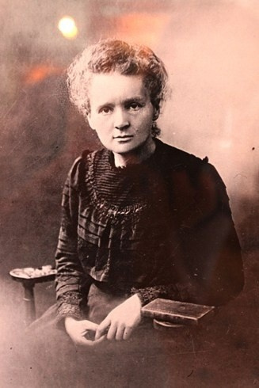
Nobel Prize Diploma in Physics, awarded in December 1903 to Peter and Maria Curie
She was awarded the Nobel Prize for the first time in 1903 - in physics, together with her husband Pierre Curie and with Henri Becquerel, for research into the phenomenon of radioactivity discovered by Becquerel. She was awarded the second time in 1911 - in chemistry, for the discovery of polonium and radium, the separation of pure radium and the study of the chemical properties of radioactive elements. She belongs to the group of only four people who have received the Nobel Prize more than once. Among them she is one of the two that have received awards in different disciplines. In the four, she is also the only woman and the only scientist honored in two different natural sciences

Slide 18
Queen Jadwiga - Jadwiga Andegaweńska (born between October 3, 1373 and February 18, 1374 in Buda, died July 17, 1399 in Krakow) - the queen of Poland from the Anjou dynasty, daughter of Ludwik Węgierski and Elizabeth of Bosnia, in 1384 crowned king of Poland, the first wife of Władysław Jagiełło , apostle of Lithuania, saint of the Catholic Church and patron saint of Poland.
Queen Jadwiga

Slide 19
Irena Stanisława Sendlerowa (born February 15, 1910 in Warsaw, died May 12, 2008 in Warsaw) - Polish social and charity activist, member of the PPS, during World War II, head of the children's section of the Council for Aid to Jews at the Government Delegation for the Country of the Righteous Among the Nations, lady of the Order of the White Eagle and the Order of the Smile.
During World War II, she risked her life to save Jewish children in the Warsaw ghetto. Thanks to her great courage, 2,500 young people were saved from death.
Irena Sendlerowa

Slide 20
Elżbieta Zawacka - (born March 19, 1909 in Toruń, died January 10, 2009 in Toruń) - during World War II, a courier of the Home Army Headquarters, the only one of the 15 candidates who successfully completed the training and later served as a 'silent unseen' (elite special-operations paratrooper), mathematician, professor of humanities specializing in modern history, in 2006 as the second Polish woman in the history of the Polish Army promoted to the rank of brigadier general. Lady of the Order of the White Eagle - the highest distinction in Poland awarded for outstanding civil and military merits.
Elżbieta Zawacka

Slide 21
Pola Negri, full name Apolonia Chałupec (born December 22, 1896 in Lipno, died August 1, 1987 in San Antonio, Texas, USA) - Polish theatre and film actress, international silent film star.
Pola Negri-
Apolonia Chałupiec

Slide 22
Irena Kirszenstein-Szewińska (born May 24, 1946 in Leningrad, died June 29, 2018 in Warsaw) - Polish athlete specialising in sprinting and long jump, after her career an activist of national and international sports organisations; Lady of the Order of the White Eagle.
She was one of the most successful Polish athletes and the most outstanding female athletes in history: she stood on the podium at four consecutive Olympic Games.
Irena Szewińska

Slide 23
Wisława Szymborska (born July 2, 1923 in Prowent, died February 1, 2012 in Kraków) - Polish poet, essayist, critic, translator, columnist; laureate of the Nobel Prize in Literature (1996), founding member of the Polish Writers' Association (1989), member of the Polish Academy of Arts and Sciences (1995), lady of the Order of the White Eagle.
Wisława Szymborska

Slide 24
Justyna Maria Kowalczyk-Tekieli (born January 19, 1983 in Limanowa) - Polish ski runner, Olympic champion and multimedalist, world champion and multimedalist, four-time winner of the World Cup in cross-country skiing. In 2018–2021, she was assistant head coach of the National Women's Team in cross-country skiing. Since March 26, 2021, he has been the sports director of the Polish Biathlon Association.
Justyna Maria Kowalczyk-Tekieli

Slide 25
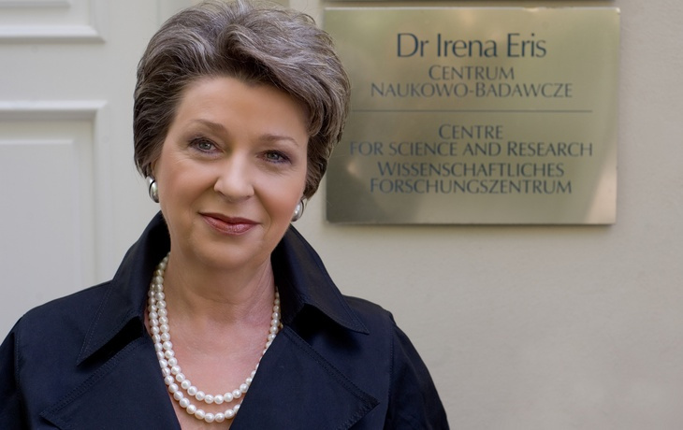
Irena Eris (born April 13, 1950 in Warsaw) - Polish pharmacist, entrepreneur, founder and co-owner of the Dr Irena Eris company; doctor of pharmacy.
She is the co-owner with her husband of Dr Irena Eris, where she is the director of research and development and the spa hotel chain. From the beginning of the company's activity, he has been involved in the creation of new products and managed the process of their creation.
She has received a number of prestigious awards, including The Business Lady of the Decade (Business Center Club, 1999), the Businessman of 1999 and in 2004 she took high 20th place on the list of the most influential women in the history of Poland - women who turned the course of events, broke stereotypes, and initiated a new way of thinking.
Irena Eris

Slide 26
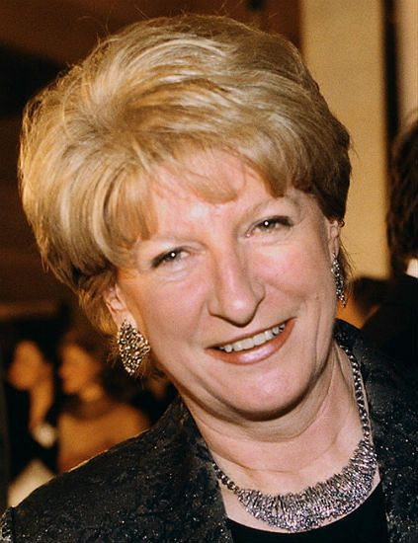
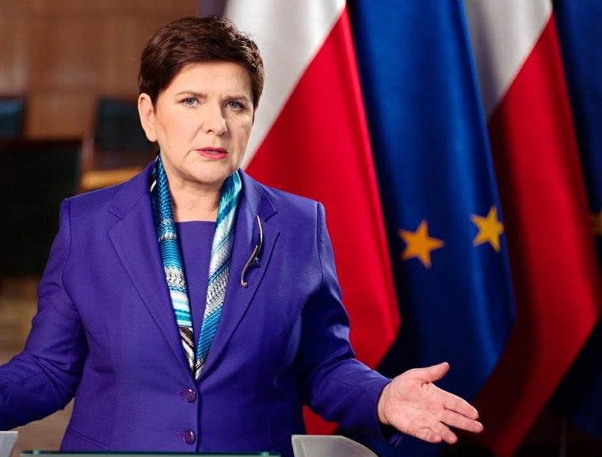
Polish Female Prime Ministers

Slide 27
Hanna Suchocka (born April 3, 1946 in Pleszew) - Polish politician, lawyer and academic teacher, President of the Council of Ministers in the years 1992–1993.
Habilitated doctor of legal sciences, associate professor of the University of Adam Mickiewicz in Poznań. One of the founders and leaders of the Democratic Union, and then the Freedom Union, in 1997-2000 the minister of justice and prosecutor general in the government of Jerzy Buzek, in 2001-2013, the Polish ambassador to the Holy See and the Order of Malta. In 1980–1985 and 1989–1991, she was a deputy to the Sejm of the People's Republic of Poland of the 8th term and contract Sejm, and in 1991–2001 for the 1st, 2nd and 3rd term of office, in 2015–2016 she was the first Vice-Chairwoman of the Venetian Commission. Lady of the Order of the White Eagle.
Hanna Suchocka

Slide 28
Beata Maria Szydło (born April 15, 1963 in Oświęcim) - Polish ethnographer, politician and local government official, in the years 2015–2017 President of the Council of Ministers.
Member of the Sejm of the 5th, 6th, 7th and 8th term (2005-2019), Member of the European Parliament of the 9th term (from 2019), Vice President of Law and Justice from 2010, Vice President of the Council of Ministers in 2017-2019 and Chairman of the Social Committee in Mateusz Morawiecki's government.
Beata Szydło

Slide 29
The aim of the principle of equal opportunities for women and men is therefore not to influence the biological differences but to ensure access to resources, activities and opportunities in such a way that each person has equal access and equal opportunities to fulfil their objectives and aspirations in professional and social life.
Thank you for your attention.

