Slide 1
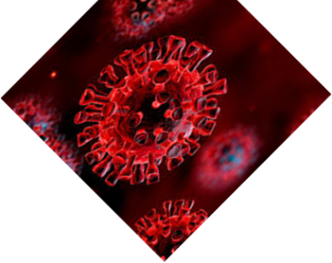
UPLIFTING OUR WORLD THROUGH LOVE IN THE TIME OF COVID-19
Martin Todorov – 9-th grade
Foreign Language School
Pleven, Bulgaria

Slide 2
Every person can have different point of view for how we can uplift the world during Covid-19 but I think we can show our love by helping people and let everyone know that we care.

Slide 3
Do you want to be involved?
Here are some tips

Slide 4
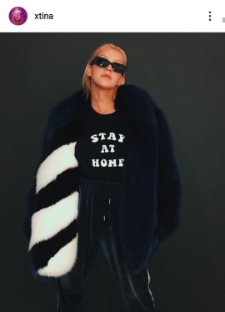
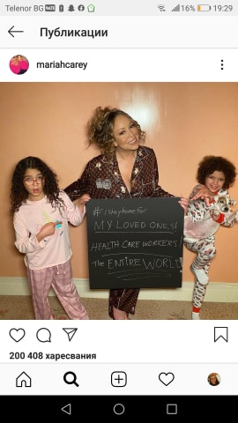
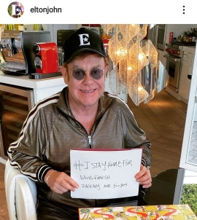
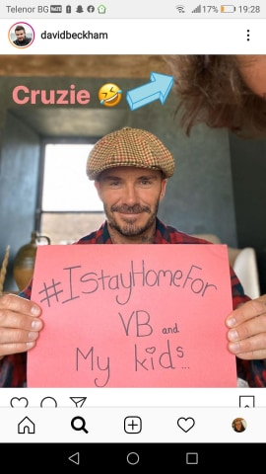
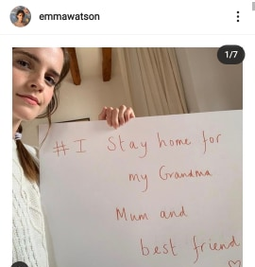
Knowing how much fans they have and what big influence they have on them , a lot of celebrities stayed home, spent time with their families and the most important is that they cancelled a lot of concerts worldwide.That’s the way they contribute for the solution of this situation.

Slide 5
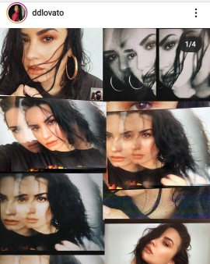
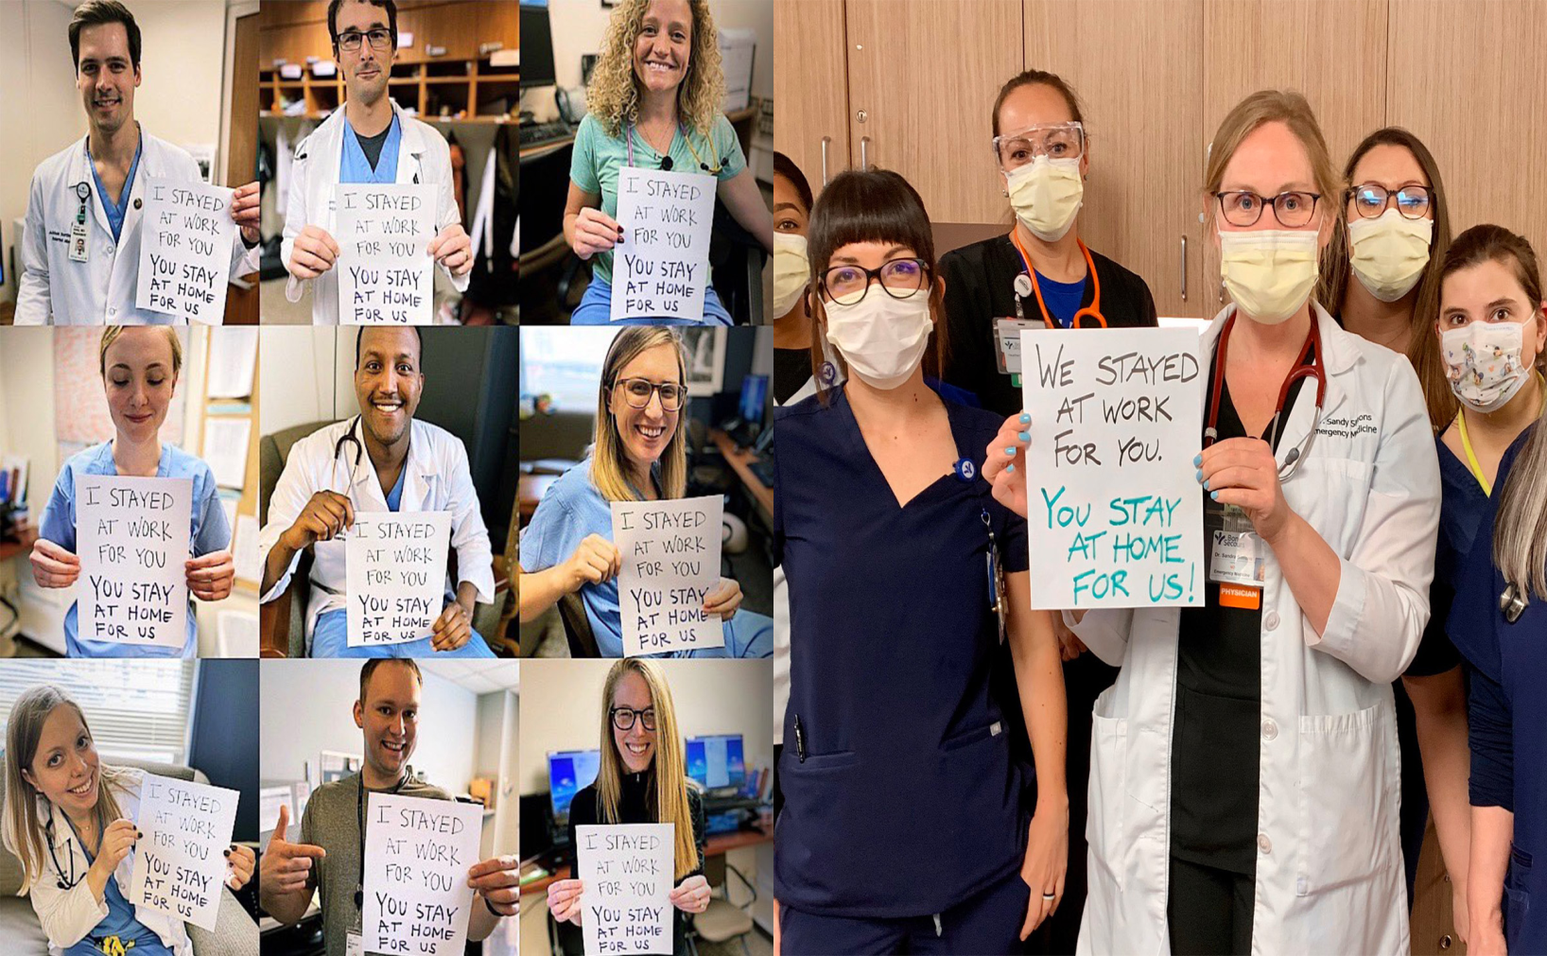
Dem Lovato took the photoshoots to a whole new level with her creativity

Slide 6
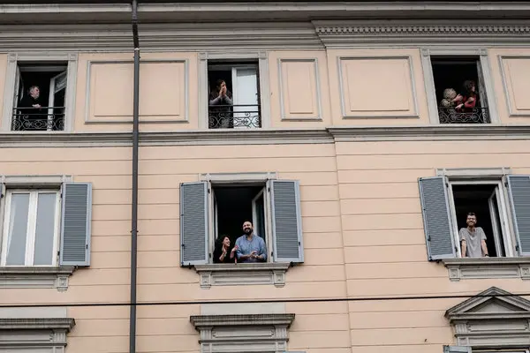
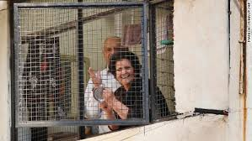
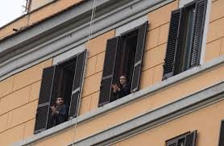
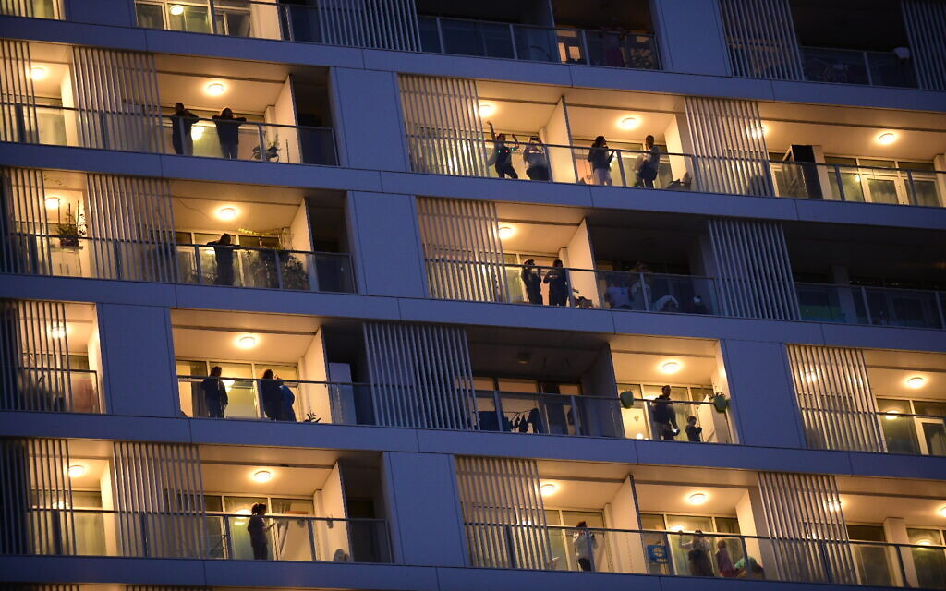
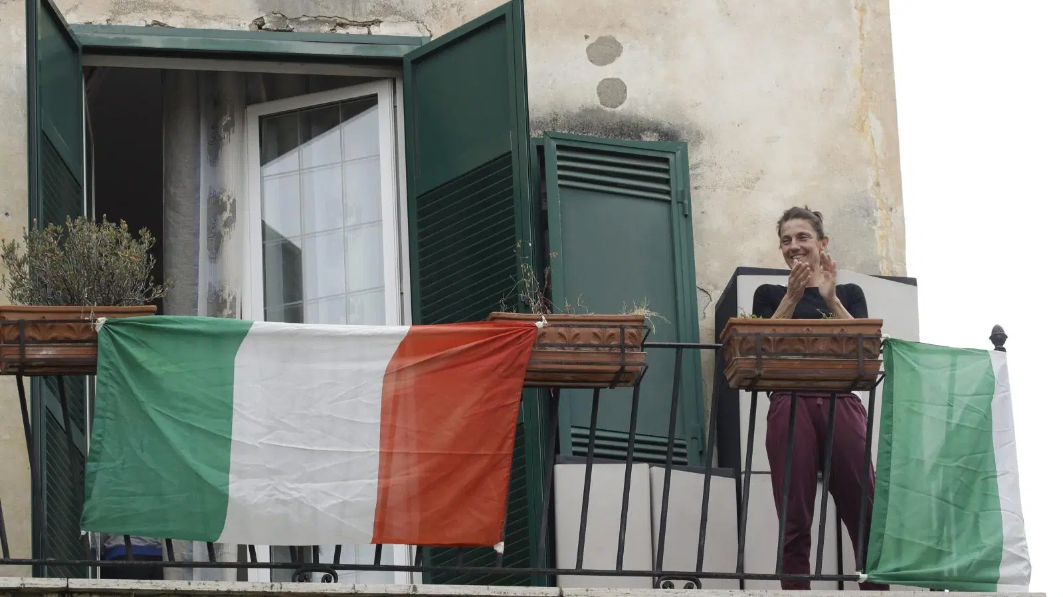
A lot of people see how serious this situation is and appreciate the hard work of doctors and nurses. And the way we share our love and thank them is by applauding them from out terraces at 9:00 pm

Slide 7
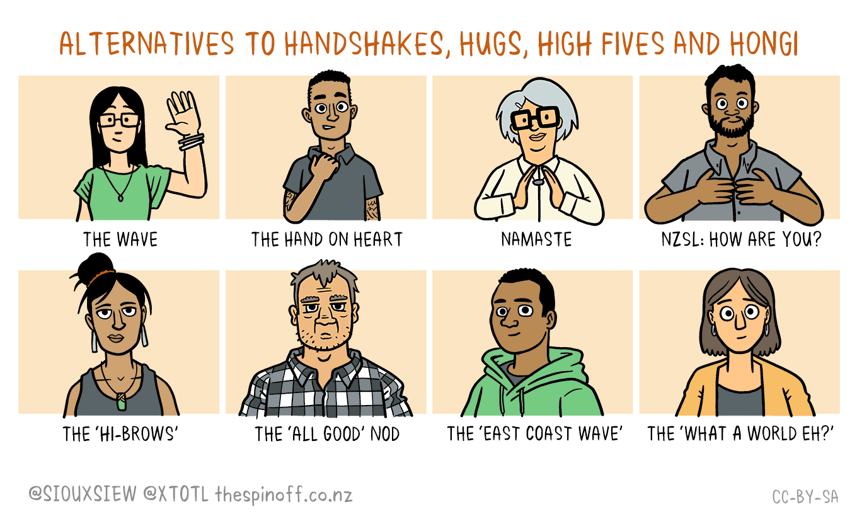
We can’t stay home the whole time because we need to go to the market or walk the pet. In that time we can meet a friend, a neighbour or a teacher but we can’t hug them or handshake because of the social distancing, so there are some alternatives

Slide 8
It’s a tough time for everyone but we can get trough it by helping each other. Don’t wait just call your close ones (your grandparents, uncle and aunts, cousins or friends) make sure they are okay an tell them you love them.
If you can’t stand staying at home that long go for a walk in the nearest park ALONE or you can go to your old neighbor ask them if they need something and shop for them.
There are so much things to do at home and so many ways to help others but only if you want and you believe we can.

Slide 9
Thank you for your attention
…and don’t forget to stay home!

