Slide 1
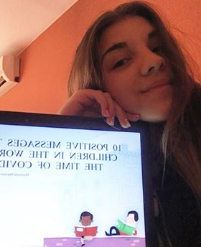
10 POSITIVE MESSAGES TO ALL CHILDREN IN THE WORLD IN THE TIME OF COVID-19
Marinela Marinova - 9th grade
Foreign Language School – Pleven, Bulgaria
#EuropeAgainstCOVID-19
#responsibletogether

Slide 2
Content
Make children feel safe
Let them know what to expect
Keep your child’s developmental stage and temperament in mind
Try to maintain a normal routine
Give them facts, and let them lead the discussion
Give them power — and responsibility
Empathy, empathy, empathy
Model the behavior you want to see
Consider adjusting the screen time limits
Take care of yourself

Slide 3
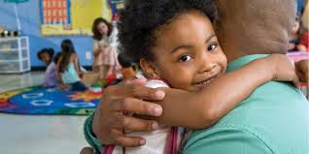
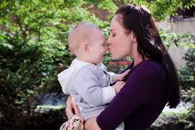
Make children feel safe
Watch your words and tone
Stay calm
susceptible to the anxiety

Slide 4
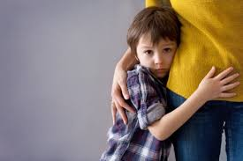
Let them know what to expect
We know that we’re going to have to find creative ways to pass the time at home.
work harder

Slide 5
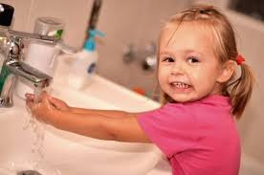
Keep your child’s developmental stage and temperament in mind
,,hands to home”
to wash your hands

Slide 6
Try to maintain a normal routine
Hatfield suggests making a calendar
new routine

Slide 7
Give them facts, and let them lead the discussion
Children need simple, honest answers.
wash our hands

Slide 8
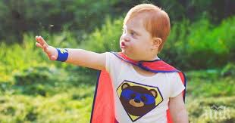
Give them power — and responsibility
After all, children are proving to be kind of like superheroes
Kids can help their neighbors and loved ones stay safe and healthy

Slide 9
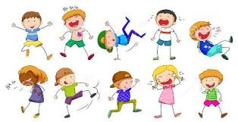
Empathy, empathy, empathy
feelings with empathy
big emotions

Slide 10
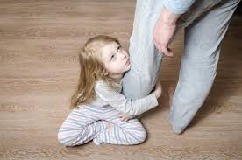
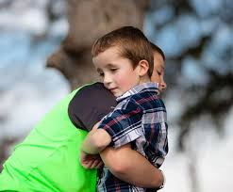
Model the behavior you want to see
Children look to us for guidance and support, especially in trying times

Slide 11
Consider adjusting the screen time limits
Get ideas online about other things to do with kids that are not screen-related, and remember that they need to run and play. Without school recess, you may want to implement

Slide 12
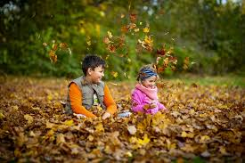
Take care of yourself
entertainment at home

Slide 13
entertainment at home
Notes:
ЗАБЕЛЕЖКА: За да промените изображенията в този слайд, изберете картината и я изтрийте. След това щракнете върху иконата за вмъкване на картина в контейнера, за да вмъкнете собствено изображение.

Slide 14
Thank you for your attention!
#stayhome
#responsibletogether
#EuropeAgainstCOVID-19

